Slide 1
We supported a tobacco player to shift its portfolio from legacy classic tobacco towards next-generation products (NGP)
Chemicals & Agriculture (GEM) | Asia-Pacific
CPG025
Client context
Approach
NGP market evolving rapidly in largest sales country
Current portfolio almost entirely focused on legacy products; limited NGP sales today
Company lagging large competitors who have started shift towards NGP, as well as high number of smaller, often more digitally native players
Prepare and build vision for the shift from legacy to NGP:
Build a consumer segmentation: who is the consumer, what is their consumer decision journey, why and how do they shift towards NGP, where do they shop when, etc.
Build a single view on revenue and profit pools across the value chain
Optimize the channel strategy and route-to-market
Across, define overall NGP strategy
What was unique: X
Client name: X
Team set-up: X
Fees Structure: X

Slide 2
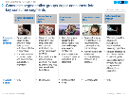
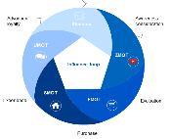
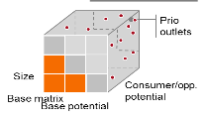


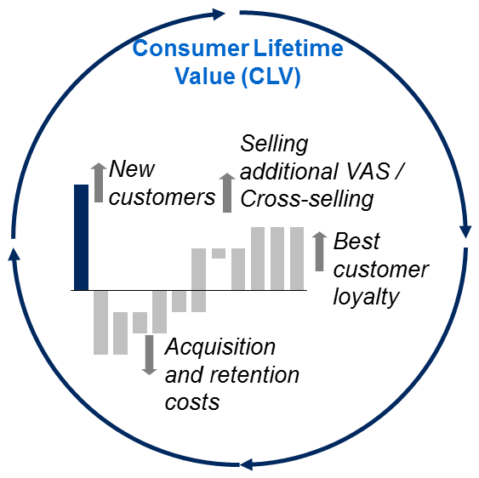
We built a bold vision to make a paradigm shift in growth
From …
To …
Product centric, technology-led pushes
Consumer centric, insights driven, segment-based approach
Stepping through a linear brand funnel, focussed on traditional marketing channels
Engaging throughout the consumer decision journey, with digital and direct-to-consumer communication at the core
Legacy route-to-market via kiosks and modern trade
Route-to-consumer via more online D2C and online retail, and vaping stores on top of existing routes
Business plan logic with annual perspective, incremental gains and yearly adjustments
Full potential, longer-term thinking, agile business empowerment, continuous adjustments to market reality
Quarterly sales figures and targets
Total consumer universe and customer lifetime value, focussing on conversion, loyalty
“Us vs. Them” with NGP profit pool vs. legacy profit pool
Integrated company perspective based on total CLV across business lines

Slide 3
Client revenue and profit pool will shift from almost entirely legacy towards majority NGP
Current value pool
Future value pool
Channels: more mass retail, tobacconist
Drivers
Channels: mass retail, tobacconist
Legacy
Stopping
Shifting
Downtrading
Channels: more online D2C and online retail, vaping stores
Channels: more online, vaping stores
Shift from legacy
Loyalty
Uptrading
CLV
Consolidation
Decreasing trade margin
NGP

Slide 4






Impact and actions
Consumer-first strategy
New ways of working
Growth
More agile + cross-functional ways of working
10x
Increase in market share (NSV)
Consumer-led portfolio
Optimise consumer touchpoints
Focus on capabilities in digital + data
15x
Increase in consumers in 1.5 yrs
Improve online experience
Single view of the customer
Build brand love
Happier customers

Slide 5
How this can be leveraged at other clients
Fast - quickly assess market growth potential + strategic options especially in new or emerging categories
Multi-lens – put consumer at the centre + tailoring consumer journeys, GTM approach, financials and value proposition to optimise for consumer targets
Focussed – prioritises and looks only at what it will take to win

