Slide 1
Case example: largest U.S. independent retailer of fine wine has leveraged Periscope by McKinsey to enable their pricing transformation
CONSUMER (CPG)| AMERICA
CPG030
Client context
Approach
Impact
Set aggressive topline growth targets as they open new stores in new markets
Extremely manual process to manage pricing across all their stores
Complex regulations in 23 states with varying regional pricing laws
Faced increasing competitive pressure from other retailers
The analyses and tools being used to drive pricing strategy were outdated:
Excel files
Buyer judgement
Non-reliable competitor store shop data
Designed and rolled out Price Advisor across 60 categories and all states to drive sales and margin growth in a highly competitive market
Price advisor enabled
Heuristic pricing across multiple forces (competitor, consumer demand, & internal economics)
Competitor indexing with cleansed shop data & outlier detection (Market Vision)
Econometrics-derived price elasticities to drive pricing strategy
Market margin & item specific targets
Rapidly adjust single store prices in response to localized competition.
Scenario models to allow fact-based simulations of pricing changes on volume, revenue and profit
>$40Mp/a & +1.5 to 4.5% ROS in year 1
projected in incremental revenue and margin delivered through the transformation initiative
Dramatically improved efficiency allowing much quicker repricing of markets
to maintain the methodologies/tools and to help extend the transformation to subsequent waves
Client name: X
Team set-up: X
Fees Structure: X
What was unique: X

Slide 2
As a team, we successfully built and delivered full planned functionality across the entire scope of data in the timeframe expected
Wave 3
Wave 2
Wave 1
Time
Month 5
Month 7
Month 9
Features & functionality to be built
Weekly refresh of data
Strategy configuration in Admin (Assign Strategy)
Price zone w/ store exception integration
Two cost types: pricing cost and financial cost
Workflow
Guardrails & alerts
Standardize rounding rules
Daily refresh stabilized
Bulk upload
Reporting capabilities
Custom rounding/cent endings
EDLP price expiration
Blackout periods visible through alerts
Visualize audit trail
What if scenario capabilities
User ability for rules administration in admin module
Comp shop & outlier detection
Models available
Top 10-11 categories within wine
All in-scope categories for econometric modeling
All in-scope categories for econometric modeling

Slide 3



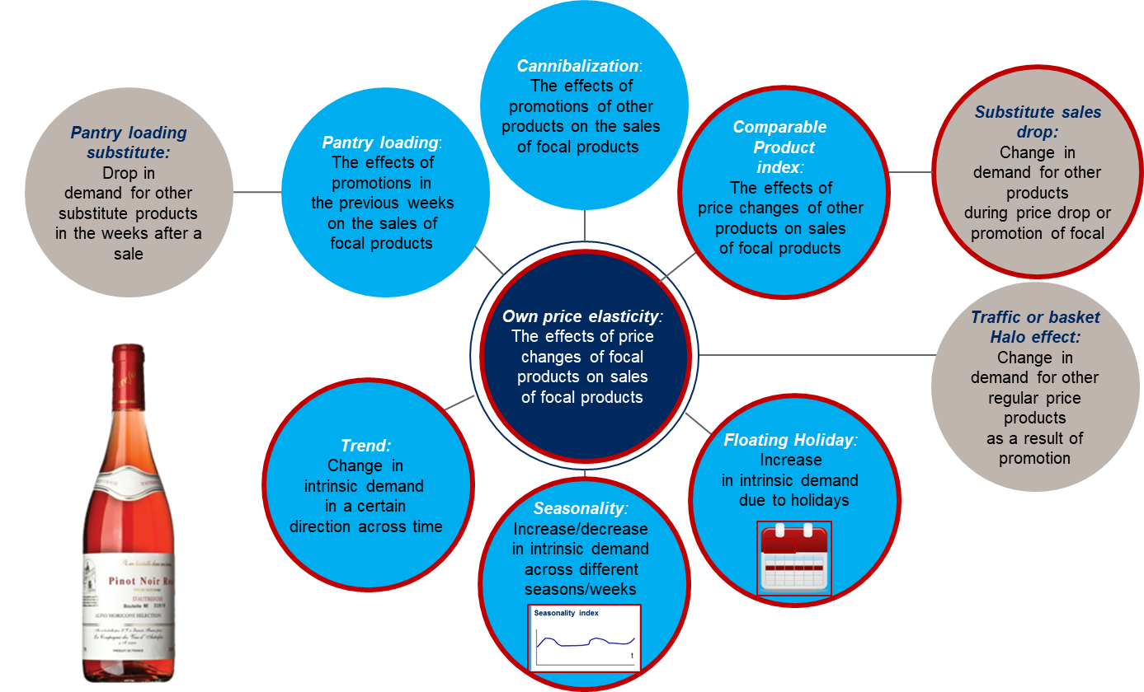
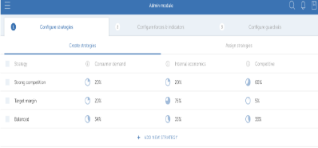
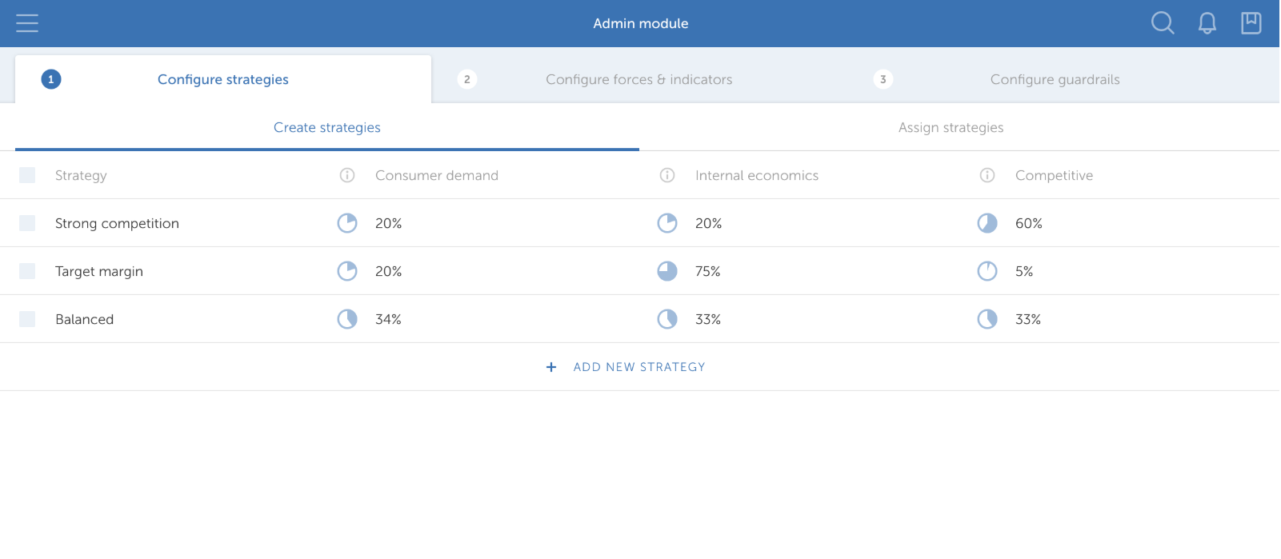
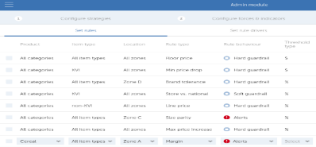
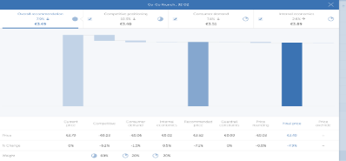
Case example: Combining advanced analytics and robust solutions enable the client to drive and sustain impact across the entire pricing organization
Advanced Analytics
Tools
Create price strategies
Manage rules & guardrails
Manage pricing exceptions
Application of a econometric workbench to generate elasticity coefficients that drive volume forecast while taking inconsideration inter category cannibalization
Systematically recommends SKU/Store level price changes for all 60 categories
Streamlines pricing management and productivity
Automates workflow managements and non-critical tasks
Tracks pricing compliance and performance

Slide 4
Team (not comprehensive)
Initial Implementation: Brian Elliott, Channie Mize (alum), Kate Mandrell (alum), Filip Linmans, Mohit Diwan, Brad Cash, Eric Bunge, Ankur Goel, Christina Du, Lawrence Heath, John Euart, Marcus Herzog, Robert Baumgartner, Przemek Latka, Doron Fertig, Jun Xia, Mathanki Balu, Sugandh Tibrewal
Ongoing support: Peter Miles-Prouten, Ibrahim Barghouti, Amit Poddar, Nitesh Kumar, Kanav Sharma, Kanika Mahajan

