Slide 1

EPNG | EUROPE
EPN008
How we helped an incumbent Energy player to become the leading brand in its industry and beyond

Slide 2
EnergyCo: initial situation – external pressures due to energy transition and gap between brand promise and perception
Initial situation and reason for project
Energy transition had a major impact on EnergyCo
EnergyCo, largest operator of coal power plants and is perceived as a heavy polluter of the environment – the nuclear phase-out is also negatively affecting business
Company
A leading European energy company
Our task
Brand promise ≠ brand experience
Customers have no perception of the EnergyCo brand promise "reliable", "future-oriented", "efficient" because the products and customer experience are extremely outdated
Revenues¹
EUR 44 billion
Profit²
EUR 2.7 billion
"NewCo" carve-out
Hence the decision in favor of radical change to the business model by spinning "Retail", "Grids", and "Regenerative Energies" out into a new company with a new brand
Employees³
~40,000
Present in 10 countries
Objective: create a 21st-century energy company
1 External turnover 2016
2 EBIT 2016
3 Status 2016
SOURCE: statista.com; McKinsey

Slide 3
We did a thorough stakeholder analysis to derive "motivators“ for the new brand
Stakeholder
6 motivators
Regulators
1
3
5
Global carbon footprint
Digital Age
Authenticity
Customers
2
4
6
Decentralisation
New Arena
User Empowerment
Partners
SOURCE: McKinsey
McKinsey & Company
3

Slide 4

Motivators were translated into a three-part mission statement
6 motivators
3 part mission statement
1
3
5
We are committed to creating a sustainable energy system for new generations to live in a world worth having
We are a fast-moving company, committed to radical innovation and playing to win in an ever-changing game of business and market development
We are committed to inspiring people, offering solutions beyond their current needs and expectations and marketing their lives easier
Global carbon footprint
Digital Age
Authenticity
2
4
6
Decentrali-sation
New Arena
User Empowerment
SOURCE: McKinsey
McKinsey & Company
4

Slide 5
Now, it's up to you…
Next task: What should be the brand statement of client? And why?

Slide 6
"Our planet will be a better place, when we create a sustainable world in which client inspires how people live and work"

Slide 7
To give you the full picture of our 6-3-1 logic: Motivators and mission statement were translated into the brand belief
6 motivators
3 part mission statement
1 brand belief
1
3
5
We are committed to creating a sustainable energy system for new generations to live in a world worth having
We are a fast-moving company, committed to radical innovation and playing to win in an ever-changing game of business and market development
We are committed to inspiring people, offering solutions beyond their current needs and expectations and marketing their lives easier
"Our planet will be a better place, when we create a sustainable world in which client inspires how people live and work"
Global carbon footprint
Digital Age
Authenticity
2
4
6
Decentrali-sation
New Arena
User Empower-ment
SOURCE: McKinsey
McKinsey & Company
7

Slide 8
Now, it's up to you…
Once we had successfully developed the brand, we were wondering what's the next thing that we now should tackle?
What would you do?

Slide 9
The brand was introduced to the broad public with a well-orchestrated three-phase campaign approach
Teaser phase
Launch phase
Product phase
15.08.2016
01.09.2016
15.09.2016
The brand introduction was a huge success achieving more than 70% aided
brand awareness in the home region and 36% nation-wide after 5 months
SOURCE: McKinsey
McKinsey & Company
9

Slide 10

The launch campaign was centered around the theme of #restart

Slide 11
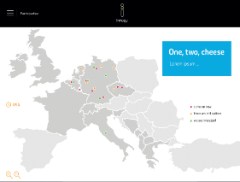
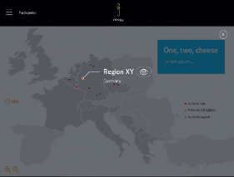
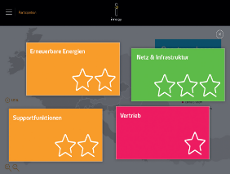
Internal activation – taking all employees from “knowing” to “promoting” the new brand
Brand Engagement Tracker
Brand Engagement Tracker builds on the outcomes of Brand Workshops
Interactive platform allows playful tracking of participation of teams
Teams can upload material and photos from Brand Workshops
SOURCE: McKinsey
McKinsey & Company
11

Slide 12
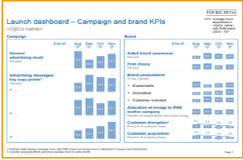
Brand delivery assurance – monitor and steer the brand for long-term success
Launch dashboard
Long-term dashboard
Weekly
Temporary
Lean
Quarterly
Permanent
Comprehensive
SOURCE: McKinsey
McKinsey & Company
12

Slide 13
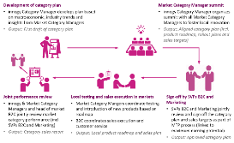
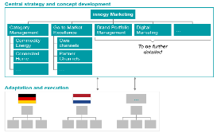
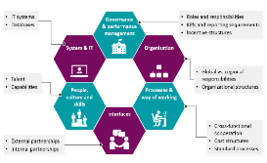
We continued to work on brand delivery – long-term implementation initiatives how to deliver the new brand in the future
Category Management
Marketing Function
New operating model
Set-up of dedicated teams to define and drive product innovations and go-to-market in focus product categories
Definition of a central marketing organization including new marketing functions to build and roll-out new capabilities
Design of a new operating model for marketing to define interfaces, split of responsibilities etc.
SOURCE: McKinsey

Slide 14
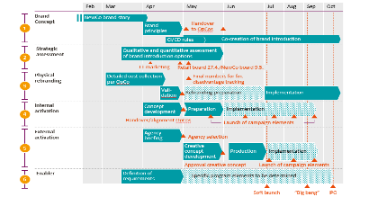
Summarizing our client case in 30 seconds
External challenges affecting the industry
Big creative idea and brand world
Implementation plan and campaign
1
3
5
Global carbon footprint
Digital Age
Authenticity
2
4
6
Decentrali-sation
New Arena
User Empower-ment
Impact
Built a new brand for 23mn customers "from scratch" in about 6 months from idea to external and internal campaign launch
On track to reach 50% brand awareness after just 6 months combined with the desired brand image perception
Biggest IPO in Europe for the last decades (~20 EUR bn market value, compared to 10 EUR bn of X previously, exceeding initial expectations by 20%)
SOURCE: McKinsey

