Slide 1
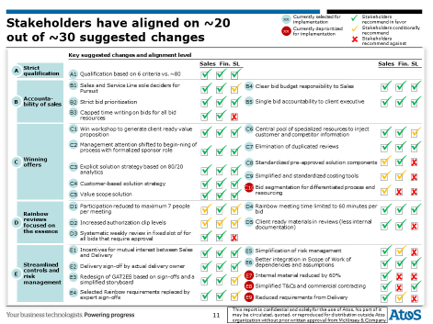
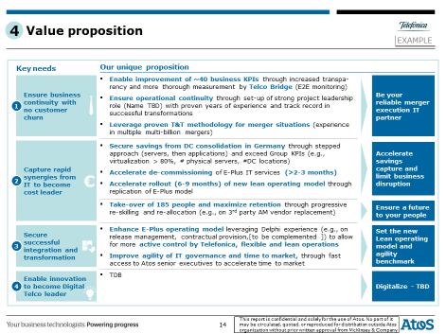
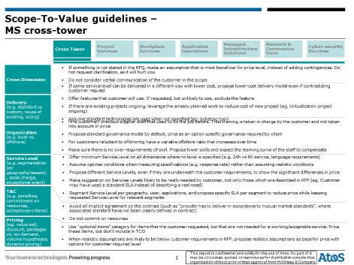
At SalesCo, we “de-complexified” significantly the solution selling process
TMT| Western Europe
HIT015
Client context
Approach
Impact
‘Textbook’ solution selling process, but…
…organization overly focused on control and compliance…
60-80 meetings per bid
65+ people involved
280+ pages of internal documentation
… with too little focus on quality of bids
Lack of End2End accountability for cross-divisional sales
Disconnect between sales and solution teams
Lack of outside-in information
~30 levers to simplify steps in End2End process of solution bid management, applied after a detailed activity diagnostic
25-35 mln savings in terms of time spend in meetings, documentation, iterations and rework, and low chance bids – to be reinvested in increasing win rate likelihood
Up to 30% cost reduction of ‘barebone’ offers, with value-add components priced in separately
2 cross-functional ‘cookbook’ methodologies for value proposition development and solution design, applied in live cases
250+ ‘caveats’ database to scope solutions to perceived customer value
Client name: X
Team set-up: X
Fees Structure: X
What was unique: X

