Slide 1

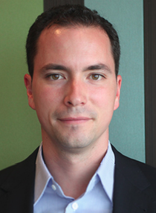
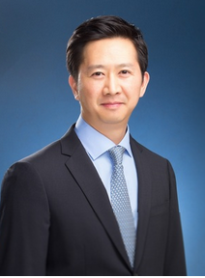

Largest telco in Asia-Pacific – we lifted total sales revenue in their outbound call centre by 12% in 6 weeks in a sustainable way
TMT | Asia-Paciifc
HIT030
Client context
Approach
Impact
Largest telco in Asia-Pacific with $3.5bn revenue, 5,500 employees and 2m customers
Declining sales performance in call centres over the last 24 months with high attrition rate and under competitive pressure
Recognised the need for a complete sales turnaround as a way to drive bottom line impact and maintain market share
Launched a sales turnaround programme focused on outbound sales first in order to showcase a major lift in revenue in the most broken business
Targeted 3 improvement levers to rapidly capture impact Implemented a sustainable needs based sales approach, developed strong team leaders focused on daily coaching and align incentives to business needs understood by the agents
Uplift in sales revenue
+12%
Pre-pilot
Post-pilot
M&S Expertise
Significant increase in conversion rate for all agents
Mobile: 520% increase from 4% to 27%
Broadband: 300% increase
Complete rollout will include all inbound call centre and stores and will represent $40m EBITDA increase
Katia Khvatova
Vincent Vuillard
Porendy Ung
Christophe Bur
Client name: X
Team set-up: X
Fees Structure: X
What was unique: X

