Slide 1
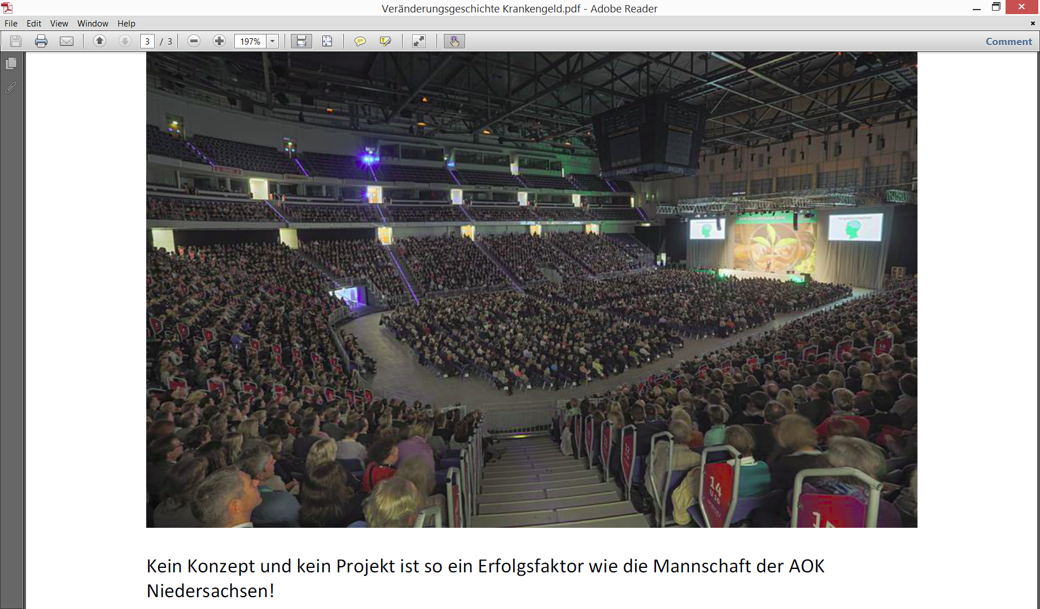
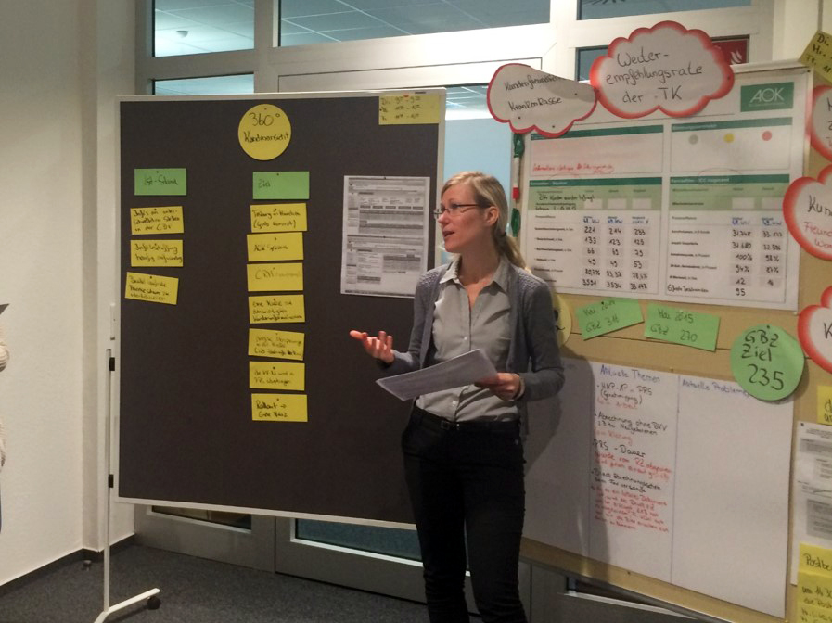
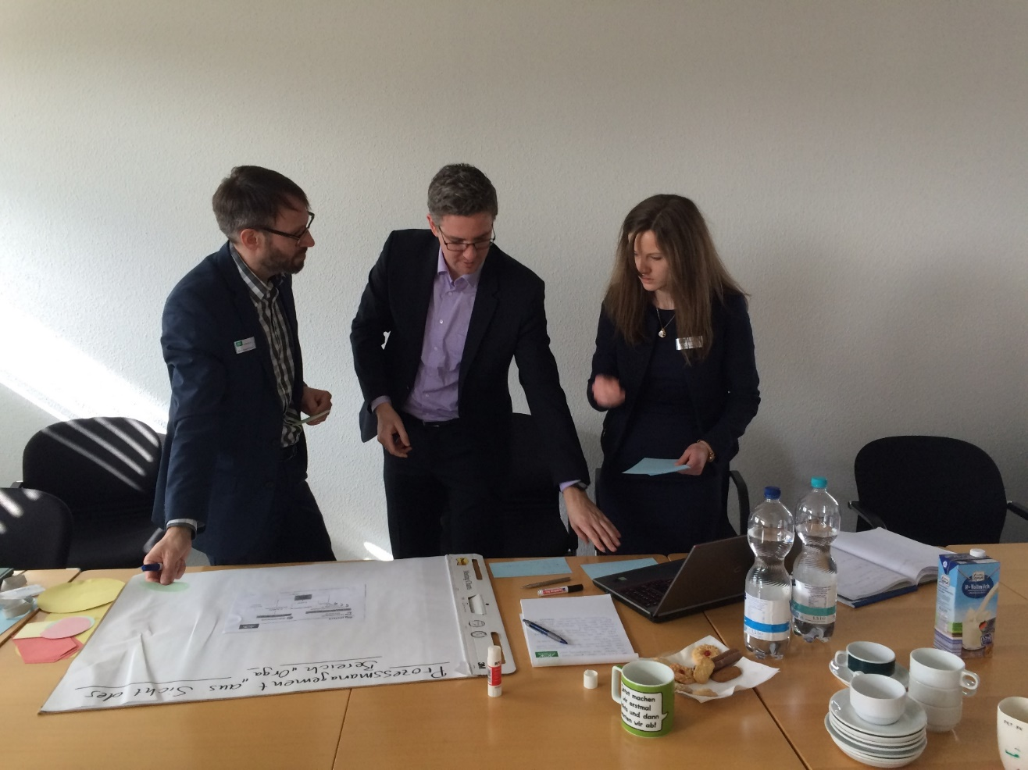
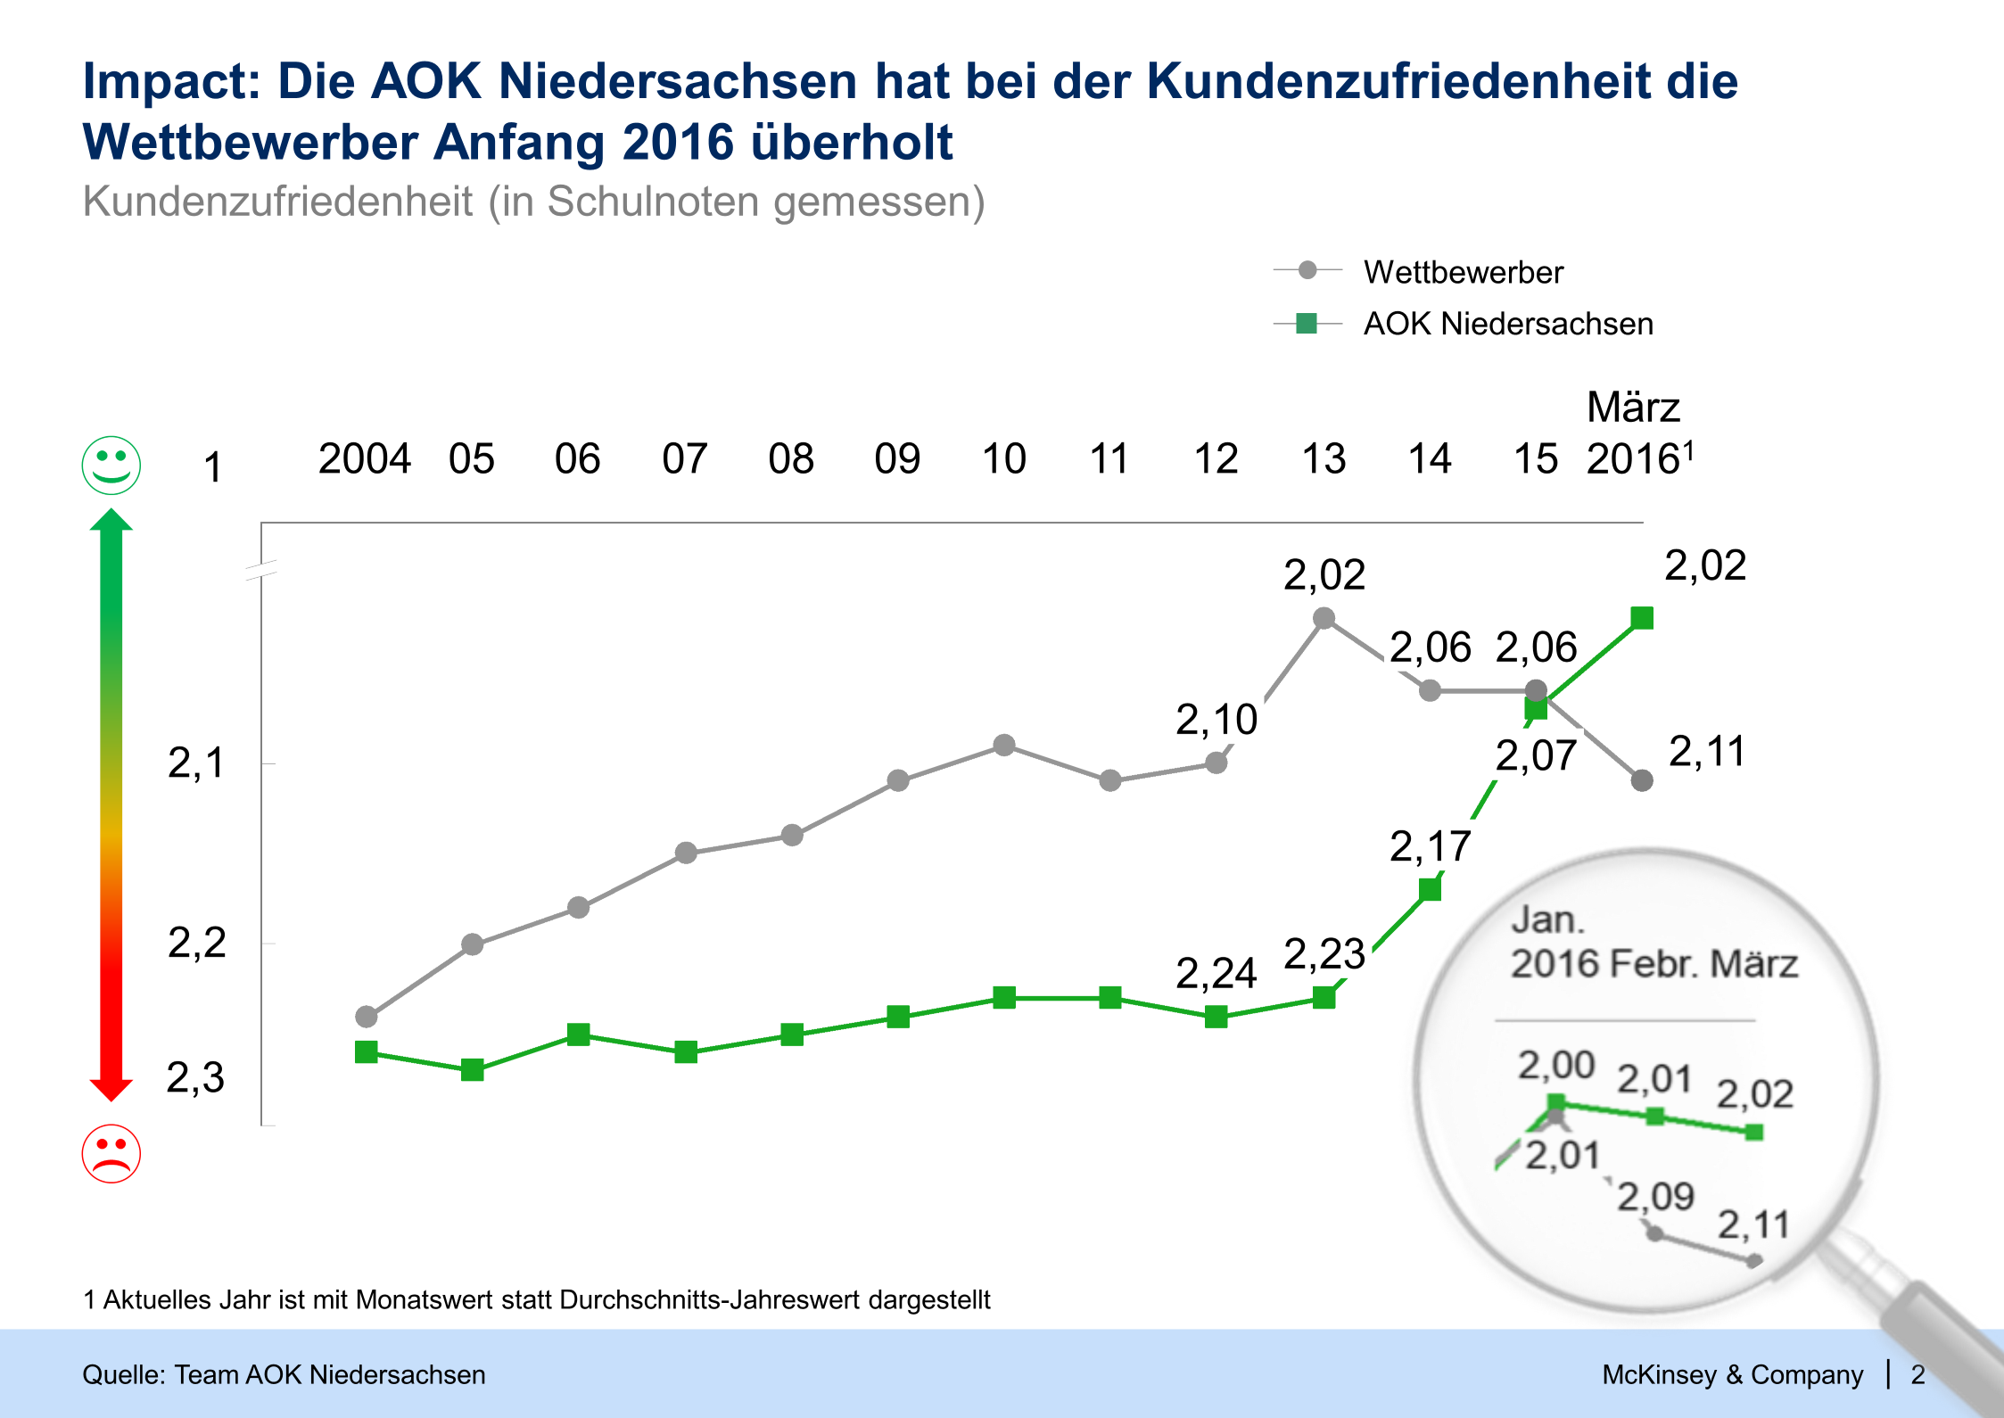
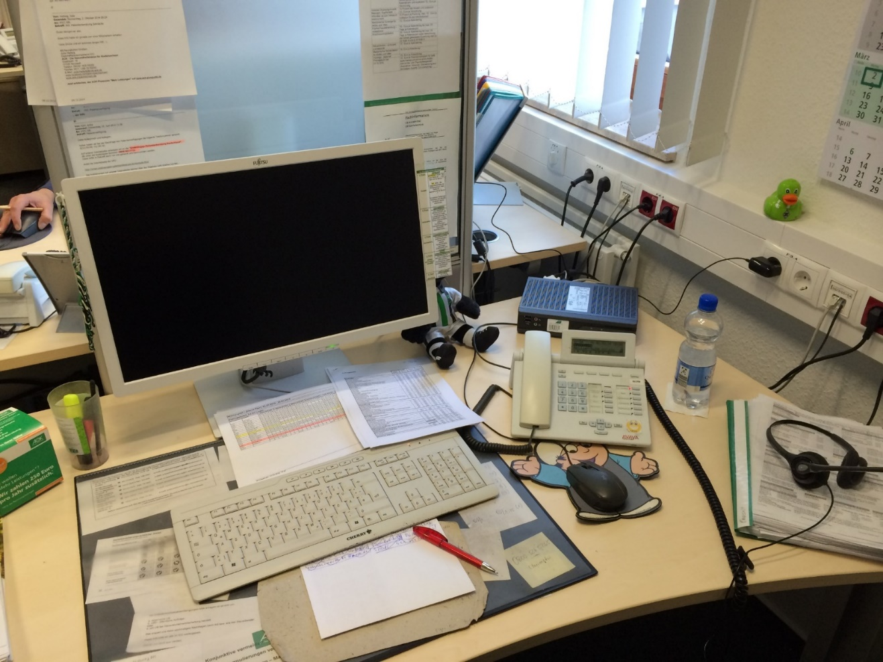
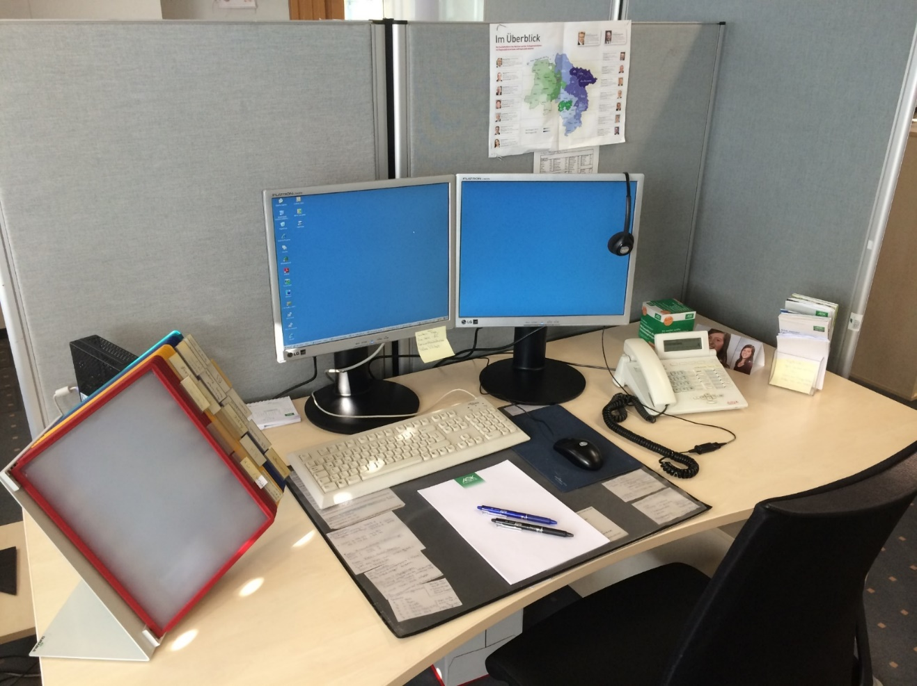
CLIENT Lower Saxony customer orientation transformation
Healthcare | North America
HSS005
2013
2016
Approach
Set direction
Mobilize employees
Change ways of working
Ensure sustainability
Analyses
TUI Arena
Regular meetings
Navigator training
Develop the value proposition and identify/prioritize the customer journeys based on intensive market research
Attune all 6,500 employees to focusing on customer orientation with high execu-tive board involvement (in workshops, in the plenary)
Develop and implement actions together with the teams (e.g., call center, sickness benefits, complaints divisions)
Build up a 10-person navigator pool that anchors the new ways of working
Impact
Concrete change (example: call center)
Before
Availability:
60%
Total processing time:
300 seconds
Avg. waiting time:
150 seconds
Customer satisfaction:
1.8
After
Availability:
> 90%
Total processing time:
225 seconds
Avg. waiting time:
40 seconds
Customer satisfaction:
1.6
SOURCE: Client Lower Saxony Customer Orientation project (key contacts: Harald Fanderl, Manuela Martin, Stephanie Lotz)

