Slide 1
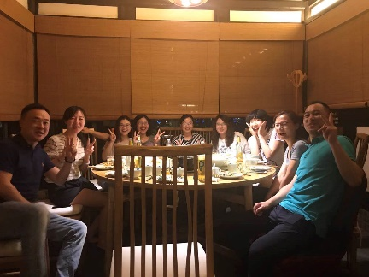
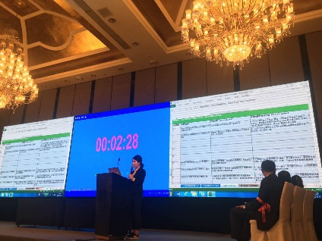
One of the global leader in eye care– we developed and rolled out a “customer centricity” programme for its cataract business in Asia to regain its growth
Pharmaceuticals and Medical Products (PMP) | Asia-Pacific
PMP009
Situation
What we did
Impact
One of the largest medical device companies specializing in eye care products
Flattened 2016 Asia topline sales after years of high growth
The company recognized the importance of “customer centricity” and engaged another consulting firm in late 2016 to develop a new customer segmentation but couldn’t be implemented
Design and pilot phase
Developed a customer-needs based segmentation with local sales team to make it more crisp and actionable
Designed a joint account planning approach and toolkit to enable internal teams (e.g. sales, marketing, medical, technical services, etc.) to coordinate efforts to best address customer needs
Piloted in two districts with cross-functional teams
Implementation phase
Helped develop a hospital master database of >1000 accounts
Helped build up sales capabilities in account planning (e.g. launch an account planning competition leveraging its cycle meeting)
Conducted change management (incl. new performance management)
The client is on track of recovery, with YTD sales ~8% higher than target
Changed front-line sales from UNHAPPY to HIGHLY MOTIVATED through series of “customer centricity” initiatives
Helped China head develop sales talent and identify team(s) with strategic thinking capabilities

