Slide 1
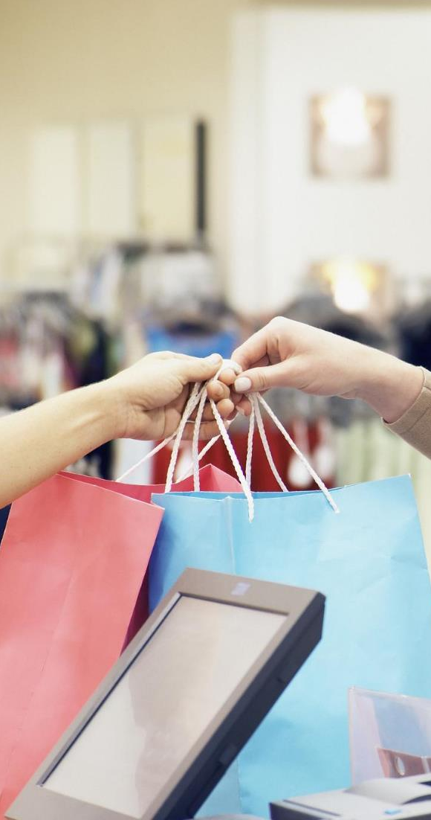

Global consumer products retailer
Retail/Apparel and Hospitality (CONSUMER) | North America
RET041
1. STORE EXPERIENCE AND FRONT-LINE ENABLEMENT
Overview: Global retailer tests and launches new technologies and experiences to seamlessly combine digital assets with mobile and in-store experiences. Stores are increasingly digitally enabled from consumer classes to checkout
Example of: Technology applications in-store to enhance customer experience
Impact delivered: Global market leader in specialty retail. Market share gains across all regions and double-digit growth in both revenue and profits in 2016. More than 100 stores opened globally in 2016
Key elements of their digital transformation
DIGITAL CONTENT
Shoppers can use mobile devices to scan products on shelves and engage in digital product content (e.g., reviews, usage recommendations). Digital content is also interwoven into center of the store with digitally-enabled workstations where social content and how-to’s are browsed simultaneously with in-person lessons
BEACON PROGRAM
Retailer’s app (on mobile and Apple watch) recognizes shoppers as they enter the store and triggers messages with experience and product recommendations
ENHANCED EXPERIENCES
Immersive experiences to increase accuracy of product recommendations: proprietary in-store technologies, Digital [..] Board with “People Like Me” search function, virtual artist capabilities such as A/R enhanced product trial

