Slide 1
Consumer | Asia-Pacific
RET047
Major Asian Cosmetic Client sets its Business goals for ~30,000 stores and 20 brands on their own

Slide 2




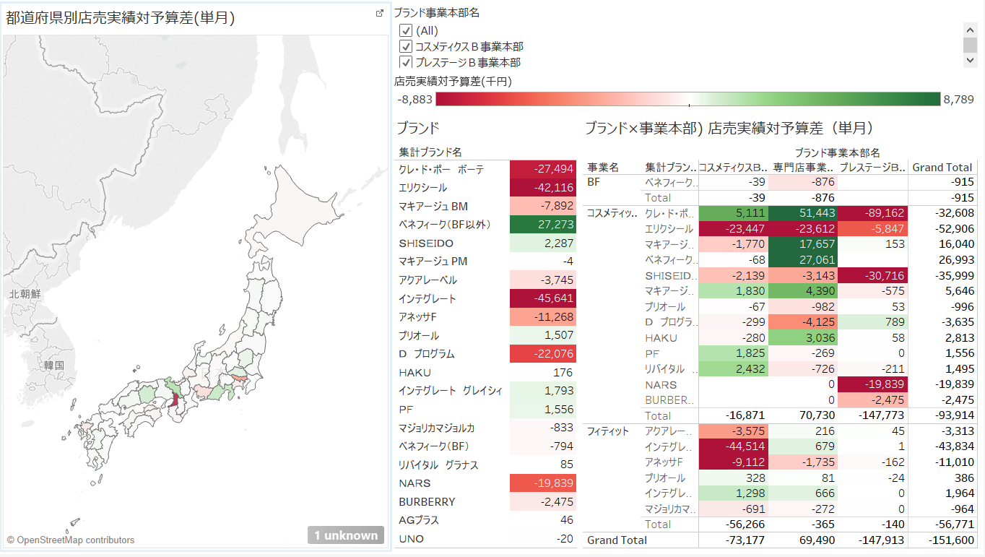
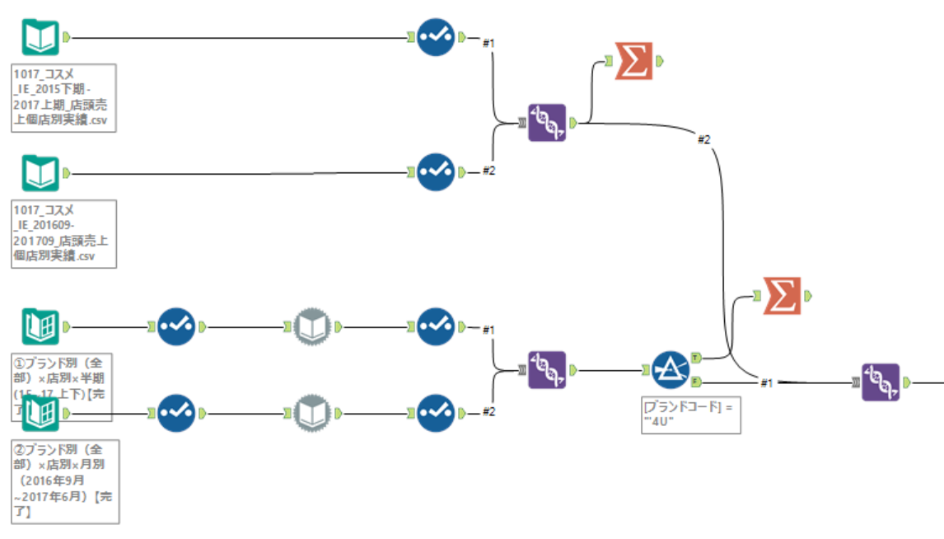

Despite the complexity, a major Asian cosmetic client is now able to set its monthly individual business goals for ~30,000 stores and 20 brands on their own
RETAIL/APPAREL AND HOSPITALITY (CONSUMER) | ASIA-PACIFIC
RET047
Our solution: Fast deployment of Tableau dashboard enabled by Alteryx
We first organized BU brand performance and linked them to corporate and sales goals in Alteryx (i.e., 20 brands for 30,000 stores per month)
The data was then connected to Tableau for the real-time visualization of result
Clients are able to modify the most interesting logics on the dashboards on their own in lieu of IT vendors
Historical monthly/quarterly sales data by BU and store
Data consolidation
with key logic
Share the final outputs of Brand x Store for each branch/individual for real-time visualization to PS the logic
Brand x Channel sales goal targets
SOURCE: Client example

Slide 3

“MIRAI” identified clear and immediate client impact, opening the door to even larger projects (e.g., sales transformation)
IT vendor cost
Client impact
Successfully allocated the overall growth target to each store by brand (first time in client history☺), also allocated the trade investment based on sales target
Reduced IT vendor cost by 75% by having a McKinsey consultant work for 1 month in place of 4+ months of vendor work
And uncovered 30% sales cost savings by identifying sales personnel activities that can be eliminated
Set up the client for a more effective decision-making and refocused the sales organization on value-adding activities
-75%
As-is
(leverage existing IT vendor )
Post-solution
Sales personnel cost
Number of position
-30%
As-is
Post-solution
As a result, McKinsey won a full-year sales transformation project starting in 2018
This can be used as teaser/trial for core M&S projects!!
SOURCE: Client example

