Slide 1
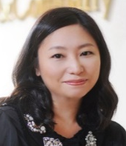

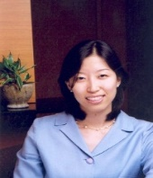
No.2 retailer in Asia-Pacific – we developed merchandising and marketing plan to ensure client’s successful entry into duty free business
Retail/Apparel and Hospitality (CONSUMER) | Asia-Pacific
RET053
MJ CHOI
Situation
What we did
Impact
No.2 retailer in Asia-Pacific with over $11 Billion in sales across multiple formats
Flattening top line sales and over-reliance on hypermart and department business
Recognized the need for business expansion into new format, and selected duty free as one of them
Prepared for bid in Large airport, No.1 airport duty free in the world
Designed a merchandising plan based on consumer insights of KR/CN/JP on new store format concepts
5 new concepts, never tried previously at airport duty free, developed
Developed a marketing plan also based on consumer insights, with a theme of “Journey”, which encompasses from travel planning to in-store experience
Focused on digital marketing activities leveraging consumers’ mobile usage when visiting Asia-Pacific
Succeeded in entry into Large airport
Won at general merchandise section (fashion, food, electronics, etc)
Financially, expected annual sales of $300 Million
Strategically, halo effect on client’ getting license in downtown duty free business in Asia-Pacific this year (estimated annual sales of $1.2 Billion)
M&S Expertise
Aimee Kim
Jun Shin
Heeyoung Hwang (Alumni)

