Slide 1
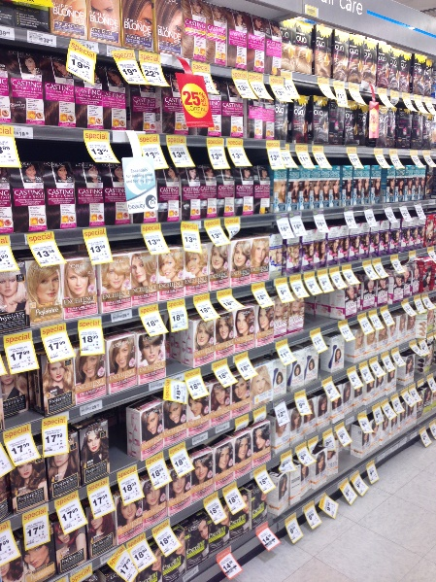
Changing prices for 80% of a supermarket chain’s range
Retail/Apparel and Hospitality (CONSUMER) | Asia-Pacific
RET054
Situation
What we did
Impact
Largest supermarket chain in Asia-Pacific - ~US $4bn in sales, 180 stores
Flattening top line sales and leakage of big baskets to discount competitor
Overreliance on promotions to drive sales – 70% of items sold on promo, but customers’ value perception deteriorating
Reset the value strategy from promo-led to KVI-led approach:
Close the price index gap on primary items
Reduce frequency of promotions and eliminate ineffective ones
Reset role of own brand
Worked category by category through 80% of sales in 10 weeks
Ran price bootcamps with category managers to help them develop a plan to reset value in their respective categories
Aggregated category plans into a masterplan via a “Control Tower”
Price perception improved – agreement with statement “Countdown is getting cheaper” up from 20% to 40% in < 8 months
Price index on KVIs reduced from 109 to 105
Slow but steady improvement in number of big baskets

