Slide 1
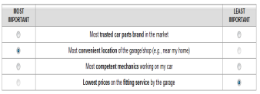
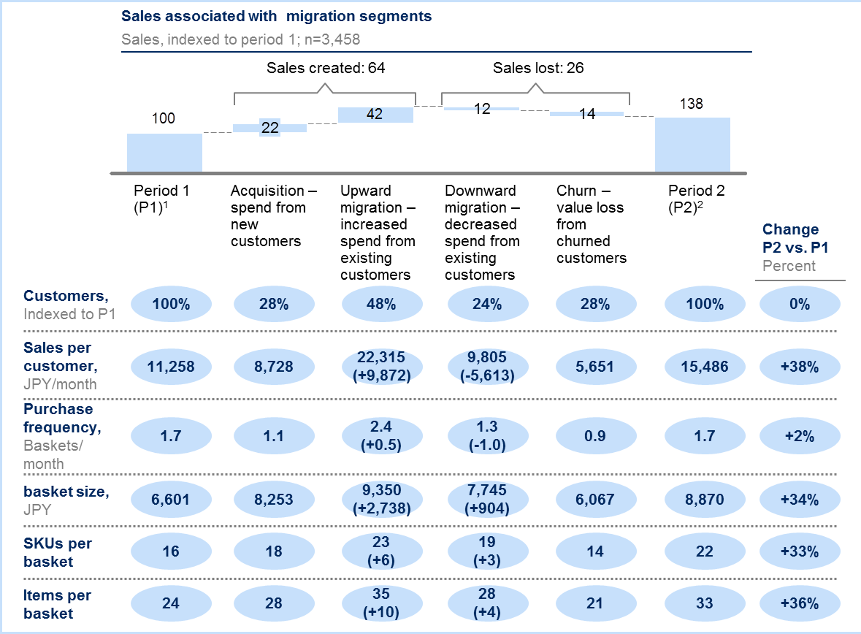




Largest retailer in Asia – successfully redirected them to focus on right metrics and led them to develop more customer centric business model
Retail/Apparel and Hospitality (CONSUMER) | Asia-Pacific
RET056
Situation
What we did
Impact
Largest retailer in Asia with over $70 Billion in sales across multiple formats
In need of transforming their online grocery business, the core of their digitization strategy, both in terms of topline and bottom line (doubling their sales within a year while making profit)
Lack of knowledge/ skills + analytic resources to speedily implement changes in the world of digital
Conducted consumer surveys to define key customer value proposition for their future growth model
Adopted ‘Max diff’ approach to define KBF of our target segments
Conducted ‘concept testing’ to develop new service model which can be implemented in the short-term
Now running 2-week ‘Digital Sprint’ initiative to deep-dive into customer purchase history to define key actions
HUGE impact created which made client immediately shift focus and resources in less than 5 weeks
Clients were shocked to realize that one of the key attributes they have been keen on improving was NOT customers’ primary concern…
New service/operating model developed accordingly and now being tested at site
First cut ‘digital sprint’ analyses highlighted their key issues, and redirected them towards more customer centric mindset
Q1. Which one is the most important and least important attribute in selecting online grocery business?
M&S Expertise
Paul McInerney
Naomi Yamakawa
Tomoharu Hirayama
Tiffany Kwok

