Slide 1

Emerging themes and first ideas
TMT | Western Europe
TEL010
Working draft based on interviews as of 12/01/2017
Commercial stimulation of stores network – impact story
GLOBAL MARKETING & SALES
Document for discussion | 15/01/2018
CONFIDENTIAL AND PROPRIETARY
Any use of this material without specific permission of McKinsey & Company is strictly prohibited
CONFIDENTIAL AND PROPRIETARY
Any use of this material without specific permission of McKinsey & Company is strictly prohibited

Slide 2
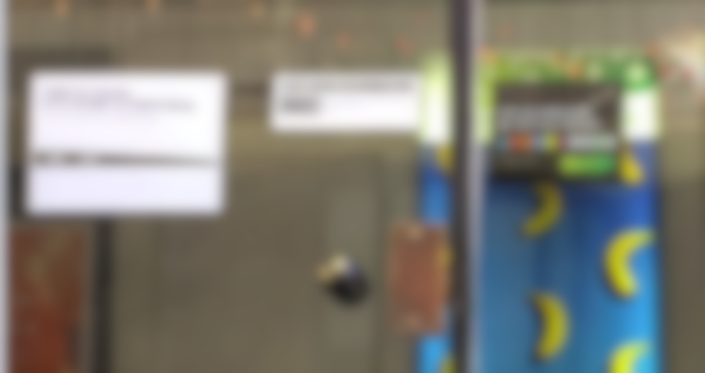
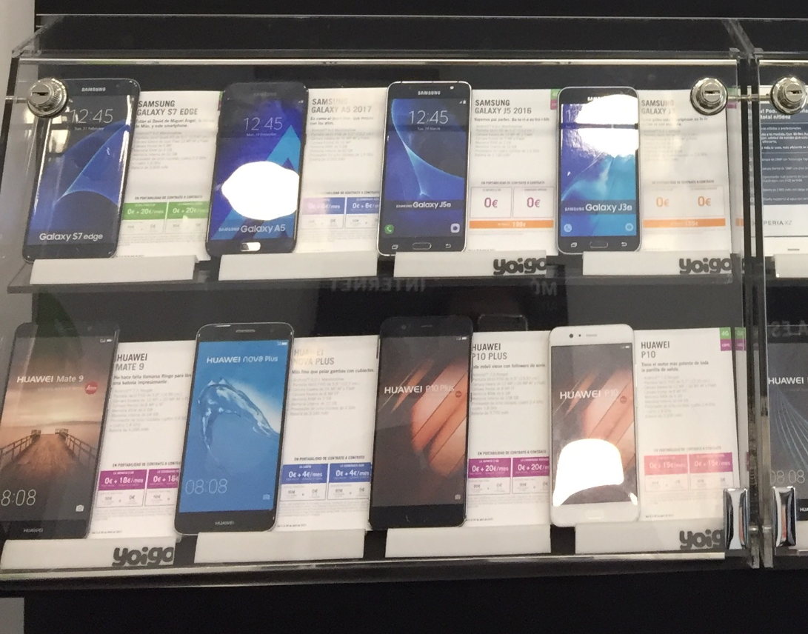
Commercial stimulation program in telco stores – the starting position
TELECOMMUNICATIONS (TMT) | WESTERN EUROPE
TEL010
What we knew from the client
What we found during mystery shopping in 30 stores
800 exclusive stores
Stores owned by exclusive master franchise
Closed stores
Average monthly sales per store
-60% below competition
Exhibited phones are plastic models or locked away
Client data not captured and no follow-up
Store size 50% below benchmarks
Agents do not try to close sales

Slide 3
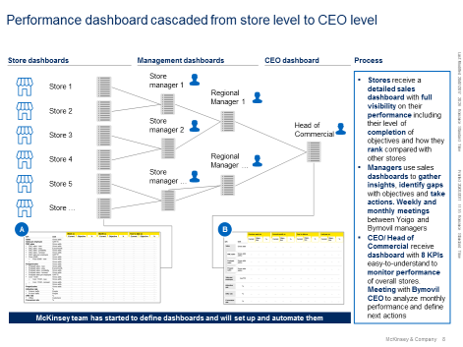
What we did during 8 weekly sprints
8 pilot stores in Western Europe
Full network
Performance management
New sales script
Daily contact with stores
Competitions between stores
Partner management incentives
New contract
Follow-up process and use of CRM
…
…
…
New terms
New objectives
New compensation model
New incentives
…
…
…
…
…
…
Store manager capability training
In-store execution
Process simplification
CRM update
Sales collateral
SMS campaign
Traffic generation initiatives
Store layout

Slide 4
Weekly sales evolution vs April 2017
Pilot
Full network
Adjusted for shop closures
Full network
not adjusted
1
Beginning of project (April 17th)
4
Stores new contract
220
5
First performance cascade
3
New master franchisee contract
2
Beginning of pilot
6
End of pilot
200
7
Beginning of rollout
196%
180
170%
160
164%
149%
149%
141%
140
132%
132%
143%
120
117%
112%
100%
100
100%
80
April
07.05.
14.05.
21.05.
28.05.
04.06.
11.06.
18.06.
25.06.
02.07.
09.07.
16.07.
23.07.

Slide 5
100% success-based billing structure with 2 options
A
Full network impact
B
Potential through pilot stores
Option 1 (full network + pilot):
Network uplift from 15% in May 2017: ~7.1m EBITDA impact 2019* x%
33% uplift in pilot stores (impact in excess of full network): ~13.8m EBITDA impact* (x-3)%
EM+3 team Apr-Jul
x% of additional EBITDA generated in 2019
X-3% of additional EBITDA generated in 2019 from pilot stores scaled to full network
Pilot and preparation of sales performance engine
Option 2 (pilot only):
48% uplift in pilot stores: ~19.6m EBITDA impact*x%

