Slide 1
A quantitative study for the prediction of anxiety, stress and depression
Group: 4
Team Line-Up:
1) Brandon Schoener
2) Ishansh Sahni
3) Rajiv Nagesh

Slide 2
Phase-2 Discussions
1) Project Pipeline
2) Data Cleaning
3) Feature Engineering
4) Intermediate ML Model (K-Means)
5) Research Questions

Slide 3
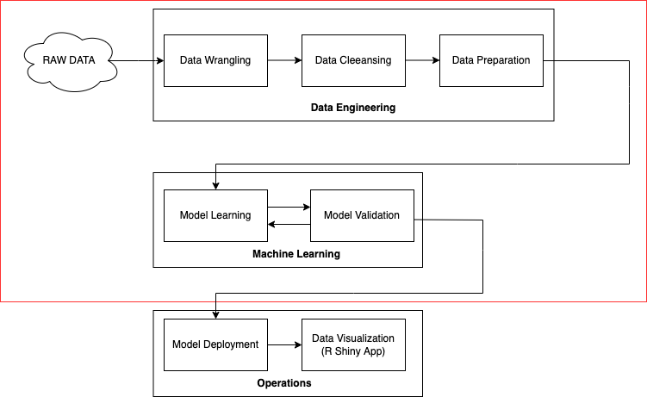
Project Pipeline

Slide 4
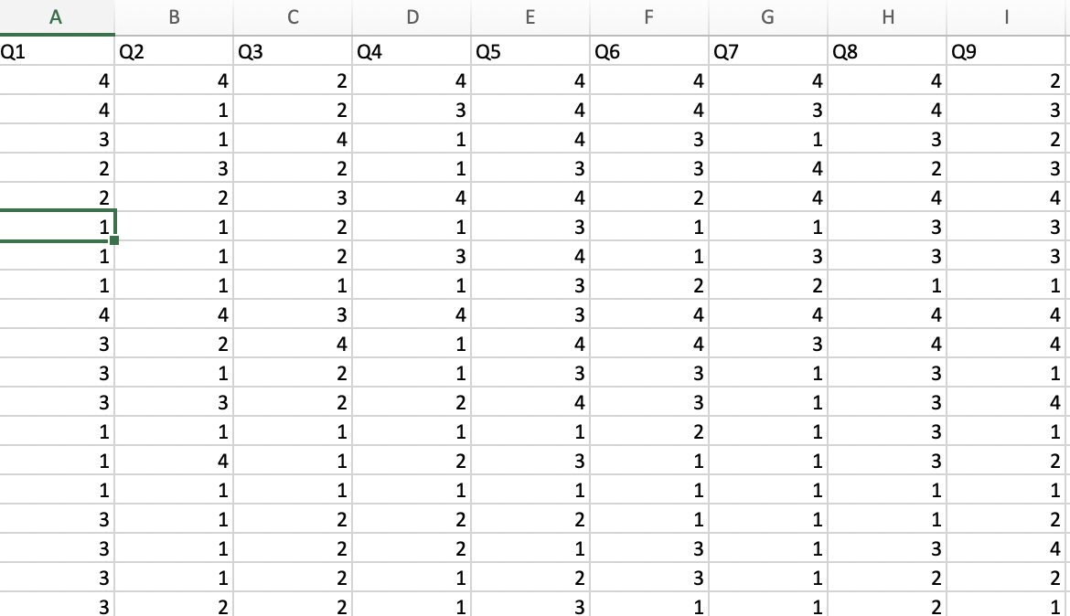
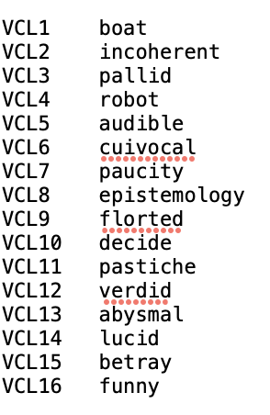
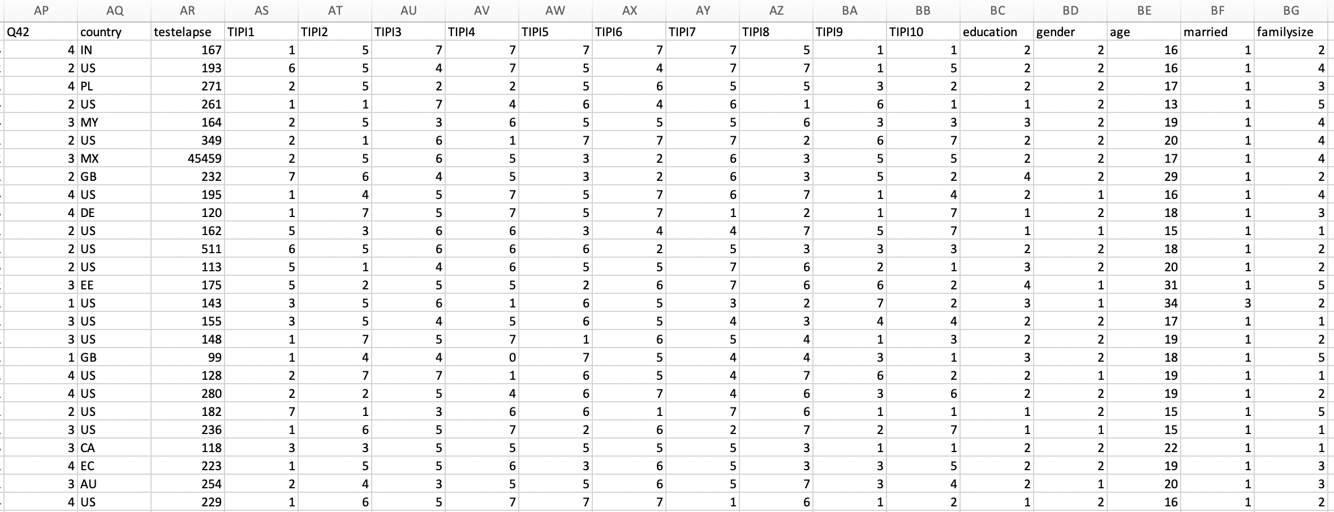
Data Engineering
Data Cleaning
Fake Responses (Check)
Feature Selection
Fig2: data snippet
Fig1: Fake Responses Check
Fig3: data snippet

Slide 5
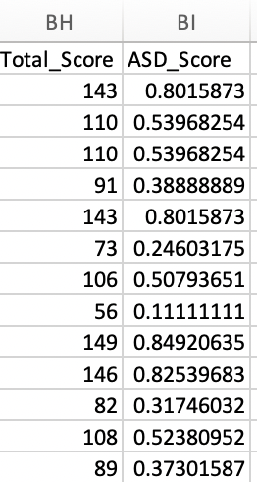
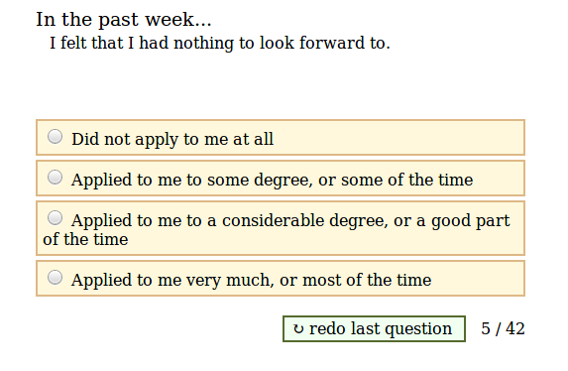
Feature Engineering
Computed ASD Score
Aggregated Time Elapsed (Each Survey)
Standardizing Numerical Features
Encoding Categorical Features
ASD (Anxiety, Stress, Disorder) Score: The score computed on the basis of responses of 42 questions to each individual with their agreement/disagreement. Ranges between 0 and 1 where 0 means not stressed and 1 means showing prominent signs of anxiety, stress or disorder.
Fig4: Sample Question
Fig5: ASD Score

Slide 6
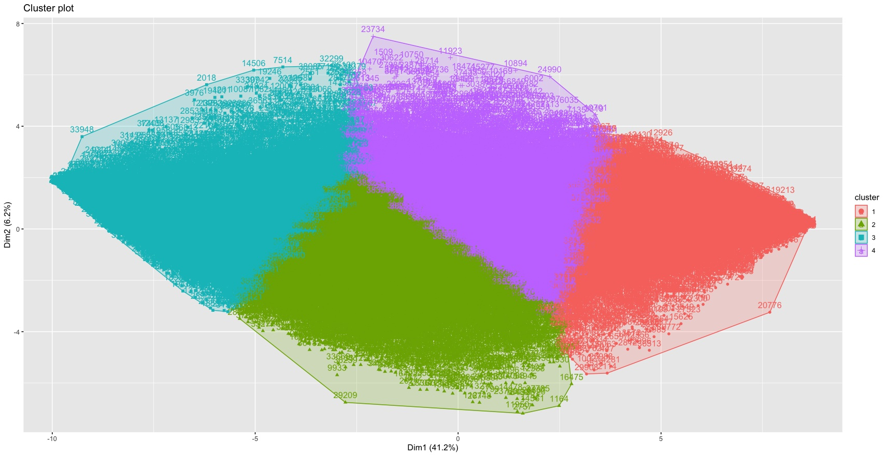
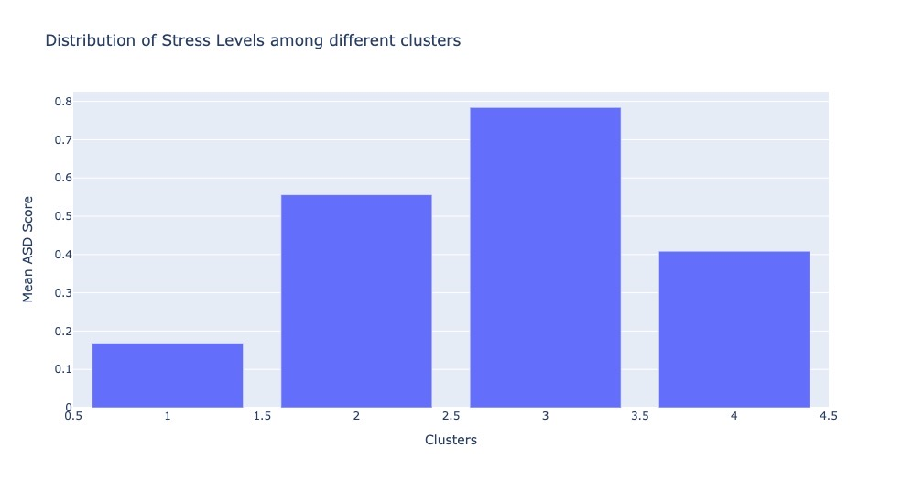
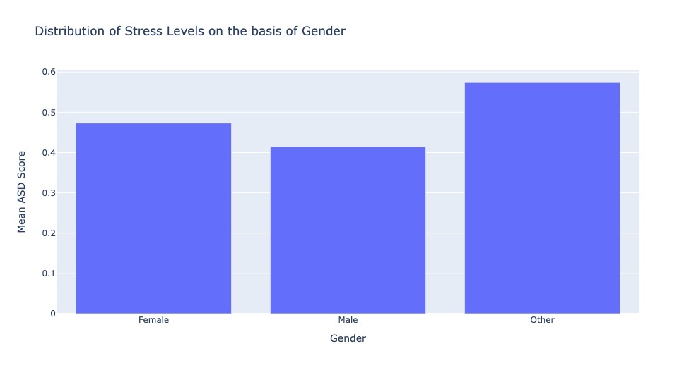
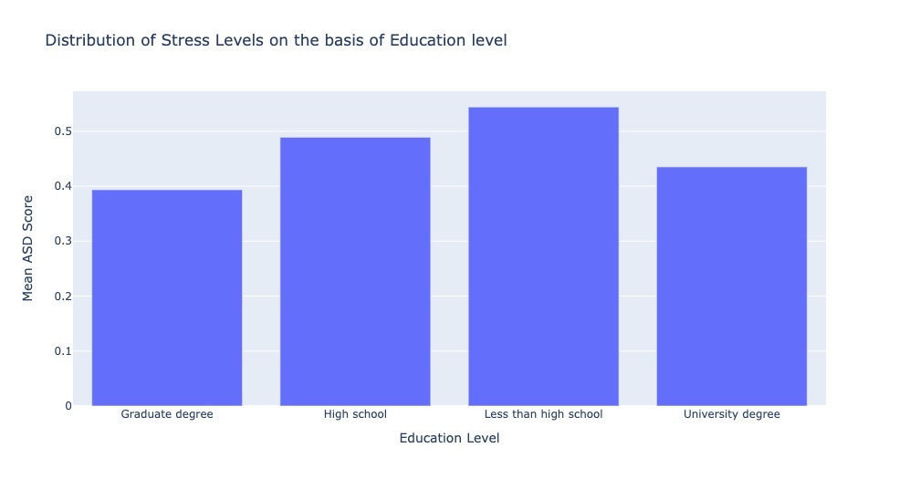
Intermediate Machine Learning Model (K-Means)

Slide 7
Research Questions and Future Scope
Challenges
Using ASD score as a metric in the everyday working scenario in organizations.
Creating an interactive R Shiny Dashboard with different metrics like Age, Gender, Country to classify which class and sector of people tend to be more/least depressed.
In the mental health department, psychiatrists can use the ASD score and treat an individual and use the model analysis to work on a particular behavior of an individual.
Cannot totally rely on data. (For ex., a person’s mental state can change on a given day).
Lack of clinical data to verify clusters obtained.
Lack of terminology for the ASD Score.

