Slide 1
A quantitative study for the CLASSIFICATION of anxiety, stress and depression
Group: 4
Team Line-Up:
1) Brandon Schoener
2) Ishansh Sahni
3) Rajiv Nagesh
4) Gurpreet Chawla
5) Shreya Joshi

Slide 2
Phase-3 Discussions
1) Project Pipeline
2) K – Means Model from Phase - 2
3) Feature Importance Using Random Forest
4) The Questions Picked
5) R Shiny Use Case
6) Demonstration
7) Conclusion and Challenges

Slide 3
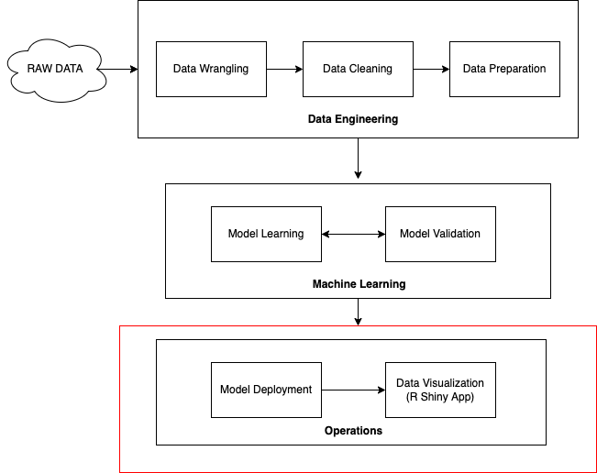
Project Pipeline

Slide 4
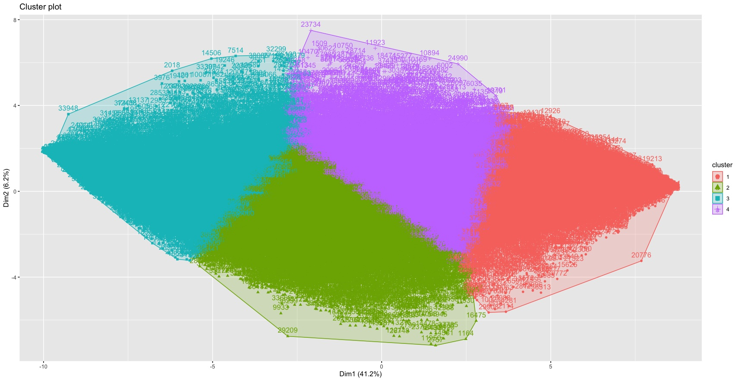
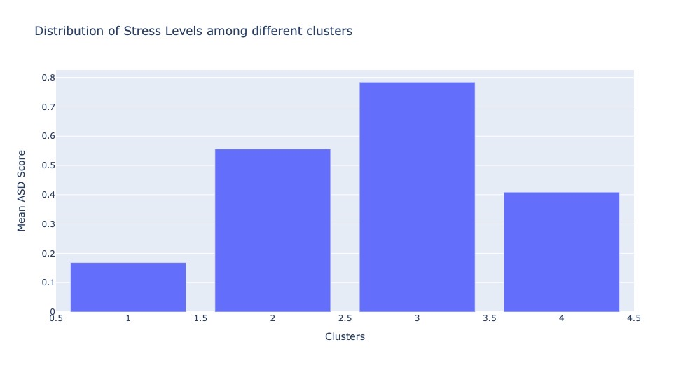
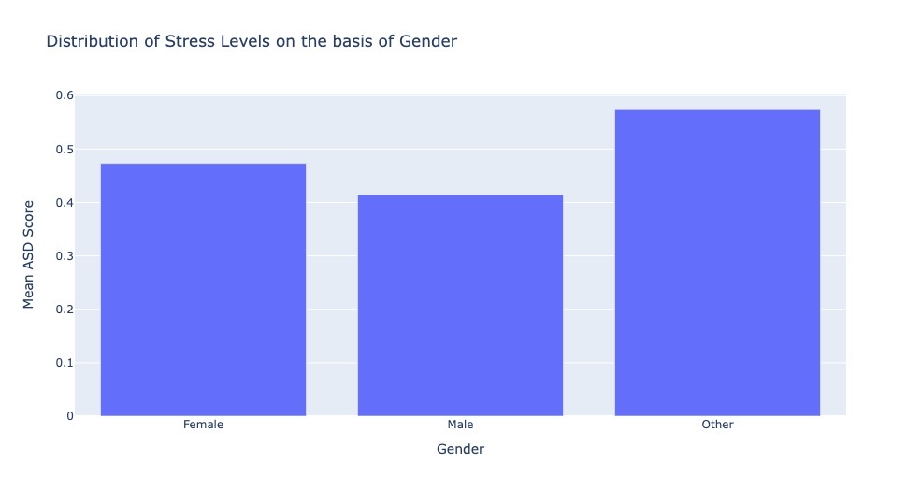
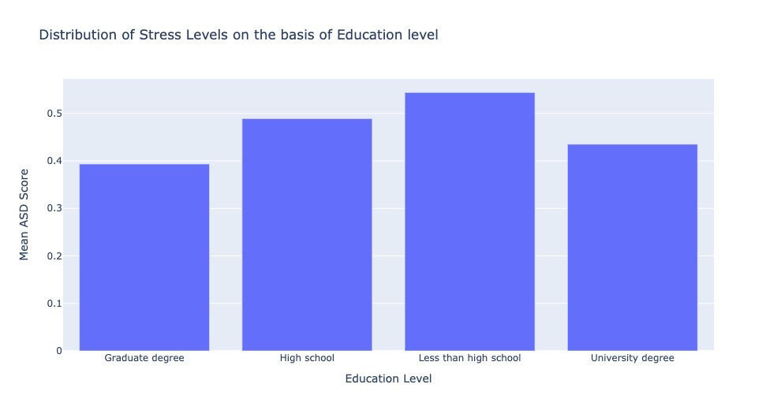
K – Means Model from Phase - 2

Slide 5
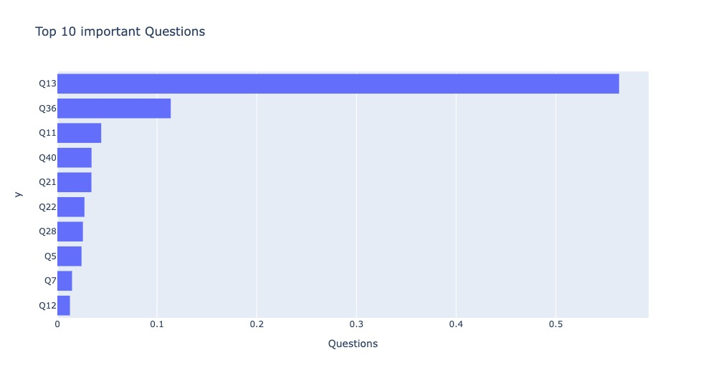
Feature Importance Using Random Forest
Used Random Forest Regression to predict the ASD score.
Selected top 10 features i.e., questions among 42 to train K-Means Model.
Top 10 questions selected covered 89% of variance in the data.
R² (with 42 questions) – (Train: .90; Test: .89)
R² (with 10 questions) – (Train: .87; Test: .86)
Fig: Top 10 Important Questions

Slide 6

WHAT ???

Slide 7
The Questions Picked
I just couldn't seem to get going.
I had a feeling of shakiness (e.g., legs going to give way).
I felt that I was using a lot of nervous energy.
I felt sad and depressed.
I found myself getting upset rather easily. – (Q13 from previous slide)
I felt that life wasn't worthwhile.
I found it hard to wind down.
I felt I was close to panic.
I felt terrified.
I was worried about situations in which I might panic and make a fool of myself.

Slide 8
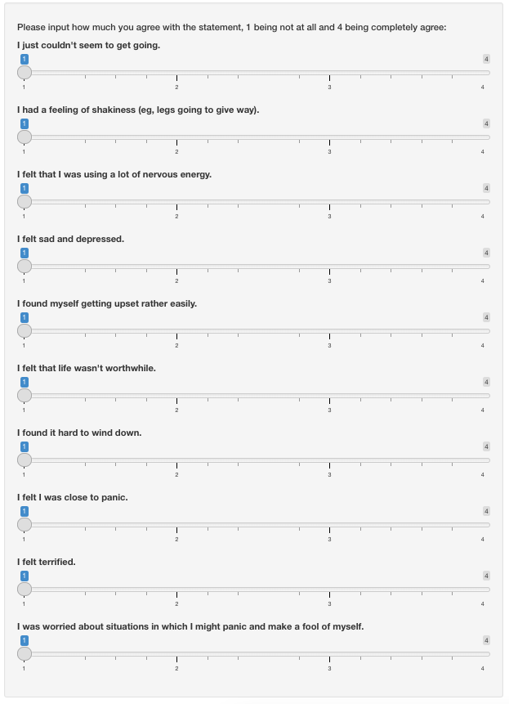
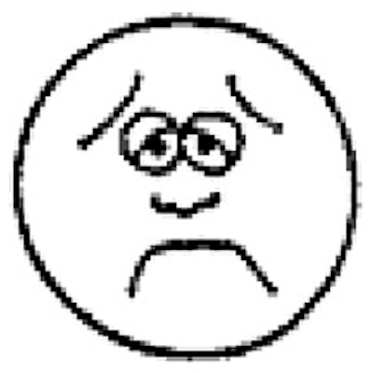
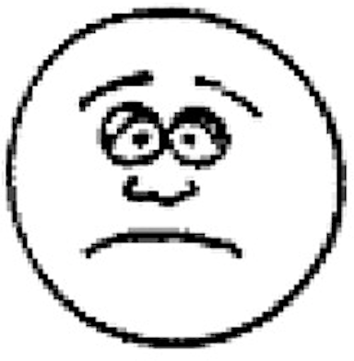
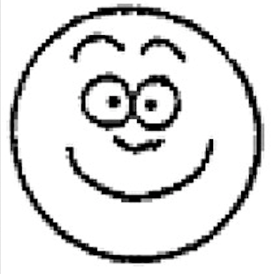
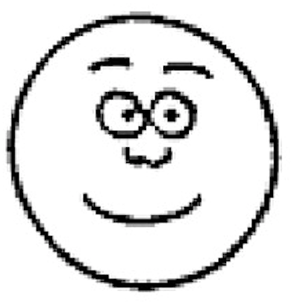
R Shiny APP Use Case
Really Sad Face
Sad Face
Really Happy Face
Happy Face
User Input Question Slider

Slide 9
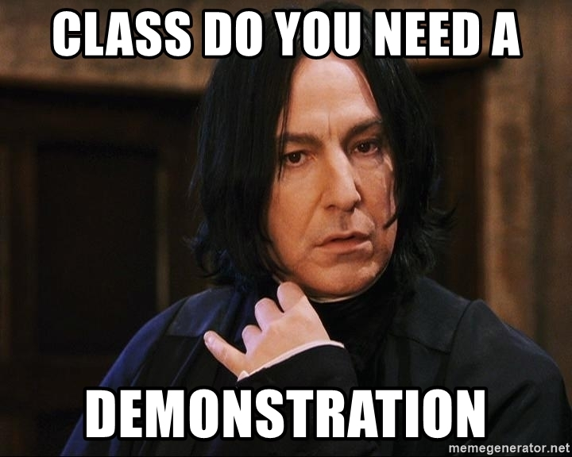

Slide 10
Conclusion and Future Scope
Challenges
Using ASD score as a metric in the everyday working scenario in organizations.
The R Shiny Dashboard classifies a person’s mood accurately.
In the mental health department, psychiatrists can use the classification of an individual based on the observation from the app and treat an individual and use the model analysis to work on a particular behavior of an individual.
Cannot totally rely on data. (For ex., a person’s mental state can change on a given day).
Lack of clinical data to verify clusters obtained.
Lack of terminology for the ASD Score.

