Slide 1
A quantitative study for the prediction of anxiety, stress and depression
Group: 4
Team Line-Up:
1) Gurpreet Chawla
2) Shreya Joshi

Slide 2
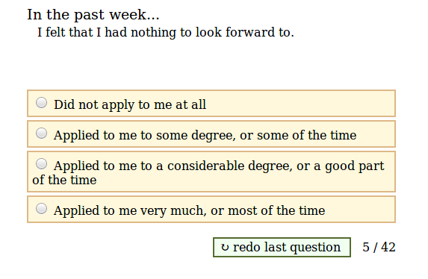
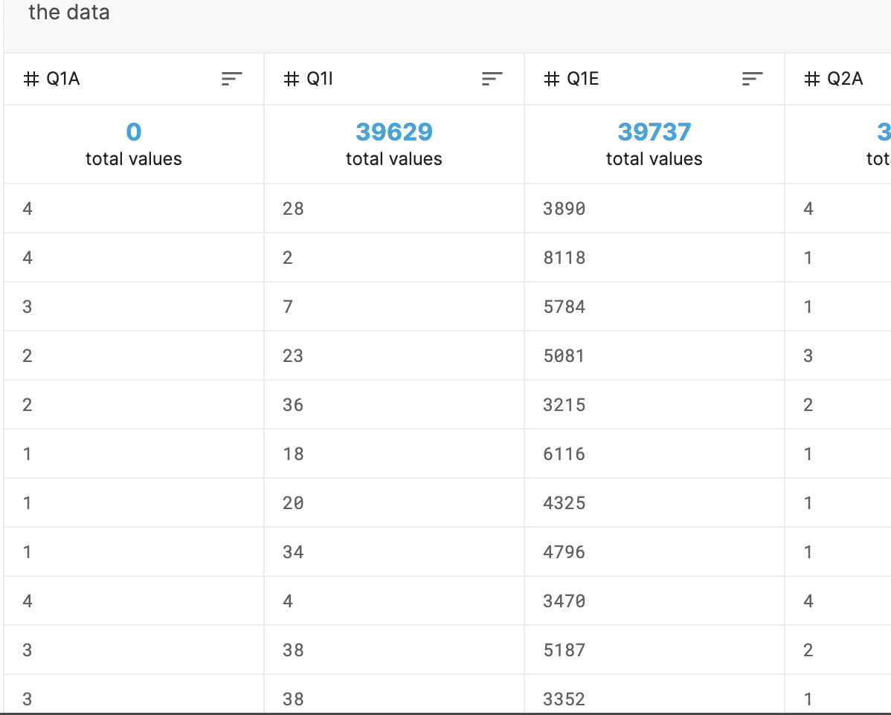
Motivation: Prediction of ASD (Anxiety, Stress, depression) Score of an individual using a dynamic R Shiny Application.
Domain: Computational Social Science
Possible Outcome: An ASD score between 1 ☹ to 0 ☺. This research project aims to ask individuals a set of questions and then compute their ASD score related to the individuals’ answers.
Questions: There are a total of 42 questions and the responses of the same are documented in the dataset
Sample Question
Data Snippet
GROUP #4

