Slide 1
INFO 5100 Fall 2021 Charity Management System
Nandita Sharma (002954757)
Prabhansh Sharma (002198201)
Rajiv Ranjan Sahu (002101619)

Slide 2

Purpose:
To provide a common platform for a Charity ecosystem extended to multiple cities (Network) for Donors, CSRs, Charities/ NGOs and the Admin management team
This application is also used to manage the funds, donation kits and managing the charitable events including fundraising
There is a level of escalation and management for each of the transactions and work request that are requested

Slide 3

Problem Statement:
“Givers Never Lack!”, with this motto in mind we have created a scalable application that tackles the problem of managing funds and donations, all under a single platform.
Our platform integrates the Donors, CSRs, Event Coordinators and the Charity’s POC for a seamless workflow. The users can effortlessly see their transactions and can get a report on the total inventory for the managers and administrators.

Slide 4

Problem Statement:
Managing various Organizations under Enterprises can impose a great challenge especially in an area where there is lack of infrastructure or where there is lack of coordination.

Slide 5

Additional Features:
Visual validators provide real-time validation status in the input field
User gets email confirmation at the time of registration
Admins and Coordinators gets a visual representation of the datapoints (funds and kits)

Slide 6
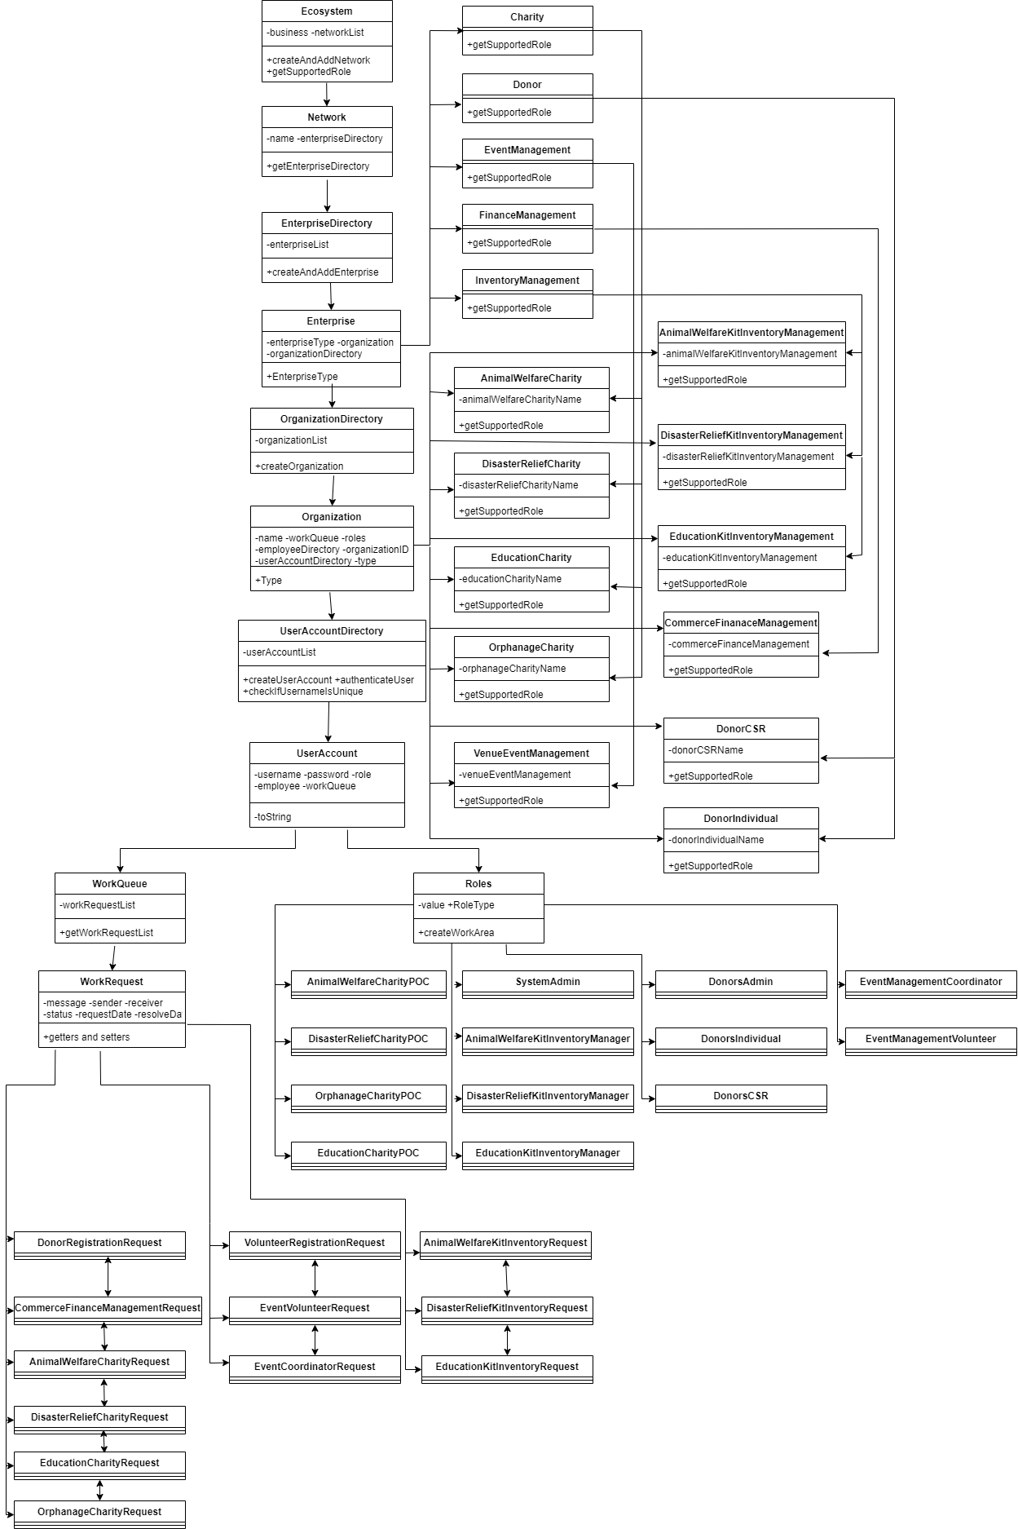
<< Object Diagram

Slide 7
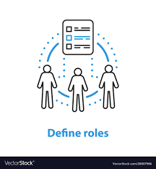
Roles and Responsibilities:
SystemAdminstrator – Creates and manages the Network, Enterprise and the Organizations
DonorAdmin – Approves the new donors and CSRs at the time of registration
DonorIndividual – Registers and donates funds and kit to the various charities
DonorCSR – Registers and donates funds and kit to the various charities.
AnimalWelfareCharityPOC – Manages the funds towards the Animal Welfare Charity.

Slide 8
Roles and Responsibilities:
DisasterReliefCharityPOC – Manages the funds towards the Disaster Relief Charity
EducationCharityPOC - Manages the funds towards the Education Charity
OrphanageCharityPOC - Manages the funds towards the Orphanage Charity
AnimalWelfareKitInventoryManager – Manages the donated kits for animal welfare
DisasterReliefKitInventoryManager - Manages the donated kits for disaster relief

Slide 9
Roles and Responsibilities:
EducationKitInventoryManager - Manages the donated kits for education
CommerceFinanceTeamLedger – Manages the incoming donation and allocates them to the corresponding charity
EventManagementCoordinator – Manages the events and venue for the events
EventManagementVolunteer – Registers for the upcoming events and fundraisers

Slide 10
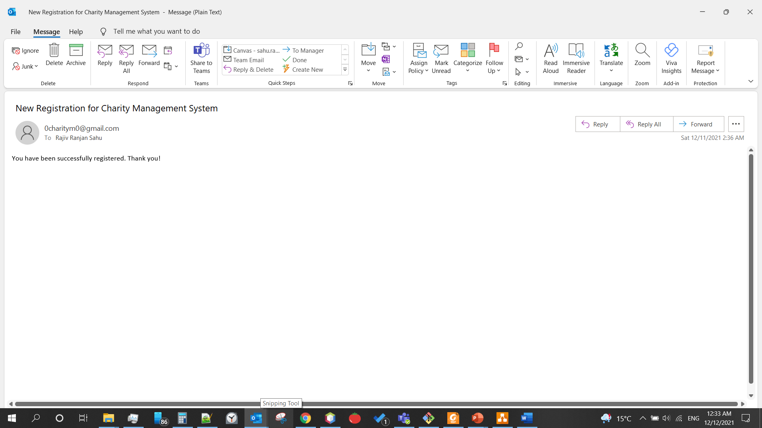
Email Verification:

Slide 11
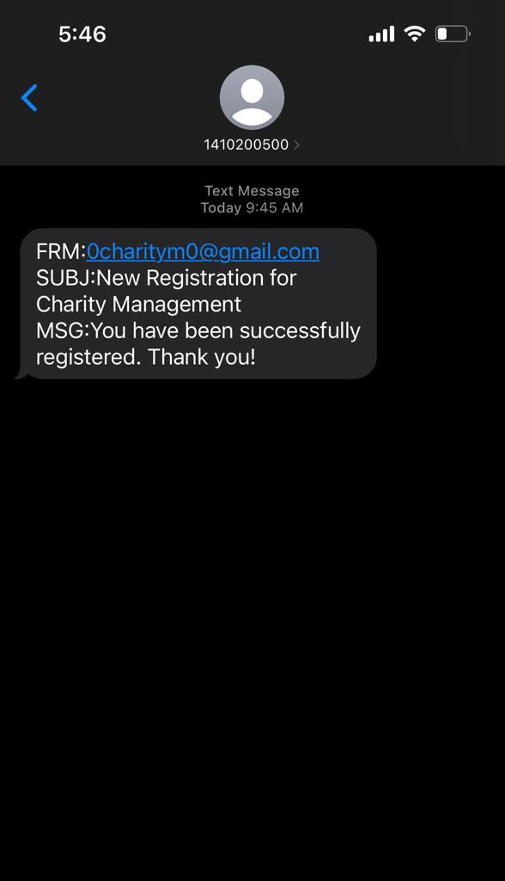
SMS Verification:

Slide 12
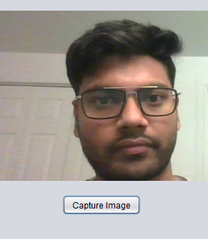

Image Addition through Webcam:

Slide 13
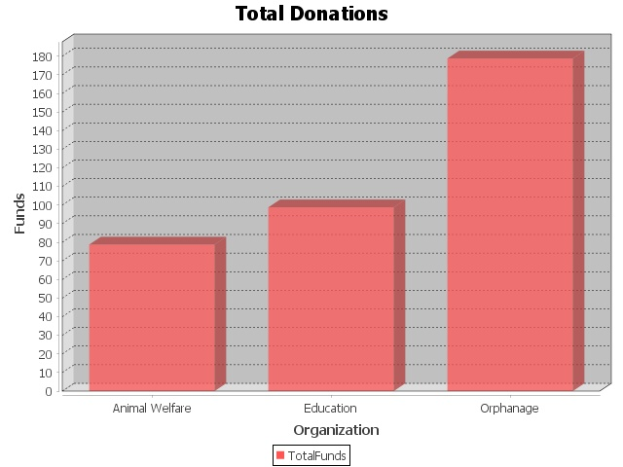
View and Download Graphs:

Slide 14

Q&A:

