Slide 1


CSYE 7374 Design Patterns: RideNow
Nandita Sharma 002954757
Rajiv Ranjan Sahu 002101619
Sparsh Sinha 001000390
Sushmita Maity 001092534

Slide 2
AGENDA
Design Patterns Implemented
UML
Deep Dive into Implementations
Contributions
Demo

Slide 3
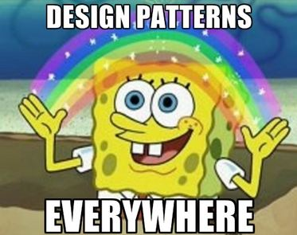
1. Behavioral 1. Command 2. Observer 3. State 4. Strategy 2. Structural 1. Adapter 2. Decorator 3. Facade 3. Creational 1. Builder 2. Factory 3. Prototype
Design Pattern Implemented

Slide 4
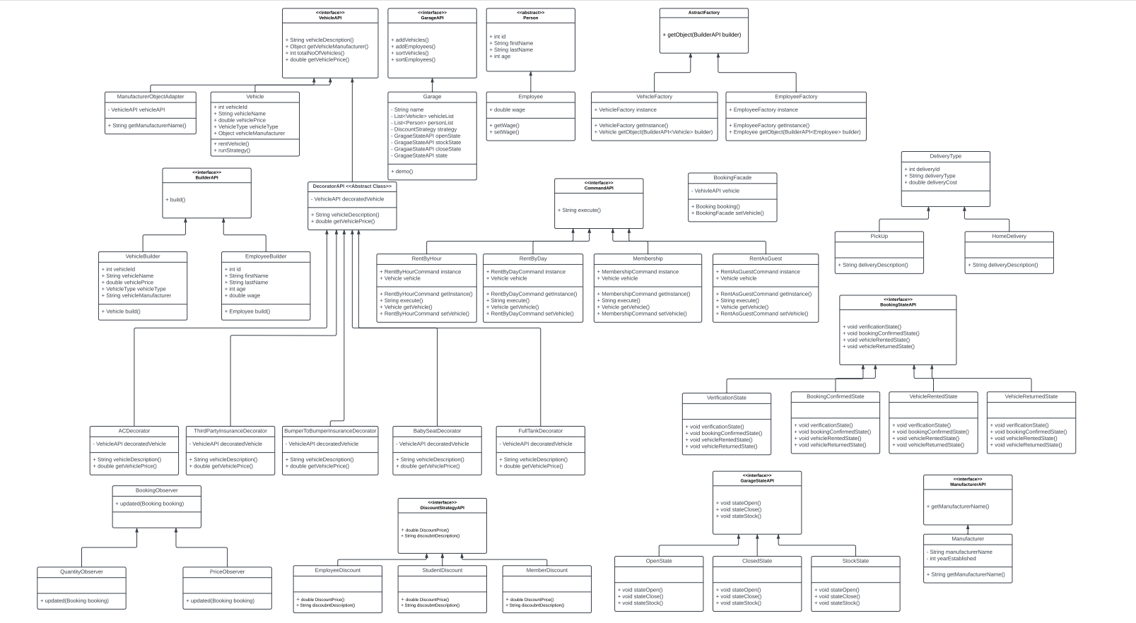
UML

Slide 5
Contributions
Nandita Sharma:
Decorator, State, Façade, Observer
Rajiv Ranjan Sahu:
UML, Builder, Factory
Sparsh Sinha:
UML, Strategy, Decorator
Sushmita Maity:
Adapter, Command, Presentation

Slide 6
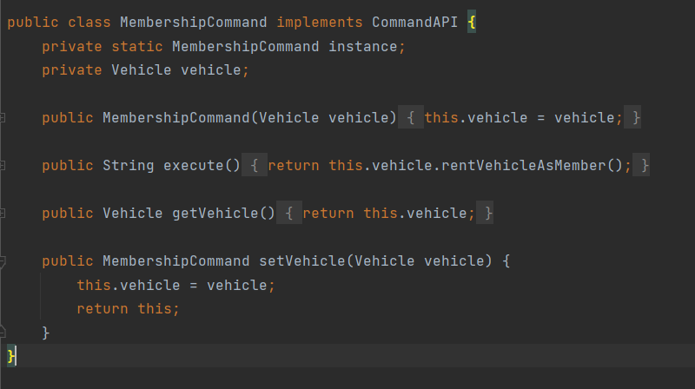
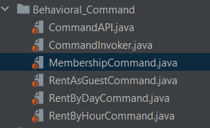
Behavioral: Command
Membership
Rent As Guest
Rent By Day
Rent By Hour

Slide 7
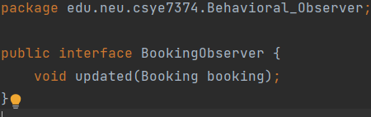
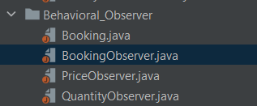
Behavioral: Observer
Booking
Price
Quantity

Slide 8
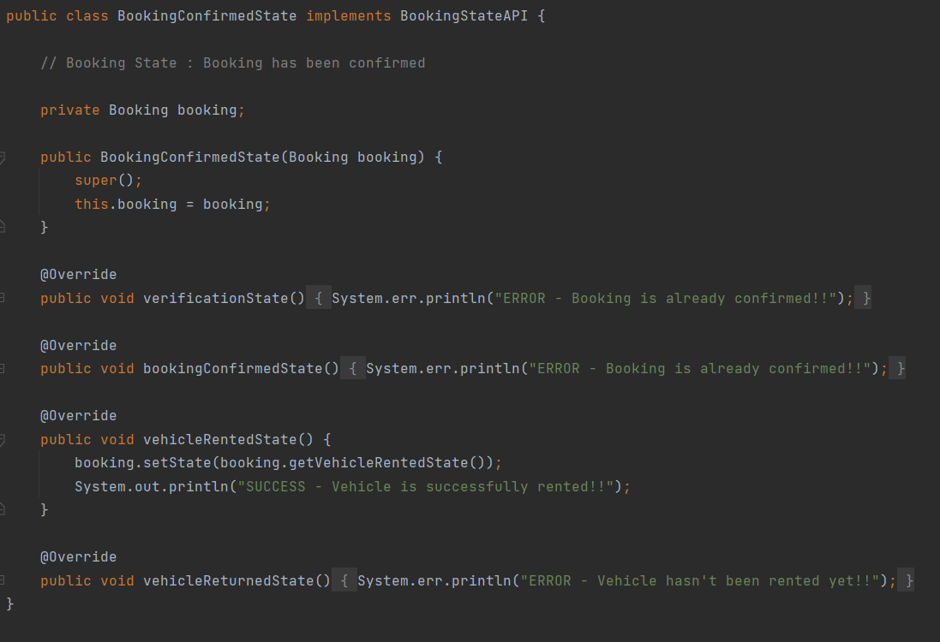
Behavioral: State
Booking Confirmed
Booking State
Open
Closed
Garage
Stock
Vehicle Rented
Vehicle Returned
Verification

Slide 9
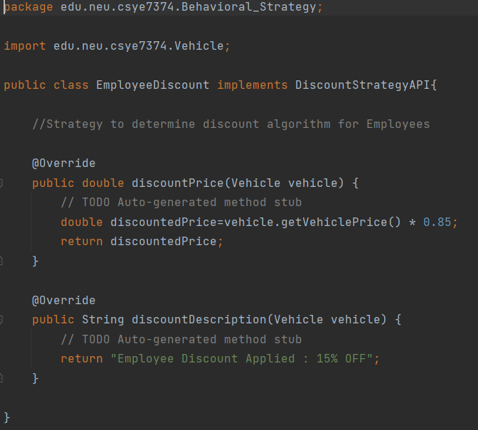
Behavioral: Strategy
Employee Discount
Student Discount
Member Discount

Slide 10
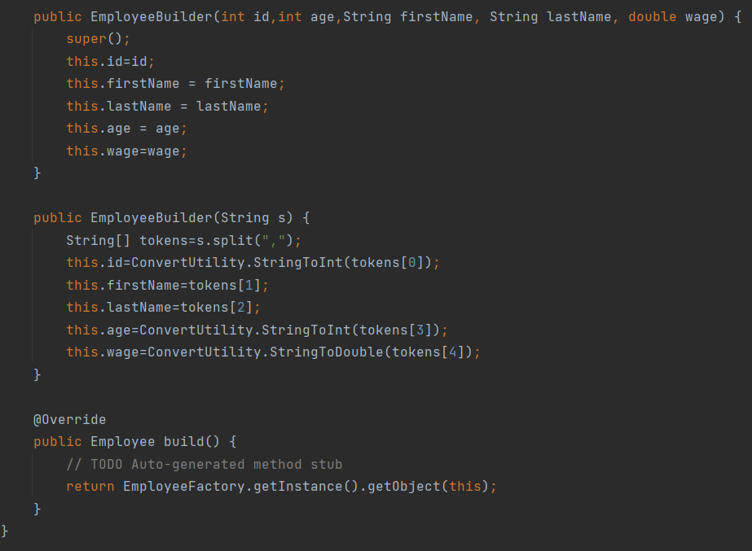
Creational: Builder
Employee
Vehicle

Slide 11
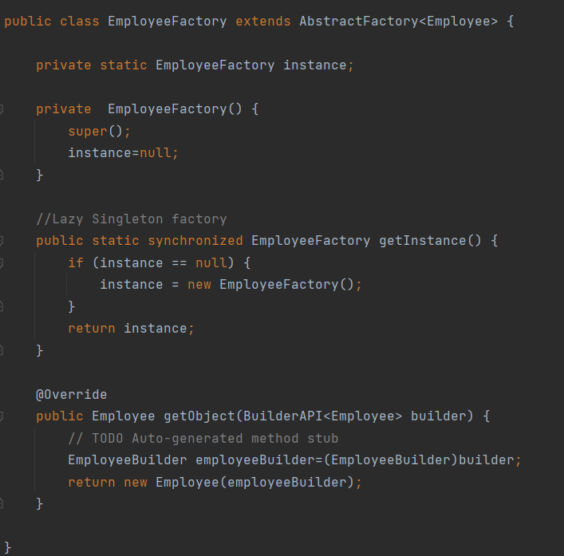
Creational: Factory
Employee Factory
Vehicle Factory

Slide 12
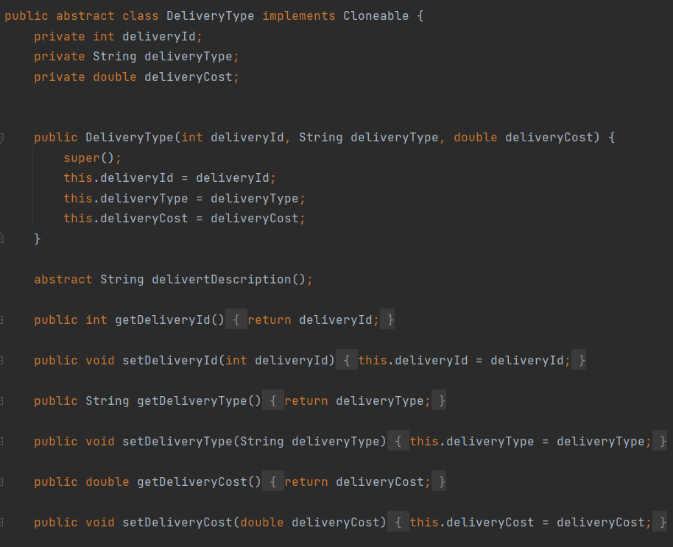
Creational: Prototype
Delivery Type:
HomeDelivery
StorePickup

Slide 13
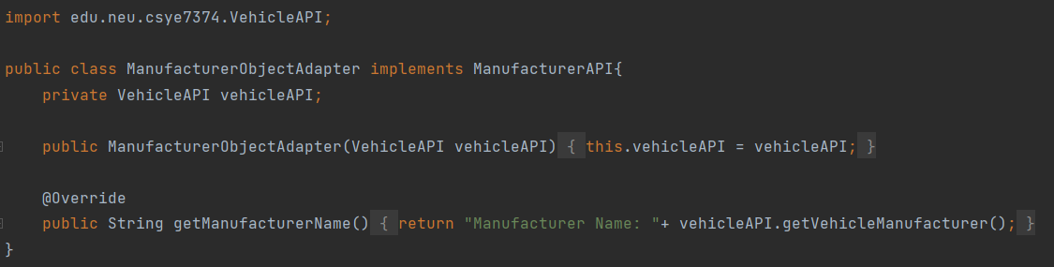
Structural: Adapter
Manufacturer

Slide 14
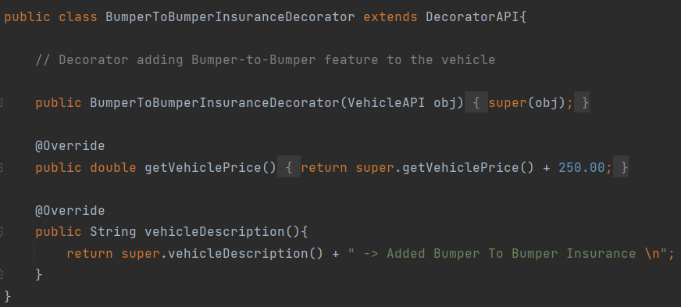
Structural: Decorator
AC
BumperToBumperInsurance
BabySeat
FullTank
ThirdPartyInsurance

Slide 15
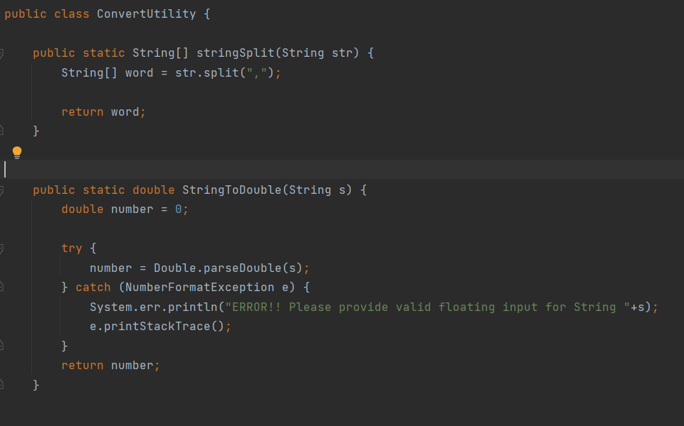
Structural: Facade
Booking Façade
Delivery Type

Slide 16
THANK YOU, PROFESSOR!

