Slide 1

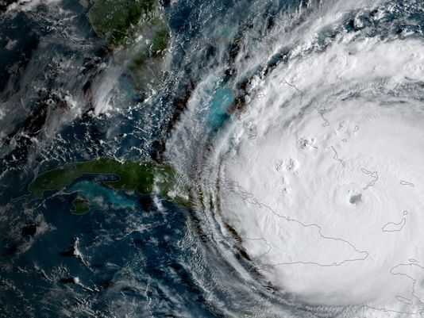
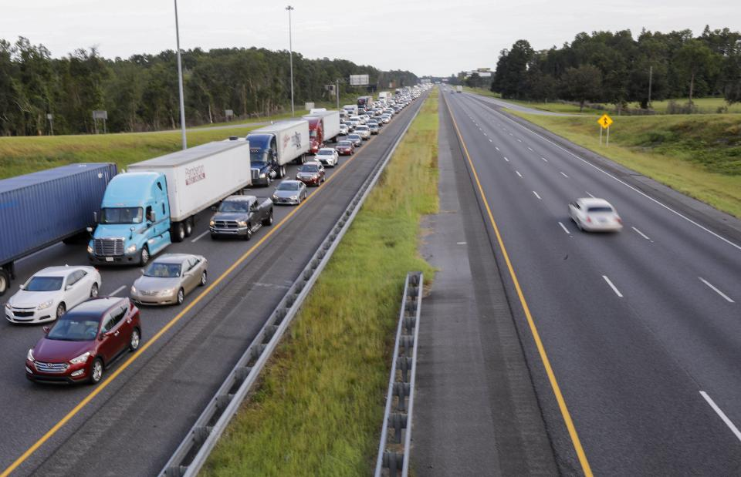
Online Deep Learning for Crisis Response using Tweets
Abhinav Khare, Samarth Kanabar, Rajiv Ranjan
16th October, 2018

Slide 2

Outline
Motivation
Objective
Data
Overall Methodology
Code Explanation
Results

Slide 3
Motivation
During crises, people post updates regarding their statuses, ask for help and other useful information, report infrastructure damages, injured people, etc., on social media platforms like Twitter.
Humanitarian organizations can use this citizen-generated information to provide relief if critical information is easily avail- able in a timely fashion.

Slide 4

Objective
Binary Classification : Classifying tweets as informative or non-informative
Multi-Class Classification : Classifying tweets as about :
Affected Individuals
Donations and Volunteering
Infrastructure and Utilities
Sympathy and Support
Other useful Information
Not Related or Irrelevant

Slide 5
Data
Initial model trained on around 1….. CRISIS NLP labeled tweets .
Online Training and testing on 12k tweets from Nepal Earthquake in the CrisisNLP dataset
Online training and testing on 4000 tweets from Hurricane Irma
Sample of the data is below
Item | Label | Label
#Death toll varies as officials struggle to assess Cyclone Pam's damage - Fox News http://t.co/ZsvYBCSinO | Affected individuals | Informative
'Complete devastation' after cyclone hits island nation of Vanuatu http://t.co/MwqMyNkhuA | Infrastructure and utilities | Informative
Devastated Vanuatu starts to get aid http://t.co/1YdPzHrrfO | Donations and volunteering | Informative
Also, I was thinking about it. Airline tickets are so expensive because of the gas. Gas isn't accessible, so naturally prices raise, #Irma | Infrastructure and utilities | Informative
usrId he he how s it going pam ? | Irrelevant Information | Non-Informative

Slide 6
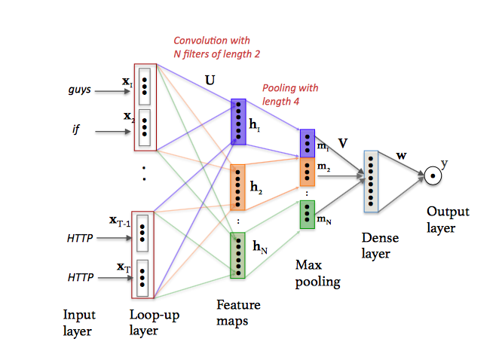
Methodology Overview
Convolutional neural network on a sample tweet: “guys if know any medical emergency around balaju area you can reach umesh HTTP doctor at HTTP HTTP”.

Slide 7
Code – Pre-processing Data
Function preprocess() is used for :
Normalizing tweets to utf8 formatting
Convert tweets to lowercase
replace multiple spaces with a single space
Normalizing digits
Normalizing URLs
Normalizing usernames
Removing special characters
Normalizing elongated characters
Replace ‘\n’ by ‘ ‘.
Tokenize using simpletwokenize() function in twokwnize.py of TweetNLP: http://www.ark.cs.cmu.edu/TweetNLP https://github.com/myleott/ark-twokenize-py ,

Slide 8
Code - Tokenizing tweets
Tokenization is difficult in the social media domain, and good tokenization is absolutely crucial for overall system performance.
Standard tokenizers, usually designed for newspapers or scientific publications, perform poorly.
Our regex-based tokenizer treats hashtags, @-replies, abbrevia- tions, strings of punctuation, emoticons and unicode glyphs (e.g. musical notes) as tokens.
Unigrams are too narrow a unit of analysis; ideally, we want to extract all phrases and subphrases. We begin with all unigrams, bigrams, and trigrams, discarding unigrams that are function words, and discarding bigrams and trigrams that cross syntactic boundaries.
These rules flag n-grams including certain types of punctuation tokens in certain positions, and ones that end with certain right-binding function words like “the” and “of.”
This simple syntactic filtering greatly improves the coherency of extracted n-grams.
Reference: Brendan O’Connor, Michel Krieger, and David Ahn. 2010b. TweetMotif: Exploratory search and topic summarization for Twitter. In Proc. of ICWSM (demo track).

Slide 9
Code – Split Data
StratifiedKFold(y, n_folds=5, shuffle=True) for dividing data into train and test data
StratifiedKFold(y, n_folds=8 , shuffle=True) for dividing data into train data into train and dev/ crosss validation data.
This way we get a 70 : 20 : 10 split of the data

Slide 10
Code – Building CNN
build_cnn (maxlen, max_features, emb_size, emb_matrix=, nb_filter, filter_length, pool_length,nb_classes, hidden_size, dropout_ratio, tune_emb=True) function used along with keras library to build the cnn
Steps inside build_cnn
Initiate a sequential model using Sequential()
Add an embedding layer with dropout ratio
Add a Convolution1D, which will learn nb_filter (word groups) filters of size filter_length. add dropout ratio. Activation = Relu
Use standard max pooling (halving the output of the previous layer). Activation = relu
Flatten the output of the conv layer, so that we can add a vanilla dense layer
Add a vanilla hidden layer . Activation layer = Relu
If binary classification : add dense output layer with sigmoid activation
If multiclass classification : add dense output layer with softmax activation

Slide 11
Code – Building CNN
build_cnn (maxlen, max_features, emb_size, emb_matrix=, nb_filter, filter_length, pool_length,nb_classes, hidden_size, dropout_ratio, tune_emb=True) function used along with keras library to build the cnn
Steps inside build_cnn
Initiate a sequential model using Sequential()
Add an embedding layer with dropout ratio
Add a Convolution1D, which will learn nb_filter (word groups) filters of size filter_length. add dropout ratio. Activation = Relu
Use standard max pooling (halving the output of the previous layer). Activation = relu
Flatten the output of the conv layer, so that we can add a vanilla dense layer
Add a vanilla hidden layer . Activation layer = Relu
If binary classification : add dense output layer with sigmoid activation
If multiclass classification : add dense output layer with softmax activation

Slide 12
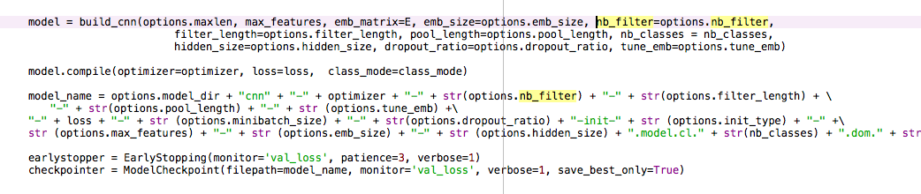
Code – Executing CNN

Slide 13
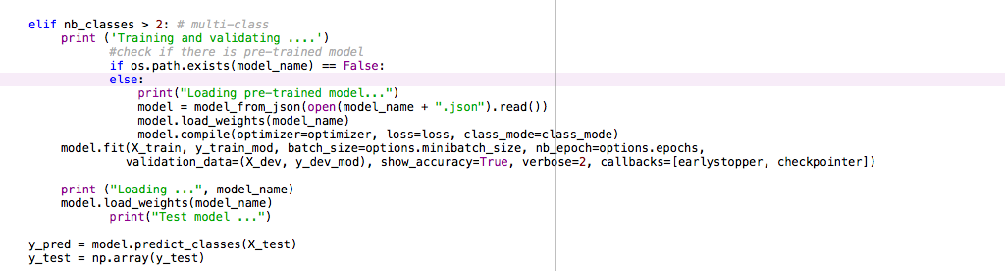
Code – Online learning

Slide 14
Code - Default Inputs
learn_alg = "adadelta”
loss = "binary_crossentropy"
minibatch_size = 32
dropout_ratio = 0.0
maxlen = 100
epochs = 25
max_features = 80
emb_size = 128
hidden_size = 128
nb_filter = 250
filter_length = 3
pool_length = 2 ,
init_type = 'random' ,
emb_file = "../data/unlabeled_corpus.vec" ,
tune_emb = True

Slide 15
Experiment
We varied the following hyperparamters to find the optimal set:
Number of epochs/patience,
Mini-batch size,
dropout ratio
learning rate

Slide 16
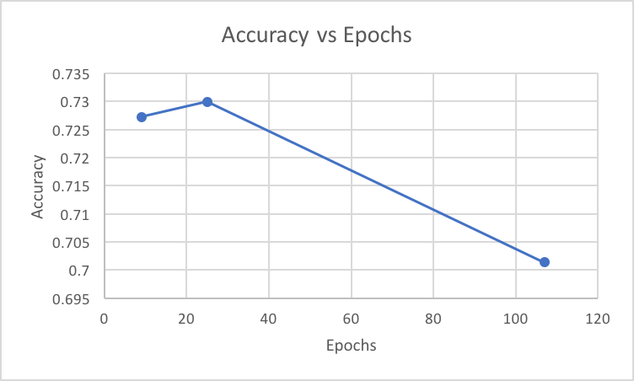
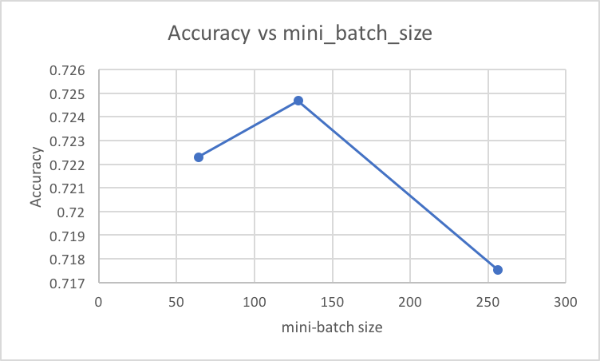
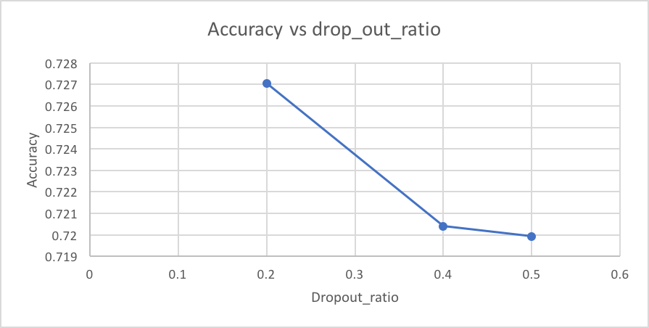
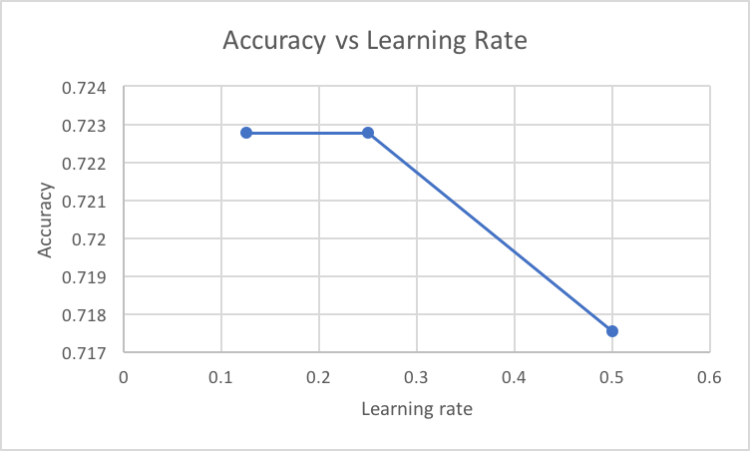
Results : Results obtained altering various hyper-parameters such as epochs, mini batch size, drop out ratio, learning rate against the accuracy of the model via various graphs.
Figure 1: As we increase the num_of_epochs, accuracy of the model decreases. The most optimum result can be found at a epoch count of 27.
Figure 2: s we increase the mini batch size, accuracy of the model decreases. The most optimum result can be found at a batch size of 135.
Figure 3: As we increase the drop out ratio, accuracy of the model decreases. The most optimum result can be found at a drop out ratio of 0.2.
Figure 8: As we increase learning rate, accuracy of the model decreases. The most optimum result can be found at a learning rate of 0.2.

Slide 17
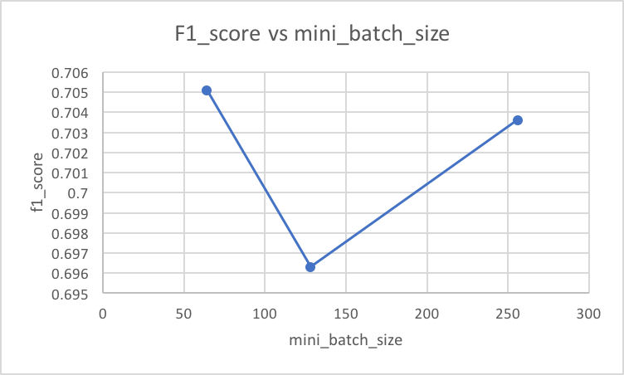
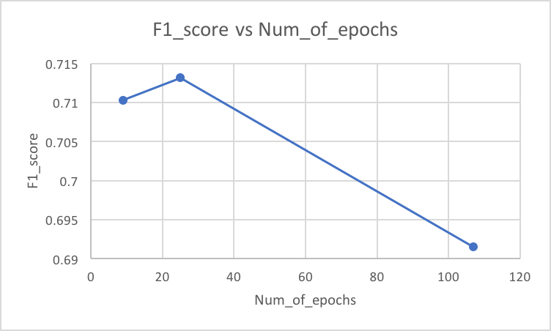
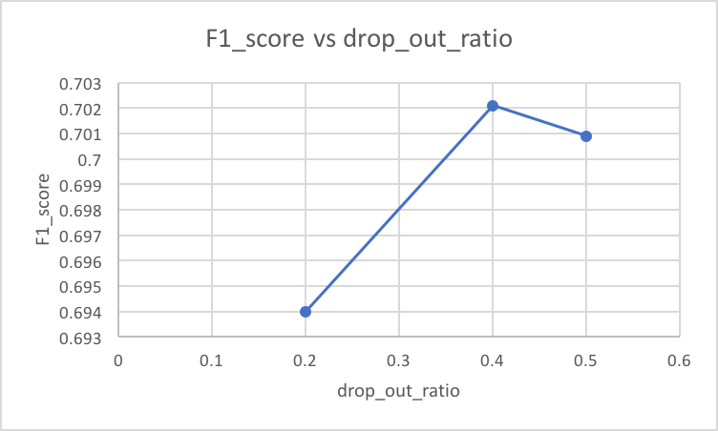
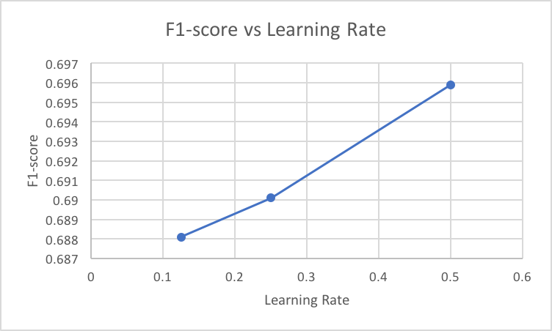
Results : Results obtained altering various hyper-parameters such as epochs, mini batch size, drop out ratio, learning rate against the accuracy of the model via various graphs.
Figure 1: As we increase the mini batch size, F1 score of the model first decreases then increases. The most optimum result can be found at a mini batch size of 130.
Figure 2: As we increase the num of epochs, F1 score of the model first increases then decreases. The most optimum result can be found at a epoch count of 25.
Figure 3: As we increase the drop out ratio, F1 score of the model first increases then decreases. The most optimum result can be found at a batch size of 0.4.
Figure 4: As we increase learning rate, accuracy of the model increases. The most optimum result can be found at a learning rate of 0.25.

Slide 18
Confusion Matrix
dropout_ratio=0.3, minibatch-size=128, filter-nb=150, filt_len=2, pool_len=3,
vocab=90, Epoch 00014: early stopping, precision: 0.7045 ,
Recall: 0.7247 , f1-score: 0.6963 , Accuracy: 0.724679029957204
 | affected_individuals | donations_and_volunteering | infrastructure_and_utilities | not_related_or_irrelevant | other_useful_information | sympathy_and_support
affected_individuals | 15 | 0 | 1 | 15 | 17 | 1
donations_and_volunteering | 0 | 2 | 1 | 12 | 13 | 0
infrastructure_and_utilities | 1 | 0 | 15 | 32 | 15 | 1
not_related_or_irrelevant | 6 | 0 | 4 | 1237 | 84 | 13
other_useful_information | 2 | 3 | 6 | 267 | 221 | 1
sympathy_and_support | 0 | 0 | 0 | 80 | 4 | 34

