Slide 1

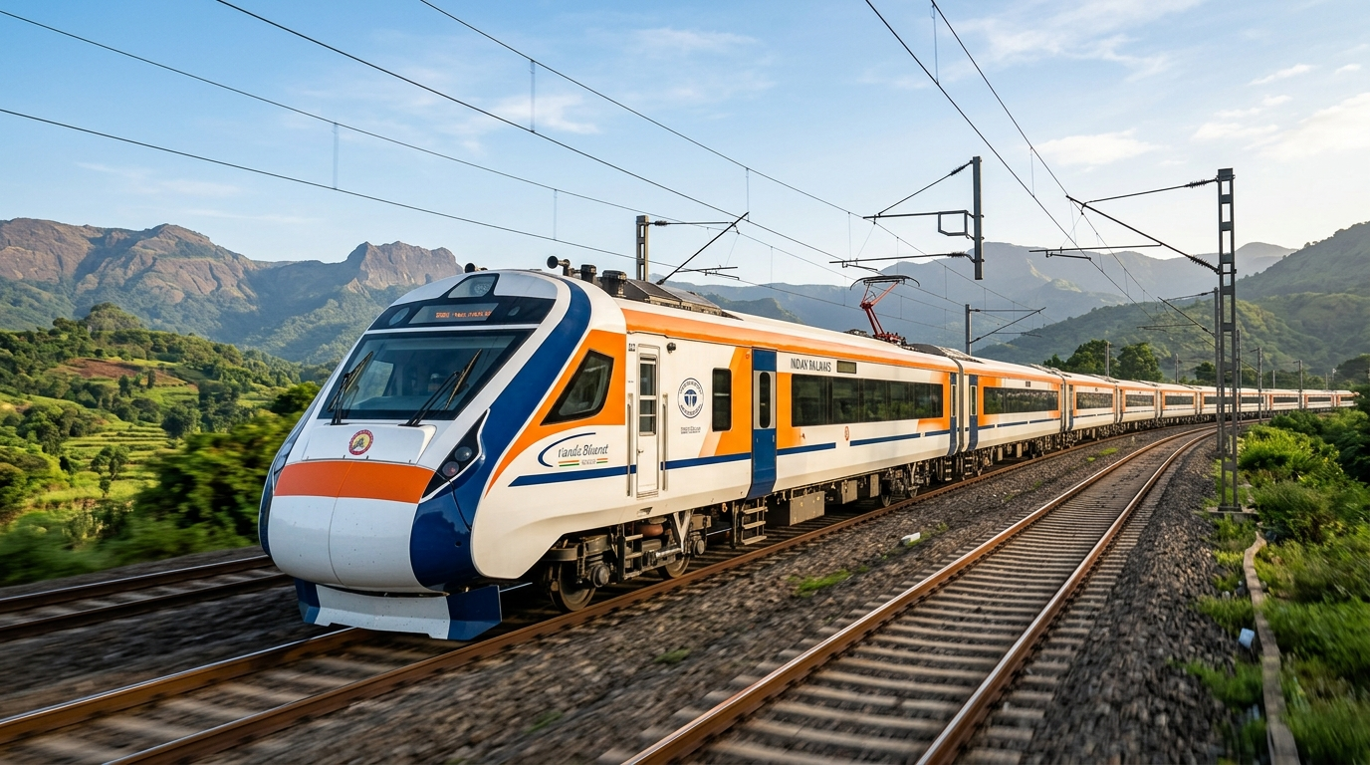
RailSahayak | Independent Technical Exploration
INDEPENDENT TECHNICAL PROPOSAL | OCTOBER 2026
RailSahayak
PASSENGER ASSISTANCE & RAILWAY SERVICE SUPPORT PROPOSAL
An Independent Prototype for Clearer Passenger Guidance and Structured Service Support
A technology concept designed to help passengers understand next steps for selected railway journey, payment, reservation-guidance, and complaint-tracking scenarios.
INDEPENDENT TECHNICAL PROPOSAL
Demonstrates local advisory capabilities only. Does not connect to live Indian Railways, IRCTC, or CRIS production systems. No transactional authority claimed.
Modern Indian Passenger Train | Concept for Clearer Journey Guidance
Independent technical exploration prototype | October 2026 | No official endorsement claimed

Slide 2
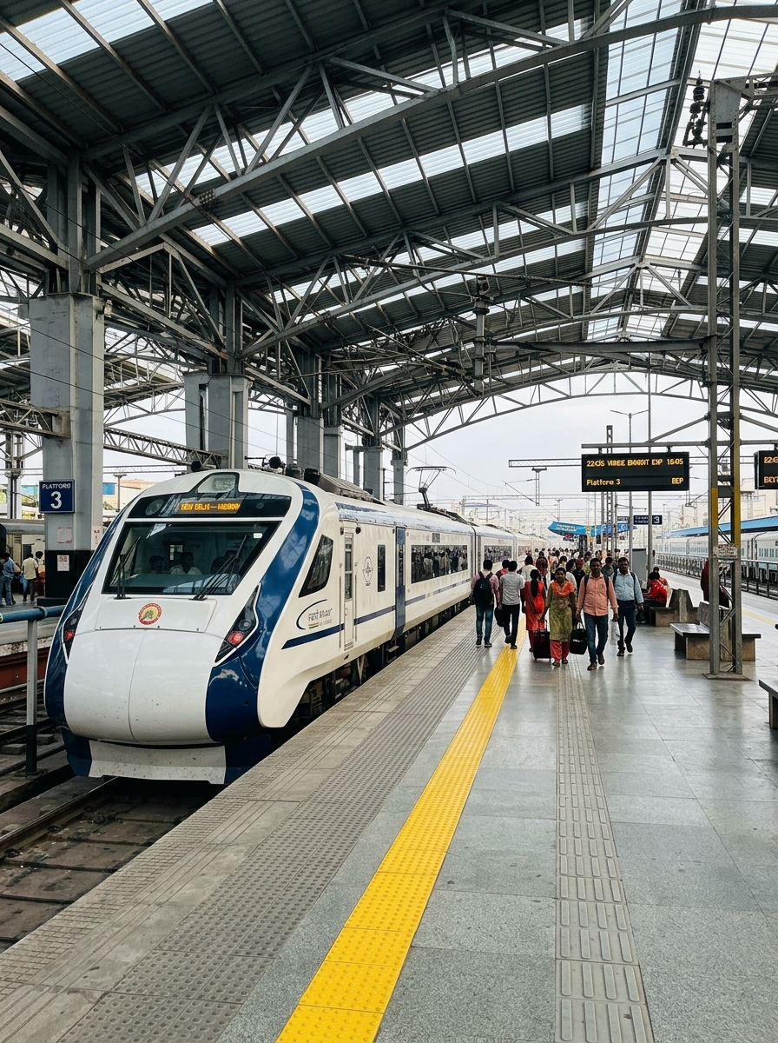
RailSahayak | Context & Journey Touchpoints
OPPORTUNITY FRAMEWORK
PASSENGER NEEDS & OPPORTUNITY
Railway journeys involve multiple decisions before travel, during booking, and when unexpected issues occur. RailSahayak explores whether clearer, structured guidance can help passengers identify appropriate next steps.
01 BEFORE TRAVEL — Route and Reservation Guidance
Passengers may need help understanding station codes, route options, quota terminology, reservation status, and official information sources.
02 WHEN A PAYMENT FAILS — Understand the Next Step
A payment debit without a generated ticket can leave a passenger uncertain about transaction status, refund procedures, and whether to contact the bank or booking platform.
03 RESERVATION & JOURNEY STATUS — Understand the Applicable Rules
Passengers may need clear explanations of waitlist status, charting, ticket category, and the limits of the information shown by an independent advisory tool.
04 AFTER AN INCIDENT — Find the Appropriate Support Channel
Passengers may need assistance identifying the relevant official channel for a commercial, payment, operational, or safety-related concern.
Opportunity: Make procedural guidance easier to understand without replacing official railway systems.
Indian Railways Platform | Point of passenger journey coordination
INDEPENDENT TECHNICAL PROPOSAL | NOT AN OFFICIAL IRCTC/CRIS/INDIAN RAILWAYS RELEASE
Page 2 of 11

Slide 3
RailSahayak | Problem Context & Analysis
CHALLENGE ANALYSIS
THE PROBLEM STATEMENT
TRANSACTION UNCERTAINTY
Payment Debits & Settlement Lags
A payment debit without ticket generation can create uncertainty about transaction reconciliation, refund procedures, and the appropriate support channel.
01
Passengers can face uncertainty when the next step depends on the type of ticket, transaction state, railway rule, or responsible service channel. The proposed focus of RailSahayak is to organize these questions into clearer guidance and structured next steps.
PASSENGER SUPPORT REALITY
Payment issues, reservation questions, and operational disruptions can leave passengers uncertain about the appropriate next step. The frequency and impact of these situations should be established through reliable evidence or a future authorized evaluation.
02
RULE COMPLEXITY
Reservation Categories & Charting
Reservation status and ticket category can affect what a passenger should do next. Explanations must be accurate, current, and tied to the relevant rules.
03
SUPPORT-CHANNEL CONFUSION
Multi-Agency Support Boundaries
Commercial, payment, operational, and safety issues may require different official channels. Clear routing guidance can help passengers understand where to seek authoritative assistance.
Boundary Note: This analysis is based on the proposed workflows and interface design; passenger impact remains to be validated. No claims are made regarding institutional workload reduction without authorized field data.
INDEPENDENT TECHNICAL PROPOSAL | NOT AN OFFICIAL IRCTC/CRIS/INDIAN RAILWAYS RELEASE
Page 3 of 11

Slide 4
RailSahayak | System Concept & Architecture
SOLUTION ARCHITECTURE
OUR SOLUTION
01
Step 01 | CLARIFY — Plain-Language Guidance
Explain selected reservation, payment-help, and complaint procedures in clear language based on the functionality actually implemented.
RailSahayak is an independent advisory prototype that brings selected passenger-support workflows into one interface. It aims to explain possible next steps and point users toward official channels when authoritative action or confirmation is required.
02
Step 02 | ORGANIZE — Structured Issue Capture
Help organize relevant incident details and complaint information without requesting unnecessary payment secrets or sensitive credentials.
IMPORTANT SYSTEM BOUNDARY
RailSahayak does not replace official booking systems. Live railway data and institutional integrations must not be represented as available unless verified and authorized.
• No live PRS integration is claimed.
• Payment credentials and cardholder data are outside the intended prototype workflow; implementation should be verified.
• Clear disclaimers directing passengers to official railway channels
03
Step 03 | DIRECT — Appropriate Next Steps
Guide the passenger toward the relevant official service or support channel when an issue requires authoritative information or action.
INDEPENDENT TECHNICAL PROPOSAL | NOT AN OFFICIAL IRCTC/CRIS/INDIAN RAILWAYS RELEASE
Page 4 of 11

Slide 5
RailSahayak | Proposed Impact & Principles
VALUE PROPOSITION
THE VALUE PROPOSITION
Four core principles shaping clearer guidance and disciplined institutional alignment.
01
02
03
04
CLARITY
Organize complex procedural information into short, understandable guidance for everyday passengers.
STRUCTURE
Capture selected issue details in a consistent format to make the next step easier to understand.
TRACEABILITY
Where implemented, show complaint identifiers and recorded status changes to help users follow a case within the prototype.
COMPLEMENTARY DESIGN
Keep official booking, payment, and railway operations under their respective authorized systems.
CORE ARCHITECTURAL POSITION
The proposed value is clearer guidance and better-organized next steps — not a replacement for official railway services.
INDEPENDENT TECHNICAL PROPOSAL | NOT AN OFFICIAL IRCTC/CRIS/INDIAN RAILWAYS RELEASE
Page 5 of 11

Slide 6
RailSahayak | User Touchpoints & Scenarios
USE CASES
TARGET AUDIENCE &
USE CASES
Case 01 | PASSENGERS PLANNING A JOURNEY
Potential use: understanding station codes, route guidance, reservation terminology, and where to find authoritative travel information.
Case 02 | PASSENGERS WITH PAYMENT QUESTIONS
Potential use: understanding what information to preserve and which official service to contact after a payment issue.
The initial prototype is intended to explore passenger-facing guidance scenarios. Its usefulness and suitability for different groups must be assessed through stakeholder review and user evaluation.
EVALUATION SCOPE & SAFEGUARDS
The use cases describe the intended scope of the prototype. Individual workflows require verification against the available implementation and test evidence. Claims of usefulness are presented as hypotheses to be evaluated in authorized technical discussions, not as pre-validated user demand.
• No simulated booking confirmation
• No fake live tracking data shown
• Direct referral to official IRCTC / NTES portals
Case 03 | RESERVATION & WAITLIST GUIDANCE
Potential use: understanding the meaning and limitations of reservation and waitlist information.
Case 04 | PASSENGERS TRACKING A COMPLAINT
Potential use: recording an issue and following the status available within the RailSahayak prototype.
INDEPENDENT TECHNICAL PROPOSAL | NOT AN OFFICIAL IRCTC/CRIS/INDIAN RAILWAYS RELEASE
Page 6 of 11

Slide 7
RailSahayak | Ecosystem Alignment & Positioning
ECOSYSTEM ARCHITECTURE
OFFICIAL RAILWAY & PAYMENT INFRASTRUCTURE
IRCTC (Ticketing) | CRIS (PRS / NTES) | RailMadad | Bank Gateways
Authoritative sources for financial transactions, live train operations, seat inventory, refunds, and formal grievance resolution.
RAILSAHAYAK IN THE ECOSYSTEM
RailSahayak is intended as a complementary, independent guidance layer. Official railway and payment systems remain the authoritative sources for transactions, operational status, refunds, and formal grievance resolution.
▲ Directs passengers to authoritative channels | Zero system override ▼
01 OFFICIAL BOOKING SYSTEMS
Official: Handles authorized booking & transaction execution.
RailSahayak Role: Explains selected procedures and guides users toward the relevant official process.
INDEPENDENT ADVISORY LAYER (RAILSAHAYAK)
Procedural Guidance | Intake Structuring | Rule Explanations | Triage
• No live PRS integration claimed · No payment secrets in prototype scope
• Explains procedural options & directs users to official portals
• Local prototype demonstrating structured assistance
02 OFFICIAL TRAIN INFORMATION
Official: Authoritative for live train running status & operational updates.
RailSahayak Role: Explains where and how to check information without falsely claiming live access.
▼ Intended to explore clearer procedural guidance (Unmeasured) ▼
POTENTIAL PASSENGER VALUE (INTENDED / UNMEASURED)
Explores whether structured guidance can help passengers navigate next steps during failed transactions or procedural questions before contacting official desks. Quantitative passenger benefits remain to be established through authorized evaluation.
03 OFFICIAL GRIEVANCE CHANNELS
Official: Responsible for established formal investigation & dispute resolution.
RailSahayak Role: Organizes selected issue details and explains the next appropriate channel.
INDEPENDENT TECHNICAL PROPOSAL | NOT AN OFFICIAL IRCTC/CRIS/INDIAN RAILWAYS RELEASE
Page 7 of 11

Slide 8
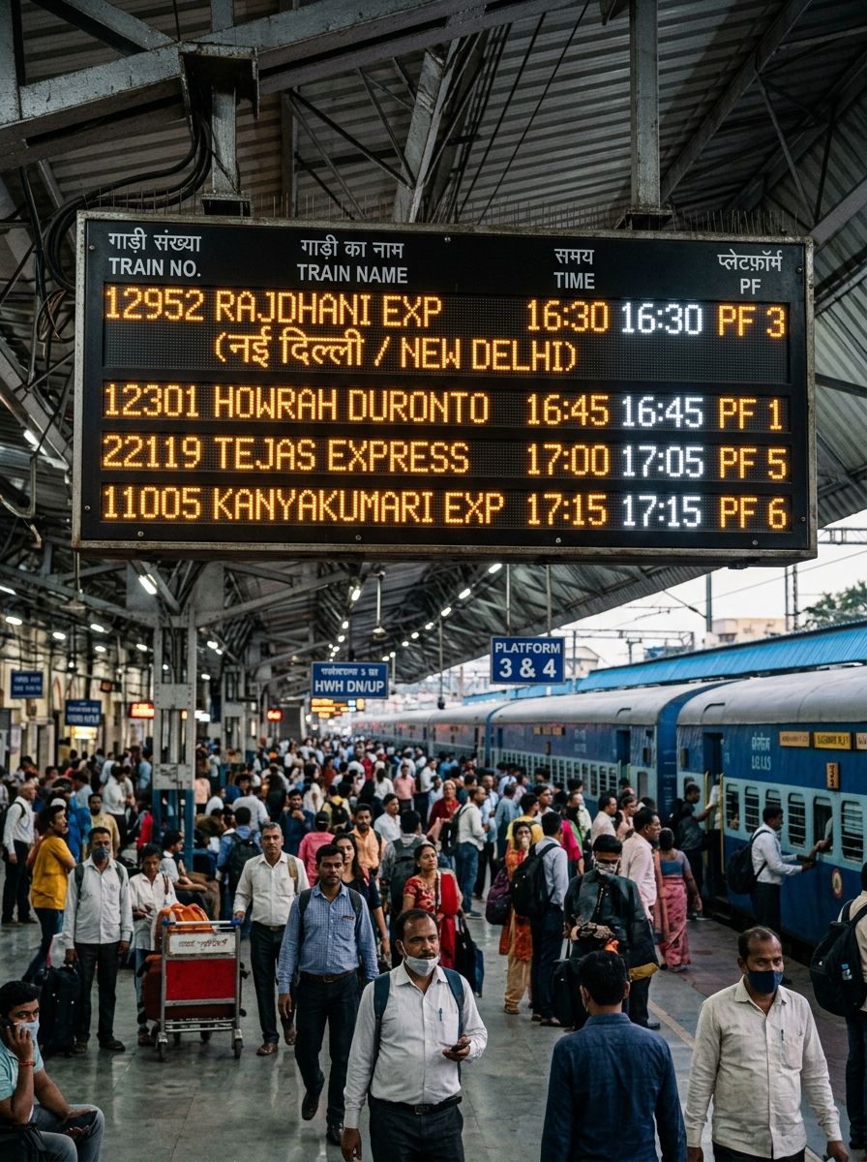
RailSahayak | Institutional Alignment & Adoption
ADOPTION FRAMEWORK
ENGAGEMENT & ADOPTION STRATEGY
The first priority is to establish technical credibility, validate guidance, and understand institutional requirements. Any future deployment or public-facing distribution would depend on the appropriate approvals and a clear operational model.
Stage 01 | TECHNICAL REVIEW
Share the prototype, explain its architecture, and invite feedback on implemented features, known limitations, and evidence.
Stage 02 | RULE VALIDATION
Request guidance on validating the railway-related procedural content against current authoritative sources.
Stage 03 | CONTROLLED EVALUATION
If stakeholders consider it appropriate, explore an authorized, limited evaluation with clearly defined scope and safeguards.
Stage 04 | FUTURE PATHWAY
Consider further development, mentorship, academic collaboration, licensing, or handover only if there is mutual interest and an appropriate institutional process.
Passenger Information Display (PIDS) | Station Operational Feed
Stakeholder engagement roadmap — not a claim of existing formal partnership.
INDEPENDENT TECHNICAL PROPOSAL | NOT AN OFFICIAL IRCTC/CRIS/INDIAN RAILWAYS RELEASE
Page 8 of 11

Slide 9
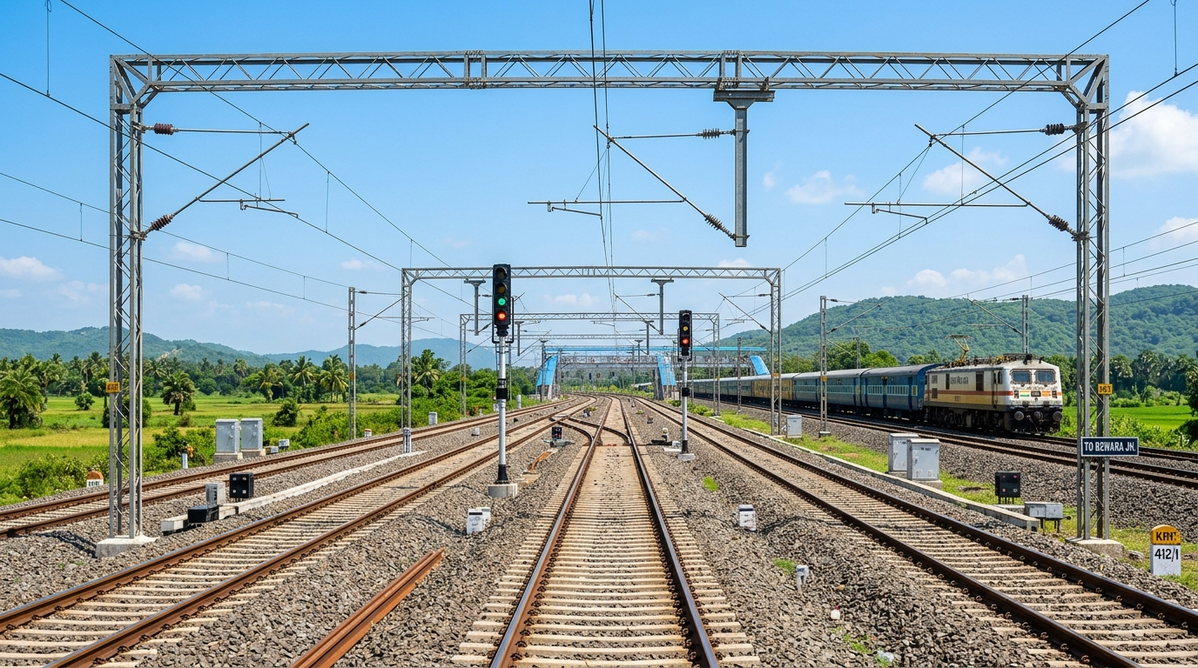
RailSahayak | Phased Testing & Evaluation
PROPOSED FRAMEWORK
IMPLEMENTATION & EVALUATION PLAN
Any further evaluation should proceed through explicit review stages. The sequence below is a proposed framework, not an approved Indian Railways schedule.
Stage 01
BASELINE REVIEW
Review source code, architecture, capabilities, limitations, and existing prototype evidence.
Stage 02
RULE & SECURITY
Validate procedural guidance, access control, privacy, logging, and security requirements.
Stage 03
AUTHORIZED TESTING
If approved, test in an appropriate environment using authorized or simulated datasets.
Stage 04
LIMITED EVALUATION
If separately authorized, evaluate bounded use cases with defined safeguards and metrics.
Stage 05
REVIEW & DECISION
Use evaluation evidence to decide whether to improve, extend, transfer, or discontinue.
Modern Indian Railway Track & Catenary Infrastructure | Proposed Phased Evaluation Framework
INDEPENDENT TECHNICAL PROPOSAL | NOT AN OFFICIAL IRCTC/CRIS/INDIAN RAILWAYS RELEASE
Page 9 of 11

Slide 10
RailSahayak | Summary & Request for Guidance
NEXT STEPS
CONCLUSION & NEXT STEPS
THE PROPOSAL
RailSahayak presents an independent software prototype exploring how selected railway passenger questions can be organized into clearer guidance, structured issue capture, and appropriate official-channel direction.
Its current value should be judged by the capabilities demonstrated in the actual prototype, the accuracy of its guidance, the quality of its implementation, and the transparency of its limitations.
THE REQUEST & COLLABORATION PATHWAY
We respectfully invite relevant technical stakeholders to review the concept and provide guidance on procedural accuracy, security expectations, authorized testing requirements, and possible future development.
If an existing railway system should not be replaced or changed, RailSahayak could still be considered for complementary evaluation, subject to technical, legal, and institutional review. Technical mentorship, skill-development guidance, further development, or a possible handover arrangement may also be discussed if appropriate.
THREE CONCRETE NEXT STEPS
1. Review the current prototype and its evidence.
2. Identify required corrections and institutional prerequisites.
3. Decide whether any further evaluation is appropriate.
INDEPENDENT TECHNICAL PROPOSAL | NOT AN OFFICIAL IRCTC/CRIS/INDIAN RAILWAYS RELEASE
Page 10 of 11

Slide 11
RailSahayak | Independent Technical Exploration
THANK YOU
RAILSAHAYAK
Passenger Assistance & Railway Service Support Proposal
Request for Technical Review and Guidance
An independent prototype presented for constructive feedback and possible future evaluation.
STAKEHOLDER EXPLORATION SESSION
Presented for technical evaluation and institutional guidance.
Project materials and technical evidence can be prepared for review.
October 2026
Dedicated to Passenger Assistance & Railway Service Support
Independent Prototype | No Official Railway Endorsement Claimed

