Slide 1

EDA of Restaurant chains in USA

Slide 2
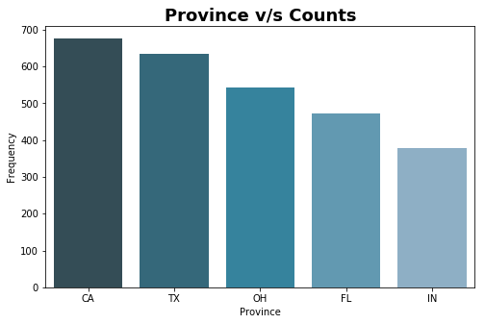
Which US provinces has high Frequency of food chains
CA, TX, OH, FL are the province with high frequency of chains

Slide 3
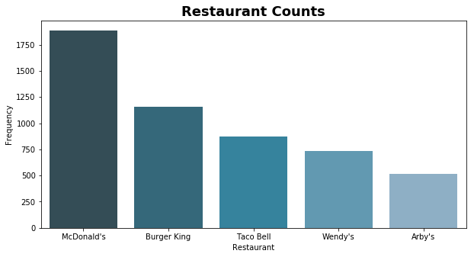
Which Restaurants has high frequency of food chains
McDonald's has highest frequency followed by Burger King and Taco Bell

Slide 4
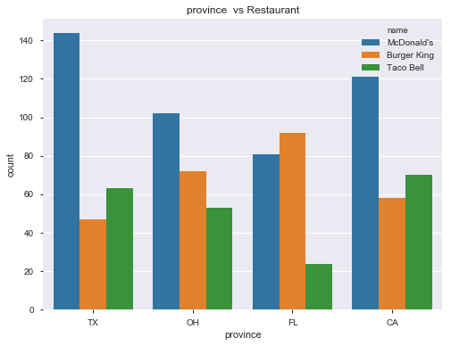
Distribution of top 3 restaurants in top 4 province
TX has Taco Bell at second position and Burger king at third position.
FL has Burger king at first position and McDonald's at second position.
CA has Taco Bell at second position and Burger King at third position.

Slide 5
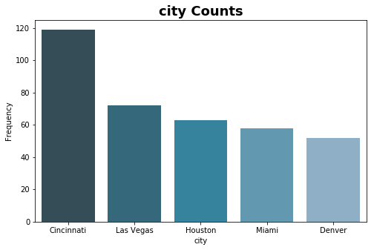
Which US provinces has high Frequency of food chains
Cincinnati has largest number of food chains followed by Las Vegas, Houston and Miami

Slide 6
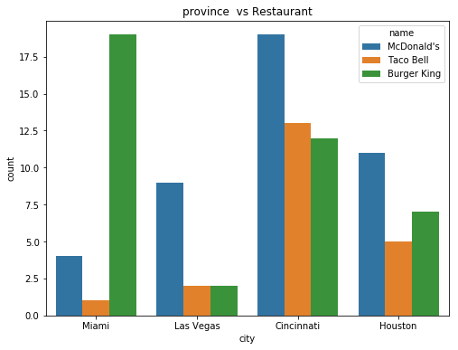
Distribution of top 3 restaurants in top 4 cities
Miami has Burger King at top followed by McDonalds and Taco Bell.
Cincinnati has Taco Bell at second followed by Burger King .
Las Vegas has Burger King and Taco Bell at same frequency.

