Slide 1


Project 4
Restaurant Management Dashboard

Slide 2
What in the world is going on?
Project 4
Economic slow down means every business needs to stay intelligent about their decision making.
Small restaurants are at risk – Less general spending by consumers as well as increasing rent costs due to interest rate hikes are causing stress on owner.
By using data and machine learning, can we optimising aspect of a running business?

Slide 3
Dashboard Objectives
Project 4
Use Point of Sale data, forecast future item sales.
Why? By predicting item sales, we can use the forecasts to predict inventory requirements. This will help decrease inventory wastage, as most restaurant items are perishable.
Use Google Trends data to highlight local search data
Why? To provide insights to consumer habits, and assist with identifying prime opportunities to deploy marketing/advertising.
Use price history of goods (meats) to predict future prices
Why? To aid in identifying cost increases that may affect profit margins, allowing owners to increase price of items in a forward thinking manner.

Slide 4
Overview
Project 4
Point of Sale
Raw data
Cleaned Dataset
Load into SQLite
Machine Learning (lstm)
Predicted Outcomes

Slide 5
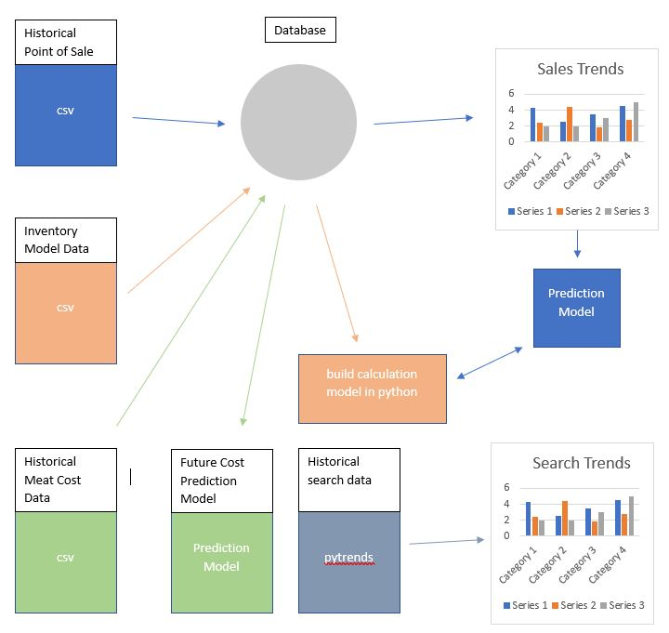
Project 4

Slide 6
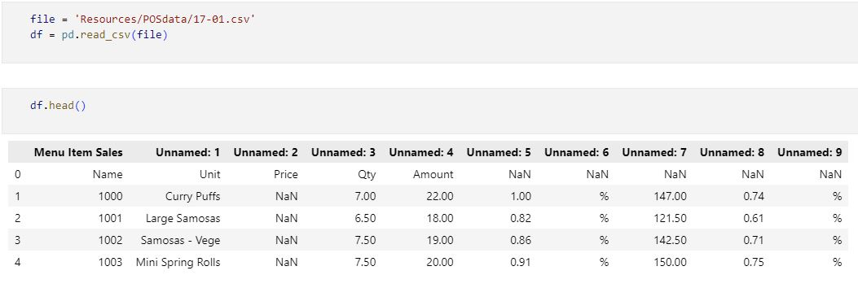
Project 4
Extract, Transform and Load
Raw Data – Monthly Datasets – 2017/01 to 2022/12

Slide 7
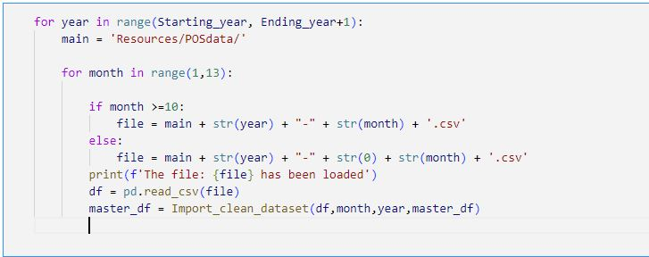
Create auto file loader – 72 files
Project 4

Slide 8
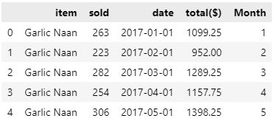
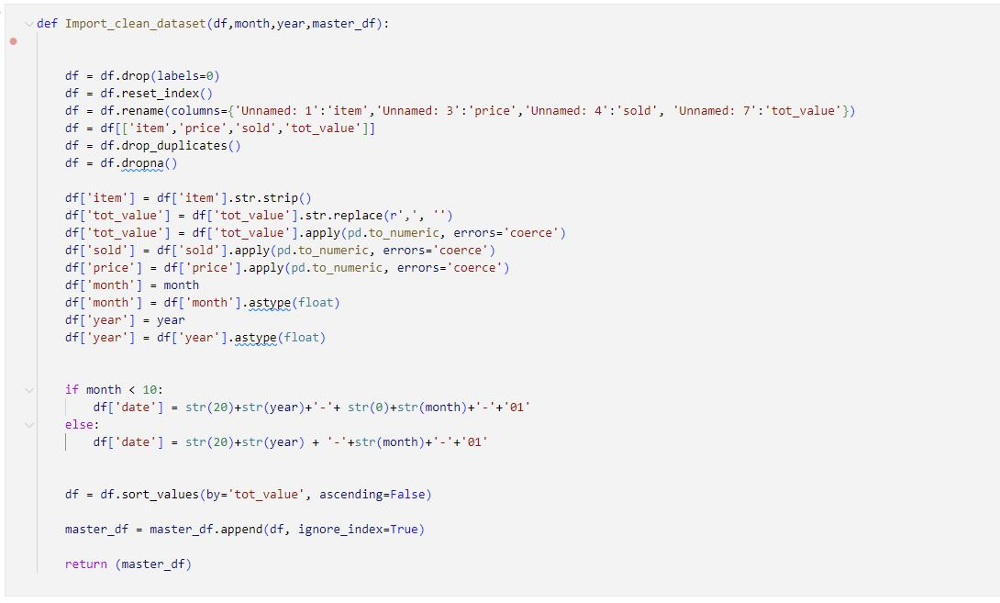
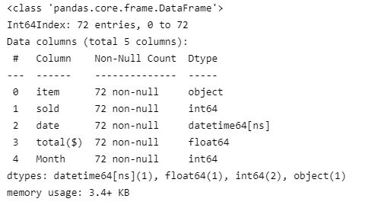
Project 4
Transform Dataset

Slide 9
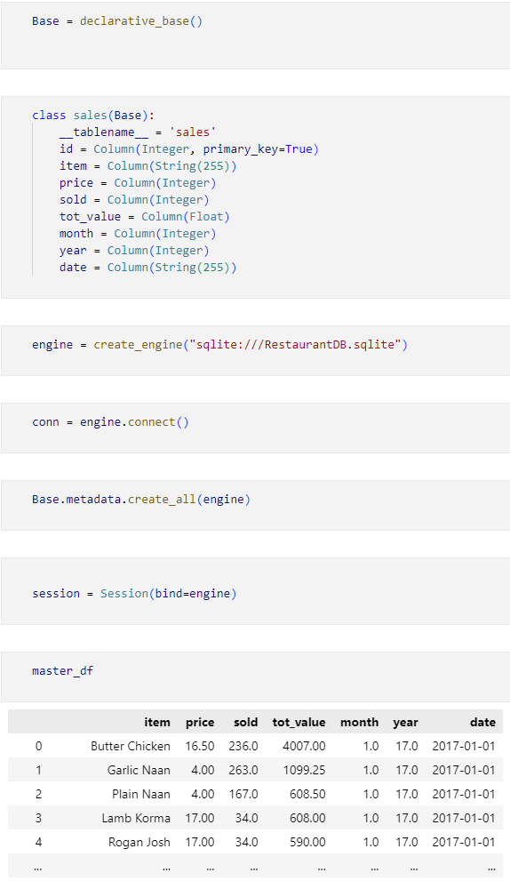
Project 4
Load Data into SQLite
Master POS database
8625 total rows of data
Historical Meat Price database
476 total rows of data

Slide 10
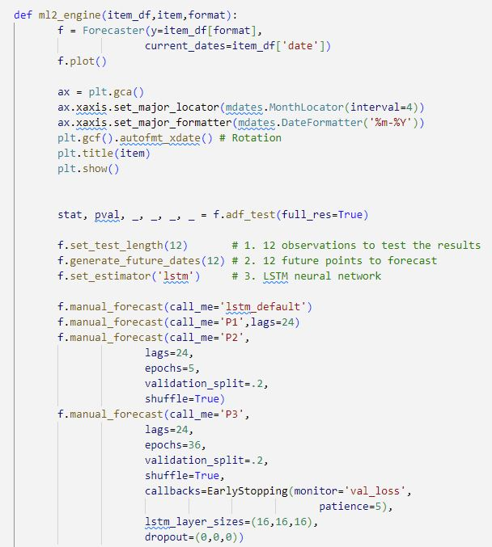

Machine Learning Model – Time Series Analysis
Project 4
Scalecast library – using forecaster for lstm neural network modelling
And
Sklearn for normalizing dataset testing both MinMaxScaler and Standard
scaler

Slide 11
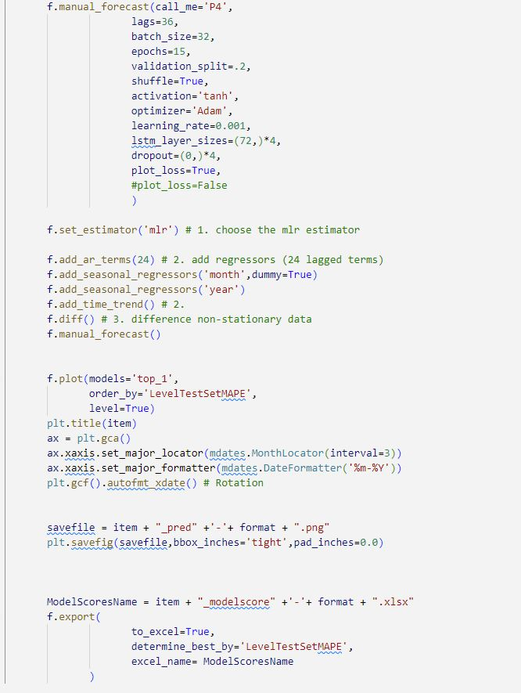
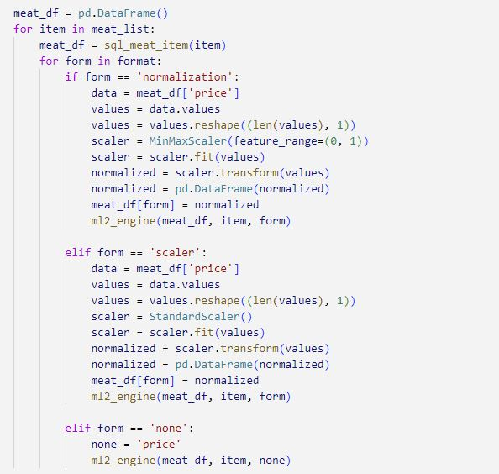
Project 4
Forecaster allows to run multiple lstm models with varing parameters, it then will output the results of the best model.
P1 to P4 and mlr models were used to identify the best prediction model.

Slide 12
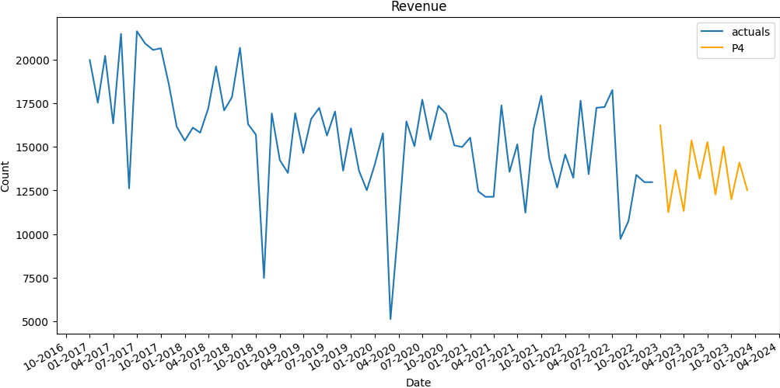
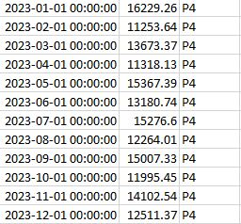
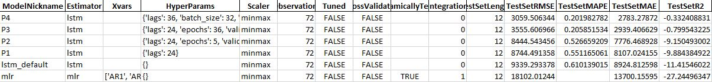
Output from ML models
Project 4
Predictions

Slide 13
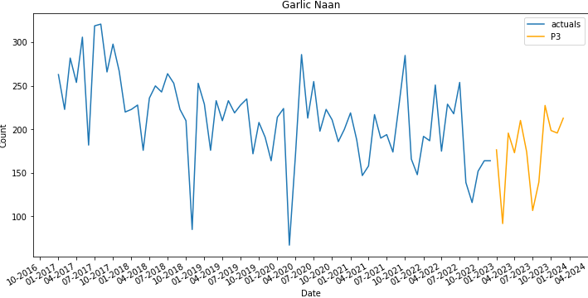
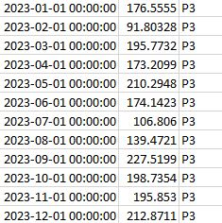
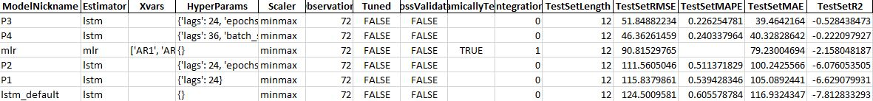
Project 4
Predictions

Slide 14
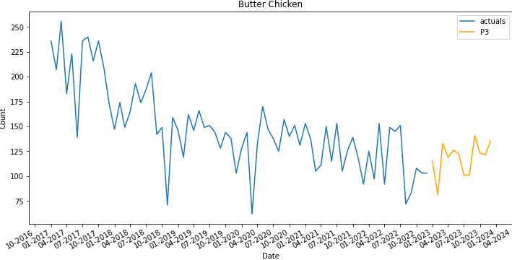
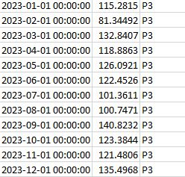
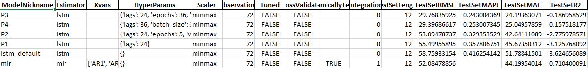
Project 4
Predictions

Slide 15
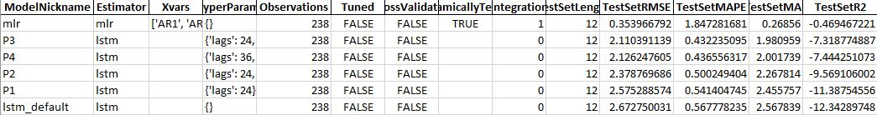
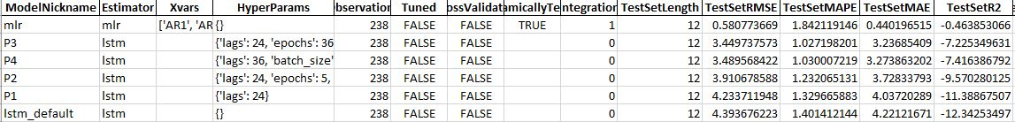
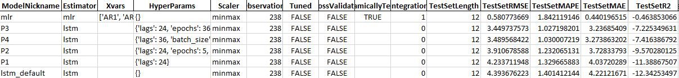
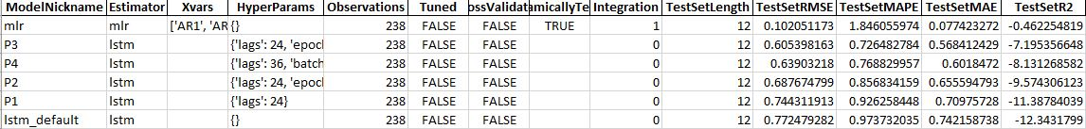
Project 4
No Scaler
StandardScaler
MinMaxScaler

Slide 16
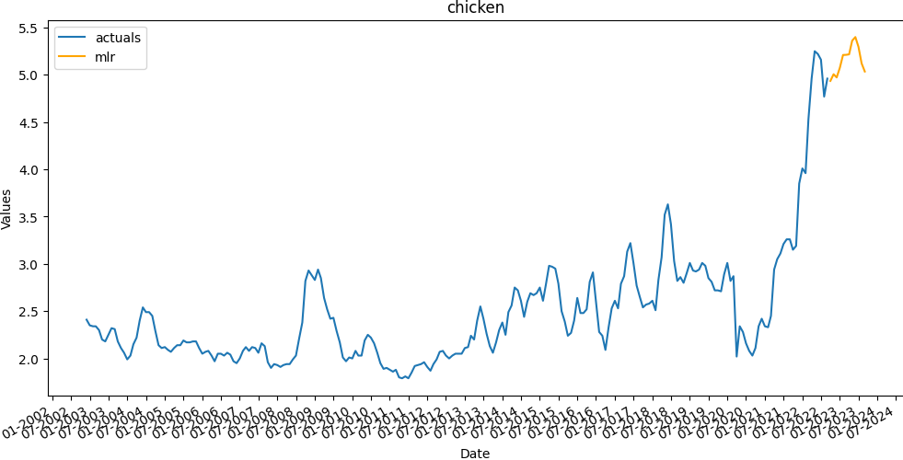
Project 4
Forecasting - Price of Chicken

Slide 17
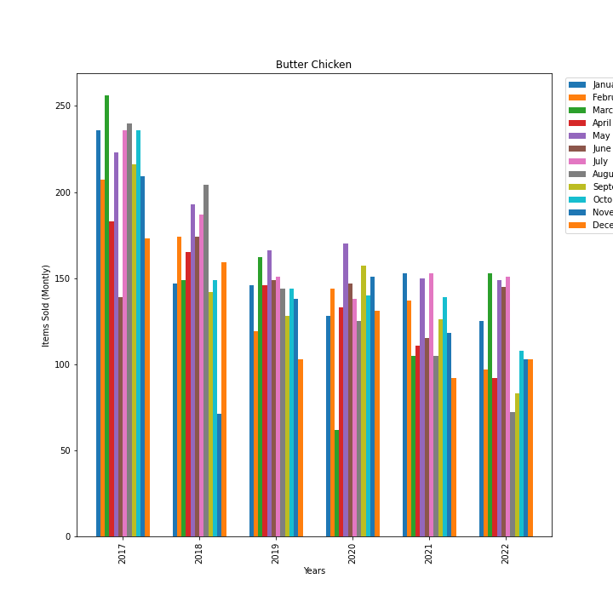
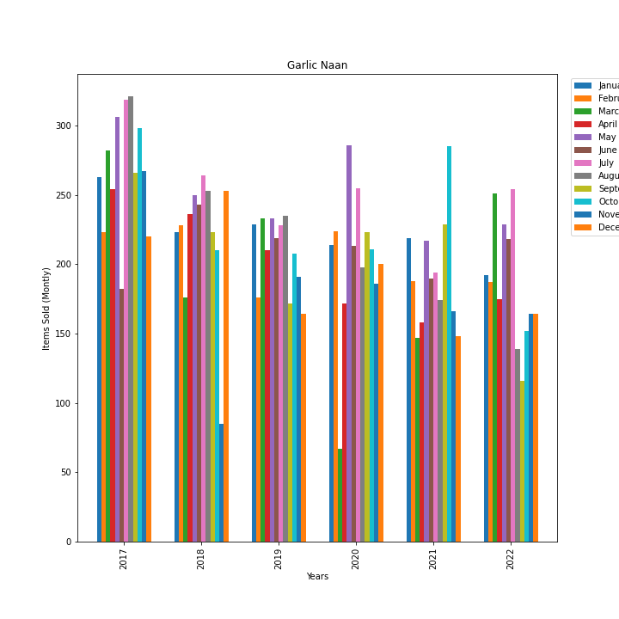
Project 4
Sales of Items colour coded by Month

Slide 18
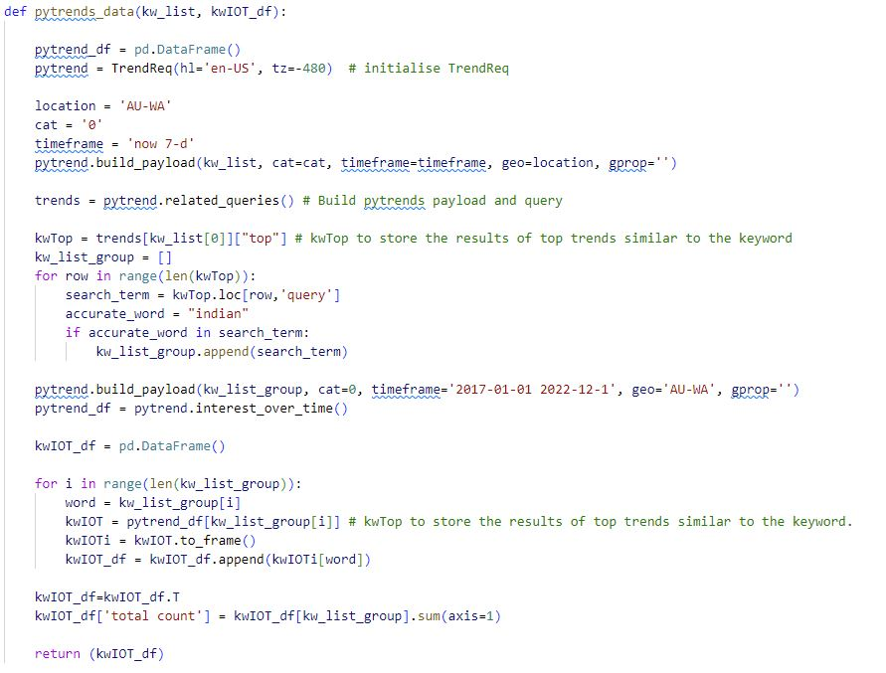
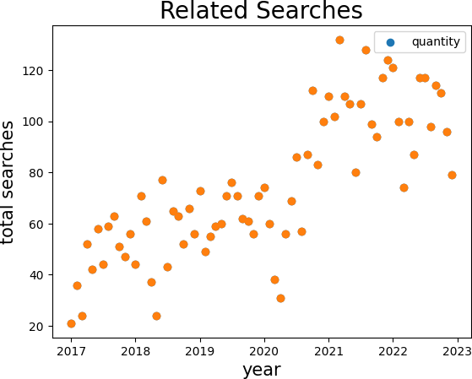
Project 4

