Slide 1
EXPERTTWIN
Preserve how experts decide.
An evidence-grounded AI Digital Employee for engineering judgment, mentoring, and institutional memory.
AI CLONES
CITED DECISIONS
WAR ROOM
Azure-powered hackathon prototype

Slide 2
THE PROBLEM
Organizations preserve documents—but lose judgment.
AI makes knowledge easier to find, yet the reasoning behind decisions remains fragmented or disappears.
01
02
03
WHAT survives
WHY gets lost
EXPERTISE walks out
Designs, meeting notes, tickets, ADRs, incident reports.
Trade-offs, rejected options, risk appetite, and situational context.
Onboarding restarts and teams repeat old debates when experts move on.
“A search tool can retrieve the decision. ExpertTwin reconstructs the decision-making pattern.”
The opportunity: turn institutional history into available, attributable guidance.
EXPERTTWIN · HACKATHON DEMO
2

Slide 3
THE SOLUTION
From scattered evidence to an Engineering Decision Fingerprint.
ExpertTwin creates a trusted digital representation of how an expert approaches engineering problems.
1
2
3
4
Capture
Structure
Fingerprint
Advise
Documents, reviews, chats, transcripts, incidents, outcomes
Extract choices, alternatives, rationale, constraints, risks
Find recurring trade-offs, safeguards, and decision criteria
Answer as one AI Clone or convene the engineering War Room
CORE PROMISE
Guidance aligned to demonstrated engineering judgment—grounded in evidence, transparent about inference, and explicit about uncertainty.
EXPERTTWIN · HACKATHON DEMO
3

Slide 4
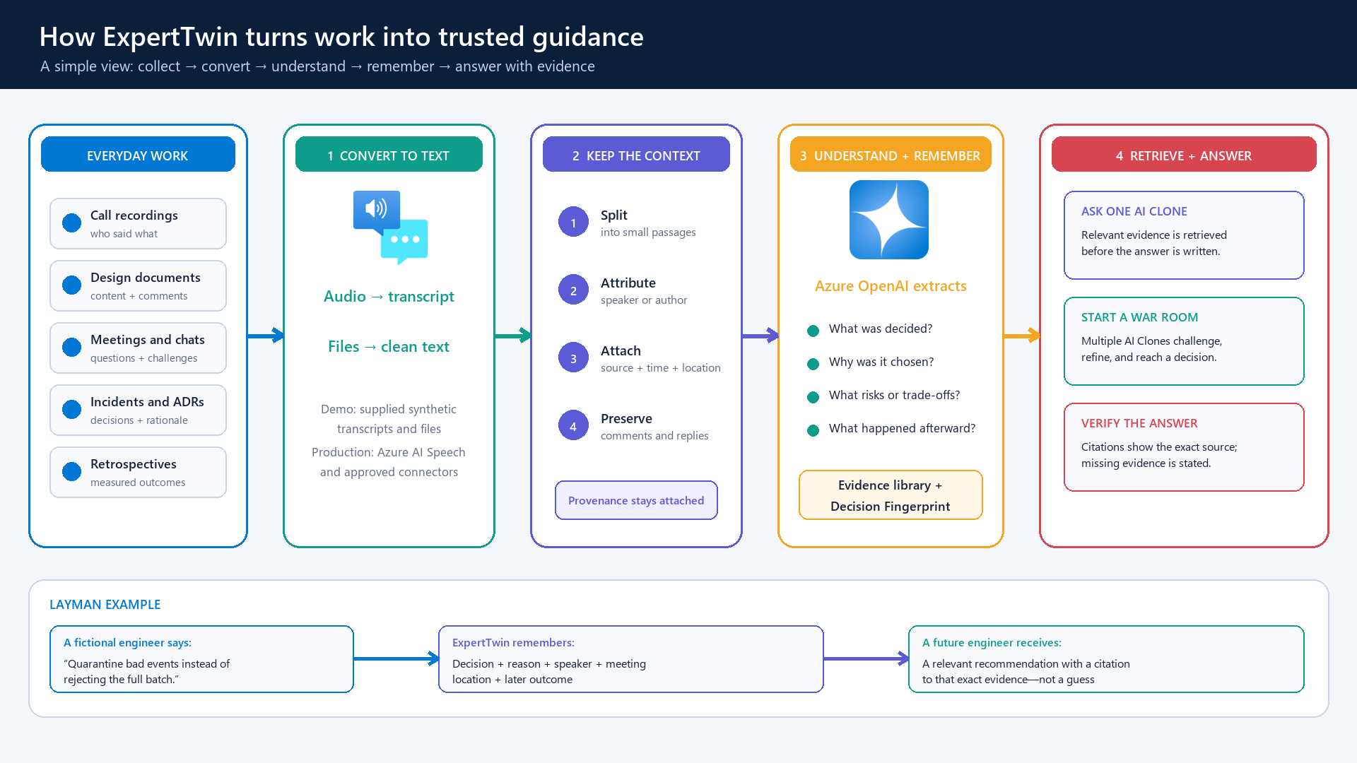

Slide 5
EVIDENCE MODEL
A body of work becomes attributable decision intelligence.
The system preserves provenance instead of flattening every source into anonymous text chunks.
ENTERPRISE SIGNALS
STRUCTURED DECISION RECORD
DECISION FINGERPRINT
Design reviews
• Expert + role + timestamp
• Choice and alternatives
• Rationale and constraints
• Risks and observed outcome
• Source, segment, thread, confidence
• Simulation and attribution status
Trade-off style
What gets optimized
Meeting turns
Risk posture
What must be protected
Engineering chat
Selection criteria
How technologies are compared
Recovery strategy
How failure is handled
Incidents
Operating principles
What production readiness means
ADRs + outcomes
EXPERTTWIN · HACKATHON DEMO
5

Slide 6
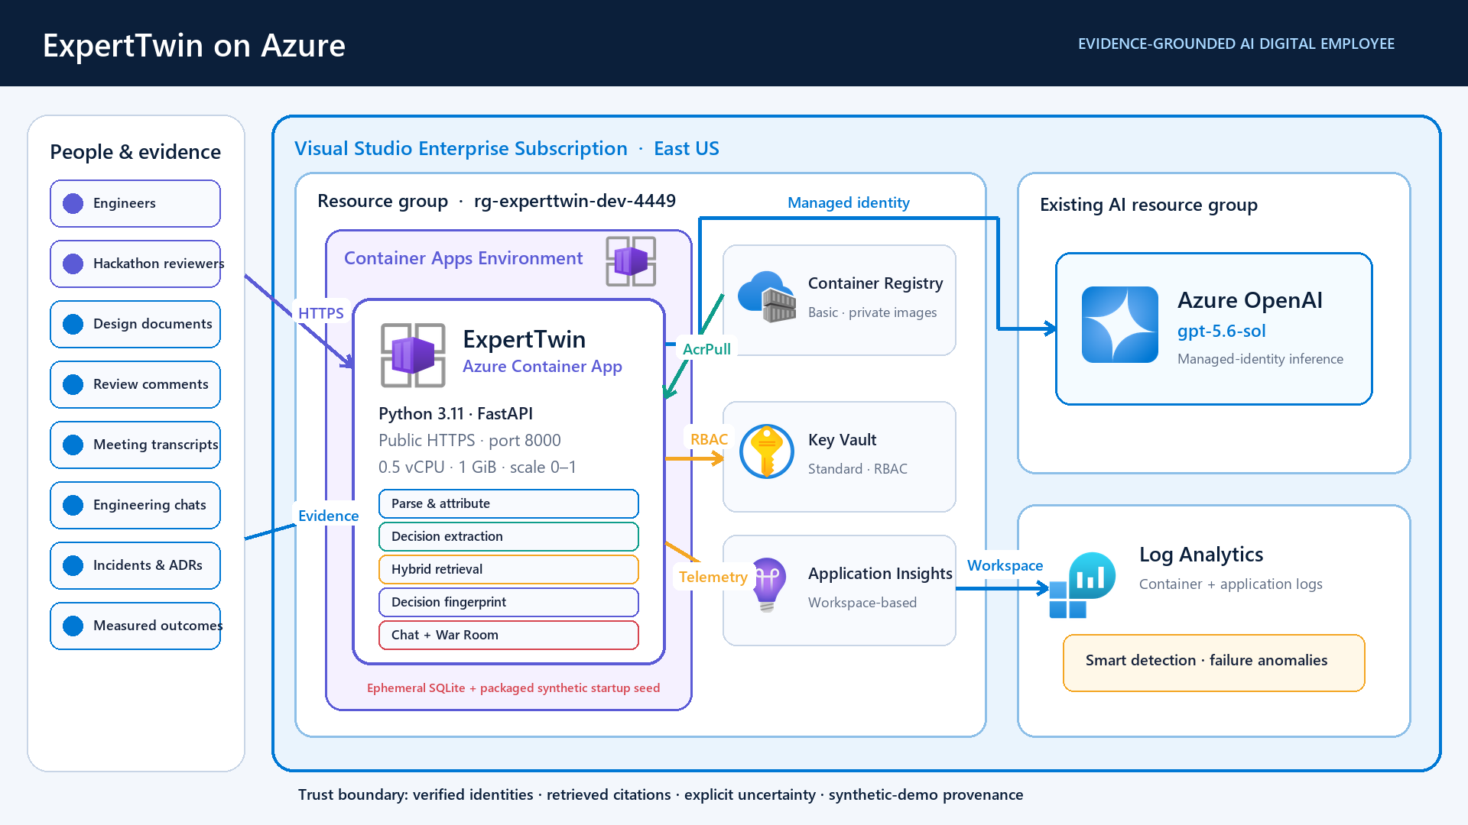

Slide 7
EXPERIENCE 1
Ask one expert’s AI Clone.
Answers reflect retrieved decision evidence—not a generic persona or an invented preference.
ASK
EVIDENCE-BACKED ANSWER
“How should we recover from partial audit-pipeline failure without losing or duplicating data?”
Use deterministic checkpoints, explicit quarantine, and batch-level reconciliation. Treat pipeline completion as insufficient unless contract validity, freshness, uniqueness, and accepted-versus-rejected counts are observable.
4 expert-attributed citations
Inference labeled
Uncertainty explicit
Selected: Rajendra Kalepu (AI Clone)
Trust behavior: when the evidence does not establish a preference, ExpertTwin says so instead of attributing a fabricated opinion.
EXPERTTWIN · HACKATHON DEMO
7

Slide 8
EXPERIENCE 2
Convene the Engineering War Room.
Eleven AI Clones discuss one decision, challenge assumptions, and converge on an accountable recommendation.
HM
AS
DS
KR
MP
NL
MANAGER-LED FINAL DECISION
Adopt replay-safe checkpoints, quarantine invalid events, and gate release on reconciliation evidence.
RK
SS
SY
TU
VS
11 authorized AI Clones
DISSENT RETAINED
RISKS + MITIGATIONS
OWNED ACTIONS
• Hrishikesh frames and owns the final decision
• Participants challenge and refine one another
• Every claim is bounded to retrieved evidence
• Dissent, risks, mitigations, and actions are preserved
The panel behaves like a group chat; the output behaves like a review record.
EXPERTTWIN · HACKATHON DEMO
8

Slide 9
DIFFERENTIATION
Beyond search, generic copilots, and static personas.
ExpertTwin combines provenance, behavior patterns, and collaborative decision simulation.
Capability
Document search / RAG
Generic copilot
ExpertTwin
Find relevant content
Yes
Sometimes
Yes
Explain why decisions were made
Partial
Generic inference
Evidence-grounded
Model recurring expert judgment
No
No
Decision Fingerprint
Attribute claims to sources/people
Source only
Often opaque
Explicit provenance
Handle missing evidence safely
Returns documents
May hallucinate
States uncertainty
Simulate multi-expert deliberation
No
Generic agents
Trusted roster + citations
Produce accountable action plan
No
Possible
Owner, dissent, risk, evidence
EXPERTTWIN · HACKATHON DEMO
9

Slide 10
HACKATHON OUTCOME
A working Azure-hosted Digital Employee prototype.
The demonstration is live, evidence-grounded, and designed around transparent trust behavior.
11
7
1
0–1
authorized AI Clones
mixed evidence formats
manager-led War Room
Container App replicas
DELIVERED
• Individual cited guidance with evidence-strength and uncertainty signals
• Eleven-person War Room with challenges, dissent, risks, and owned actions
• Managed-identity Azure OpenAI access—no API key in the image or infrastructure
• Scale-to-zero hosting with an estimated fixed infrastructure cost of about $5/month
LIVE
Azure Container Apps
East US · public hackathon endpoint
EXPERTTWIN · HACKATHON DEMO
10

Slide 11
TRUST BY DESIGN
The AI Clone must know what it knows—and what it does not.
ExpertTwin is designed to avoid turning plausible language into false employee attribution.
Attribution
Only explicitly attributed evidence shapes the selected expert’s fingerprint.
Citations
Returned citation IDs must come from the evidence retrieved for that speaker.
Uncertainty
Missing comparative evidence produces assumptions and evaluation gates—not invented preferences.
Identity
The War Room accepts only the authorized roster and trusted role mapping.
HACKATHON BOUNDARY
Synthetic evidence only · public demo access · ephemeral uploads · not a claim about real employee behavior
EXPERTTWIN · HACKATHON DEMO
11

Slide 12
FROM HACKATHON TO ENTERPRISE
A focused path to trusted institutional memory.
The prototype proves the interaction model; productionization strengthens data, identity, governance, and evaluation.
NOW
NEXT
SCALE
Azure-hosted MVP
Enterprise-ready
Knowledge platform
Synthetic corpus · cited chat · 11-person War Room
Entra authentication · durable storage · approved connectors
Azure AI Search · evaluations · consent and retention controls
ExpertTwin turns the history of engineering decisions into an always-available mentor—without hiding the evidence.
EXPERTTWIN · HACKATHON DEMO
12

