Slide 1


i-Hack: India's Premier Hackathon E-Summit'25
Problem Statement : Combating Spam Calls, Deepfake Fraud, and VKYC Exploitation in Financial Services.
Track : <i-Hack> Financial Security Track
Organizers: E-cell, IIT-Bombay
Team Name : Innovators
Team Members : 1) Ajinkya Wagh
2) Bhavesh Patil
3) Shivani Pawar

Slide 2





Team
IDEA & SOLUTION APPROACH
Innovators
Idea/Prototype
Solution Approach
The financial industry faces growing threats from technologically advanced fraud schemes, including spam calls, deepfake-based identity fraud, and unauthorized VKYC manipulations. This project introduces a unified AI-driven platform to comprehensively detect and prevent fraud using cutting-edge AWS services and machine
learning models.
1.Data Storage and Security:
1.All data, including call logs, VKYC session videos, and
financial transactions, is securely stored in
Amazon S3
.
.
2.Preprocessing Pipeline:
1.AWS Glue
transforms raw data into structured formats for
optimal analysis by downstream processes.
Prototype :
The architecture integrates multiple AWS components for seamless fraud management: •Data Storage:Amazon S3 for storing transcripts, video records, and transaction data. •Serverless Execution:AWS Lambda for triggering real-time fraud checks. •NLP and Language Analysis:AWS Transcribe and Comprehend. •Face and Deepfake Detection:Amazon Recognition. •Machine Learning Deployment:Sage Maker for training fraud- detection models. •Alerts and Feedback:AWS SNS and Amplify to notify users and
collect reports for iterative learning.
3.Spam Detection:
1.Convert voice data to text with
AWS Transcribe for phishing keyword
.
2.Apply
AWS Comprehend
identification.
3.Analyse metadata using
AWS Lambda
to detect
suspicious patterns.
4.Transaction Monitoring:
1.Machine learning models trained in Sage Makeranalyse
patterns for transaction anomalies.
This expansion integrates detailed steps and technologies, ready for refinement into a presentation or report.
2

Slide 3






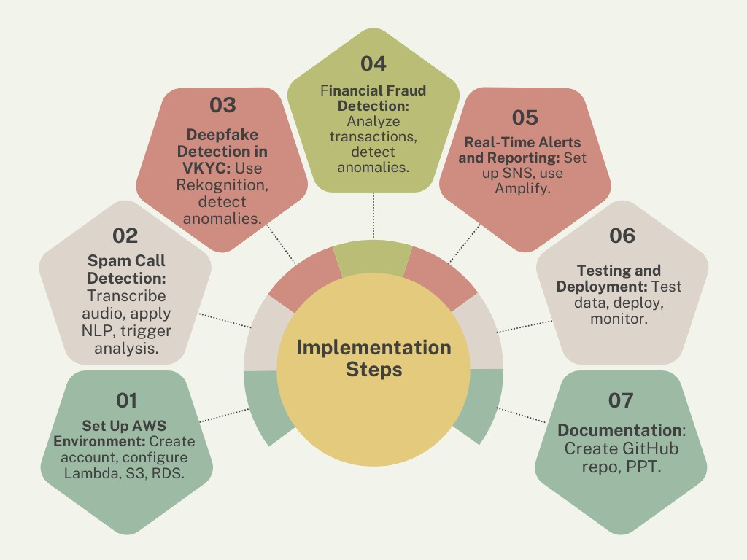
Team
INNOVATION & CONSTRUCTION
Innovators
Innovation & Uniqueness
Flow of Construction Activities & ML Model
Used :-
Holistic Fraud Management:Unlike single-purpose solutions, this system integrates call monitoring, deepfake detection, and transaction analysis Proactive Fraud Alerts:Real-time alerts offer users immediate actionability.
Cloud-Native Scalability:Built on AWS, ensuring
resilience, reliability, and the ability to handle high
transaction volumes. Dynamic Model Updates:Integrates continuous learning from user feedback to adapt to evolving fraud techniques. Behavioural Pattern Analysis:Goes beyond static data matching to analyse transaction behaviours and user interaction anomalies. Comprehensive Security:Combines AI and cloud- native solutions to offer end-to-end security with minimal
latency.
.
3

Slide 4





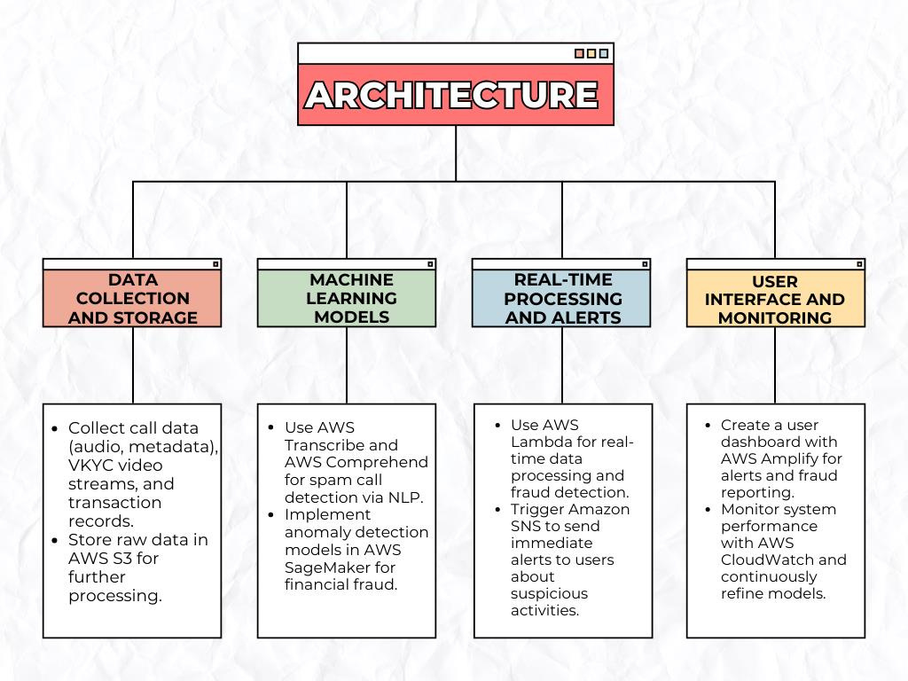
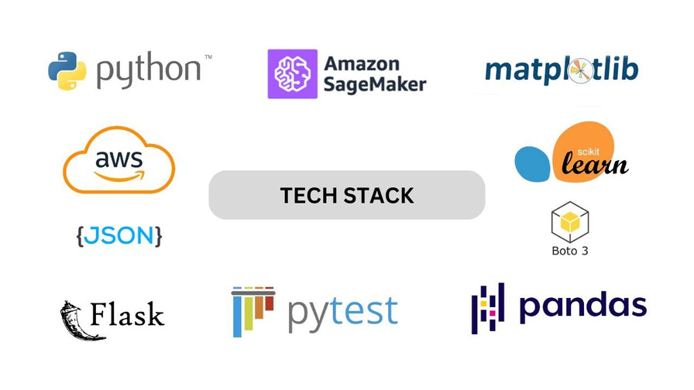



Team
TECHNICAL APPROACH
Innovators
INPUT
METHODOLOGIES:
NLP for Spam Detection
: AWS Transcribe converts audio to text, and
AWS Comprehend analyzes text for phishing keywords.. Deepfake Detection: Amazon Recognition verifies facial features, and custom models on Sage Maker detect anomalies in voice and facial patterns. Transaction Analysis: Data pipelines with AWS Glue prepare financial data, and Sage Maker anomaly detection algorithms identify suspicious transactions. Real-Time Alerts: AWS SNS provides notifications, while AWS Amplify offers a user-friendly interface for reporting fraud. Risk-Based Authentication: This methodology dynamically adjusts the level of authentication required based on the perceived risk of a transaction or user action.
4

Slide 5






Team
FEASIBILITY AND VIABILITY
Innovators
Feasibility Analysis
Potential Challenges
Overcoming
& Risks
Challenges
TechnologicalFeasibility:Utilizes proven AWS services, ensuring robust AI/ML capabilities without extensive infrastructure management. Operational Feasibility: Serverless
architecture reduces maintenance; user-
friendly interfaces allow easy fraud reporting. Economic Feasibility: Pay-per-use AWS pricing makes the system cost-effective for various scalesofoperation. Legal and Regulatory Feasibility: The
system complies with industry standards and
regulations related to data privacy such as
GDPR, and financial data protection laws.
False Positives: Legitimate actions flagged as fraud leading to user frustration and potential loss of trust in the system. Privacy Concerns: Handling sensitive user data securely such as personal identification, transaction records, and VKYC information, presents significant privacy challenges Deepfake Sophistication: Rapid evolution of deepfake technology it becomes increasingly challenging to detect manipulated content. Latency Issues: Delays in real-time fraud detection affecting user experience.
Enhanced ML Training: Use large, diverse datasets to improve detection accuracy.
Data
and
encryption or AWS Identity and Access
Management (IAM) controls. Adaptive Models: Continuously update ML models to adapt to evolving fraud patterns.
Security:
Implement
strong
Optimized
computing
Architecture:
Use
edge
strategies
and
caching
to reduce latency..
Revenue Sources:
Subscription Plans:
Tiered pricing for individuals and businesses based on usage.
Check Prototype:
API Access Fees: Enterprise Solutions:
Licensing fraud detection APIs to third-party applications.
bit.ly/40Hr2Si
Customized deployments for financial institutions.
Partnerships:
Revenue-sharing models with telecom providersandbanks
5

Slide 6











Team
IMPACT AND BENEFITS
Innovators
POTENTIAL IMPACTS
BENEFITS
Target Audience:
SOCIAL
Fraud Reduction: Detects and prevents fraudulent activities like spam calls, deepfake fraud, and unauthorized transactions, significantly minimizing financial scams.
User Trust: Increases consumer confidence in digital financial
services by providing proactive protection and real-time alerts
against security threats.
Operational Efficiency: Automates fraud detection
processes, reducing the need for manual monitoring and
saving time and resources for financial institutions.
Social Safety and Security: Enhances financial literacy and
safety for vulnerable populations, protecting them from scams
and malicious actors.
Economic Stability: Reduces losses due to fraud,
contributing to a more secure and stable financialecosystem.
Safer financial ecosystems for vulnerable populations. Reduced exposure to scams and phishing attacks.
.
ECONOMIC
Minimized financial losses due to fraud. Increased consumer confidence in digital banking. .
ENVIRONMENTAL
Reduction in manual verification processes.
Lower carbon footprint from reduced physical paperwork and fewer in-person verifications.
6

Slide 7




Team
RESEARCH
Innovators
Research Papers and Articles
ExistingSystems
1.Fraud Detection in Financial Transactions using Machine Learning Algorithms Authors: S. Raj and V. Portia
1.Truecaller (Spam Call Detection): Overview: Uses crowd- sourced data and machine learning for spam call detection. Limitations: Relies on user reports, making it less effective for newfraudschemes.
2.Call Control (Spam Call Detection): Overview: Blocks
robocalls and spam using an AI-driven algorithm. Limitations:
Dependent on community-driven spam lists, missing emerging
fraud types.
3.Veriff (VKYC and Fraud Prevention): Overview: Offers
identity verification with AI and machine learning for deepfake
detection. Limitations: Vulnerable to advanced deepfakes and
requiresimprovementsinvoice/behavioralanalysis.
4.PayPal (Financial Fraud Detection): Overview: Monitors
transactions using machine learning to flag suspicious activities.
Limitations: Relies on historical fraud patterns, which may not
detectnewtactics.
5.AWS Fraud Detection (AWS Services for Financial Fraud):
Overview: Uses services like Sage Maker, Lambda, and RDS for
fraud detection. Limitations: Requires fine-tuning models to
handleevolvingfraudtactics.
Published inInternational Journal of Computer Applications
:
.
Link: ResearchGate Summary: This paper explores different machine learning techniques for fraud detection and evaluates their performance in identifying financial fraud. It highlights the use of decision trees, SVM, and neural networks. 2.Spam Call Detection Using Natural Language Processing Authors: P. Gupta, M. Singh Published in: International Journal of Engineering Science and Computing
Summary
: This research presents NLP-based approaches to identify
and filter spam calls based on textual data derived from audio.
3.Real-Time Fraud Detection Using AWS and Machine Learning AWS Whitepaper Link: Available from AWS Documentation Summary: Explains AWS services for implementing fraud detection
solutions using Lambda, SageMaker, and other cloud services.
7

