Slide 1
AI-Based Resume Matcher System
Using NLP & Machine Learning

Slide 2
Problem Statement
1. Companies receive 1000+ resumes for a single job.
• Manual screening is:
• Time-consuming
• Inconsistent
2. Many good candidates are rejected due to:
• Missing skills
👉 Need an automated ATS (Applicant Tracking System)

Slide 3
Objective
• Build a system to:
• Compare Resume vs Job Description
• Extract skills automatically
• Calculate match score
• Help:
• Recruiters → filter candidates
• Students → improve resumes

Slide 4
Key Features
PDF Resume Upload
Automatic Text Extraction
Skill Detection (Regex + BERT)
Semantic Matching
ATS Score Calculation
Missing Skills Identification

Slide 5
Technologies Used
Python
Django (Web Framework)
NLP Libraries:
• spaCy
• Sentence Transformers
PDF Processing:
• PyMuPDF

Slide 6
System Architecture
Flow:
1. User uploads Resume (PDF)
2. Extract text
3. Clean & preprocess text
4. Extract skills
5. Compare with Job Description
6. Generate score
👉 Output:
• Match Score
• Missing Skills

Slide 7
Skill Extraction
Method 1: Regex Matching
• Direct keyword matching
• Example:
• Python, SQL, Machine Learning
Method 2: Semantic Matching (BERT-based)
• Uses embeddings
• Understands meaning
• Example:
• Neural Networks ≈ Deep Learning

Slide 8
Sentence Similarity
• Compare resume & JD sentences
• Use cosine similarity
👉 Finds:
• Context relevance
• Not just keywords
• Final Score = 0.7 × Skill Score + 0.3 × Semantic Score

Slide 9
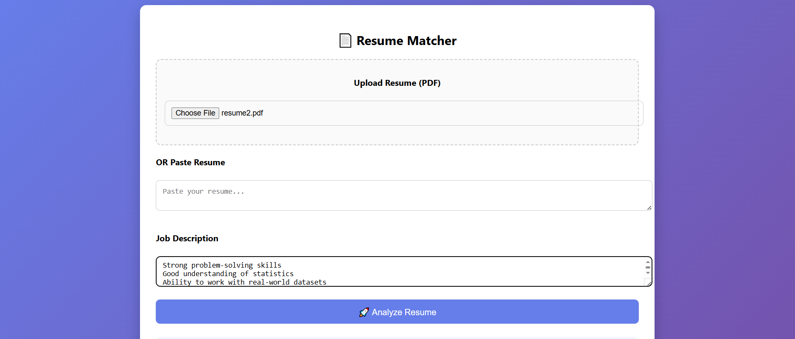
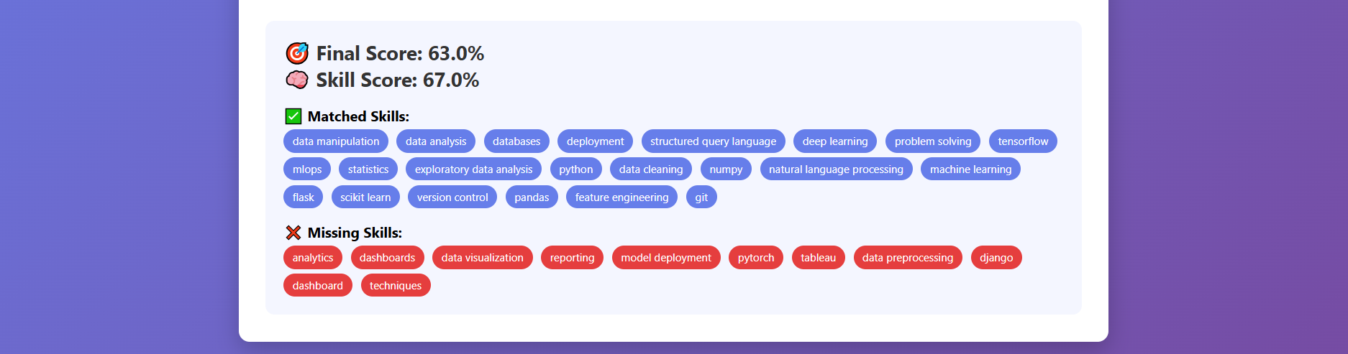

Slide 10
Advantages
• Helps students to improve resumes
• Reduces manual effort in resume shortlisting
• Saves time
Future Improvements
• Add recommendations in resume
• Rank multiple resumes

Slide 11
Thank you

