Slide 1
Stock Market Index Direction Prediction Using Limit Order Book Data
MTech (Data Science & AI) Capstone — Final Submission
PES University, Bengaluru
Joseph Raj · Sumanth G. M · Abhishek Kumar · Kumara Swamy C · R Raghav Srivatsav
Notes:
PRESENTER 1 — R Raghav Srivatsav (Intro & Overview).
Welcome the panel; state the title and the one-line problem: predict short-horizon mid-price direction from LOB data.

Slide 2
Background & Project Overview
High-level context and abstract — the detailed literature survey follows in 'Related Work'.
• A Limit Order Book (LOB) records every resting buy/sell order at each price level — a rich, high-frequency signal.
• Deep learning on LOBs has steadily advanced mid-price prediction: CNN+LSTM (DeepLOB) → transformers (TLOB) → linear-time state-space models (Mamba).
– But this progress sits almost entirely on developed markets and the public FI-2010 benchmark.
• This project, in brief: we engineer the first ML-ready Indian index-futures LOB dataset, reproduce the standard baselines, introduce MambaLOB / ConvMambaLOB, and characterise the efficiency–accuracy trade-off honestly.
• Roadmap: motivation → data engineering → models → results → efficiency → conclusions.
Notes:
PRESENTER 1 — R Raghav Srivatsav.
Background & overview: what a LOB is, the deep-LOB progression (DeepLOB->TLOB->Mamba), that it's all developed-markets, and our project abstract in one breath. Give the roadmap, then: 'Now the motivation in detail.'

Slide 3
Problem & Motivation
• Predict short-horizon mid-price direction from Limit Order Book (LOB) data — Down / Stationary / Up.
• LOB carries a rich microstructural signal; deep models show small but real predictive power.
• But research is concentrated on developed markets (NASDAQ, Nordic) and the FI-2010 benchmark.
– Indian index futures are highly liquid yet structurally distinct and almost entirely unstudied with modern LOB architectures.
• No clean, ML-ready Indian index-futures LOB dataset existed — a data-engineering gap.
Notes:
PRESENTER 1 — R Raghav Srivatsav.
Motivation: LOB has microstructure signal; prior work is developed-markets/FI-2010 only; Indian index futures unstudied; no clean dataset existed.

Slide 4
Objectives & Research Questions
• Engineer the first ML-ready NSE index-futures LOB dataset (NIFTY, BANKNIFTY).
• Reproduce published baselines (DeepLOB, MLPLOB, TLOB) on FI-2010 and validate.
• Introduce MambaLOB — a selective state-space model with linear-time O(L) scaling.
• Quantify transfer from FI-2010 to NSE, honestly reporting degradation.
– RQ: Is a linear-time SSM competitive with the transformer at lower compute?
– RQ: Does microstructure feature engineering improve the Indian-market signal?
Notes:
PRESENTER 1 — R Raghav Srivatsav.
State the objectives and the two research questions (efficient SSM? do features help?). Keep crisp.

Slide 5
Related Work
• FI-2010 (Ntakaris et al., 2018) — first public LOB benchmark + protocol.
• DeepLOB (Zhang et al., 2019) — CNN + Inception + LSTM; the 40-feature template.
• MLPLOB / TLOB (Berti & Kasneci, 2025) — dual-attention transformer, current SOTA.
• S4 / Mamba (Gu et al.) — structured / selective state-space models, sub-quadratic.
• LOBCAST (Prata et al., 2024) — benchmark study: models overfit FI-2010, drop on new data.
• Microstructure priors: order-flow imbalance (Cont), micro-price (Stoikov).
Notes:
PRESENTER 1 — R Raghav Srivatsav.
Related work in 4 names: FI-2010, DeepLOB, TLOB, Mamba/LOBCAST. Then: 'I'll hand over to Kumar for how we built our dataset.'

Slide 6
Data Engineering — Building the NSE Dataset
The most substantial part of the project: no dataset existed, so we built one end-to-end.
• Reverse-engineered the undocumented Dhan 20-level binary depth feed (1992 B full / 664 B compact frames).
– Fixed non-obvious decode issues: bid-price byte offset, denormalised empty levels, int64 overflow.
• Cloud collection: EC2 WebSocket collector → daily zstd Parquet → S3 (cron-scheduled, auto token refresh).
• Front-month stitching across the May→June expiry roll; per-day segmentation.
• Result: 21 trading days, ~1.1 M events per instrument (exceeds FI-2010's ~400 k scale).
Notes:
PRESENTER 2 — Kumar Swamy C (Data Engineering & Dataset). THE PROJECT'S STRONGEST SLIDE.
Reverse-engineered Dhan binary feed (1992B/664B), EC2->Parquet->S3 pipeline, front-month stitch. ~1.1M events. (Joseph built this — route deep DE questions to him in Q&A.)

Slide 7
Datasets
• FI-2010 (benchmark): 5 Nasdaq Nordic stocks, 10 days, 10 levels, pre-normalised; horizons k = 10/20/50/100.
• NSE index futures (engineered): NIFTY & BANKNIFTY 20-level depth via Dhan; 12 May – 12 June 2026.
– First 10 of 20 levels → 40-feature vector identical in layout to FI-2010 → models transfer unchanged.
– Stored cadence ≈ 0.4 s (~2.5 Hz) regular snapshots (honestly: not tick-by-tick).
• Unique to Dhan: per-level order-count channel (absent from FI-2010 / Kite).
Notes:
PRESENTER 2 — Kumar Swamy C.
Datasets: FI-2010 spec + engineered NSE spec; first 10 levels = 40 features = FI-2010 layout -> models transfer unchanged. Be upfront: ~0.4s snapshot cadence, not tick-level.

Slide 8
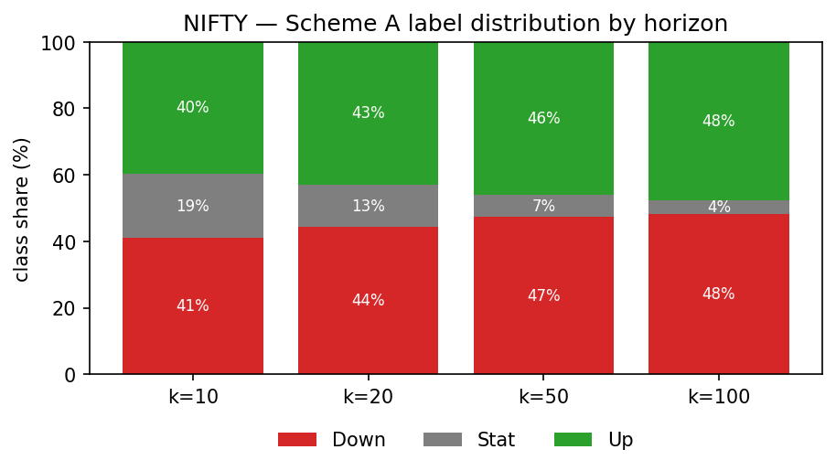
Exploratory Data Analysis (NSE)
• Stationary class shrinks 19% → 4% as horizon k grows 10 → 100.
• Long-horizon task is effectively binary (Down/Up).
• Median relative spread ≈ 3.3 bps.
• Regular ~0.4 s update cadence (CV ≈ 0.34).
Notes:
PRESENTER 2 — Kumar Swamy C.
EDA: Stationary class shrinks 19%->4% with horizon; spread ~3.3 bps; regular ~2.5Hz cadence.

Slide 9
Preprocessing & Labelling
• Reorder Dhan columns to interleaved FI-2010 layout [Pa, Va, Pb, Vb] × 10.
• Clean crossed quotes and tick spikes; segment per trading day (no cross-day/contract windows).
• Z-score using training statistics only; lazy 100-step sliding windows.
• Labels (smoothed mid %-change): Up if r > α, Down if r < −α, else Stationary (fixed α = 1e-5).
• Microstructure features engineered: OFI, micro-price, depth imbalance, relative spread, order counts.
Notes:
PRESENTER 2 — Kumar Swamy C.
Preprocessing pipeline + labelling (alpha=1e-5) + engineered microstructure features. Hand to Sumanth for the models.

Slide 10
Models
• Baselines (reproduced): DeepLOB (CNN+Inception+LSTM), MLPLOB (MLP+BiN), TLOB (dual-attention transformer).
• MambaLOB (proposed): Linear → n selective state-space (Mamba) blocks → Bilinear Norm → FC(3).
– Input-dependent linear recurrence → O(L) time & memory, params independent of sequence length.
• ConvMambaLOB: DeepLOB convolutional spatial front-end → Mamba temporal core (replaces the LSTM).
• All models share one (B, 100, 40) → 3-class contract for a fair comparison.
Notes:
PRESENTER 3 — Sumanth G M (Models & Reproduction).
Baselines (DeepLOB/MLPLOB/TLOB) + proposed MambaLOB (selective SSM, O(L)) + ConvMambaLOB. One contract for all.

Slide 11
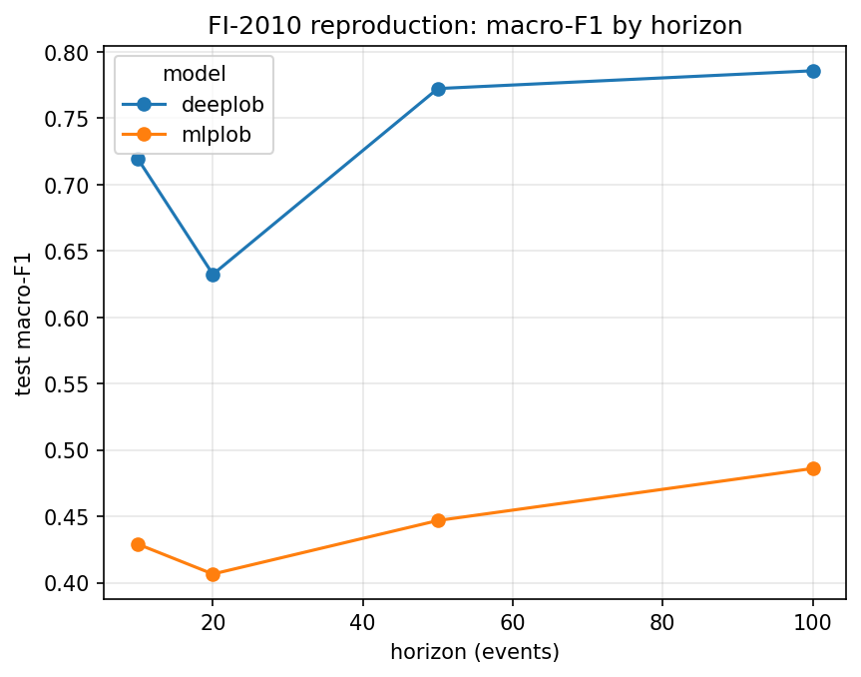
Results — FI-2010 Reproduction
• DeepLOB weighted-F1 ≈ 82.5% — matches paper (~83.4%).
• TLOB reaches the SOTA range (up to ~92.5%).
• Ordering & range match published + independent (LOBCAST) results.
• Validates the pipeline before transfer to NSE.
Notes:
PRESENTER 3 — Sumanth G M.
FI-2010 reproduction validates the pipeline: DeepLOB ~= paper, TLOB in SOTA range. Then hand to Joseph for the NSE transfer + Phase-2.

Slide 12
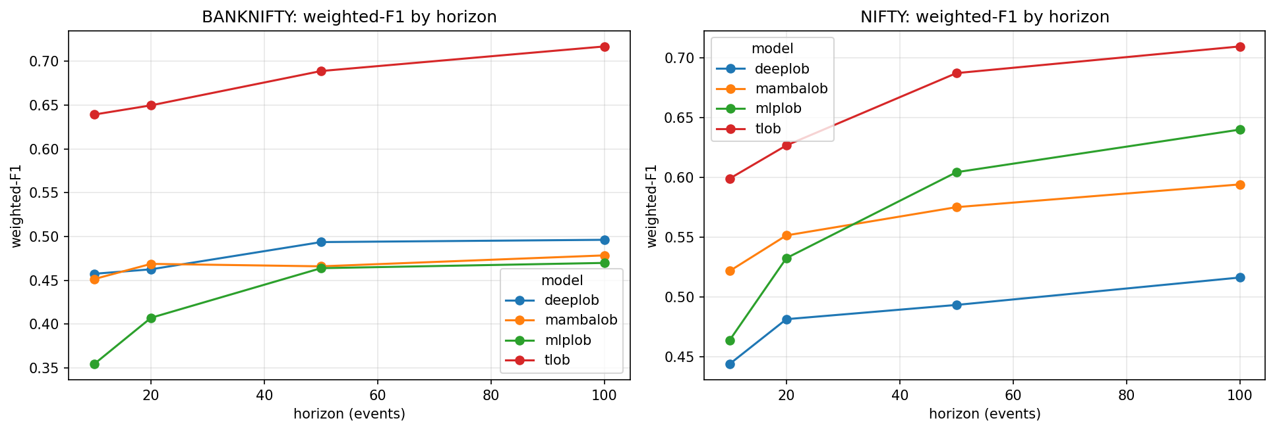
Results — NSE Transfer (Scheme A)
• All models beat naive baselines → learnable signal exists.
• Absolute scores below FI-2010 (expected, per LOBCAST).
• TLOB leads throughout.
• Key: MambaLOB (68k) beats DeepLOB (191k) on NIFTY — transfers better than on FI-2010.
Notes:
PRESENTER 4 — Joseph Raj.
NSE transfer (your opener): all beat baselines (signal exists); below FI-2010 (expected, per LOBCAST); TLOB leads; MambaLOB beats DeepLOB on NIFTY at 1/27 params and transfers BETTER to NSE than on FI-2010. Bridge: 'these use raw features -- next, what microstructure features add.'

Slide 13
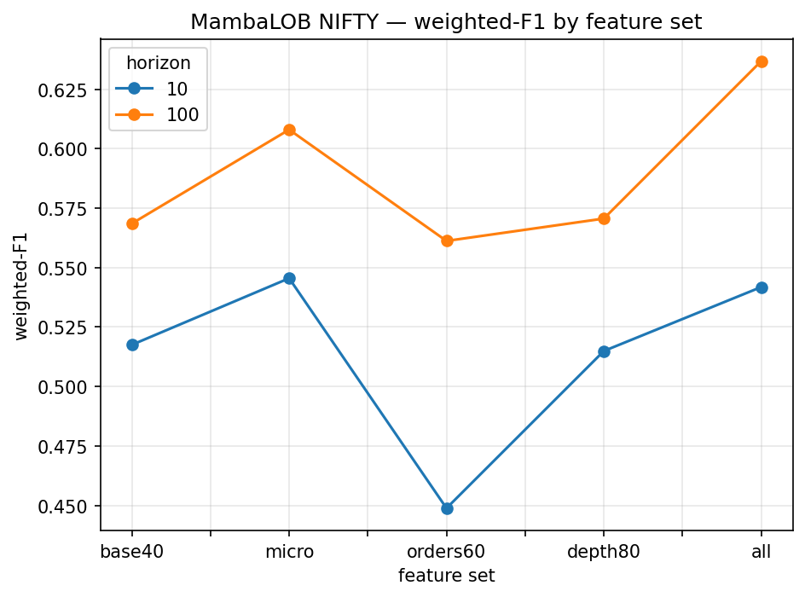
Tier A — Microstructure Feature Engineering
• Engineered 'micro' / 'all' feature sets beat raw LOB.
• Gain grows with horizon (up to +0.068 wF1 at k=100).
• Statistically significant: +0.084 wF1, p = 0.001 (multi-seed).
• Order counts help only combined; deep levels add nothing.
Notes:
PRESENTER 4 — Joseph Raj (Phase-2 DS contributions).
Tier A: microstructure features give a SIGNIFICANT gain (+0.084 wF1, p=0.001).

Slide 14
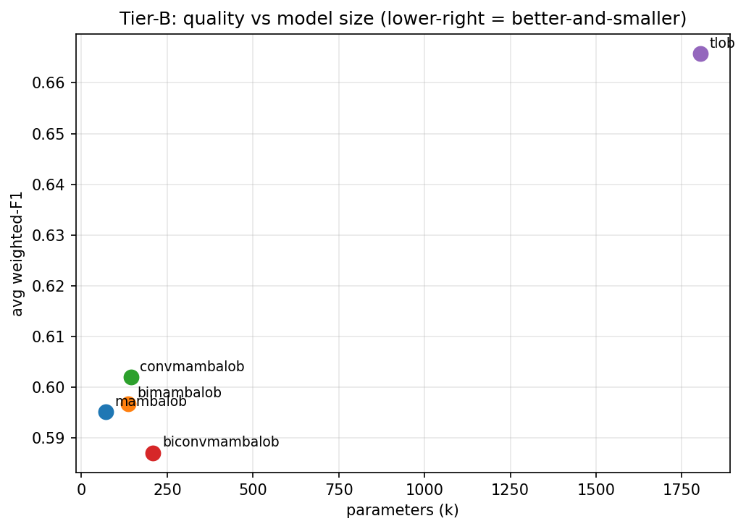
Tier B — Improved Architectures
• ConvMambaLOB = best of the proposed variants.
• Recovers ~90% of TLOB's quality at 12.5× fewer parameters.
• Bidirectionality / stacking give diminishing returns.
• Honest: an efficiency trade-off, not an accuracy win.
Notes:
PRESENTER 4 — Joseph Raj.
Tier B: ConvMambaLOB best of ours, ~90% of TLOB at 12.5x fewer params. Honest: efficiency trade-off, not accuracy win.

Slide 15
Tier C — Statistical Rigour
• 3-seed study with paired across-seed + per-sample significance tests.
• Microstructure features: significant (p = 0.001). TLOB's accuracy lead: significant (p < 0.001).
– ConvMambaLOB gain over base: not robust across seeds (p = 0.25).
• Hyperparameter optimisation (Optuna): tuned base MambaLOB (1 layer, d=32) matches the hybrid.
• Probability calibration: already well-calibrated (ECE 0.041, T = 1.00).
• Class imbalance: weighted cross-entropy a sound default; focal marginal at long horizons.
Notes:
PRESENTER 4 — Joseph Raj.
Tier C rigour: multi-seed significance, calibration (ECE 0.041), HPO, class-imbalance. Features significant; ConvMamba gain not robust (we report it honestly). Hand to Abhishek.

Slide 16
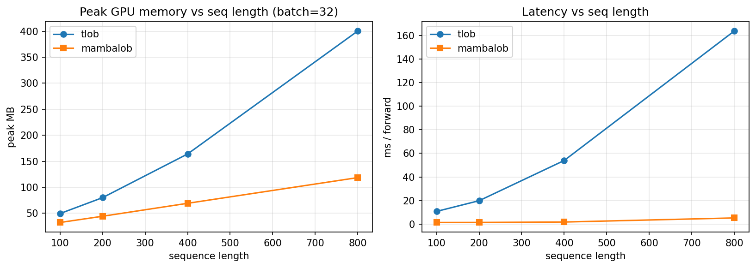
Efficiency — O(L) vs O(L²) Scaling
• MambaLOB: parameters constant in L; memory/latency grow linearly.
• TLOB attention grows quadratically.
• At L = 800: MambaLOB ≈ 31× faster, ≈ 750× fewer parameters.
• Basis of the architecture's efficiency claim.
Notes:
PRESENTER 5 — Abhishek Kumar (Efficiency, Conclusion & Q&A).
Efficiency: O(L) vs O(L^2); at L=800 ~31x faster, ~750x fewer params.

Slide 17
Conclusion & Future Work
• Built the first ML-ready NSE index-futures LOB dataset via full reverse-engineering + cloud pipeline.
• Reproduced baselines; introduced MambaLOB & ConvMambaLOB; evaluated with multi-seed rigour.
• Headline (honest): SSM models reach ~90% of transformer accuracy at 12–25× fewer parameters — efficiency, not an accuracy win.
• Largest significant gain comes from microstructure feature engineering, not architecture.
• Future work: spread-relative labelling, cost-aware backtest, walk-forward across more months/instruments.
Notes:
PRESENTER 5 — Abhishek Kumar.
Conclusion: dataset + efficient SSM + significant feature finding; honest framing. Future work: spread-relative labelling, cost-aware backtest, walk-forward.

Slide 18
Thank You
Questions & Discussion
Notes:
PRESENTER 5 — Abhishek Kumar.
Thank the panel and open for questions. The whole team fields Q&A — route each question to whoever owns that section (deep data-engineering -> Joseph).

