Slide 1

PR PROJECT
Mentor: Dr. Deep Prakash Samajdar
Raj Pandey 22bec095
Asheesh Sharma 22BEC021
Somendra Sengar 22bec119
Tejal Padghan 22bec081
Nehal Sarraf 22bec078

Slide 2
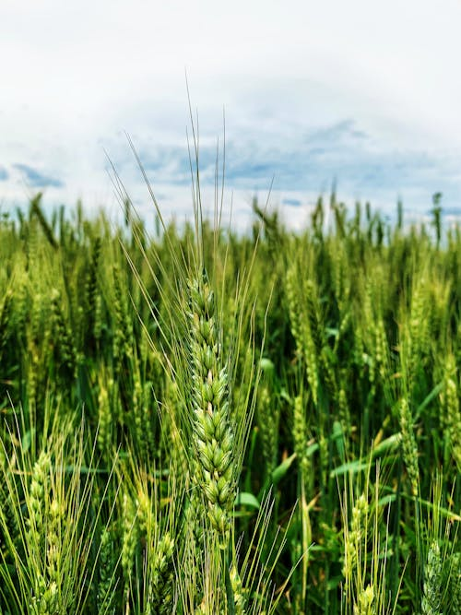
Aim of the Project
Develop a robust system for early detection of crop diseases using sensor technologies

Slide 3
Goals:
Improve
Improve crop yield by timely identification and treatment of diseases.
Minimize
Minimize crop losses and increase farmers' productivity.
Utilize
Utilize advanced technology to automate disease detection processes.

Slide 4
How We Made It
Sensor Network: Implementing a network of IoT sensors deployed in fields.
Data Collection: Gathering data on environmental conditions (humidity, temperature, etc.) and plant health indicators (color changes, leaf texture).
Data Processing: Using machine learning algorithms to analyze sensor data for disease patterns.
Alert System: Developing a real-time alert system to notify farmers of potential disease outbreaks.

Slide 5
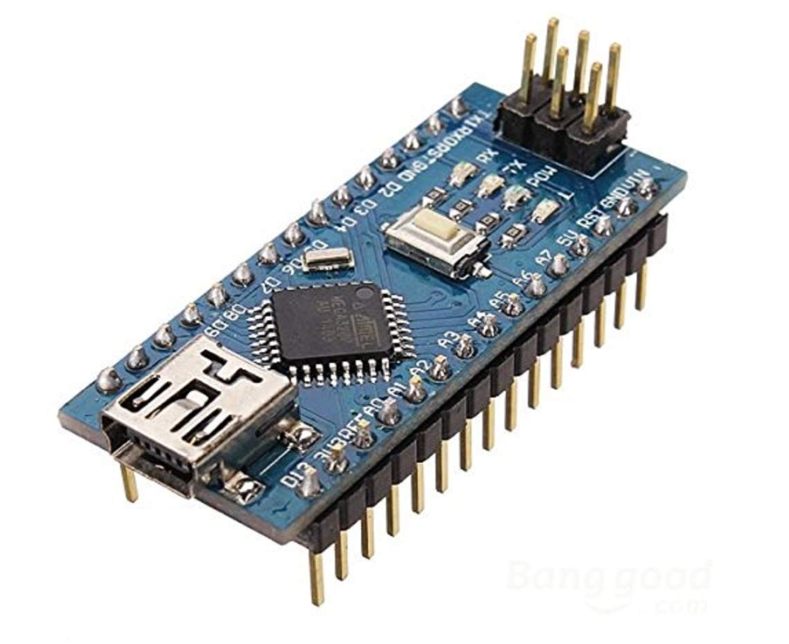
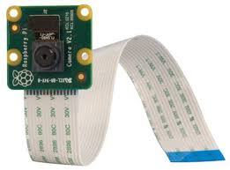
Components
Arduino Nano
The Arduino Nano serves as an excellent platform for interfacing with a wide variety of sensors, thanks to its diverse input pins, sensor libraries, communication protocols, and support for event-driven programming. Its versatility and ease of use make it a popular choice for projects involving sensor data acquisition and processing.
Raspberry Pi Camera Module
The Raspberry Pi camera module empowers developers and enthusiasts to explore image processing applications with ease, thanks to its affordability, compact size, and compatibility with the Raspberry Pi ecosystem.

Slide 6
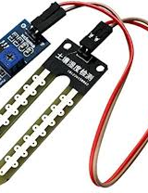
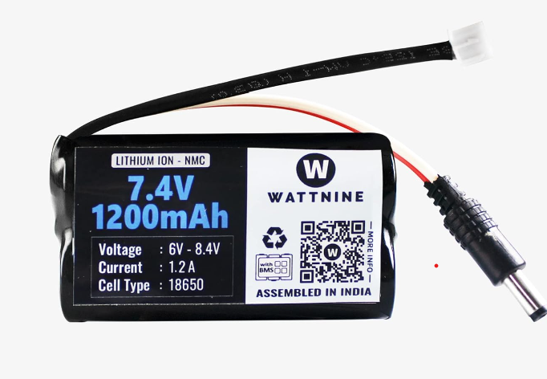
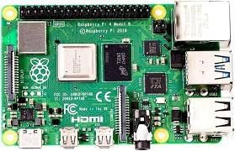
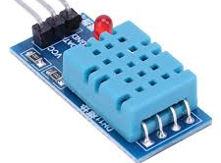
Battery
Sensors
Raspberry Pi
Moisture sensor
Temperature sensor

Slide 7
Existing Similar Technology
Overview:
Existing technologies like satellite imaging, drone-based monitoring, and handheld devices for disease detection.
Examples:
Remote sensing technologies for large-scale disease mapping.
Handheld spectroscopy devices for on-site disease diagnosis.

Slide 8
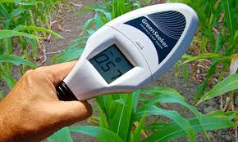
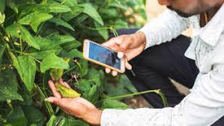
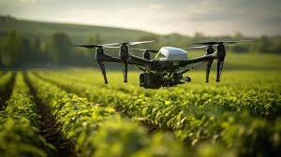
Existing Technologies
Remote Sensing:
satellite-based crop monitoring systems.
Handheld Devices: portable devices for in-field disease detection.
Drone Technology: Touch on drone-based crop surveillance

Slide 9
Key Differences
Real-time Monitoring: the continuous, real-time monitoring capability of our sensor-based system.
Localized Detection: the ability to detect diseases at the individual plant level.
Cost-Effectiveness: our solution offers a more affordable and scalable alternative.
User-Friendly Interface: ease of use for farmers and integration into existing farm management systems.

Slide 10
Benefits And Impact
Benefits
Early Disease Detection
Increased Crop Yield
Reduced Pesticide Use
Enhanced Farm Management
Impact
Improved Food Security
Economic Benefits for Farmers

Slide 11
Any questions or feedback?

Slide 12
Thank You.

