Slide 1
Text Classification
using
Naive Bayes Algorithm

Slide 2
Aim:
The aim of the project is to correctly classify Amazon reviews into two classes, Positive and Negative, using labelled data
Through a supervised learning algorithm
Labelled Data: example
No | Sentence | Class
1 | I am Happy | Positive
2 | I am enjoying | Positive
3 | This is fun | Positive
4 | Its such a gloomy day | Negative
5 | I don’t like this | negative
6 | I am excited to go to school | Positive
7 | I don’t like this product | Negative
N | ……………………. | …………..

Slide 3
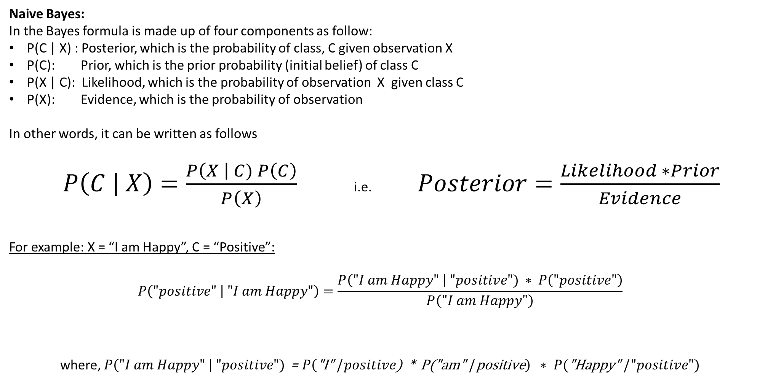
Algorithm used
Naive Bayes:
In the Bayes formula is made up of four components as follow:
P(C | X) : Posterior, which is the probability of class, C given observation X
P(C): Prior, which is the prior probability (initial belief) of class C
P(X | C): Likelihood, which is the probability of observation X given class C
P(X): Evidence, which is the probability of observation
In other words, it can be written as follows
$P\left(\left.C \right| X\right)=\frac{P\left(X \right| C) P\left(C\right)}{P\left(X\right)}$ i.e. $Posterior=\frac{Likelihood ∗Prior}{Evidence}$
For example: X = “I am Happy”, C = “Positive”:
$$P\left(\left."positive" \right| "I am Happy"\right)=\frac{P\left("I am Happy" \right| "positive") ∗ P\left("positive"\right)}{P\left("I am Happy"\right)}$$
where, $P\left("I am Happy" \right| "positive")$ = $P\left(\text{"}\text{I}\text{" | }positive\text{) ∗ }\text{P}\text{("}\text{am}\text{" | }\text{positive}\right) ∗$ $P(\text{"}\text{Happy}\text{" | }"positive")$

Slide 4
Dataset Analysis
The amazon review dataset was analyzed to find the data distribution, check metadata as well as to check if data is unbalanced and other. We used 20,000 data points for training and 4000 for testing due to compute limitation but this can be increased when necessary
Total data points: 20,000
Data in Class, “Positive”: 10,257
Data in Class, “Negative”: 9,743

Slide 5
Dataset Cleaning
The dataset available has a huge amount of data however, the labelling although done was not proper and the model would not be able understand the labels. Hence:
The labels were changed
0: for negative
1: for positive
The dataset also contained data points which had arbitrary sentences, punctuations, website link and many other characters which had little to do with the actual sentiment of the review. Hence:
The data was cleaned to remove all such unwanted information.

Slide 6
Pre-processing
Word to vectors:
Since Machine learning models cannot understand text, they have to be converted to a numerical form:
We have used a Bag of Words (BoW) encoding to transform the text into respective vectors
.
Calculating Priors
The priors I,e probability of a certain class was pre-calculated by counting the number of occurrences of each class divided by the total number of reviews which in our case is 20, 000
Prior of “Positive” = Number of Positive reviews/Total number of reviews
Prior of “Negative” = Number of Negative reviews/Total number of reviews

Slide 7
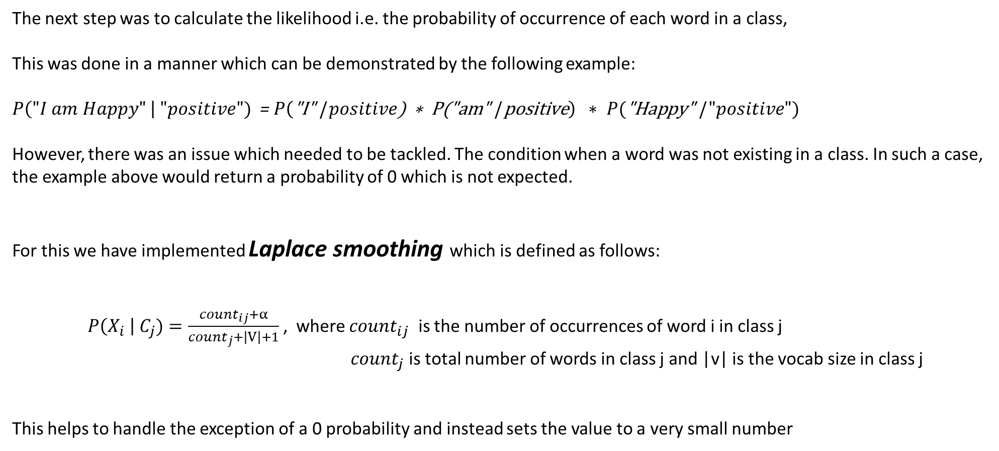
Calculating Likelihood
The next step was to calculate the likelihood i.e. the probability of occurrence of each word in a class,
This was done in a manner which can be demonstrated by the following example:
$P\left("I am Happy" \right| "positive")$ = $P\left(\text{"}\text{I}\text{" | }positive\text{) ∗ }\text{P}\text{("}\text{am}\text{" | }\text{positive}\right) ∗$ $P(\text{"}\text{Happy}\text{" | }"positive")$
However, there was an issue which needed to be tackled. The condition when a word was not existing in a class. In such a case, the example above would return a probability of 0 which is not expected.
For this we have implemented Laplace smoothing which is defined as follows:
$P\left(X_{i} \right| C_{j})=\frac{{count}_{ij}+α}{{count}_{j}+\left|V\right|+1}$ , where ${count}_{ij}$ is the number of occurrences of word i in class j
${count}_{j}$ is total number of words in class j and |v| is the vocab size in class j
This helps to handle the exception of a 0 probability and instead sets the value to a very small number
.

Slide 8
Training, Testing and Validation
Finally, the model was trained using the training set created.
It was tested using the test set and validated using the validation set.
Given Below is the confusion matrix for training and validation
 | Predicted Negative | Predicted Positive
Actual Negative: | TN = 8779 | FP = 964
Actual Positive: | FN = 1408 | TP = 8849
The resulting metrics are:
Training precision: 90.18 %
Training accuracy: 88.14%
Training recall: 86.27%
F1 Score: 0.882
Training Set
 | Predicted Negative | Predicted Positive
Actual Negative: | TN = 1652 | FP = 299
Actual Positive: | FN = 343 | TP = 1706
The resulting metric are:
Training precision: 85.087 %
Training accuracy: 83.95 %
Training recall: 83.26 %
F1 Score: 0.8416
Validation Set

