Slide 1
Java Fullstack Development (Course Overview)
JAVA
HIBERNATE
SWING
MVC
SPRING
JUNIT
MySQL
Kabiraj Shrestha
Java Instructor

Slide 2
Coverage
Environment Setup
Introduction to Java
Introduction to MySQL and JDBC
Hibernate ORM Framework
Introduction To Swing
Web Application
Introduction To Spring Framework
Spring Boot
Spring Security
Microservice Architecture
Testing

Slide 3

Learning Methodology
Interactive sessions for feedback and questions
Hands-on experience with project-based learning
Career support for full-stack development
Real-world projects for building your portfolio
Personalized feedback to improve skills
Access to resources including code snippets, documentation, examples and Recorded Videos

Slide 4
Projects
A minor project on swing UI
A minor project on Java Web Application with basic CRUD Operation with MySQL
A major project, a full fledge e-commerce application with Springboot, Rest API’s, Thymeleaf, Spring Security, Microservice Design Pattern…
One of each to be submitted by the students as well.

Slide 5

What is Java?
Java is a computer programming language that is -
Object-Oriented
.

Slide 6

What is Java?
Java is a computer programming language that is -
Class-based
Object-Oriented

Slide 7

What is Java?
Java is a computer programming language that is -
Concurrent
Class-based
Object-Oriented
.

Slide 8

What is Java?
Java is a computer programming language that is -
Concurrent
Class-based
Low Dependencies
Object-Oriented

Slide 9










Where is Java Used?
3 billion devices use Java Runtime Environment
To develop Android Applications
To develop Hadoop Applications
To develop business process management (BPM) tools
To develop web servers
To develop application servers etc.

Slide 10

Where is Java Used?
Java has been used to develop below frameworks:

Slide 11

Where is Java Used?
Java has been used to develop below frameworks:

Slide 12


Where is Java Used?
Java has been used to develop below frameworks:

Slide 13

Where is Java Used?
Java has been used to develop below frameworks:

Slide 14



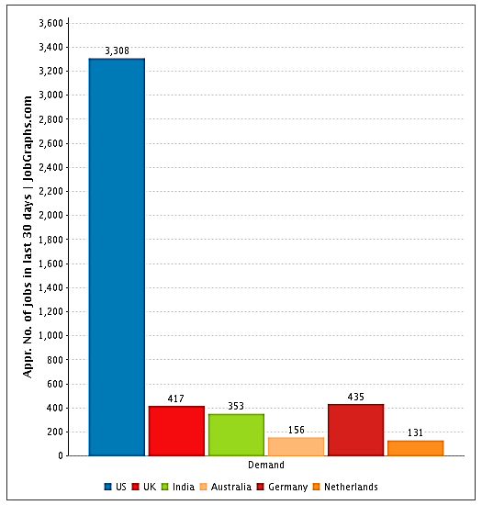
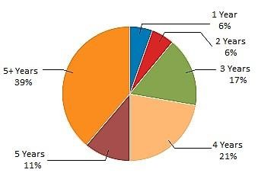
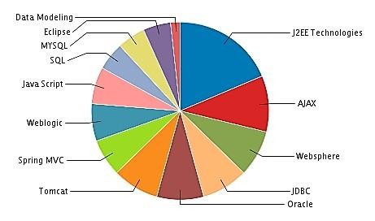

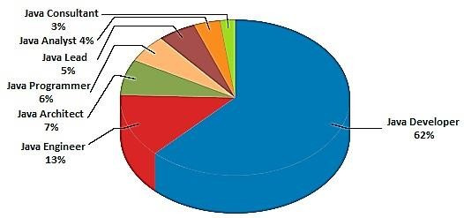
Java-Job, Demand and Experience Trends
http://jobgraphs.com/java

Slide 15
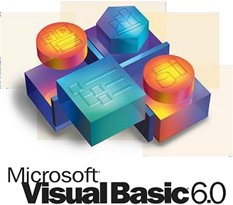
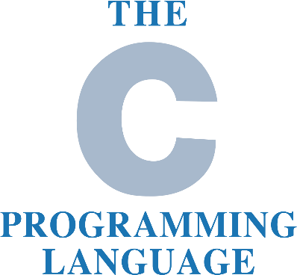

Languages before Java
Before Java emerged as a programming language, there were many other programming languages:

Slide 16

Why not C++?
C++ does not provide efficient means for garbage
collection

Slide 17
Why not C++?
C++ does not provide efficient means for garbage
collection
No built in support for threads

Slide 18
Why not C++?
C++ does not provide efficient means for garbage
collection
No built in support for threads
It gets complex when u want to develop a graphics rich application

Slide 19
Why not C++?
C++ does not provide efficient means for garbage
collection
No built in support for threads
It gets complex when u want to develop a graphics rich application
C++ is not platform independent

Slide 20
Why not C++?
C++ does not provide efficient means for garbage
collection
No built in support for threads
It gets complex when u want to develop a graphics rich application
C++ is not platform independent
In C++ memory allocation and de-allocation has to be done by the developer

Slide 21
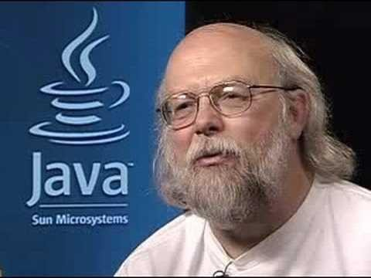
History of Java
Java was developed by James Gosling in Sun Microsystems
It is a platform independent programming language
This language was initially named as OAK and later renamed as Java

Slide 22
Java Versions
Jan 1996
Java 1.0 Oak
Jan 1997
Java 1.1
Dec 1998
Java 1.2 Playground
May 2000
Java 1.3 Kestrel
Feb 2002
Java 1.4 Merlin
Sept 2004
Java 5 Tiger
Dec 2006
Java 6 Mustang
July 2011
Java 7 Dolphin
Mar 2014
Java 8
Sept 2017
Java 9 Dolphin

Slide 23
Features of Java

Slide 24












Features of Java
{OOPS}
Simple
Portable
Object-oriented
Secure
Distributed
Dynamic
Robust
High Performance

Slide 25







Features of Java
Simple
Portable
Object-oriented
Secure
Distributed Dynamic Robust
High Performance
Java was designed to be easy for professional programmer to learn and use effectively
Simple

Slide 26




Features of Java
Simple
Portable Object-oriented Secure
Distributed Dynamic Robust
High Performance
Applications written using Java are portable in the sense that they can be executed on any kind of computer containing any CPU or any operating system
Portable

Slide 27
Features of Java
Simple
Portable
Object-oriented Secure Distributed
Dynamic Robust
High Performance
Java is true object oriented language.
Everything is considered to be an “object” and all operations are performed using these objects
{OOPS}
Object-oriented

Slide 28
Features of Java
Simple
Portable
Object-oriented
Secure
Distributed Dynamic
Robust
High Performance
Java Programs run inside virtual machine sandbox to prevent any activity from untrusted sources.
No use of explicit pointer
Secure

Slide 29
Features of Java
Simple
Portable
Object-oriented Secure Distributed Dynamic
Robust
High Performance
Java has a feature called Remote Method Invocation (RMI) using which a program can invoke method of another program across a network and get the output
Distributed

Slide 30

Features of Java
Simple
Portable
Object-oriented Secure Distributed
Dynamic
Robust
High Performance
Java programs carry with them substantial amounts of run-time type information that is used to verify and resolve accesses to objects at run time
Dynamic

Slide 31
Features of Java
Simple
Portable
Object-oriented Secure Distributed
Dynamic
Robust
High Performance
Java checks the code during the compilation time and run time also
Java completely takes care of memory allocation and releasing, which makes the Java program more robust
Robust

Slide 32
Features of Java
Simple
Portable
Object-oriented Secure Distributed
Dynamic Robust
High Performance
Java achieves high performance through the use of bytecode which can be easily translated into native machine code
High Performance

Slide 33
Environment Setup
Install JRE
Install JDK
Install IDE
Install MySQL/Xampp

Slide 34
JRE java Runtime Environment
The Java Runtime Environment (JRE) is software that Java programs require to run correctly.
The JRE is the underlying technology that communicates between the Java program and the operating system.
Download Link: https://www.java.com/en/download/

Slide 35
JDK is a bundle of software development tools and supporting libraries combined with the Java Runtime Environment (JRE) and Java Virtual Machine (JVM)
Download Link: https://www.oracle.com/java/technologies/downloads/
JDK Java development kit

Slide 36
IDE integrated Development Environment
An integrated development environment (IDE) is a software application that helps programmers develop software code efficiently.
It increases developer productivity by combining capabilities such as software editing, building, testing, and packaging in an easy-to-use application.

Slide 37
IDE Options
Spring Tool Suite
https://spring.io/tools
Eclipse EE
https://www.eclipse.org/downloads/packages/
Intellij IDEA
https://www.jetbrains.com/idea/download/#section=windows
Visual Studio Code
https://code.visualstudio.com/download

Slide 38
the most popular Open Source SQL database management system, is developed, distributed, and supported by Oracle Corporation.
Download Link: https://dev.mysql.com/downloads/mysql/
MySQL

Slide 39
Conclusion
Comprehensive understanding of Java Programming Language and Spring Ecosystem
Skills and confidence for pursuing web development careers
Two practical projects for building your portfolio
Interview Ready teaching learning Approach

