Slide 1
CSE 331
Review: Classes, Inheritance, and Collections
slides created by Marty Stepp
based on materials by M. Ernst, S. Reges, D. Notkin, R. Mercer, Wikipedia
http://www.cs.washington.edu/331/

Slide 2
Recall: A typical Java class
  public class Point {
  private int x; // fields
  private int y;
  public Point(int x, int y) { // constructor
  this.x = x;
  this.y = y;
  }
  public int getX() { return x; } // accessor
  public int getY() { return y; }
  public void translate(int dx, int dy) {
  x += dx;
  y += dy; // mutator
  }
  public String toString() { // for printing
  return "(" + x + ", " + y + ")";
  }
  }

Slide 3
Effective Java Tip #10
Throughout this course, we will refer to design heuristics from Joshua Bloch's excellent Effective Java (2nd edition) book.
Tip #10: Always override toString.
Why?
  If you can print your objects, you can easily see their state.
  Clients can print your objects, which is a very common thing to do.
  Clients can put them into collections and print the collection.
  Nobody likes to see the default "ClassName@a97e2f" output.
  Helps with debugging your own code as you're writing it.

Slide 4
Multiple constructors
  public class Point {
  private int x;
  private int y;
  public Point() {
  this(0, 0);
  }
  public Point(int x, int y) {
  this.x = x;
  this.y = y;
  }
  ...
  }
    Avoids redundancy between constructors
    Only a constructor (not a method) can call another constructor

Slide 5

Class question
We are given a class BankAccount where each object represents a user's bank data such as name and balance.
We must add functionality to the class so that each account object is automatically given a new unique ID number as it is created.
  First account = ID 1; second account = ID 2; etc.
How do we do it?

Slide 6
Static fields
  private static type name;
  or,
  private static type name = value;
  Example:
  private static int theAnswer = 42;
static: Shared by all instances (objects) of a class.
  A shared global field that all objects of the class can access/modify.
  Like a class constant, except that its value can be changed.

Slide 7
BankAccount solution
  public class BankAccount {
  // static count of how many accounts are created
  // (only one count shared for the whole class)
  private static int objectCount = 0;
  private String name; // fields (replicated
  private int id; // for each object)
  public BankAccount() {
  objectCount++; // advance the id, and
  id = objectCount; // give number to account
  }
  ...
  public int getID() { // return this account's id
  return id;
  }
  }
  What would happen if objectCount were non-static? If id were static?

Slide 8
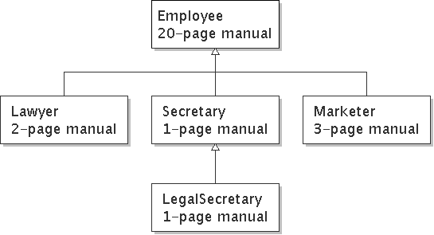
Recall: Inheritance
inheritance: Forming new classes based on existing ones.
  a way to share/reuse code between two or more classes
  introduces polymorphism (can treat the classes the same way)
  superclass: Parent class being extended.
  subclass: Child class that inherits behavior from superclass.
  is-a relationship: Each object of the subclass also "is a(n)" object of the superclass and can be treated as one.

Slide 9
A typical subclass
  public class CheckingAccount extends BankAccount {
  private double fee; // adding new state
  public CheckingAccount(String name, double fee) {
  super(name); // call superclass c'tor
  this.fee = fee;
  }
  // adding new behavior
  public double getFee() {
  return fee;
  }
  // overriding existing behavior
  public void withdraw(double amount) {
  super.withdraw(amount + fee);
  }
  }
    Question: Why not just add optional fee behavior to BankAccount?

Slide 10
Effective Java Tip #20
Tip #20: Prefer class hierarchies to "tagged" classes.
What's a "tagged" class, and why is it bad?
  If we add the fee code to BankAccount, each object will need some kind of field to "tag" or flag whether it uses fees or not.
  Adding that code complicates the existing class.
    The new behavior will add ifs and logic to otherwise simple code.
  BankAccount already works; why risk breaking it?
  inheritance = additive rather than invasive change
    The fee / no-fee logic will be decided entirely by the object type used.

Slide 11
Polymorphism
polymorphism: Quality where the same code can be used with different kinds of objects and will behave in different ways.
We can store a subclass object in a superclass variable.
  BankAccount acct = new CheckingAccount("Bob", 1.50);
We can pass a subclass object as a superclass parameter.
  doStuff(acct);
  ...
  public static void doStuff(BankAccount ba) {
The object we pass will always behave the same way ("its" way).
  If doStuff calls withdraw on acct, the version from CheckingAccount is used.

Slide 12
Recall: Interfaces
interface: A list of methods that a class can promise to implement.
  Gives an is-a relationship and polymorphism without code sharing.
Consider shape classes Circle, Rectangle, and Triangle.
Some things are common to all shapes but computed differently:
  perimeter: distance around the outside of the shape
  area: amount of 2D space occupied by the shape

Slide 13
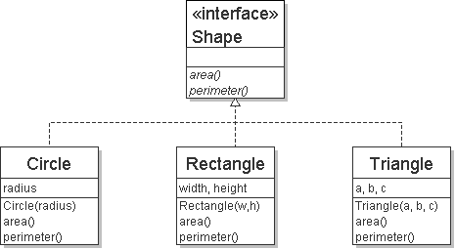
Interface syntax
  public interface name {
  public type name(type name, ..., type name);
  public type name(type name, ..., type name);
  ...
  public type name(type name, ..., type name);
  }
  Example:
  public interface Shape {
  public double area();
  public double perimeter();
  }

Slide 14
Implementing an interface
  public class name implements interface {
  ...
  Example:
  public class Rectangle implements Shape {
  ...
  public double area() { ... }
  public double perimeter() { ... }
  }
A class can declare that it "implements" an interface.
  The class promises to implement each method in that interface.
    (Otherwise it will fail to compile.)

Slide 15
Collections as fields
Many objects must store a collection of structured data.
  Many data structures to choose from:
    array, list, set, map, stack, queue, ...
  Most kinds of collections have multiple implementations:
    List: ArrayList, LinkedList
    Set: HashSet, TreeSet, LinkedHashSet
    Map: HashMap, TreeMap, LinkedHashMap
  Which structure is best to use depends on the situation:
    Does the data need to be in a particular order?
    Are duplicates allowed?
    Do we need to store pairs or look things up by partial values ("keys")?
    How will we access the data (randomly, in order, etc.)?
    ...

Slide 16
Collections summary
collection | ordering | benefits | weaknesses
array | by index | fast; simple | little functionality; cannot resize
ArrayList | by insertion, by index | random access; fast to modify at end | slow to modify in middle/front
LinkedList | by insertion, by index | fast to modify at both ends | poor random access
TreeSet | sorted order | sorted; O(log N) | elements must be comparable
HashSet | unpredictable | very fast; O(1) | unordered
LinkedHashSet | order of insertion | very fast; O(1) | uses extra memory
TreeMap | sorted order | sorted; O(log N) | elements must be comparable
HashMap | unpredictable | very fast; O(1) | unordered
LinkedHashMap | order of insertion | very fast; O(1) | uses extra memory

Slide 17
Effective Java Tip #25
Tip #25: Prefer lists to arrays.
In the majority of cases where you want to store structured data, a list works much better than an array. Why?
  Lists automatically resize.
  Lists contain more useful operations such as insertion, removal, toString, and searching (indexOf / contains).
  Lists are more type-safe than arrays in certain cases.
    Works: BankAccount[] a = new CheckingAccount[10]; // bad
    Fails: List<BankAccount> l = new ArrayList<CheckingAccount>();

Slide 18
Abstract data types (ADTs)
abstract data type (ADT): A specification of a collection of data and the operations that can be performed on it.
  The external view of a given type of objects.
  Describes what an object does, not how it does it.
  When you write classes, you are creating new ADTs.
Clients of the object don't know exactly how its behavior is implemented, and they don't need to.
  They just need to understand the idea of what the object represents and what operations it can perform.

Slide 19
Effective Java Tip #52
Tip #52: Item 52: Refer to objects by their interfaces.
  Bad: ArrayList<String> list = new ArrayList<String>();
  Good: List<String> list = new ArrayList<String>();
Why?
  allows you to switch list implementations later if needed
  keeps you from relying on behavior exclusive to ArrayList
  also use the above style for declaring parameter / return types!
  public static List<String> read(String file) {...

Slide 20
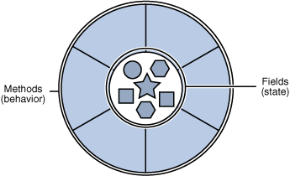
From spec to code
As developers, we are often given
a spec and asked to implement it.
The spec may tell us what classes
and public methods to write.
(Later in this course, it won't...!)
  Either way, it does not describe
  in detail how to implement them.
We must figure out what internal state (fields) and helping
behavior (methods) are necessary to implement the spec.

Slide 21
Spec-to-code question
Let's implement a class BuddyList whose objects store all information about a user's instant messenger buddy list.
Required functionality:
  create a new empty buddy list for a given user name
  add new buddies to the list (an object of type Buddy)
  examine the buddies in the list, in unspecified order
  search for a buddy in the list by name
  broadcast a message to all of the buddies in the list
    Note: All methods should be as efficient as possible.
How should the class be implemented?
  What are its methods and fields? What data structures to use?

Slide 22
Effective Java Tip #16
Tip #16: Favor composition over inheritance.
A BuddyList is similar to one of the existing Java collections, but with a bit of added functionality. So why not extend HashMap, etc.?
  When you extend a class, your subclass inherits all of its behavior.
  We don't want our buddy list to have all of those various methods.
    BuddyList would now have methods like clear, retainAll, keySet, ...
    This might expose the internal buddies data in ways we don't want.
  This isn't a true "is-a" relationship. A buddy list isn't a map; it uses a map to help implement its functionality. It "has-a" map.
    composition: Using another object as part of your state.

