Slide 1
CSE 331
Exceptions and Error-Handling
slides created by Marty Stepp
based on materials by M. Ernst, S. Reges, D. Notkin, R. Mercer, Wikipedia
http://www.cs.washington.edu/331/

Slide 2

Exceptions
exception: An object representing an error.
  Other languages don't have this concept;
  they represent errors by returning error codes
  (null, -1, false, etc.).
    Are exceptions better? What are their benefits?
throw: To cause an exception to occur.
  What are some actions that commonly throw exceptions?
catch: To handle an exception.
  If an exception is thrown and no code catches it, the program's execution will stop and an error trace will be printed.
  If the exception is caught, the program can continue running.

Slide 3
Code that throws exceptions
dividing by zero:
  int x = 0;
  System.out.println(1 / x); // ArithmeticException
trying to dereference a null variable:
  Point p = null;
  p.translate(2, -3); // NullPointerException
trying to interpret input in the wrong way:
  // NumberFormatException
  int err = Integer.parseInt("hi");
reading a non-existent file:
  // FileNotFoundException
  Scanner in = new Scanner(new File("notHere.txt"));

Slide 4
Exception avoidance
In many cases, the best plan is to try to avoid exceptions.
  // better to check first than try/catch without check
  int x;
  ...
  if (x != 0) {
  System.out.println(1 / x);
  }
  File file = new File("notHere.txt");
  if (file.exists()) {
  Scanner in = new Scanner(file);
  }
  // can we avoid this one?
  int err = Integer.parseInt(str);

Slide 5
Catching an exception
  try {
  statement(s);
  } catch (type name) {
  code to handle the exception
  }
  The try code executes. If the given exception occurs, the try block stops running; it jumps to the catch block and runs that.
  try {
  Scanner in = new Scanner(new File(filename));
  System.out.println(input.nextLine());
  } catch (FileNotFoundException e) {
  System.out.println("File was not found.");
  }

Slide 6
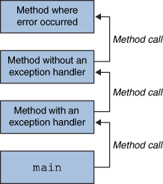
Throwing and catching
At any time, your program has an active call stack of methods.
When an exception is thrown, the
JVM looks up the call stack until
it finds a method with a
matching catch block for it.
  If one is found, control jumps
  back to that method.
  If none is found, the program crashes.
Exceptions allow non-local error handling.
  A method many levels up the stack can handle a deep error.

Slide 7
Catch, and then what?
  public void process(String str) {
  int n;
  try {
  n = Integer.parseInt(str);
  } catch (NumberFormatException nfe) {
  System.out.println("Invalid number: " + str);
  }
  ...
Possible ways to handle an exception:
  retry the operation that failed
  re-prompt the user for new input
  print a nice error message
  quit the program
  do nothing (!) (why? when?)

Slide 8
Exception methods
All exception objects have these methods:
  try {
  readFile();
  } catch (IOException e) {
  System.out.println("I/O error: " + e.getMessage());
  }
Method | Description
public String getMessage() | text describing the error
public String toString() | exception's type and description
getCause(), getStackTrace(), printStackTrace() | other methods

Slide 9
Design and exceptions
Effective Java Tip #57:
Use exceptions only for exceptional conditions.
  The author of the Integer.parseInt method got this wrong.
  Strings that are not legal as ints are common (not "exceptional").
    (What should they have done instead?)
  // Can we avoid this one? Not really. :-(
  int n;
  try {
  n = Integer.parseInt(str);
  } catch (NumberFormatException nfe) {
  n = -1;
  }

Slide 10

Ignoring exceptions
Effective Java Tip #65: Don't ignore exceptions.
  An empty catch block is (a common) poor style.
    often done to get code to compile or hide an error
  try {
  readFile(filename);
  } catch (IOException e) {} // do nothing on error
  At a minimum, print out the exception so you know it happened.
  } catch (IOException e) {
  e.printStackTrace(); // just in case
  }

Slide 11
Catch multiple exceptions
  try {
  statement(s);
  } catch (type1 name) {
  code to handle the exception
  } catch (type2 name) {
  code to handle the exception
  ...
  } catch (typeN name) {
  code to handle the exception
  }
  You can catch more than one kind of exception in the same code.
  When an exception is thrown, the matching catch block (if any) is used.
  If multiple catch blocks match, the most specific match is chosen.

Slide 12
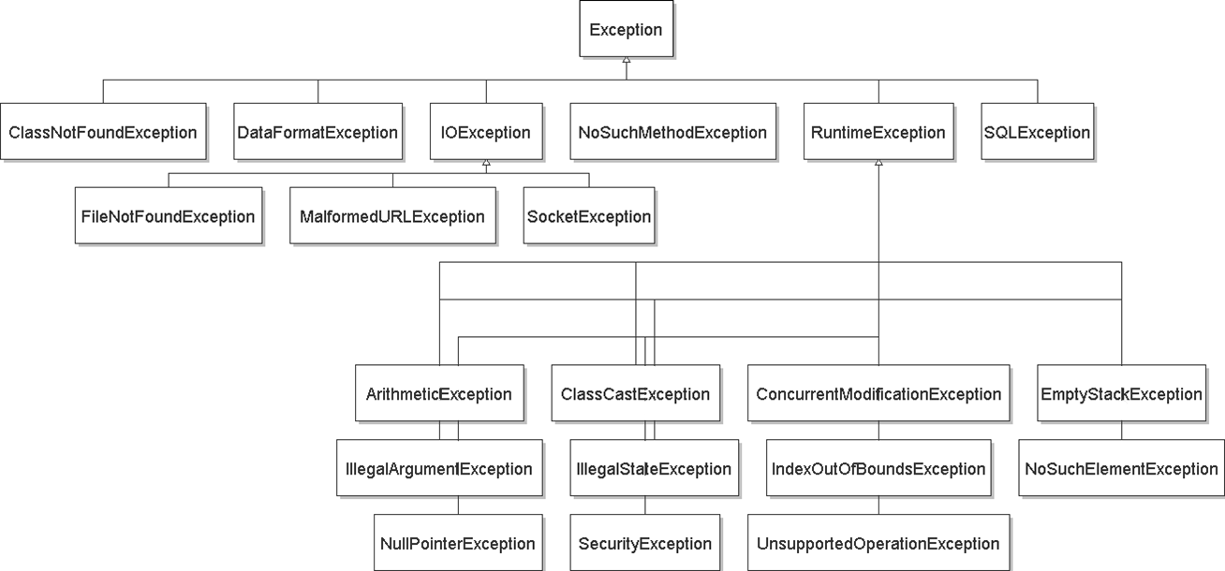
Exception inheritance
All exceptions extend from a common superclass Exception

Slide 13
Some common exceptions
ArithmeticException
BufferOverflowException
ClassCastException
ClassNotFoundException
CloneNotSupportedException
ConcurrentModificationException
EmptyStackException
IllegalArgumentException
IllegalStateException
IndexOutOfBoundsException
InterruptedException
IOException
  EOFException, FileNotFoundException, InterruptedIOException, MalformedURLException, ...
  ... NotSerializableException, SocketException, SSLException, UnknownHostException, ZipException
JarException
MalformedURLException
NegativeArraySizeException
NoSuchElementException
NullPointerException
ProtocolException
RuntimeException
SecurityException
UnknownElementException
UnsupportedOperationException
see also:
http://mindprod.com/jgloss/exception.html

Slide 14
Inheritance and exceptions
You can catch a general exception to handle any subclass:
  try {
  Scanner input = new Scanner(new File("foo"));
  System.out.println(input.nextLine());
  } catch (Exception e) {
  System.out.println("File was not found.");
  }
Similarly, you can state that a method throws any exception:
  public void foo() throws Exception { ...
  Are there any disadvantages of doing so?

Slide 15
Catching with inheritance
  try {
  statement(s);
  } catch (FileNotFoundException fnfe) {
  code to handle the file not found exception
  } catch (IOException ioe) {
  code to handle any other I/O exception
  } catch (Exception e) {
  code to handle any other exception
  }
  a SocketException would match the second block
  an ArithmeticException would match the third block

Slide 16
Who should catch it?
The code that is able to handle the error properly should be the code that catches the exception.
  Sometimes this is not the top method on the stack.
Example:
  main → showGUI() → click() → readFile() → FileNotFoundException!
    Which method should handle the exception, and why?
  main → new PokerGame() → new Player() → loadHistory() → Integer.parseInt() -> NumberFormatException
    Which method should handle the exception, and why?

Slide 17
Throwing an exception
throw new ExceptionType("message");
It is common practice to throw exceptions on unexpected errors.
  public void deposit(double amount) {
  if (amount < 0.0) {
  throw new IllegalArgumentException();
  }
  balance += amount;
  }
  Why throw rather than just ignoring the negative value?
    Why not return a special error code, such as -1 or false?

Slide 18
Good throwing style
An exception can accept a String parameter for a message describing what went wrong.
  This is the string returned by getMessage in a catch block.
  public void deposit(double amount) {
  if (amount < 0.0) {
  throw new IllegalArgumentException(
  "negative deposit: " + amount);
  }
  balance += amount;
  }
EJ Tip #63: Include failure-capture information in detail messages.
  Tell the caller what went wrong, to help them fix the problem.

Slide 19
Commenting exceptions
If your method throws, always explain this in the comments.
  State the types of exceptions thrown and under what conditions.
  // Places the given amount of money into this account.
  // Throws an IllegalArgumentException on negative deposits.
  public void deposit(double amount) {
  if (amount < 0.0) {
  throw new IllegalArgumentException(
  "negative deposit: " + amount);
  }
  balance += amount;
  }
EJ Tip #62: Document all exceptions thrown by each method.
  The client must know this in order to avoid or catch the exceptions.

Slide 20
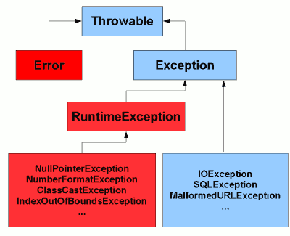
Checked exceptions
Java has two major kinds of exceptions:
  checked exceptions: Ones that MUST be handled by a try/catch block (or throws clause) or else the program will not compile.
    Meant for serious problems that the caller ought to deal with.
    Subclasses of Exception in the inheritance tree.
  runtime exceptions: Ones that don't have to be
  handled; if not handled, the program halts.
    Meant for smaller errors or programmer errors.
    Subclasses of RuntimeException in the tree.
    Mistakes that could have been avoided by a test.
      check for null or 0, check if a file exists, check array's bounds, ...

Slide 21
The throws clause
  public type name(parameters) throws type {
A clause in a method header claiming it may cause an exception.
  Needed when a method may throw an uncaught checked exception.
  public void processFile(String filename)
  throws FileNotFoundException {
  The above means one of two possibilities:
    processFile itself might throw an exception.
    processFile might call some sub-method that throws an exception, and it is choosing not to catch it (rather, to re-throw it out to the caller).

Slide 22
Writing an exception class
EJ Tip #61: Throw exceptions appropriate to the abstraction.
  When no provided exception class is quite right for your app's kind of error, you should write your own Exception subclass.
  // Thrown when the user tries to play after the game is over.
  public class GameOverException extends RuntimeException {
  private String winner;
  public GameOverException(String message, String winner) {
  super(message);
  this.winner = winner;
  }
  public String getWinner() {
  return winner;
  }
  }
  // in Game class...
  if (!inProgress()) {
  throw new GameOverException("Game already ended", winner);

Slide 23
Checked exceptions suck!
EJ Tip #59: Avoid unnecessary use of checked exceptions.
  Checked exceptions are (arguably) a wart in the Java language.
  It should be the client's decision whether or not to catch exceptions.
  When writing your own exception classes, extend RuntimeException so that it doesn't need to be caught unless the client wants to do so.
    Some cases still require throwing checked exceptions (e.g. file I/O)
  public void play() throws Exception { // no
  public void play() throws RuntimeException { // better
  public void play() throws MP3Exception { // best
  public class MP3Exception extends RuntimeException { ... }

Slide 24
Problem: redundant code
  public void process(OutputStream out) {
  try {
  // read from out; might throw
  ...
  out.close();
  } catch (IOException e) {
  out.close();
  System.out.println("Caught IOException: "
  + e.getMessage());
  }
  }
  The close code appears redundantly in both places.
  Can't move it out below the try/catch block because close itself could throw an IOException.

Slide 25
The finally block
  try {
  statement(s);
  } catch (type name) {
  code to handle the exception
  } finally {
  code to run after the try or catch finishes
  }
  finally is often used for common "clean-up" code.
  try {
  // ... read from out; might throw
  } catch (IOException e) {
  System.out.println("Caught IOException: "
  + e.getMessage());
  } finally {
  out.close();
  }
    The catch block is optional; try/finally is also legal.

Slide 26
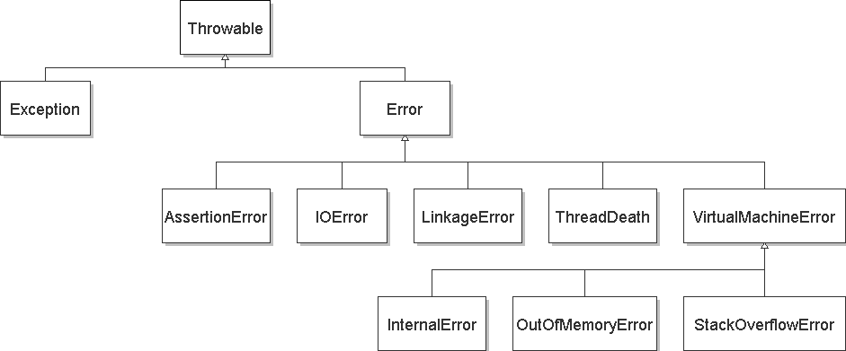
Exceptions and errors
There are also Errors, which represent serious Java problems.
  Error and Exception have common superclass Throwable.
  You can catch an Error (but you probably shouldn't)

Slide 27
Common errors
AbstractMethodError
AWTError
ClassFormatError
ExceptionInInitializerError
IllegalAccessError
InstantiationError
InternalError
LinkageError
NoClassDefFoundError
NoSuchFieldError
NoSuchMethodError
OutOfMemoryError
ServerError
StackOverflowError
UnknownError
UnsatisfiedLinkError
UnsupportedClassVersionError
VerifyError
VirtualMachineError

