Slide 1
CSE 331
Lecture XX
Unit Testing and Debugging
slides created by Marty Stepp
based on materials by M. Ernst, S. Reges, D. Notkin, R. Mercer
http://www.cs.washington.edu/331/

Slide 2
CSE 143
Lecture 5
More ArrayIntList:
Pre/postconditions; exceptions;
testing and JUnit
reading: 15.2 - 15.3
slides created by Marty Stepp
http://www.cs.washington.edu/143/

Slide 3
Preconditions
precondition: Something your method assumes is true
at the start of its execution.
  Often documented as a comment on the method's header:
  // Returns the element at the given index.
  // Precondition: 0 <= index < size
  public void remove(int index) {
  return elementData[index];
  }
  Stating a precondition doesn't "solve" the problem, but it at least documents our decision and warns the client what not to do.
  What should we do if the client violates the precondition?
Notes:
returning -1 is no better than returning 0 (could be a legal value)
println is not a very strong deterrent to the client (esp. GUI)

Slide 4
Throwing exceptions (4.5)
throw new ExceptionType();
throw new ExceptionType("message");
Causes the program to immediately crash with an exception.
Common exception types:
  ArithmeticException, ArrayIndexOutOfBoundsException, FileNotFoundException, IllegalArgumentException, IllegalStateException, IOException, NoSuchElementException, NullPointerException, RuntimeException, UnsupportedOperationException
Why would anyone ever want a program to crash?

Slide 5
Exception example
  public void get(int index) {
  if (index < 0 || index >= size) {
  throw new ArrayIndexOutOfBoundsException(index);
  }
  return elementData[index];
  }
  Exercise: Modify the rest of ArrayIntList to state preconditions and throw exceptions as appropriate.

Slide 6
Private helper methods
private type name(type name, ..., type name) {
statement(s);
}
a private method can be seen/called only by its own class
  your object can call the method on itself, but clients cannot call it
  useful for "helper" methods that clients shouldn't directly touch
private void checkIndex(int index, int min, int max) {
if (index < min || index > max) {
throw new IndexOutOfBoundsException(index);
}
}

Slide 7
Postconditions
postcondition: Something your method promises will be true
at the end of its execution.
  Often documented as a comment on the method's header:
  // Makes sure that this list's internal array is large
  // enough to store the given number of elements.
  // Postcondition: elementData.length >= capacity
  public void ensureCapacity(int capacity) {
  // double in size until large enough
  while (capacity > elementData.length) {
  elementData = Arrays.copyOf(elementData,
  2 * elementData.length);
  }
  }
  If your method states a postcondition, clients should be able to rely on that statement being true after they call the method.

Slide 8
Thinking about testing
If we wrote ArrayIntList and want to give it to others, we must make sure it works adequately well first.
Some programs are written specifically to test other programs.
We could write a client program to test our list.
  Its main method could construct several lists, add elements to them, call the various other methods, etc.
  We could run it and look at the output to see if it is correct.
  But that is tedious and error-prone; there is a better way.

Slide 9
Testing with JUnit
(in brief)

Slide 10
Unit testing
unit testing: Looking for errors in a subsystem in isolation.
  generally a "subsystem" means a particular class or object
  the Java library JUnit helps us to easily perform unit testing
the basic idea:
  For a given class Foo, create another class FooTest to test it that contains "test case" methods to run.
  Each method looks for particular results and passes / fails.
JUnit provides "assert" commands to help us write tests.

Slide 11
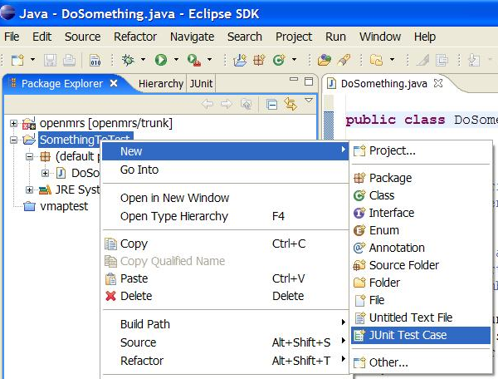
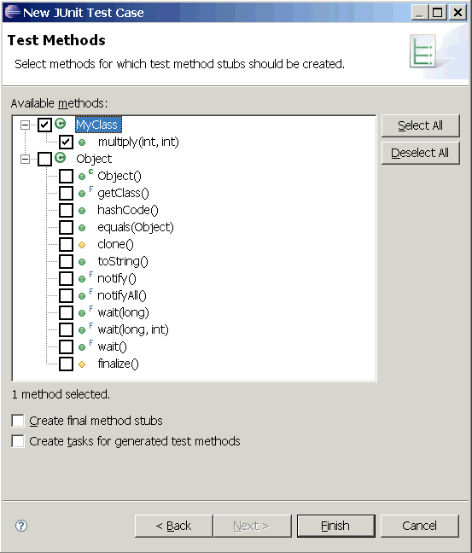
JUnit and Eclipse
To add JUnit to an Eclipse project, click:
  Project → Properties → Build Path → Libraries →
  Add Library... → JUnit → JUnit 4 → Finish
  (see web site for jGRASP instructions)
To create a test case:
  right-click a file and
  choose New Test
  or click File → New →
  JUnit Test Case
  Eclipse can create stubs
  of method tests for you.

Slide 12
A JUnit test class
  import org.junit.*;
  import static org.junit.Assert.*;
  public class name {
  ...
  @Test
  public void name() { // a test case method
  ...
  }
  }
  A method with @Test is flagged as a JUnit test case
    all @Test methods run when JUnit runs your test class

Slide 13
JUnit assertion methods
  The idea: Put assertion calls in your @Test methods to check things you expect to be true. If they aren't, the test will fail.
    Why is there no pass method?
  Each method can also be passed a string to show if it fails:
    e.g. assertEquals("message", expected, actual)
assertTrue(test) | fails if the boolean test is false
assertFalse(test) | fails if the boolean test is true
assertEquals(expected, actual) | fails if the values are not the same
fail() | immediately causes current test to fail
other assertion methods: assertNull, assertNotNull, assertSame, assertNotSame, assertArrayEquals

Slide 14
ArrayIntList JUnit test
  import org.junit.*;
  import static org.junit.Assert.*;
  public class TestArrayIntList {
  @Test
  public void testAddGet1() {
  ArrayIntList list = new ArrayIntList();
  list.add(42);
  list.add(-3);
  list.add(15);
  assertEquals(42, list.get(0));
  assertEquals(-3, list.get(1));
  assertEquals(15, list.get(2));
  }
  @Test
  public void testIsEmpty() {
  ArrayIntList list = new ArrayIntList();
  assertTrue(list.isEmpty());
  list.add(123);
  assertFalse(list.isEmpty());
  }
  ...
  }

Slide 15
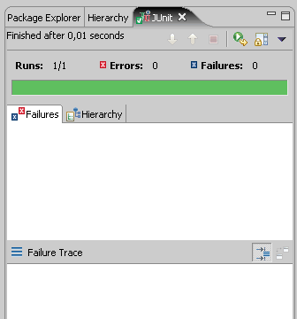
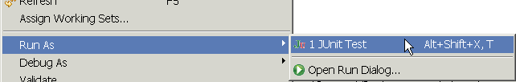
Running a test
Right click it in the Eclipse Package Explorer at left; choose:
  Run As → JUnit Test
the JUnit bar will show green if all tests pass, red if any fail
the Failure Trace shows which tests
failed, if any, and why

Slide 16
Testing for exceptions
  @Test(expected = ExceptionType.class)
  public void name() {
  ...
  }
  will pass if it does throw the given exception, and fail if not
    use this to test for expected errors
  @Test(expected = ArrayIndexOutOfBoundsException.class)
  public void testBadIndex() {
  ArrayIntList list = new ArrayIntList();
  list.get(4); // should fail
  }

Slide 17
Tests with a timeout
  @Test(timeout = 5000)
  public void name() { ... }
  The above method will be considered a failure if it doesn't finish running within 5000 ms
  private static final int TIMEOUT = 2000;
  ...
  @Test(timeout = TIMEOUT)
  public void name() { ... }
  Times out / fails after 2000 ms

Slide 18
Tips for testing
You cannot test every possible input, parameter value, etc.
  So you must think of a limited set of tests likely to expose bugs.
Think about boundary cases
  positive; zero; negative numbers
  right at the edge of an array or collection's size
Think about empty cases and error cases
  0, -1, null; an empty list or array
test behavior in combination
  maybe add usually works, but fails after you call remove
  make multiple calls; maybe size fails the second time only

Slide 19
CSE 403
Lecture 16
Testing; Unit Testing
Reading:
various and sundry unit testing tutorials;
Code Complete, Ch. 22: Developer Testing (McConnell)
Object-Oriented Software Engineering, Ch. 9 (B. Bruegge, A. Dutoit)
slides created by Marty Stepp
http://www.cs.washington.edu/403/

Slide 20
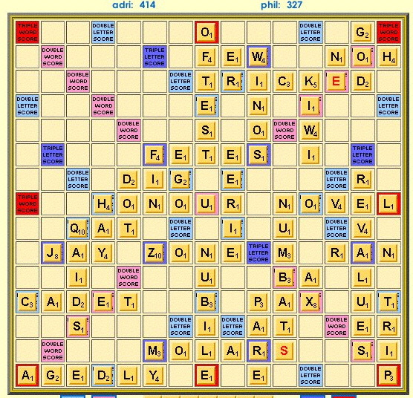
Example: Scrabble moves
Think about code to validate Scrabble board moves:
  Where can we
  start a move?
  Where can tiles
  be in relation to
  the starting tile?
  How do we compute
  scores for a move?
  How do we do
  word challenges?

Slide 21
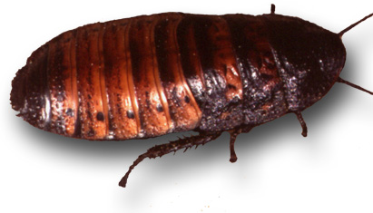
Bugs and testing
software reliability: Probability that a software system will not cause failure under specified conditions.
  measured by uptime, MTTF (mean time till failure), crash data
bugs are inevitable in any complex software system
  industry estimates: 10-50 bugs per 1000 lines of code
  a bug can be visible or can hide in your code until much later
testing: A systematic attempt to reveal errors.
  failed test: an error was demonstrated
  passed test: no error was found (for this particular situation)

Slide 22
Difficulties of testing
perception by some developers and managers
  testing is seen as a novice's job
  assigned to the least experienced team members
  done as an afterthought (if at all)
limitations of what testing can show you
  it is impossible to completely test a system
  testing does not always directly reveal the actual bugs in the code
  testing does not show absence of errors in software

Slide 23

Faults and errors
error: incorrect software behavior
  example: Message box said, "Welcome, null!"
fault: mechanical or algorithmic cause of error (bug)
  example: Account name field is not set properly.
  Requirements specify desired behavior;
  if the system deviates from that, it has a fault.

Slide 24
Quality control techniques
fault avoidance: Prevent errors before system is released.
  reviews, inspections, walkthroughs,
  development methodologies, configuration management
fault tolerance: When system can recover by itself.
  rollbacks, redundancy, mirroring
fault detection: Find faults without recovering from them.
  debugging, testing

Slide 25
Some kinds of testing
unit testing: Looks for errors in subsystems in isolation.
integration testing: find errors when connecting subsystems
  bottom-up: integrate upward into double, triple, quadruple test
  top-down: test UI first, then add layers to replace stubs
  stub/mock: an incomplete object/subsystem in masquerade
system testing: test entire system behavior as a whole, with respect to scenarios and requirements
  functional testing: test whether system meets requirements
  performance, load, stress testing
  acceptance, usability, installation, beta testing

Slide 26
Unit testing
unit testing: Looks for errors in subsystems in isolation.
  generally a "subsystem" means a class or object
benefits:
  1. reduces number of things to test
  2. easier to find faults when errors occur
  3. can test many components in parallel
In principle, test all objects.
  Because of time, test important ones involved in use cases.

Slide 27
When to write/run tests
Unit tests can be written before (!), during, or after code.
Unit tests can be run immediately after writing them, and again later in the software process.
regression testing: Re-executing prior tests after a change.
  often done by scripts, automated testing
  used to ensure that old fixed bugs are still fixed
    a new feature/fix can cause a new bug or reintroduce an old bug
  especially important in evolving systems
many products have a set of mandatory check-in tests that must pass before code can be added to repository

Slide 28
JUnit and Eclipse
Adding JUnit to an Eclipse project:
  click Project → Properties → Add External JARs... →
  eclipse folder / plugins / org.junit_x.x.x / junit.jar
Create a test case
  click File → New →
  JUnit Test Case
  or right-click a file and
  choose New Test
  Eclipse can create stubs
  of method tests for you

Slide 29
A JUnit test class
  import org.junit.*;
  import static org.junit.Assert.*;
  public class name {
  ...
  @Test
  public void name() {
  ...
  }
  }
  Methods with a @Test annotation are flagged as JUnit test cases; they run when JUnit runs your test class

Slide 30
JUnit assertion methods
assertTrue (message, test) (italic = optional )
assertFalse (message, test)
assertEquals (message, expected, actual)
assertNotEquals (message, expected, actual)
assertSame (message, expected, actual)
assertNotSame (message, expected, actual)
  compares with ==
assertNull (message, obj)
assertNotNull (message, obj)
fail (message )
  causes the test to immediately fail (why no pass method?)

Slide 31
Running a test
Right click its file in the Package Explorer, choose:
  Run As → JUnit Test
JUnit bar will show green if all tests pass, red if any fail
Failure Trace shows which tests
failed, if any, and why

Slide 32
Hamcrest assertions
assertThat(message, matcher)
  Tests using various matcher functions. These include:
  anything(), describedAs(), is(), allOf(), anyOf()
  not(), equalTo(), equalToIgnoringCase(), equalToIgnoringWhiteSpace(), sameInstance(), containsString(), endsWith(), startsWith()
  hasToString(), hasProperty()
  instanceOf(), isCompatibleType()
  nullValue(), notNullValue()
  array(), hasItemInArray()
  hasEntry(), hasKey(), hasValue(), hasItem(), hasItems()
  closeTo(), greaterThan(), greaterThanOrEqualTo(), lessThan(), lessThanOrEqualTo()
  @Test public void testStudentName() {
  assertThat(s.getName(), is(anyOf("Marty", "V", K")));
  }

Slide 33
Tests with a timeout
  @Test(timeout = 5000)
  public void name() { ... }
  The above method will be considered a failure if it doesn't finish running within 5000 ms
  private static final int TIMEOUT = 2000;
  ...
  @Test(timeout = TIMEOUT)
  public void name() { ... }
  Times out / fails after 2000 ms

Slide 34
Testing for exceptions
  @Test(expected = IllegalArgumentException.class)
  public void name() {
  ...
  }
  The above method will pass if it does throw the given exception,
  and fail if it doesn't
    use this to test for expected errors

Slide 35
Setup and teardown
  @Before
  public void name() { ... }
  @After
  public void name() { ... }
  methods to run before/after each test case method is called
  @BeforeClass
  public static void name() { ... }
  @AfterClass
  public static void name() { ... }
  methods to run once before/after the entire test class runs

Slide 36
Testing questions
Which code of my project should I test the most/least?
How do I know if I've tested well/enough?
Can I test all possible inputs to see whether something works?
What constitutes a good or bad test case method?
Is it good or bad if a test case fails?
What if the test case itself has a bug in it?

Slide 37
JUnit exercise
Given a Date class with the following methods:
  public Date(int year, int month, int day)
  public Date() // today
  public int getDay(), getMonth(), getYear()
  public void addDays(int days) // advances by days
  public int daysInMonth()
  public String dayOfWeek() // e.g. "Sunday"
  public boolean equals(Object o)
  public boolean isLeapYear()
  public void nextDay() // advances by 1 day
  public String toString()
Come up with unit tests to check the following:
  That no Date object can ever get into an invalid state.
  That the addDays method works properly.
    It should be efficient enough to add 1,000,000 days in a call.
Notes:
a good equals method has some initial checks like checking for null, checking whether this == that, check instanceof, etc... then it calls compareTo

Slide 38
Test-driven development
Imagine that we'd like to add a method subtractWeeks to our Date class, that shifts this Date backward in time by the given number of weeks.
Write code to test this method before it has been written.
  This way, once we do implement the method, we'll know whether it works.

Slide 39
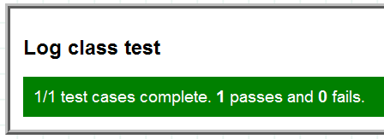
PHP SimpleTest
Integrated with CakePHP framework
  outputs nicely formatted HTML (or text) when you run it
  assertTrue($x)
  assertFalse($x)
  assertNull($x)
  assertNotNull($x)
  assertIsA($x, $t)
  assertEqual($x, $y)
  assertNotEqual($x, $y)
  assertIdentical($x, $y)
  assertNotIdentical($x, $y)
  assertReference($x, $y)
  assertCopy($x, $y)
  assertNoErrors()
  assertError($x)

Slide 40
PHP SimpleTest example
<?php
require_once("simpletest/unit_tester.php");
require_once("simpletest/reporter.php");
# Tests the Grade-It Student class.
class TestStudent extends UnitTestCase {
...
# This student should get all pre-grade points.
function testGrade1() {
$student = new Student("tests/fakestudent6a", TRUE);
$student->readGrade();
$this->assertEqual(11, $student->score);
$this->assertEqual(4, $student->correct);
}
...
}
...
# add and run a group of test files
$suite = &new GroupTest("All Grade-It Tests");
$suite->addTestCase(new TestStudent());
$suite->run(new HtmlReporter());
?>

Slide 41
Ruby's Test::Unit
  require 'test/unit'
  class name < Test::Unit::TestCase
  def setup
  ...
  end
  def teardown
  ...
  end
  def name # a test case
  ...
  assert(condition, message )
  end
  end

Slide 42
Ruby assertions
assert(boolean, [msg]) - ensures the object/expression is true
assert_equal(obj1, obj2, [msg]) - ensures obj1 obj2 is true
assert_not_equal(obj1, obj2, [msg]) - ensures obj1 obj2 is false
assert_same(obj1, obj2, [msg]) - ensures obj1.equal?(obj2) is true
assert_not_same(obj1, obj2, [msg]) - ensures obj1.equal?(obj2) is false
assert_nil(obj, [msg]) - ensures obj.nil? is true
assert_not_nil(obj, [msg]) - ensures obj.nil? is false
assert_match(regexp, string, [msg]) - ensures a string matches the regular expression
assert_no_match(regexp, string, [msg]) - ensures string doesn't match regex
assert_in_delta(expecting, actual, delta, [msg]) - ensures numbers are within delta
assert_throws(symbol, [msg]) { block } - ensures a block throws the symbol
assert_raises(exceptions) { block } - ensures block raises an exception
assert_nothing_raised(exceptions) { block } - a block doesn’t raise the exceptions
assert_instance_of(class, obj, [msg]) - ensures obj is the class type
assert_kind_of(class, obj, [msg]) - ensures obj is or descends from class
assert_respond_to(obj, symbol, [msg]) - ensures obj has a method called symbol
assert_operator(obj1, operator, obj2, [msg]) - ensures obj1.operator(obj2) is true
assert_send(array, [msg]) - ensures that executing method listed in array[1] on the
object in array[0] with parameters of array[2+] is true
flunk([msg]) - Forcibly fails this test

Slide 43
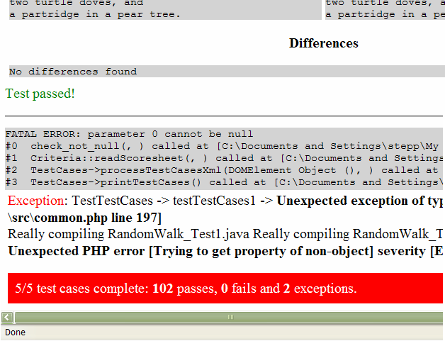
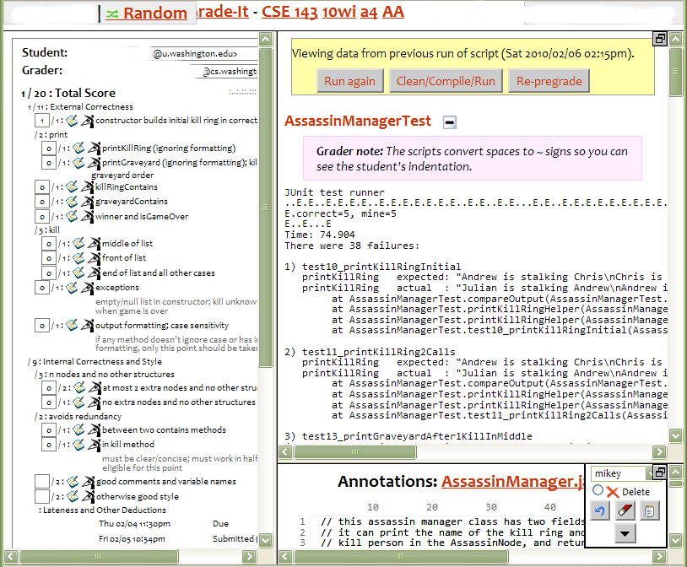
Unit tests in Grade-It
  grading scripts test student homework using JUnit test cases
  the web grading system tests itself using PHPunit/Simpletest

Slide 44
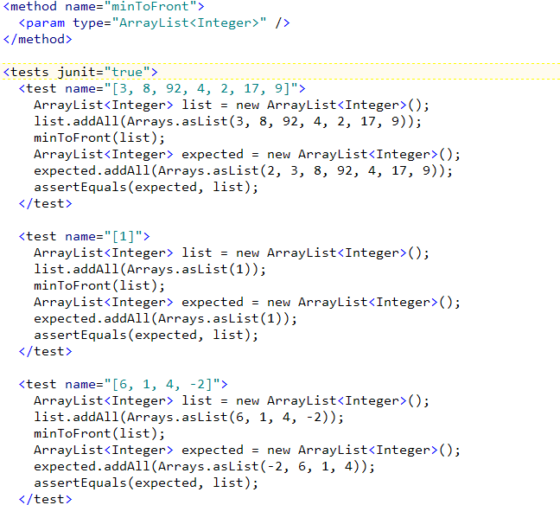
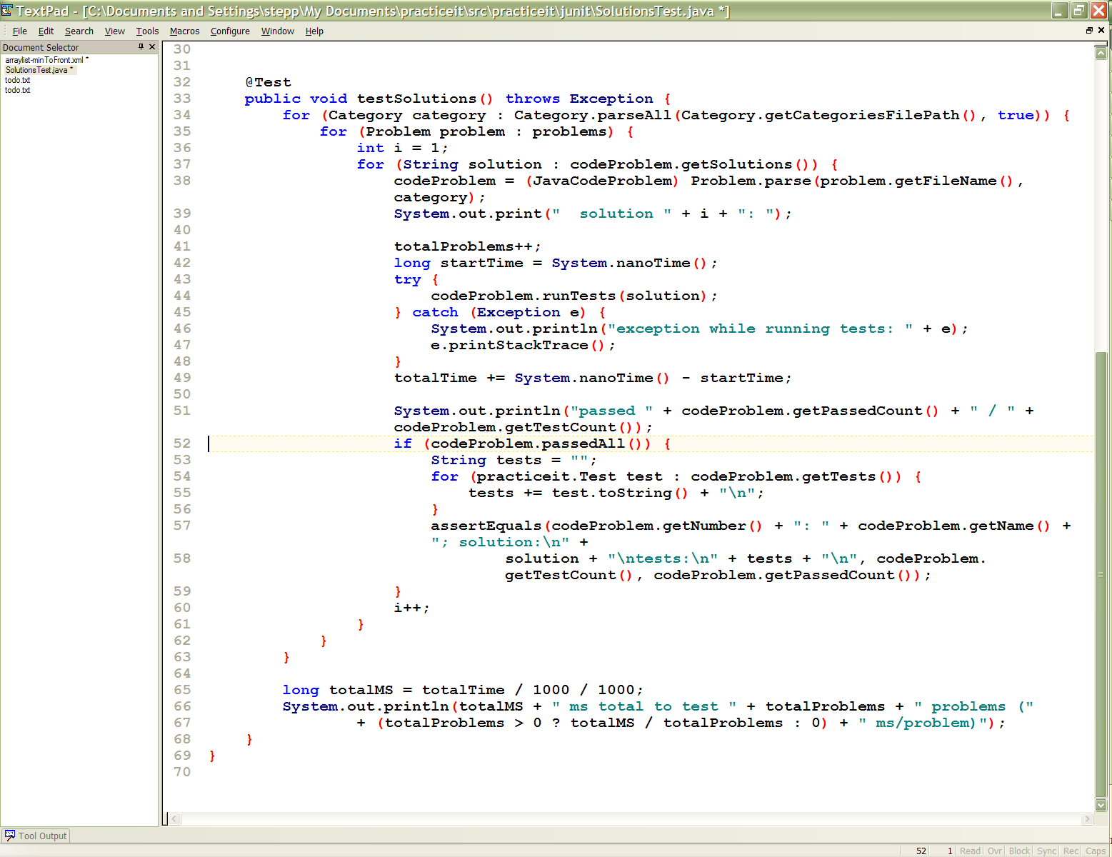
Unit tests in Practice-It
the system tests submitted student code using JUnit
the system (written in Java/JSP) also tests itself using JUnit

Slide 45
CSE 403
Lecture 18
Effective Unit Testing
Reading:
The Art of Unit Testing, Ch. 7 (Osherove)
slides created by Marty Stepp
http://www.cs.washington.edu/403/

Slide 46
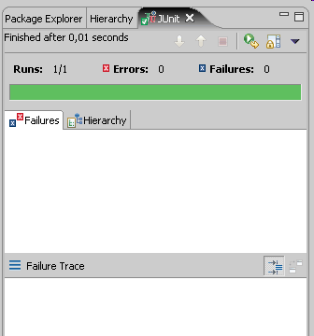

Qualities of good tests
test cases free of bugs
  a broken test isn't much help
readable test case code
easy to add/update tests
easy/fast to run
  unit tests are often run on
  each build or checkin, so fast = good

Slide 47
Bugs in tests
hard to find
  developers assume that tests are correct
manifest in odd ways
  sometimes test initially passes, then begins to fail much later
    code under test may have been altered in a subtle way
    test case may have relied on invalid assumptions
    API of code under test may have changed
often test wasn't written by developer
  bug assigned back and forth

Slide 48
What's wrong with this?
public class DateTest {
@Test
public void test1() {
Date d = new Date(2050, 2, 15);
d.addDays(4);
assertEquals(d.getYear(), 2050);
assertEquals(d.getMonth(), 2);
assertEquals(d.getDay(), 19);
}
@Test
public void test2() {
Date d = new Date(2050, 2, 15);
d.addDays(14);
assertEquals(d.getYear(), 2050);
assertEquals(d.getMonth(), 3);
assertEquals(d.getDay(), 1);
}
}

Slide 49
Well-structured assertions
public class DateTest {
@Test
public void test1() {
Date d = new Date(2050, 2, 15);
d.addDays(4);
assertEquals(2050, d.getYear()); // expected
assertEquals(2, d.getMonth()); // value should
assertEquals(19, d.getDay()); // be at LEFT
}
@Test
public void test2() {
Date d = new Date(2050, 2, 15);
d.addDays(14);
assertEquals("year after +14 days", 2050, d.getYear());
assertEquals("month after +14 days", 3, d.getMonth());
assertEquals("day after +14 days", 1, d.getDay());
} // test cases should usually have messages explaining
} // what is being checked, for better failure output

Slide 50
Expected answer objects
public class DateTest {
@Test
public void test1() {
Date d = new Date(2050, 2, 15);
d.addDays(4);
Date expected = new Date(2050, 2, 19);
assertEquals(expected, d); // use an expected answer
} // object to minimize tests
// (Date must have toString
@Test // and equals methods)
public void test2() {
Date d = new Date(2050, 2, 15);
d.addDays(14);
Date expected = new Date(2050, 3, 1);
assertEquals("date after +14 days", expected, d);
}
}

Slide 51
Pervasive timeouts
public class DateTest {
@Test(timeout = DEFAULT_TIMEOUT)
public void test1() {
Date d = new Date(2050, 2, 15);
d.addDays(4);
Date expected = new Date(2050, 2, 19);
assertEquals("date after +4 days", expected, d);
}
@Test(timeout = DEFAULT_TIMEOUT)
public void test2() {
Date d = new Date(2050, 2, 15);
d.addDays(14);
Date expected = new Date(2050, 3, 1);
assertEquals("date after +14 days", expected, d);
}
// almost every test should have a timeout so it can't
// lead to an infinite loop; good to set a default, too
private static final int DEFAULT_TIMEOUT = 2000;
}

Slide 52
Naming test cases
public class DateTest {
@Test(timeout = DEFAULT_TIMEOUT)
public void addDays_withinSameMonth_1() {
Date actual = new Date(2050, 2, 15);
actual.addDays(4);
Date expected = new Date(2050, 2, 19);
assertEquals("date after +4 days", expected, actual);
}
// give test case methods really long descriptive names
@Test(timeout = DEFAULT_TIMEOUT)
public void addDays_wrapToNextMonth_2() {
Date actual = new Date(2050, 2, 15);
actual.addDays(14);
Date expected = new Date(2050, 3, 1);
assertEquals("date after +14 days", expected, actual);
}
// give descriptive variable names to expected/actual values
private static final int DEFAULT_TIMEOUT = 2000;
}

Slide 53
Squashing redundancy
public class DateTest {
@Test(timeout = DEFAULT_TIMEOUT)
public void addDays_withinSameMonth_1() {
addHelper(2050, 2, 15, +4, 2050, 2, 19);
}
@Test(timeout = DEFAULT_TIMEOUT)
public void addDays_wrapToNextMonth_2() {
addHelper(2050, 2, 15, +14, 2050, 3, 1);
}
// use lots of helpers to make actual tests extremely short
private void addHelper(int y1, int m1, int d1, int add,
int y2, int m2, int d2) {
Date actual = new Date(y, m, d);
actual.addDays(add);
Date expect = new Date(y2, m2, d2);
assertEquals("after +" + add + " days", expect, actual);
}
// can also use "parameterized tests" in some frameworks
...

Slide 54
Flexible helpers
public class DateTest {
@Test(timeout = DEFAULT_TIMEOUT)
public void addDays_multipleCalls_wrapToNextMonth2x() {
Date d = addHelper(2050, 2, 15, +14, 2050, 3, 1);
addhelper(d, +32, 2050, 4, 2);
addhelper(d, +98, 2050, 7, 9);
}
// Helpers can box you in; hard to test many calls/combine.
// Create variations that allow better flexibility
private Date addHelper(int y1, int m1, int d1, int add,
int y2, int m2, int d2) {
Date date = new Date(y, m, d);
addHelper(date, add, y2, m2, d2);
return d;
}
private void addHelper(Date date, int add,
int y2, int m2, int d2) {
date.addDays(add);
Date expect = new Date(y2, m2, d2);
assertEquals("date after +" + add + " days", expect, d);
}
...

Slide 55
What's wrong with this?
public class DateTest {
@Test
public void test_addDays_addJustOneDay_1() {
Date actual = new Date(2050, 2, 15);
actual.addDays(1);
Date expected = new Date(2050, 2, 16);
assertEquals("after adding one day to 2050/2/15,\n" +
"should have gotten " + expected + "\n" +
" but instead got " + actual\n",
expected, actual);
}
...
}

Slide 56
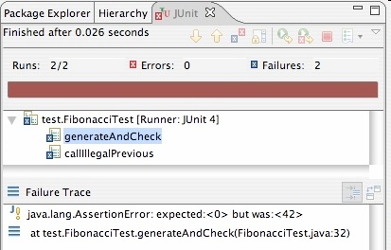
Good assertion messages
public class DateTest {
@Test
public void test_addDays_addJustOneDay_1() {
Date actual = new Date(2050, 2, 15);
actual.addDays(1);
Date expected = new Date(2050, 2, 16);
assertEquals("add one day to 2050/2/15",
expected, actual);
}
...
}
// JUnit will already show
// the expected and actual
// values in its output;
//
// don't need to repeat them
// in the assertion message

Slide 57
What's wrong with this?
public class DateTest {
// test every day of the year
@Test
public void tortureTest() {
Date date = new Date(2050, 1, 1);
int month = 1;
int day = 1;
for (int i = 1; i < 365; i++) {
date.addDays(1);
if (day < DAYS_PER_MONTH[month]) {day++;}
else {month++; day=1;}
assertEquals(new Date(2050, month, day), date);
}
}
private static final int[] DAYS_PER_MONTH = {
0, 31, 28, 31, 30, 31, 30, 31, 31, 30, 31, 30, 31
}; // Jan Feb Mar Apr May Jun Jul Aug Sep Oct Nov Dec
}

Slide 58
Trustworthy tests
Test one thing at a time per test method.
  10 small tests are much better than 1 test 10x as large.
Each test method should have few (likely 1) assert statements.
  If you assert many things, the first that fails stops the test.
  You won't know whether a later assertion would have failed.
Tests should avoid logic.
  minimize if/else, loops, switch, etc.
  avoid try/catch
    If it's supposed to throw, use expected=... if not, let JUnit catch it.
Torture tests are okay, but only in addition to simple tests.

Slide 59
What's wrong with this?
public class DateTest {
// shared Date object to test with (saves memory!!1)
private static Date DATE;
@Test(timeout = DEFAULT_TIMEOUT)
public void addDays_sameMonth() {
DATE = new Date(2050, 2, 15); // first test;
addhelper(DATE, +4, 2050, 2, 19); // DATE = 2/15 here
}
@Test(timeout = DEFAULT_TIMEOUT)
public void addDays_nextMonthWrap() { // second test;
addhelper(DATE, +10, 2050, 3, 1); // DATE = 2/19 here
}
@Test(timeout = DEFAULT_TIMEOUT)
public void addDays_multipleCalls() { // third test;
addDays_sameMonth(); // go back to 2/19;
addhelper(DATE, +1, 2050, 2, 20); // test two calls
addhelper(DATE, +1, 2050, 2, 21);
}
...
}

Slide 60

Isolation/order "smells"
Tests should be self-contained
and not care about each other.
"Smells" (bad things to avoid) in tests:
  Constrained test order : Test A must run before Test B.
  (usually a misguided attempt to test order/flow)
  Tests call each other : Test A calls Test B's method
  (calling a shared helper is OK, though)
  Mutable shared state : Tests A/B both use a shared object. If A breaks it, what happens to B?

Slide 61
Useful language features
Elegant tests use the expressive features of your language.
Java and many languages support variable numbers of params:
  public void depositAll(Account a, double... amounts) {
  for (double amount : amounts) {
  a.deposit(amount);
  }
  }
  ...
  Account a = new Account("Shirley", 10.00);
  a.depositAll(4.00, 5.67, 8.90);
  a.depositAll(100.50);

Slide 62
Tests and data structures
Need to pass lots of arrays? Use array literals
  public void exampleMethod(int[] values) { ... }
  ...
  exampleMethod(new int[] {1, 2, 3, 4});
  exampleMethod(new int[] {5, 6, 7});
Need a quick ArrayList? Try Arrays.asList
  List<Integer> list = Arrays.asList(7, 4, -2, 3, 9, 18);
Need a quick set, queue, etc.? Many collections can take a list
  Set<Integer> list = new HashSet<Integer>(
  Arrays.asList(7, 4, -2, 9));

Slide 63
More data structures
Need a quick Map or something else? Roll your own helper
  // pre-populates a map from given keys to given values
  public static <K, V> Map<K, V> asMap(List<K> keys,
  List<V> values) {
  Map<K, V> map = new HashMap<K, V>();
  for (int i = 0; i < keys.size(); i++) {
  map.put(keys.get(i), values.get(i));
  }
  return map;
  }
  ...
  Map<String, Integer> taAges = asMap(
  Arrays.asList("Marty", "Logan", "Kelly", "Marisa"),
  Arrays.asList(23, 14, 39, 25);
  );

Slide 64
TCSS 305, Autumn 2005
Unit 7:
Debugging, testing, and JUnit
Horstmann Ch. 11 pp. 611-618
These lecture notes are copyright (C) Marty Stepp and Stuart Reges, 2005. They may not be rehosted, sold, or modified without expressed permission from the authors. All rights reserved.

Slide 65
Bugs
it is very likely that our code will some bugs in it
  bugs are inevitable in any complex software system
  a bug can be very visible or can hide in your code until a much later date
debugging: The process of finding and removing causes of failures in software.
  debugger: A tool for tracing program execution to find bugs.
  (preferred over System.out.println statements)

Slide 66
Debugging in Eclipse
To show line numbers in Eclipse:
  Window -> Preferences -> General ->
  Editors -> Text Editors -> Show Line Numbers
To set Eclipse UI to 'Debug' mode:
  switch to the 'Debug' perspective
  Window -> Open Perspective -> Debug
While in Debug mode:
  any exception will halt the program
  you can examine the state of the program at the point of its crash
  you can set breakpoints and/or step through execution (see next slide)

Slide 67
Breakpoints
breakpoint: a line at which the execution of the program will halt
  useful so that you can examine variables, objects, and other data in mid-execution
  can step (execute each statement one at a time) to see when and how a program becomes incorrect
To set a breakpoint in Eclipse:
  double-click the gray margin left of the desired line
  (or right-click it and choose Toggle Breakpoint)

Slide 68
QA practices
debugging is only one part of the larger goal of assuring that our software meets quality standards
  quality assurance (QA): A planned and systematic pattern of all actions necessary to provide confidence that adequate technical requirements are established, that products and services conform to established technical requirements, and that satisfactory performance is achieved.
we can hunt down the cause of a known bug using print statements or our IDE's debugger ...
but how do we discover all of the bugs in our system, even those with low visibility?
  ANSWER: testing and Quality Assurance practices

Slide 69
Testing exercise
Imagine that we have a Date class with working methods like isLeapYear(year), getDaysInMonth(month, year), and addDays(days).
  Let's talk about the pseudo-code for the algorithm for an addDays(days) method that moves the current Date object forward in time by the given number of days. A negative value moves the Date backward in time.
  Come up with a set of test values for the getDaysInMonth method to test its correctness.
  Come up with a set of test values for your addDays method to test its correctness.

Slide 70
JUnit exercise
Using our Date class, let's:
Enforce a contract with invariants on our Date objects, so that they can never hold an invalid state.
Write an addDays method that takes an int and adjusts the current Date's date by the given number of days forward in time. If the argument is negative, go backward in time.
Write a compareTo method that compares Dates chronologically.
Write an equals method that tells whether two Dates store the same date.
Write getDaysFrom that takes another Date object and returns the number of days this Date is away from the date of the given other Date object.
(It is therefore implied that after a call of
this.addDays(-this.getDaysFrom(other)), the statement
this.equals(other) would be true.)
Write JUnit test code that checks each of the above methods for correctness. Utilize intelligent testing techniques as presented in class.
Notes:
a good equals method has some initial checks like checking for null, checking whether this == that, check instanceof, etc... then it calls compareTo

Slide 71
When to test
test-first: write test code, then write code under test (test as spec)
regression test: when it breaks, write a test first to fix it
when nothing is broken but want to get coverage

