Slide 1
CSE 331
Design Patterns 1:
Iterator, Adapter, Singleton, Flyweight
slides created by Marty Stepp
based on materials by M. Ernst, S. Reges, D. Notkin, R. Mercer
http://www.cs.washington.edu/331/

Slide 2

Design patterns
design pattern:
A standard solution to a common software problem in a context.
  describes a recurring software structure or idiom
  is abstract from any particular programming language
  identifies classes and their roles in the solution to a problem
in 1990 a group called the Gang of Four or "GoF"
(Gamma, Helm, Johnson, Vlissides) compile a
catalog of design patterns
  1995 book Design Patterns:
  Elements of Reusable Object-Oriented
  Software is a classic of the field

Slide 3
Benefits of using patterns
Patterns give a design common vocabulary for software design:
  Allows engineers to abstract a problem and talk about that abstraction in isolation from its implementation.
  A culture; domain-specific patterns increase design speed.
Capture expertise and allow it to be communicated:
  Promotes design reuse and avoid mistakes.
  Makes it easier for other developers to understand a system.
Improve documentation (less is needed):
  Improve understandability (patterns are described well, once).

Slide 4
Gang of Four (GoF) patterns
Creational Patterns (abstracting the object-instantiation process)
  Factory Method Abstract Factory Singleton
  Builder Prototype
Structural Patterns (how objects/classes can be combined)
  Adapter Bridge Composite
  Decorator Facade Flyweight
  Proxy
Behavioral Patterns (communication between objects)
  Command Interpreter Iterator
  Mediator Observer State
  Strategy Chain of Responsibility Visitor
  Template Method

Slide 5
Describing a pattern
Problem: In what situation should this pattern be used?
Solution: What should you do? What is the pattern?
  describe details of the objects/classes/structure needed
  should be somewhat language-neutral
Advantages: Why is this pattern useful?
Disadvantages: Why might someone not want this pattern?

Slide 6
Pattern: Iterator
objects that traverse collections

Slide 7
Iterator pattern
Problem: To access all members of a collection, must perform a specialized traversal for each data structure.
  Introduces undesirable dependences.
  Does not generalize to other collections.
Solution:
  Provide a standard iterator object supplied by all data structures.
  The implementation performs traversals, does bookkeeping.
    The implementation has knowledge about the representation.
  Results are communicated to clients via a standard interface.
Disadvantages:
  Iteration order is fixed by the implementation, not the client.
  Missing various potentially useful operations (add, set, etc.).

Slide 8
Pattern: Adapter
an object that fits another object into a given interface

Slide 9
Adapter pattern
Problem: We have an object that contains the functionality we need, but not in the way we want to use it.
  Cumbersome / unpleasant to use. Prone to bugs.
Example:
  We are given an Iterator, but not the collection it came from.
  We want to do a for-each loop over the elements,
  but you can't do this with an Iterator, only an Iterable:
  public void printAll(Iterator<String> itr) {
  // error: must implement Iterable
  for (String s : itr) {
  System.out.println(s);
  } }

Slide 10
Adapter in action
Solution: Create an adapter object that bridges the provided and desired functionality.
  public class IterableAdapter implements Iterable<String> {
  private Iterator<String> iterator;
  public IterableAdapter(Iterator<String> itr) {
  this.iterator = itr;
  }
  public Iterator<String> iterator() {
  return iterator;
  }
  }
  ...
  public void printAll(Iterator<String> itr) {
  IterableAdapter adapter = new IterableAdapter(itr);
  for (String s : adapter) { ... } // works
  }

Slide 11

Pattern: Singleton
A class that has only a single instance

Slide 12
Creational Patterns
Constructors in Java are inflexible:
  Can't return a subtype of the class they belong to.
  Always returns a fresh new object; can never re-use one.
Creational factories:
  Factory method
  Abstract Factory object
  Prototype
  Dependency injection
Sharing:
  Singleton
  Interning
  Flyweight

Slide 13
Restricting object creation
Problem: Sometimes we really only ever need (or want) one instance of a particular class.
  Examples: keyboard reader, bank data collection, game, UI
  We'd like to make it illegal to have more than one.
Issues:
  Creating lots of objects can take a lot of time.
  Extra objects take up memory.
  It is a pain to deal with different objects floating around if they are essentially the same.
  Multiple objects of a type intended to be unique can lead to bugs.
    What happens if we have more than one game UI, or account manager?

Slide 14
Singleton pattern
singleton: An object that is the only object of its type.
  (one of the most known / popular design patterns)
  Ensuring that a class has at most one instance.
  Providing a global access point to that instance.
    e.g. Provide an accessor method that allows users to see the instance.
Benefits:
  Takes responsibility of managing that instance away from the programmer (illegal to construct more instances).
  Saves memory.
  Avoids bugs arising from multiple instances.

Slide 15
Restricting objects
One way to avoid creating objects: use static methods
  Examples: Math, System
  Is this a good alternative choice? Why or why not?
Disadvantage: Lacks flexibility.
  Static methods can't be passed as an argument, nor returned.
Disadvantage: Cannot be extended.
  Example: Static methods can't be subclassed and overridden like an object's methods could be.

Slide 16
Implementing Singleton
Make constructor(s) private so that they can not be called from outside by clients.
Declare a single private static instance of the class.
Write a public getInstance() or similar method that allows access to the single instance.
  May need to protect / synchronize this method to ensure that it will work in a multi-threaded program.

Slide 17
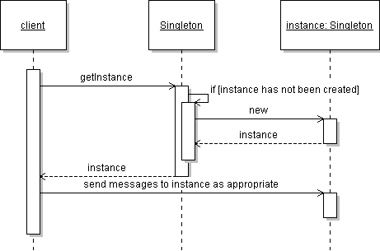
Singleton sequence diagram

Slide 18
Singleton example
Class RandomGenerator generates random numbers.
  public class RandomGenerator {
  private static final RandomGenerator gen =
  new RandomGenerator();
  public static RandomGenerator getInstance() {
  return gen;
  }
  private RandomGenerator() {}
  ...
  }

Slide 19
Lazy initialization
Can wait until client asks for the instance to create it:
  public class RandomGenerator {
  private static RandomGenerator gen = null;
  public static RandomGenerator getInstance() {
  if (gen == null) {
  gen = new RandomGenerator();
  }
  return gen;
  }
  private RandomGenerator() {}
  ...
  }

Slide 20
Singleton Comparator
Comparators make great singletons because they have no state:
  public class LengthComparator
  implements Comparator<String> {
  private static LengthComparator comp = null;
  public static LengthComparator getInstance() {
  if (comp == null) {
  comp = new LengthComparator();
  }
  return comp;
  }
  private LengthComparator() {}
  public int compare(String s1, String s2) {
  return s1.length() - s2.length();
  }
  }

Slide 21
Pattern: Flyweight
a class that has only one instance for each unique state

Slide 22
Redundant objects
Problem: Redundant objects can bog down the system.
  Many objects have the same state.
  example: File objects that represent the same file on disk
    new File("mobydick.txt")
    new File("mobydick.txt")
    new File("mobydick.txt")
    ...
    new File("notes.txt")
  example: Date objects that represent the same date of the year
    new Date(4, 18)
    new Date(4, 18)

Slide 23
Flyweight pattern
flyweight: An assurance that no more than one instance of a class will have identical state.
  Achieved by caching identical instances of objects.
  Similar to singleton, but one instance for each unique object state.
  Useful when there are many instances, but many are equivalent.
  Can be used in conjunction with Factory Method pattern to create a very efficient object-builder.
  Examples in Java: String, Image, Toolkit, Formatter, Calendar, JDBC

Slide 24
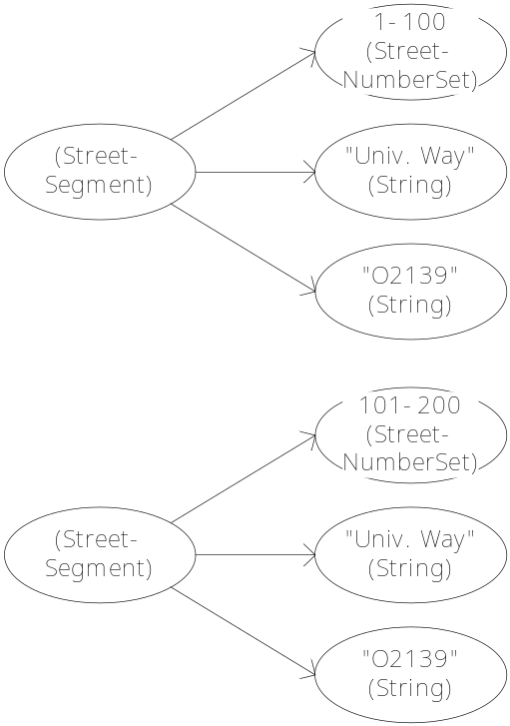
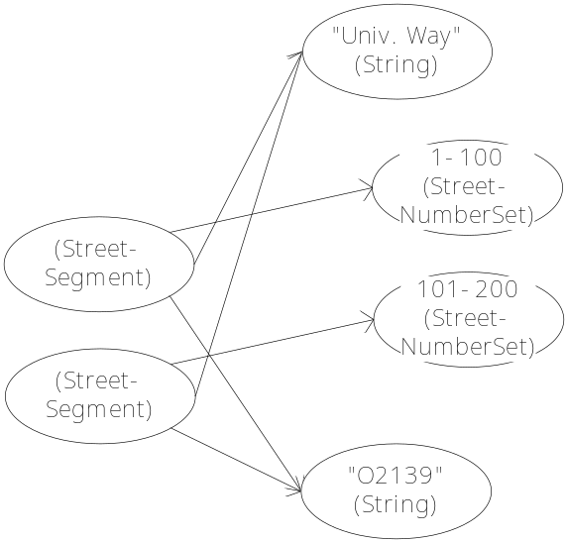
Flyweight diagram
Flyweighting shares objects and/or shares their internal state
  saves memory
  allows comparisons with == rather than equals (why?)
StreetSegment with interning
StreetSegment without interning

Slide 25
Implementing a Flyweight
Flyweighting works best on immutable objects. (Why?)
Class pseudo-code sketch:
  public class Name {
    static collection of instances
    private constructor
    static method to get an instance:
      if (we have created this kind of instance before):
      get it from the collection and return it.
      else:
      create a new instance, store it in the collection and return it.
  }

Slide 26
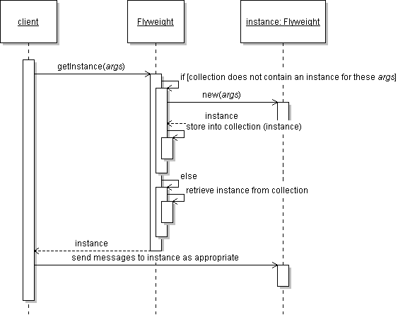
Flyweight sequence diagram

Slide 27
Implementing a Flyweight
  public class Flyweighted {
  private static Map<KeyType, Flyweighted> instances
  = new HashMap<KeyType, Flyweighted>();
  private Flyweighted(...) { ... }
  public static Flyweighted getInstance(KeyType key) {
  if (!instances.contains(key)) {
  instances.put(key, new Flyweighted(key));
  }
  return instances.get(key);
  }
  }

Slide 28
Class before flyweighting
public class Point {
private int x, y;
public Point(int x, int y) {
this.x = x;
this.y = y;
}
public int getX() { return x; }
public int getY() { return y; }
public String toString() {
return "(" + x + ", " + y + ")";
}
}

Slide 29
Class after flyweighting
public class Point {
private static Map<String, Point> instances =
new HashMap<String, Point>();
public static Point getInstance(int x, int y) {
String key = x + ", " + y;
if (!instances.containsKey(key)) {
instances.put(key, new Point(x, y));
}
return instances.get(key);
}
private final int x, y; // immutable
private Point(int x, int y) {
...

Slide 30
String flyweighting
interning: Synonym for flyweighting; sharing identical instances.
  Java String objects are automatically interned (flyweighted) by the compiler whenever possible.
  If you declare two string variables that point to the same literal.
  If you concatenate two string literals to match another literal.
    String a = "neat";
    String b = "neat";
    String c = "n" + "eat";
So why doesn't == always work with Strings?
String
n
e
a
t

Slide 31
Limits of String flyweight
    String a = "neat";
    Scanner console = new Scanner(System.in);
    String b = console.next(); // user types "neat"
    if (a == b) { ... // false
There are many cases the compiler doesn't / can't flyweight:
  When you build a string later out of arbitrary variables
  When you read a string from a file or stream (e.g. Scanner)
  When you build a new string from a StringBuilder
  When you explicitly ask for a new String (bypasses flyweighting)
You can force Java to flyweight a particular string with intern:
  b = b.intern();
  if (a == b) { ... // true

Slide 32
String interning questions
  String fly = "fly"; String weight = "weight";
  String fly2 = "fly"; String weight2 = "weight";
Which of the following expressions are true?
  a) fly == fly2
  b) weight == weight2
  c) "fly" + "weight" == "flyweight"
  d) fly + weight == "flyweight"
  String flyweight = new String("fly" + "weight");
  e) flyweight == "flyweight"
  String interned1 = (fly + weight).intern();
  String interned2 = flyweight.intern();
  f) interned1 == "flyweight"
  g) interned2 == "flyweight"

