Slide 1
CSE 331
Design Patterns 2:
Prototype, Factory
slides created by Marty Stepp
based on materials by M. Ernst, S. Reges, D. Notkin, R. Mercer
http://www.cs.washington.edu/331/

Slide 2
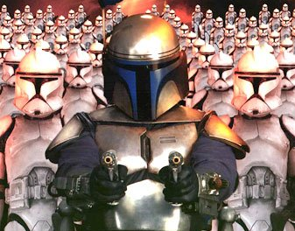
Pattern: Prototype
An object that serves as a basis for creation of others

Slide 3
Objects as prototypes
prototype: An object that serves as a template or model to assist in the creation of other similar/equal objects.
Problem: Client wants another object similar to an existing one, but doesn't care about the details of the state of that object.
  Sometimes client doesn't even care about the object's exact type.
Solution: Clone or copy the object's state into a new object, modify as needed, then use it.
  Often closely related to Java's clone method.
  Sometimes done with producer methods that return new objects.
  (Prototype is a creational pattern.)

Slide 4
Scenario: Store products
Suppose a store has a hierarchy of classes representing products.
  public class Product {...}
  public class Book extends Product {...}
  public class DVD extends Product {...}
  The store keeps a large catalog of all products by ID.
Customers want to buy products from the catalog and put them into their shopping carts.
  The add-to-cart code doesn't want to worry about what kind of product is being bought, its state, etc.
  We don't want to add the original product to the customer's cart, because it is mutable and they will modify its price/status/etc.

Slide 5
Prototype store products
The following code gives each customer his own product copy:
  // maps from product IDs to the products themselves
  private Map<Integer, Product> catalog;
  ...
  public void addToCart(ShoppingCart cart,
  int id, double price) {
  Product p = catalog.get(id);
  p = p.clone(); // make a copy for this user
  p.setPrice(price);
  cart.add(p);
  }

Slide 6
Prototype producer method
Sometimes the object serves as a prototype by supplying producer method(s) that return new objects similar to itself:
  public class Product implements Cloneable {
  ...
  public Product clone() { ... }
  // a new product like this one, but half price
  public Product halfPrice() {
  Product copy = this.clone();
  copy.setPrice(this.getPrice() / 2);
  return copy;
  }
  }

Slide 7
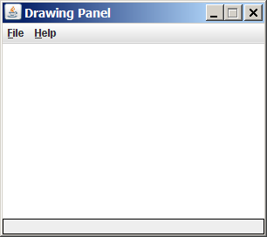
Drawing fonts/colors
Suppose we want to draw fonts/colors on a graphical window.
  We will make use of a CSE 142/143 class, DrawingPanel .
To create a window:
  DrawingPanel name = new DrawingPanel(width, height);
  Example:
  DrawingPanel panel = new DrawingPanel(300, 200);
The window has nothing on it.
  We draw shapes / lines on it with
  another object of type Graphics.

Slide 8

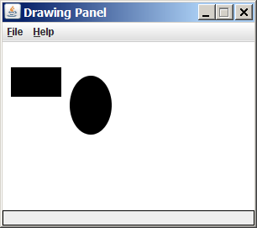
Graphics
"Pen" or "paint brush" object to draw lines and shapes
  import java.awt.*; // needed to use Graphics
  Access it by calling getGraphics on your DrawingPanel.
  Graphics g = panel.getGraphics();
Draw shapes by calling methods
on the Graphics object.
  g.fillRect(10, 30, 60, 35);
  g.fillOval(80, 40, 50, 70);

Slide 9
Graphics methods
Method name | Description
g.drawImage(Image, x, y, [w, h], panel); | an image at the given x/y position and size
g.drawLine(x1, y1, x2, y2); | line between points (x1, y1), (x2, y2)
g.drawOval(x, y, width, height); | outline largest oval that fits in a box of size width * height with top-left at (x, y)
g.drawRect(x, y, width, height); | outline of rectangle of size width * height with top-left at (x, y)
g.drawString(text, x, y); | text with bottom-left at (x, y)
g.fillOval(x, y, width, height); | fill largest oval that fits in a box of size width * height with top-left at (x, y)
g.fillRect(x, y, width, height); | fill rectangle of size width * height with top-left at (x, y)
g.setColor(color); | paint any following shapes in the given color
g.setFont(font); | draw any following text with the given font

Slide 10
Specifying colors
Pass a Color to Graphics object's setColor method.
  Specified by constructor, using Red-Green-Blue (RGB) values 0-255:
  Color brown = new Color(192, 128, 64);
  Or use predefined Color class constants:
  Color.CONSTANT_NAME where CONSTANT_NAME is one of:
    BLACK, BLUE, CYAN, DARK_GRAY, GRAY, GREEN, LIGHT_GRAY, MAGENTA, ORANGE, PINK, RED, WHITE, YELLOW
  Or create a new color, using an existing color as a prototype:
  public Color brighter()
  public Color darker()

Slide 11
Specifying fonts
Pass a Font to Graphics object's setFont method.
  Specified by the Font constructor:
  public Font(String name, int style, int size)
    Styles are represented as integer constants in the Font class:
    public static final int PLAIN
    public static final int BOLD
    public static final int ITALIC
  Or create a new font, using an existing font as a prototype:
    public Font deriveFont(float size)
    public Font deriveFont(int style, float size)

Slide 12

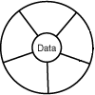
Pattern: Factory
A method or object that creates other objects

Slide 13
Factory pattern
factory: A method or object whose primary purpose is to manage the creation of other objects (usually of a different type).
Problem: Object creation is cumbersome or heavily coupled for a given client. Client needs to create but doesn't want the details.
Factory Method pattern
  A helper method that creates and returns the object(s).
  Can return subclass objects if so desired (hidden from client).
Abstract Factory pattern
  A hierarchy of classes/objects, each of which is a factory for a type.
  Allows hot-swappable factory to be used by a given client.
  (Factory is a creational pattern.)

Slide 14
DateFormat as a factory
DateFormat class knows how to format dates/times as text
  Options: Just date? Just time? Date+time? Where in the world?
  Instead of passing all options to constructor, use factories.
  The subtype created doesn't need to be specified.
  DateFormat df1 = DateFormat.getDateInstance();
  DateFormat df2 = DateFormat.getTimeInstance();
  DateFormat df3 = DateFormat.getDateInstance(
  DateFormat.FULL, Locale.FRANCE);
  Date today = new Date();
  System.out.println(df1.format(today)); // "Apr 20, 2011"
  System.out.println(df2.format(today)); // "10:48:00 AM"
  System.out.println(df3.format(today));
  // "mecredi 20 avril 2011"

Slide 15
Border factory
Java graphical components like DrawingPanel can have borders:
  public void setBorder(Border border)
But Border is an interface; cannot construct a new Border .
  There are many different kinds of borders (classes).
Instead, use the provided BorderFactory class to create them:
  public static Border createBevelBorder(...)
  public static Border createEtchedBorder(...)
  public static Border createLineBorder(...)
  public static Border createMatteBorder(...)
  public static Border createTitledBorder(...)
  Avoids a constructor that takes too many "option / flag" arguments.

Slide 16


Scenario: Drawing images
Suppose we want to display images on a graphical window.
The Graphics object has a drawImage method:
  public void drawImage(Image img, int x, int y, panel)
  public void drawImage(Image img, int x, int y,
  int w, int h, panel)
Images are hard drive files in a given format:
  GIF, JPEG, PNG, BMP, TIFF, ...
So how do we get an Image object to draw?
Can't simply say new Image :
  Image img = new Image("bobafett.gif"); // error

Slide 17
Toolkits
Toolkit is a class for GUI system info and resource loading.
Java handles loading of images through Toolkits:
  public Image getImage(String filename)
  public Image getImage(URL url)
Can't simply say new Toolkit :
  Toolkit tk = new Toolkit(); // error
Have to call a static method to get a toolkit (Why? What is this?):
  public static Toolkit getDefaultToolkit()
  Toolkit tk = Toolkit.getDefaultToolkit(); // ok

Slide 18
Buggy image client
The following well-intentioned client does not show the images:
  public static void main(String[] args) {
  Toolkit tk = Toolkit.getDefaultToolkit();
  Image img1 = tk.getImage("calvin.gif");
  Image img2 = tk.getImage("cuteicecream.jpg");
  Image img3 = tk.getImage("tinman.png");
  DrawingPanel panel = new DrawingPanel(600, 500);
  Graphics g = panel.getGraphics();
  g.drawImage(img1, 0, 0, panel);
  g.drawImage(img2, 200, 50, panel);
  g.drawImage(img3, 400, 200, panel);
  }

Slide 19
Media trackers
When you tell a toolkit to load an image, it doesn't actually do so.
  It simply buffers a request to eventually load the image.
  If you try to draw the image too quickly, it won't be loaded yet.
Java uses media tracker objects to wait for an image to load:
  public MediaTracker(panel)
  public void addImage(Image img, int id)
  public void removeImage(Image img)
  public void removeImage(Image img, int id)
  public void waitForAll() **
  public void waitForAll(long ms) **
  public void waitForID(int id) **
  public void waitForID(int id, long ms) **
    ** throws InterruptedException

Slide 20
Media tracker example
  public static void main(String[] args) {
  Toolkit tk = Toolkit.getDefaultToolkit();
  Image img1 = tk.getImage("calvin.gif");
  Image img2 = tk.getImage("cuteicecream.jpg");
  Image img3 = tk.getImage("tinman.png");
  MediaTracker mt = new MediaTracker(panel);
  mt.addImage(img1, 1);
  mt.addImage(img2, 2);
  mt.addImage(img3, 3);
  try {
  mt.waitForAll();
  } catch (InterruptedException e) {}
  DrawingPanel panel = new DrawingPanel(600, 500);
  Graphics g = panel.getGraphics();
  g.drawImage(img1, 0, 0, panel);
  g.drawImage(img2, 200, 50, panel);
  g.drawImage(img3, 400, 200, panel);
  }

Slide 21
Image loading factory
The preceding code is too cumbersome to write every time we want to load an image.
  Let's make a factory method to load images more easily:
  public static Image loadImage(
  String filename, DrawingPanel panel) {
  Toolkit tk = Toolkit.getDefaultToolkit();
  Image img = tk.getImage(filename);
  MediaTracker mt = new MediaTracker(panel);
  mt.addImage(img, 0);
  try {
  mt.waitForAll();
  } catch (InterruptedException e) {}
  return img;
  }

Slide 22
A factory class
Factory methods are often put into their own class for reusability:
  public class ImageFactory {
  public static Image loadImage(
  String filename, DrawingPanel panel) {
  Toolkit tk = Toolkit.getDefaultToolkit();
  Image img = tk.getImage(filename);
  MediaTracker mt = new MediaTracker(panel);
  mt.addImage(img, 0);
  try {
  mt.waitForAll();
  } catch (InterruptedException e) {}
  return img;
  }
  public static Image loadImage(
  File file, DrawingPanel panel) {
  return loadImage(file.toString(), panel);
  }
  }

Slide 23
Exercise: Caching factory
Loading large images from the disk repeatedly can be slow.
Write a modified version of the image factory that caches images so that it does not ever have to re-load the same image file twice.
Things to think about:
  Can you think of any cases where caching would not be desired?
  How could we provide the client the ability to turn caching on/off?
  Can we make this decision transparent to most client code, settable in a single place?
Another possibility: A factory that loads images from URLs.

Slide 24
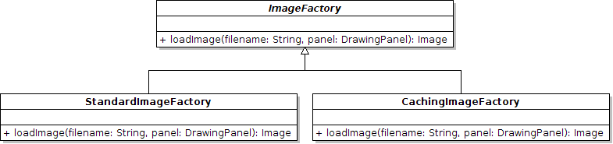
Abstract Factory pattern
abstract factory: A superclass factory that can be extended to provide different sub-factories, each with different features.
  Often implemented with an abstract superclass.
  Idea: Client is given an instance of ImageFactory, which will actually be a Standard or Caching ImageFactory.
  Client just uses it and doesn't worry about which one it was given.

Slide 25
Abstract factory code
public abstract class ImageFactory {
public abstract Image loadImage(
String filename, DrawingPanel panel);
}
public class StandardImageFactory extends ImageFactory {
public Image loadImage(String filename,
DrawingPanel panel) { ... }
}
public class CachingImageFactory extends ImageFactory {
public Image loadImage(String filename,
DrawingPanel panel) { ... }
}
public class WebImageFactory extends ImageFactory {
public Image loadImage(String filename,
DrawingPanel panel) { ... }
}

