Slide 1
CSE 331
Visual Index of Swing GUI Components
slides created by Marty Stepp
based on materials by M. Ernst, S. Reges, D. Notkin, R. Mercer, Wikipedia
http://www.cs.washington.edu/331/

Slide 2
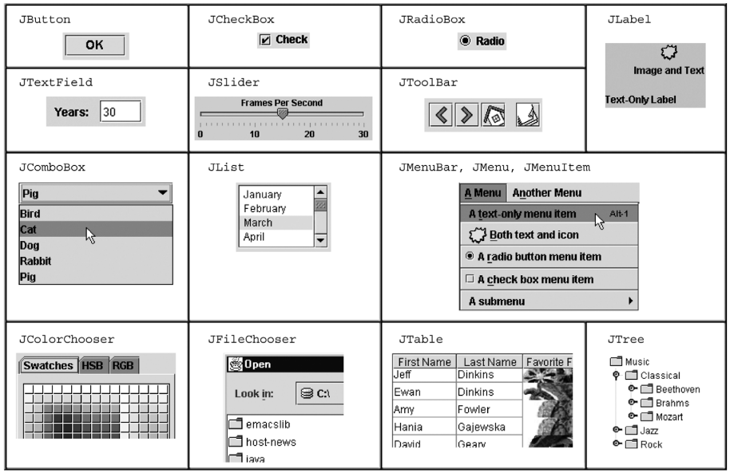
Components

Slide 3
Swing inheritance hierarchy
Component (AWT)
  Window
    Frame
      JFrame (Swing)
      JDialog
  Container
    JComponent (Swing)
      JButton JColorChooser JFileChooser
      JComboBox JLabel JList
      JMenuBar JOptionPane JPanel
      JPopupMenu JProgressBar JScrollbar
      JScrollPane JSlider JSpinner
      JSplitPane JTabbedPane JTable
      JToolbar JTree JTextArea
      JTextField ...
import java.awt.*;
import javax.swing.*;

Slide 4
Component properties
  Each has a get (or is) accessor and a set modifier method.
  examples: getColor, setFont, setEnabled, isVisible
name | type | description
background | Color | background color behind component
border | Border | border line around component
enabled | boolean | whether it can be interacted with
focusable | boolean | whether key text can be typed on it
font | Font | font used for text in component
foreground | Color | foreground color of component
height, width | int | component's current size in pixels
visible | boolean | whether component can be seen
tooltip text | String | text shown when hovering mouse
size, minimum / maximum / preferred size | Dimension | various sizes, size limits, or desired sizes that the component may take

Slide 5
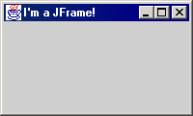
JFrame
a graphical window to hold other components
public JFrame()
public JFrame(String title)
Creates a frame with an optional title.
  Call setVisible(true) to make a frame appear on the screen after creating it.
public void add(Component comp)
Places the given component or container inside the frame.

Slide 6
More JFrame
public void setDefaultCloseOperation(int op)
Makes the frame perform the given action when it closes.
  Common value passed: JFrame.EXIT_ON_CLOSE
  If not set, the program will never exit even if the frame is closed.
public void setSize(int width, int height)
Gives the frame a fixed size in pixels.
public void pack()
Resizes the frame to fit the components inside it snugly.

Slide 7
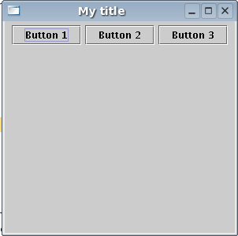
JButton
a clickable region for causing actions to occur
public JButton(String text)
Creates a new button with the given string as its text.
public String getText()
Returns the text showing on the button.
public void setText(String text)
Sets button's text to be the given string.

Slide 8
JLabel
a string of text displayed on screen in a graphical
program. Labels often give information or
describe other components
public JLabel(String text)
Creates a new label with the given string as its text.
public String getText()
Returns the text showing on the label.
public void setText(String text)
Sets label's text to be the given string.

Slide 9
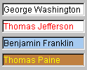

JTextField, JTextArea
an input control for typing text values
(field = single line; area = multi-line)
public JTextField(int columns)
public JTextArea(int lines, int columns)
Creates a new field, the given number of letters wide.
public String getText()
Returns the text currently in the field.
public void setText(String text)
Sets field's text to be the given string.

Slide 10
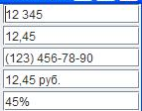
JFormattedTextField
a text box that allows special formatting
and can enforce constraints about allowable text
public JFormattedTextField(Format format)
Creates a new field that constrains itself to the given text format.
(e.g. DateFormat, NumberFormat, CurrencyFormat, MaskFormat)
public Object getValue()
public void getValue(Object value)
The value currently set in the field, which may lag behind the text.
public void setFocusLostBehavior(int b)
Sets what field should do if user stops editing and value is illegal.

Slide 11
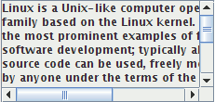
JScrollPane
a container that adds scrollbars
around any other component
public JScrollPane(Component comp)
Wraps the given component with scrollbars.
  After constructing the scroll pane, you must add the scroll pane, not the original component, to the onscreen container:
  myContainer.add(new JScrollPane(textarea),
  BorderLayout.CENTER);

Slide 12
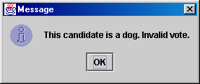
JOptionPane
JOptionPane.showMessageDialog(parent, message);
import javax.swing.*;
JOptionPane.showMessageDialog(null,
"This candidate is a dog. Invalid vote.");
Advantages:
  Simple; looks better than console.
Disadvantages:
  Created with static methods;
  not object-oriented.
  Not powerful (just simple dialog boxes).

Slide 13
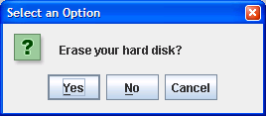
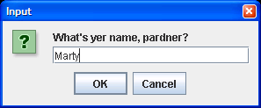
More JOptionPane
JOptionPane.showConfirmDialog(parent, message)
  Displays a message and list of choices Yes, No, Cancel.
  Returns an int such as JOptionPane.YES_OPTION or NO_OPTION to indicate what button was pressed.
JOptionPane.showInputDialog(parent, message)
  Displays a message and text field for input.
  Returns the value typed as a String
  (or null if user presses Cancel).

Slide 14
JPanel
the default container class in Swing
public JPanel()
public JPanel(LayoutManager mgr)
Constructs a panel with the given layout (default = flow layout).
public void add(Component comp)
public void add(Component comp, Object info)
Adds a component to the container, possibly giving extra information about where to place it.
public void remove(Component comp)
public void setLayout(LayoutManager mgr)
Uses the given layout manager to position components.

Slide 15
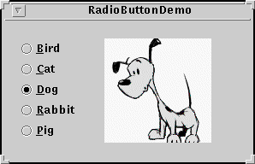
JCheckBox, JRadioButton
a toggleable yes/no value (checkbox)
or a way choose between options (radio)
public JCheckBox(String text)
public JCheckBox(String text, boolean checked)
public JRadioButton(String text)
Creates a checked/unchecked check box with given text.
public boolean isSelected()
Returns true if the check box is checked.
public void setSelected(boolean selected)
Sets box to be checked/unchecked.

Slide 16
ButtonGroup
a logical collection to ensure that exactly one
radio button from a group is checked at a time
public ButtonGroup()
public void add(JRadioButton button)
  The ButtonGroup is not a graphical component, just a logical group; the RadioButtons themselves also need to be added to an onscreen container to be seen.

Slide 17

Icon
a picture that can appear inside a component
public class ImageIcon implements Icon
  public ImageIcon(String filename)
  public ImageIcon(URL address)
in JButton, JRadioButton, JCheckBox, JLabel, etc...
  constructor that takes an Icon
  public void setIcon(Icon)
  public void setSelectedIcon(Icon)
  public void setRolloverIcon(Icon)

Slide 18
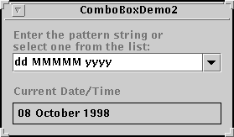
JComboBox
a drop-down list of selectable items
public JComboBox()
public JComboBox(Vector items)
public JComboBox(ComboBoxModel model)
Constructs a combo box. Can optionally pass a vector or model of items. (See DefaultComboBoxModel for a model implementation.)
public void addActionListener(ActionListener al)
Causes an action event to be sent to listener al when the user selects or types a new item in the combo box.

Slide 19
JComboBox methods
public void addItem(Object item)
public Object getItemAt(int index)
public void removeAllItems()
public void removeItem(Object item)
public void removeItemAt(int index)
public int getSelectedIndex()
public Object getSelectedItem()
public void setSelectedItem(Object item)
public void setSelectedIndex(int index)
public void setEnabled(boolean enabled)
public void setEditable(boolean editable)
If editable, the user can type new arbitrary values into the box.

Slide 20

JList
a list of selectable pre-defined text items
public JList()
Constructs an empty JList.
public JList(ListModel model)
public JList(Object[] data)
public JList(Vector data)
Constructs a JList that displays the given data.
public void addListSelectionListener(
ListSelectionListener lsl)
Adds the given listener to be informed when the selected index changes for this list.

Slide 21
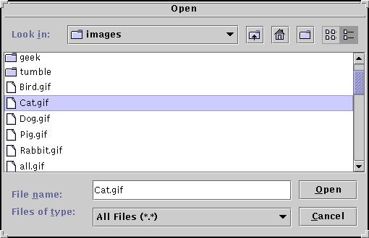
JFileChooser
a dialog box that allows the user
to browse for a file to read/write
public JFileChooser()
public JFileChooser(String currentDir)
public int showOpenDialog(Component parent)
public int showSaveDialog(Component parent)
public File getSelectedFile()
public static int APPROVE_OPTION, CANCEL_OPTION
Possible result values from showXxxDialog(...)

Slide 22
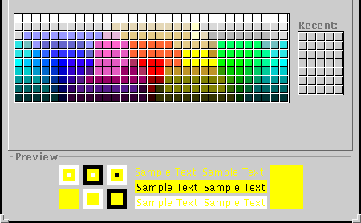
JColorChooser
a dialog box that allows the user
to choose a color from a palette
public JColorChooser()
public JColorChooser(Color initial)
public Color showDialog(Component parent,
String title, Color initialColor)
  returns null if user chooses the Cancel button

Slide 23

JMenuBar
a drop-down menu of commands
public JMenuBar()
public void add(JMenu menu)
Usage: in JFrame, the following method exists:
  public void setJMenuBar(JMenuBar bar)

Slide 24
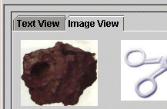
JTabbedPane
a container that holds subcontainers,
each with a "tab" label and content
public JTabbedPane()
public JTabbedPane(int tabAlignment)
Constructs a new tabbed pane. Defaults to having the tabs on top; can be set to JTabbedPane.BOTTOM, LEFT, RIGHT, etc.
public void addTab(String title, Component comp)
public void insertTab(...)
public void remove(Component comp)
public void remove(int index)
public void removeAll()
public void setSelectedComponent(Component c)
public void setSelectedIndex(int index)

Slide 25
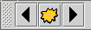
JToolbar
a movable dock container to hold
common app buttons and commands
public JToolBar()
public JToolBar(int orientation)
public JToolBar(String title)
public JToolBar(String title, int orientation)
Constructs a new tool bar, with optional title and orientation; can be JToolBar.HORIZONTAL or VERTICAL, default horizontal
public void add(Component comp)
Adds the given component to this tool bar.
  Note: If using JToolbar, don't put other components in N/E/S/W.

Slide 26


JMenu
a sub-menu of commands with a JMenuBar
public JMenu(String text)
public void add(JMenuItem item)
public void addSeparator()
public void setMnemonic(int key)

Slide 27

JMenuItem
an entry within a JMenu that can
be clicked to execute a command
public JMenuItem(String text)
public JMenuItem(String text, Icon icon)
public JMenuItem(String text, int mnemonic)
public void setAccelerator(KeyStroke ks)
public void setEnabled(boolean b)
public void setMnemonic(int mnemonic)
public void addActionListener(ActionListener al)

Slide 28

J(CheckBox|RadioButton)MenuItem
a JMenuItem with a check box or radio circle
public J_____MenuItem(String text)
public J_____MenuItem(String text, boolean selected)
public J_____MenuItem(String text, Icon icon)
public J_____MenuItem(String text,
Icon icon, boolean selected)
public void addActionListener(ActionListener al)
public boolean isSelected()
public void setSelected(boolean b)
Recall: in a ButtonGroup, the following method exists:
  public void add(AbstractButton button)
  These two classes extend AbstractButton.

Slide 29
Mnemonics
mnemonic: A context-sensitive menu hotkey assigned to a specific button or other graphical component.
  Usually visible as an underlined key, activated by pressing Alt+key.
  Only works when input focus is on the appropriate component.
  usage: call setMnemonic(char) method
    Menu items also have a constructor that takes a mnemonic.
  myQuitButton.setMnemonic('Q');
  JMenuItem myNewItem = new JMenuItem("New", 'N');
  // or: myNewItem.setMnemonic('N');

Slide 30
Accelerators
accelerator: A global hotkey that performs an action (ex: Alt-X to exit the program) even on components that aren't in focus / visible.
  Can be run at any time in the application.
  Can optionally include modifiers like Shift, Alt.
  To create an accelerator:
    Call the static getKeyStroke factory method of the KeyStroke class.
    Pass its result to the setAccelerator method of the component.
  menuItem.setAccelerator(
  KeyStroke.getKeyStroke('T',KeyEvent.ALT_MASK));

Slide 31
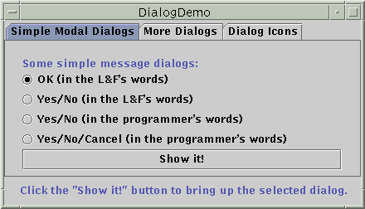
JDialog
a dialog box is a sub-window connected
to a given main window frame that
pops up for a short time
public JDialog(Frame parent, String title,
boolean modal)
Constructs a new dialog with the given parent and title. If modal is set, this dialog is a child of the parent and the parent will be locked until the dialog is closed.
JDialog has most all JFrame methods: getContentPane(), setJMenuBar, setVisible, setTitle(String), ...

