Slide 1
CSE 331
Composite Layouts; Decorators
slides created by Marty Stepp
based on materials by M. Ernst, S. Reges, D. Notkin, R. Mercer, Wikipedia
http://www.cs.washington.edu/331/

Slide 2
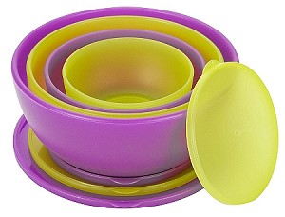

Pattern: Composite
objects that can contain their own type

Slide 3
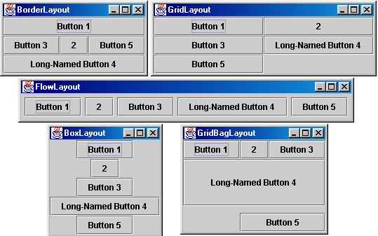
Containers and layout
Place components in a container; add the container to a frame.
  container: An object that stores components and governs their positions, sizes, and resizing behavior.

Slide 4
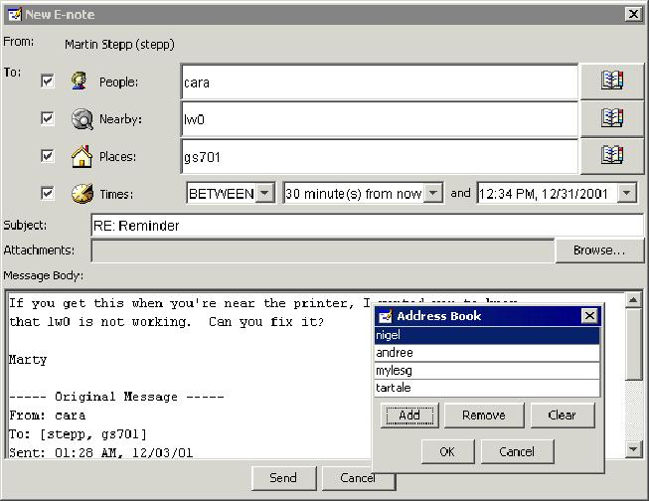
Complex layout ... how?
How would you create a complex layout like this, using only the layout managers shown?

Slide 5
Composite pattern
composite: An object that can be either an individual item or a collection of many items.
  Can be composed of individual items or other composites.
  Recursive definition: Objects that can hold themselves.
  Often leads to a tree structure of leaves and nodes:
    <node> ::= <leafnode> | <compositenode>
    <compositenode> ::= <node>*
Examples in Java:
  collections (e.g. a list of lists)
  GUI layout (containers of containers of components)

Slide 6
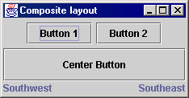
Composite layout
composite layout: One made up of containers within containers.
Each container has a different layout, and by combining the layouts, more complex / powerful layout can be achieved.
  Example: A flow layout in the south region of a border layout.
  Example: A border layout in square (1, 2) of a grid layout.
In the GUI at right:
  How many containers are there?
  What layout is used in each?

Slide 7
JPanel
the default container class in Swing
public JPanel()
public JPanel(LayoutManager mgr)
Constructs a panel with the given layout (default = flow layout).
public void add(Component comp)
public void add(Component comp, Object info)
Adds a component to the container, possibly giving extra information about where to place it.
public void remove(Component comp)
public void setLayout(LayoutManager mgr)
Uses the given layout manager to position components.

Slide 8

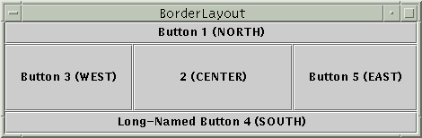
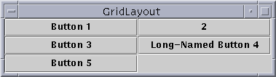
Flow, Border, Grid layouts
Container panel1 = new JPanel(new FlowLayout());
panel1.add(new JButton("Button 1"));
panel1.add(new JButton("Button 2"));
Container panel2 = new JPanel(new BorderLayout());
panel2.add(new JButton("Button 1 (NORTH)"),
BorderLayout.NORTH);
Container panel3 = new JPanel(new GridLayout(3, 2));
panel3.add(new JButton("Button 1"));
panel3.add(new JButton("Button 2"));

Slide 9
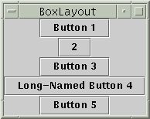
Box layout
Container box1 = Box.createHorizontalBox();
Container box2 = Box.createVerticalBox();
aligns components in container in a single row or column
components use preferred sizes and align based on their preferred alignment
  vertical box is used to get a "vertical flow layout"

Slide 10

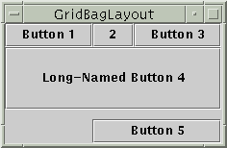
Other layouts
CardLayout
Layers of "cards" stacked
on top of each other;
one visible at a time.
GridBagLayout
Powerful, but very complicated;
Our recommendation:
never use it.
null layout
allows you to define absolute positions using setX/Y and setWidth/Height (not recommended; platform dependent)

Slide 11
Composite layout code
  Container north = new JPanel(new FlowLayout());
  north.add(new JButton("Button 1"));
  north.add(new JButton("Button 2"));
  Container south = new JPanel(new BorderLayout());
  south.add(new JLabel("Southwest"), BorderLayout.WEST);
  south.add(new JLabel("Southeast"), BorderLayout.EAST);
  // overall panel contains the smaller panels (composite)
  Container overall = new JPanel(new BorderLayout());
  overall.add(north, BorderLayout.NORTH);
  overall.add(new JButton("Center"), BorderLayout.CENTER);
  overall.add(south, BorderLayout.SOUTH);
  frame.add(overall);

Slide 12
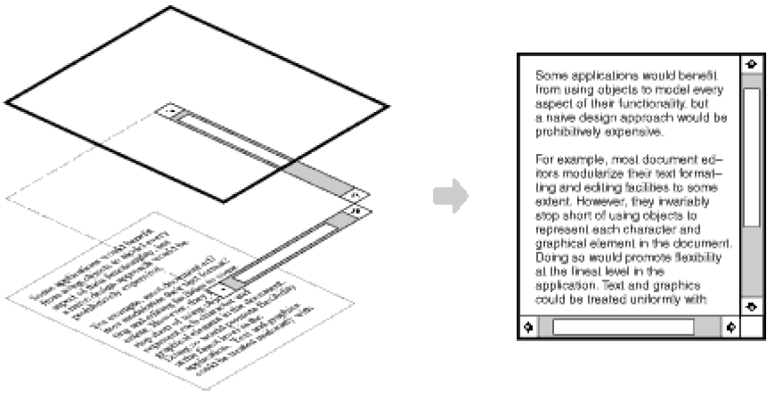
Pattern: Decorator
objects that "wrap" other objects to add features

Slide 13
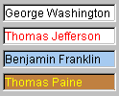

JTextField, JTextArea
an input control for typing text values
(field = single line; area = multi-line)
public JTextField(int columns)
public JTextArea(int lines, int columns)
Creates a new field, the given number of letters wide.
public String getText()
Returns the text currently in the field.
public void setText(String text)
Sets field's text to be the given string.
  What if the text area is too big to fit in the window?

Slide 14
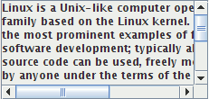
JScrollPane
a container that adds scrollbars
around any other component
public JScrollPane(Component comp)
Wraps the given component with scrollbars.
  After constructing the scroll pane, you must add the scroll pane, not the original component, to the onscreen container:
  myContainer.add(new JScrollPane(textarea),
  BorderLayout.CENTER);

Slide 15
Decorator pattern
decorator: An object that modifies behavior of, or adds features to, another object.
  Must maintain the common interface of the object it wraps up.
  Used so that we can add features to an existing simple object without needing to disrupt the interface that client code expects when using the simple object.
  The object being "decorated" usually does not explicitly know about the decorator.
Examples in Java:
  Multilayered input streams adding useful I/O methods
  Adding scroll bars to GUI controls

Slide 16
Decorator example: I/O
normal InputStream class has only public int read() method to read one letter at a time
decorators such as BufferedReader or Scanner add additional functionality to read the stream more easily
  // InputStreamReader/BufferedReader decorate InputStream
  InputStream in = new FileInputStream("hardcode.txt");
  InputStreamReader isr = new InputStreamReader(in);
  BufferedReader br = new BufferedReader(isr);
  // because of decorator streams, I can read an
  // entire line from the file in one call
  // (InputStream only provides public int read() )
  String wholeLine = br.readLine();

Slide 17
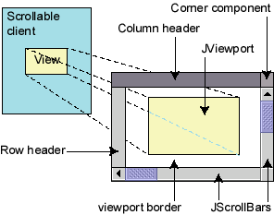
Decorator example: GUI
JScrollPane is a container with scroll bars to which you can add any component to make it scrollable
// JScrollPane decorates GUI components
JTextArea area = new JTextArea(20, 30);
JScrollPane sp = new JScrollPane(area);
contentPane.add(sp);
  Components also have a setBorder method to add a "decorative" border. Is this another example of the Decorator pattern? Why or why not?

Slide 18
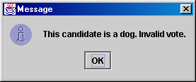
JOptionPane
JOptionPane.showMessageDialog(parent, message);
import javax.swing.*;
JOptionPane.showMessageDialog(null,
"This candidate is a dog. Invalid vote.");
Advantages:
  Simple; looks better than console.
Disadvantages:
  Created with static methods;
  not object-oriented.
  Not powerful (just simple dialog boxes).

Slide 19
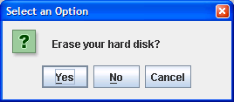
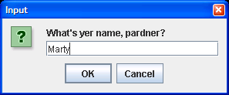
More JOptionPane
JOptionPane.showConfirmDialog(parent, message)
  Displays a message and list of choices Yes, No, Cancel.
  Returns an int such as JOptionPane.YES_OPTION or NO_OPTION to indicate what button was pressed.
JOptionPane.showInputDialog(parent, message)
  Displays a message and text field for input.
  Returns the value typed as a String
  (or null if user presses Cancel).

