Slide 1
CSE 331
Model/View Separation and Observer Pattern
slides created by Marty Stepp
based on materials by M. Ernst, S. Reges, D. Notkin, R. Mercer, Wikipedia
http://www.cs.washington.edu/331/

Slide 2
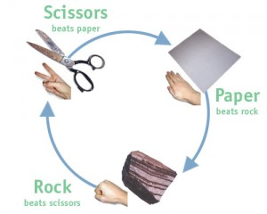
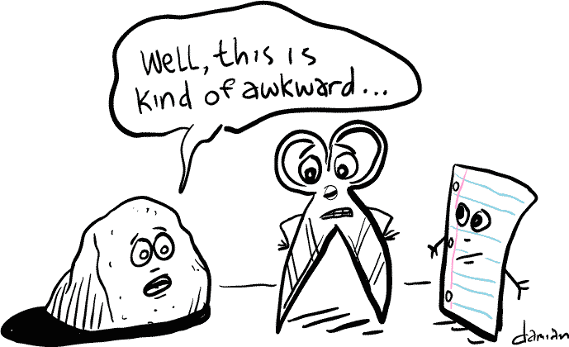
GUI exercise
Let's develop a graphical game of Rock-Paper-Scissors.
  Write a GUI for the game using Swing.
  Initially make both players choose random moves every time, but then change it to allow the human (first) player to choose his move.
  Add the ability to bet on each game and track the player's money.

Slide 3
Model and view
model: Classes in your system that are related to the internal representation of the state and behavior of the system.
  often part of the model is connected to file(s) or database(s)
  examples (card game): Card, Deck, Player
  examples (bank system): Account, User, UserList
view: Classes in that display the state of the model to the user.
  generally, this is your GUI (could also be a text UI)
  should not contain crucial application data
  Different views can represent the same data in different ways
    Example: Bar chart vs. pie chart
  examples: PokerGUI, PacManCanvas, BankApplet

Slide 4
Model-view-controller
model-view-controller (MVC): Design paradigm for graphical systems that promotes strict separation between model and view.
controller: classes that connect model and view
  defines how user interface reacts to user input (events)
  receives messages from view (where events come from)
  sends messages to model (tells what data to display)
data for rendering
Model
View
View
Component
Model
updates
events
Controller
Controller

Slide 5
Model/view separation
Your model classes should NOT:
  import graphical packages (java.awt.*, javax.swing.*)
  store direct references to GUI classes or components
  know about the graphical classes in your system
  store images, or names of image files, to be drawn
  drive the overall execution of your program
Your view/controller classes should:
  store references to the model class(es)
  call methods on the model to update it when events occur
Tricky part: Updating all aspects of the view properly when the state of the model changes...

Slide 6


Pattern: Observer
objects that listen for updates to the state of others

Slide 7
Observer pattern
observer: An object that "watches" the state of another object and takes action when the state changes in some way.
Problem: You have a model object with a complex state, and the state may change throughout the life of your program.
  You want to update various other parts of the program when the object's state changes.
Solution: Make the complex model object observable.
observable object: An object that allows observers to examine it (notifies its observers when its state changes).
  Permits customizable, extensible event-based behavior for data modeling and graphics.

Slide 8
Benefits of observer
Abstract coupling between subject and observer; each can be extended and reused individually.
Dynamic relationship between subject and observer; can be established at run time (can "hot-swap" views, etc) gives more programming flexibility.
Broadcast communication: Notification is broadcast automatically to all interested objects that subscribed to it.
Can be used to implement model-view separation in Java easily.

Slide 9
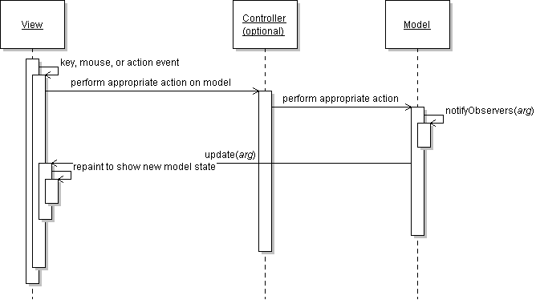
Observer sequence diagram

Slide 10
Observer interface
  // import java.util.*;
  public interface Observer {
  public void update(Observable o, Object arg);
  }
  public class Observable { ... }
Basic idea:
  Make your view code implement Observer.
  Make your main model class extend Observable.
  Attach the view to the model as an observer.
  The view's update method will be called when the observable model changes, so write code to handle the change inside update.

Slide 11
Observable class
Method name | Description
addObserver(Observer) | adds an Observer to this object; its update method is called when notifyObservers is called
deleteObserver(Observer) | removes an Observer from this object
notifyObservers() notifyObservers(arg) | inform all observers about a change to this object; can pass optional object with more information
setChanged() | flags that this object's state has changed; must be called prior to each call to notifyObservers

Slide 12
Multiple views
Make an Observable model.
Write an abstract View superclass which is a JComponent.
  make View an observer
Extend View for all of your actual views.
  Give each its own unique inner components and code to draw the model's state in its own way.
Provide a mechanism in GUI to set the view (perhaps via menus).
  To set the view, attach it to observe the model.

Slide 13
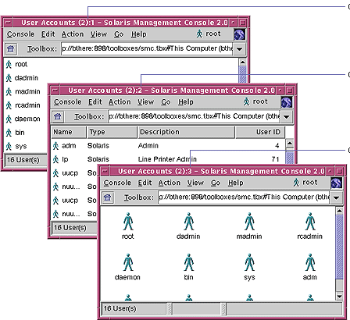
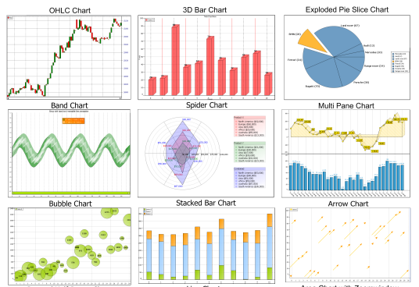
Multiple views examples
File explorer (icon view, list view, details view)
Games (overhead view, rear view, 3D view)
Graphs and charts (pie chart, bar chart, line chart)

