Slide 1
CSE 331
2D Graphics
slides created by Marty Stepp
based on materials by M. Ernst, S. Reges, D. Notkin, R. Mercer, Wikipedia
http://www.cs.washington.edu/331/

Slide 2
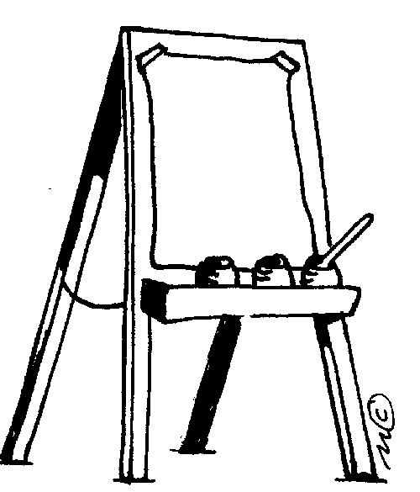
Custom components
AWT/Swing come with lots of components that you can use to implement a fully-featured GUI.
But there are cases when you need a custom component.
  Usually this is when you want to paint custom 2-D graphics.
  We often call a custom painted component a canvas.
To do so, write a class that extends JComponent .
  Override method paintComponent to tell Java how to draw it:
  public void paintComponent(Graphics g)
    Some programmers extend JPanel rather than JComponent .

Slide 3
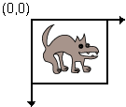
A drawing canvas
Coordinate system: (0, 0) at top-left,
x-axis increases rightward, y-axis downward.
Component's surface is transparent unless drawn on.
JComponent's paintComponent does important things that we don't want to lose. (e.g. paints the component's background)
  So call the method super.paintComponent first thing.
  public void paintComponent(Graphics g) {
  super.paintComponent(g);
  ...
  }

Slide 4
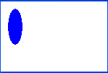
Quick drawing example
public class MyCanvas extends JComponent {
public MyCanvas() {
this.setBackground(Color.WHITE);
}
public void paintComponent(Graphics g) {
super.paintComponent(g);
g2.setPaint(Color.BLUE);
g2.fillOval(10, 10, 20, 50);
}
}

Slide 5

Graphics methods
Method name | Description
drawImage(Image, x, y, [w, h], panel) | an image at the given x/y position and size
drawLine(x1, y1, x2, y2) | line between points (x1, y1), (x2, y2)
drawOval(x, y, width, height) | outline largest oval that fits in a box of size width * height with top-left at (x, y)
drawRect(x, y, width, height) | outline of rectangle of size width * height with top-left at (x, y)
drawString(text, x, y) | text with bottom-left at (x, y)
fillOval(x, y, width, height) | fill largest oval that fits in a box of size width * height with top-left at (x, y)
fillRect(x, y, width, height) | fill rectangle of size width * height with top-left at (x, y)
setColor(color) | paint any following shapes in the given color
setFont(font) | draw any following text with the given font

Slide 6
Graphics2D
The Graphics object g passed to paintComponent is a "graphical context" object to draw on the component.
  The actual object passed in is a Graphics2D (can cast).
  Graphics2D g2 = (Graphics2D) g;
Graphics2D is a subclass of Graphics that adds new features, new shapes, matrix transformations, color gradients, etc.
  Added to Java in v1.2 to improve on the features of Graphics.
  Why didn't they just add the new methods and features to Graphics directly? Why did they bother to make it a separate class?
    Answer: Open-Closed Principle. Graphics already worked just fine.
    Why risk breaking it by adding new features to the same file?

Slide 7
Graphics2D methods
method name | description
draw(Shape) | draws the outline of a given shape object (replaces drawRect, etc.)
fill(Shape) | draws the outline and interior of a given shape object
getPaint(), setPaint(Paint) | returns or sets the current paint used for drawing (Color is one kind of Paint, but there are others)
getStroke(), setStroke(Stroke) | returns or sets the current line stroke style used for drawing (can be thin/thick, solid/dashed/dotted, etc.)
rotate(angle) | rotates any future drawn shapes by the given angle (radians)
scale(sx, sy) | resizes any future drawn shapes by the given x/y factors
translate(dx, dy) | moves any future drawn shapes by the given x/y amounts
setRenderingHint( key, value) | sets "rendering hints" such as anti-aliasing and smoothing
shear(shx, shy) | gives a slanted perspective to future drawn shapes
transform(t) | adds a transformation that will be applied to all shapes

Slide 8






Shapes (java.awt.geom)
Arc2D.Double(x, y, w, h, start, extent, type)
An arc, which is a portion of an ellipse.
Ellipse2D.Double(x, y, w, h)
Line2D.Double(x1, y1, x2, y2)
Line2D.Double(p1, p2)
A line between two points.
Rectangle2D.Double(x, y, w, h)
RoundRectangle2D.Double(x, y, w, h, arcx, arcy)
GeneralPath()
A customizable polygon.

Slide 9
Methods of all shapes
method name | description
contains(x, y) contains(point) contains(rectangle) | whether the given point is inside the bounds of this shape
getBounds() | a rectangle representing the bounding box around this shape
getCenterX/Y() getMinX/Y() getMaxX/Y() | various corner or center coordinates within the shape
intersects(x,y,w,h) intersects(rectangle) | whether this shape touches the given rectangular region

Slide 10
Drawing with objects
public class MyCanvas extends JComponent {
public MyCanvas() {
this.setBackground(Color.WHITE);
}
public void paintComponent(Graphics g) {
super.paintComponent(g);
Graphics2D g2 = (Graphics2D) g;
Shape shape = new Ellipse2D.Double(10, 10, 20, 50);
g2.setPaint(Color.BLUE);
g2.fill(shape);
}
}

Slide 11
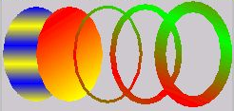
Colors and paints
Color (a simple single-colored paint)
  public Color(int r, int g, int b)
  public Color(int r, int g, int b, int alpha)
    a partially-transparent color (range 0-255, 0=transparent)
GradientPaint (a smooth transition between 2 colors)
  public GradientPaint(float x1, float y1, Color
  color1, float x2, float y2, Color color2)
java.awt.TexturePaint
(use an image as a "paint" background)

Slide 12
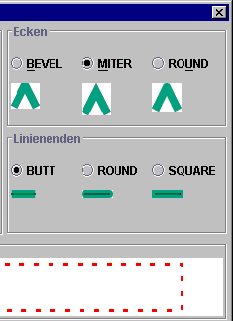
Strokes (pen styles)
Graphics2D
  public void setStroke(Stroke s)
  Sets type of drawing pen (color, width, style)
  that will be used by this Graphics2D.
BasicStroke
A pen stroke for drawing outlines.
  public BasicStroke(float width)
  public BasicStroke(float width, int cap, int join)
  public BasicStroke(float width, int cap,
  int join, float miterlimit,
  float[] dash, float dash_phase)
    cap can be: CAP_BUTT, CAP_ROUND, CAP_SQUARE
    join can be: JOIN_BEVEL, JOIN_MITER, JOIN_ROUND

Slide 13
Repainting
Most canvases are drawing the state of fields, a model, etc.
  When the state updates, you must tell the canvas to re-draw itself.
  But you can't call its paintComponent method, because you don't have the Graphics g to pass.
  The proper way is to call repaint on the canvas instead:
  public void repaint()
    ...
    public void update(Observable o, Object arg) {
    myView.repaint(); // perhaps this.repaint();
    }

Slide 14
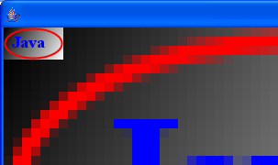
Anti-aliasing
Onscreen text and shapes can have jagged edges, or aliases. These can be removed by smoothing, or anti-aliasing, the component.
  public void setRenderingHint(key, value)
  Example:
  g2.setRenderingHint(
  RenderingHints.KEY_ANTIALIASING,
  RenderingHints.VALUE_ANTIALIAS_ON);

Slide 15
Creating images
// import java.awt.image.*;
BufferedImage
A blank graphic image buffer surface onto which you can draw
  public BufferedImage(int w, int h, int type)
    where type is a constant such as BufferedImage.TYPE_INT_ARGB
  public Graphics getGraphics()
    returns a graphical pen for "drawing on" this image
  you can draw a BufferedImage onto the screen from within the paintComponent method of your canvas:
    g.drawImage(BufferedImage, x, y, this);

