Slide 1
CSE 331
The Strategy and State Patterns
slides created by Marty Stepp
based on materials by M. Ernst, S. Reges, D. Notkin, R. Mercer, Wikipedia
http://www.cs.washington.edu/331/

Slide 2
Gang of Four (GoF) patterns
Creational Patterns (abstracting the object-instantiation process)
  Factory Method Abstract Factory Singleton
  Builder Prototype
Structural Patterns (how objects/classes can be combined)
  Adapter Bridge Composite
  Decorator Facade Flyweight
  Proxy
Behavioral Patterns (communication between objects)
  Command Interpreter Iterator
  Mediator Observer State
  Strategy Chain of Responsibility Visitor
  Template Method

Slide 3
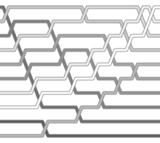
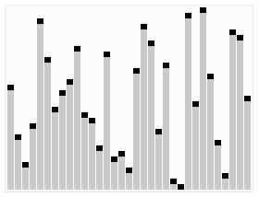
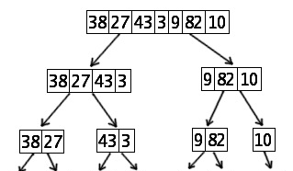
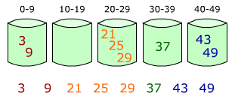
Pattern: Strategy
objects that hold different algorithms to solve a problem

Slide 4
The problem situation
Problem: We want to generalize behavior of one part of our app.
  Example: Layout of components within containers.
  Example: Ways of sorting to arrange data.
  Example: Computer game player AI algorithms.
Poor solutions to the problem:
  Boolean flags or many set methods to enable various algorithms.
    myContainer.useFlow(); game.playerDifficulty(3);
  Lots of if statements in our app to choose between algorithms.
    if (abc) { mergeSort(data); } else if (xyz) { bubbleSort(data); }
  Rewriting entire model classes just to change the algorithm.
    FlowContainer, BorderContainer, ..., EasyPlayer, HardPlayer

Slide 5
Strategy pattern
strategy: An algorithm separated from the object that uses it, and encapsulated as its own object.
  A behavioral pattern.
  Each strategy implements one specific behavior;
  one implementation of how to solve the same problem.
  Separates algorithm for behavior from object that wants to act.
  Allows changing an object's behavior dynamically without extending or changing the object itself.
examples:
  file saving; file compression; sorting; Comparators
  layout managers on GUI containers
  AI algorithms for computer game players
Notes:
difference from Command pattern:
command objects each solve different problems
strategy objects all solve the same problem in different ways

Slide 6
Implementing strategies
Write an interface representing the general behavior / algorithm.
  public interface CardStrategy {...}
Provide a way to supply an object that meets this interface into the larger overall model (sometimes called dependency injection ).
  public class CardGame {
  public void setStrategy(CardStrategy strat) {...}
  }
Write classes that implement the interface w/ specific algorithms.
  public class TimidStrategy implements CardStrategy {...}
  public class RandomStrategy implements CardStrategy {...}
  public class CleverStrategy implements CardStrategy {...}

Slide 7
LayoutManager strategies
Layout managers in Java implement the Strategy pattern.
  Each LayoutManager object has an algorithm to position components.
  public interface LayoutManager {
  void addLayoutComponent(String name, Component comp);
  void layoutContainer(Container container);
  Dimension minimumLayoutSize(Container parent);
  Dimension preferredLayoutSize(Container parent);
  void removeLayoutComponent(Component comp);
  }
  public class BorderLayout implements LayoutManager {...}
  public class FlowLayout implements LayoutManager {...}
  public class GridLayout implements LayoutManager {...}

Slide 8
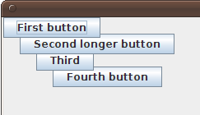
Custom layout example
import java.awt.*;
// Lays out components at preferred sizes in a stack that
// cascades from top/left down with 20px between each.
public class CascadingLayout implements LayoutManager {
private static final int GAP = 20;
public void layoutContainer(Container container) {
int xy = 0;
for (Component comp : container.getComponents()) {
comp.setSize(comp.getPreferredSize());
comp.setLocation(xy, xy);
xy += GAP;
}
}
public Dimension minimumLayoutSize(Container c) {
return new Dimension(0, 0);
}
public Dimension preferredLayoutSize(Container c) {
return new Dimension(500, 500);
}
public void addLayoutComponent(String n, Component c) {}
public void removeLayoutComponent(Component c) {}
}

Slide 9
Strategies as observers
Sometimes strategies must react to changes in the state of a model.
  Example: Game player strategies must play when it is their turn.
So it can be useful to have the strategy observe the model:
  myGame.addObserver(myStrategy);
Possible complication: Can the strategy do something malicious?
Can a rogue strategy put the game into an invalid state?
  How might we avoid or fix this problem?

Slide 10
Strategy exercise
Modify the Rock-Paper-Scissors game to pit a human player against a computer player.
Give the computer player the ability to use different strategies:
  RockStrategy: Always chooses rock.
  RandomStrategy: Chooses completely at random.
  LearningStrategy: Chooses the weapon to beat the weapon that was chosen by the human player last game.
  StatisticalStrategy: Chooses the weapon that will beat the weapon being used by the human player the majority if the time. If there is a tie, chooses any weapon randomly.

Slide 11
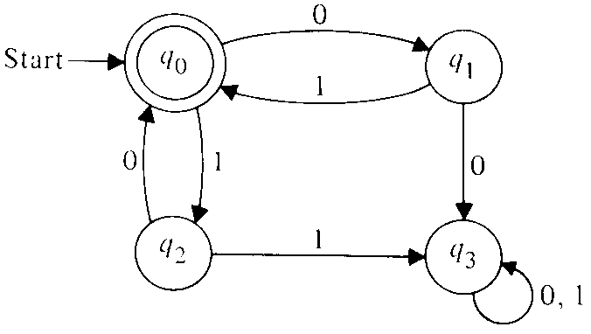
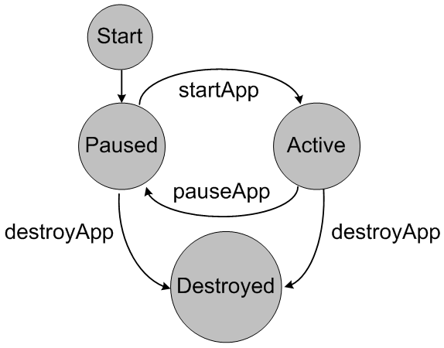
Pattern: State
representing the state of one object using another object

Slide 12
The problem situation
Problem: We have a model with complex states.
  Example: A poker game that can be in progress, betting, drawing, ...
  Example: A network app that can wait for messages, send, ...
  Various parts of our code (in and out of the model) need to understand and react to that state in different ways.
Poor solutions to the problem:
  Trying to deduce the model's state based on complex analysis of various fields within the model.
    if the winner is null and current player is p2, then ...
    if my message buffer queue is empty and 0 bytes available, then ...

Slide 13
State pattern
state: An object whose sole purpose is to represent the current "state" or configuration of another larger object.
  A behavioral pattern.
  Often implemented with an enum type for the states.
  Each state object represents one specific state for the larger object.
  The larger object will set its state in response to various mutations.
  Allows various observers and interested parties to quickly and accurately know what is going on with the larger object's status.
Analogous to the notion of finite state machines.
  Set of states (nodes)
  Set of edges (mutations that cause state changes)
Notes:
difference from Command pattern:
command objects each solve different problems
strategy objects all solve the same problem in different ways

Slide 14
State enum example
// Represents states for a poker game.
public enum GameState {
NOT_STARTED, IN_PROGRESS, WAITING_FOR_BETS,
DEALING, GAME_OVER;
}
// Poker game model class.
public class PokerGame {
private GameState state;
public GameState getState() { return state; }
public void ante(int amount) {
...
state = WAITING_FOR_BETS; // change state
setChanged();
notifyObservers(state);
}
}

