Slide 1
CSE 331
Java Packages; JAR Archives
slides created by Marty Stepp
based on materials by M. Ernst, S. Reges, D. Notkin, R. Mercer, Wikipedia
http://www.cs.washington.edu/331/

Slide 2
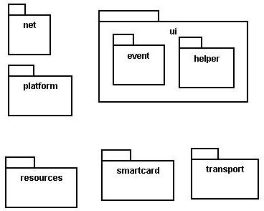
Java packages
package: A collection of related classes.
  Can also "contain" sub-packages.
  Sub-packages can have similar names,
  but are not actually contained inside.
    java.awt does not contain java.awt.event
Uses of Java packages:
  group related classes together
  as a namespace to avoid name collisions
  provide a layer of access / protection
  keep pieces of a project down to a manageable size

Slide 3

Packages and directories
package ←→ directory (folder)
class ←→ file
A class named D in package a.b.c should reside in this file:
a/b/c/D.class
  (relative to the root of your project)
The "root" directory of the package hierarchy is determined by your class path or the directory from which java was run.

Slide 4
Classpath
class path: The location(s) in which Java looks for class files.
Can include:
  the current "working directory" from which you ran javac / java
  other folders
  JAR archives
  URLs
  ...
Can set class path manually when running java at command line:
  java -cp /home/stepp/libs:/foo/bar/jbl MyClass

Slide 5
A package declaration
package name;
public class name { ...
Example:
package pacman.model;
public class Ghost extends Sprite {
...
}
File Sprite.java should go in folder pacman/model .

Slide 6
Importing a package
import packageName.*; // all classes
Example:
package pacman.gui;
import pacman.model.*;
public class PacManGui {
...
Ghost blinky = new Ghost();
}
PacManGui must import the model package in order to use it.

Slide 7
Importing a class
import packageName.className; // one class
Example:
package pacman.gui;
import pacman.model.Sprite;
public class PacManGui {
Ghost blinky = new Ghost();
}
Importing single classes has high precedence:
  if you import .*, a same-named class in the current dir will override
  if you import .className, it will not

Slide 8
Static import
import static packageName.className.*;
Example:
import static java.lang.Math.*;
...
double angle = sin(PI / 2) + ln(E * E);
Static import allows you to refer to the members of another class without writing that class's name.
Should be used rarely and only with classes whose contents are entirely static "utility" code.

Slide 9
Referring to packages
packageName.className
Example:
java.util.Scanner console =
new java.util.Scanner(java.lang.System.in);
You can use a type from any package without importing it if you write its full name.
Sometimes this is useful to disambiguate similar names.
  Example: java.awt.List and java.util.List
  Or, explicitly import one of the classes.

Slide 10
The default package
Compilation units (files) that do not declare a package are put into a default, unnamed, package.
Classes in the default package:
  Cannot be imported
  Cannot be used by classes in other packages
Many editors discourage the use of the default package.
Package java.lang is implicitly imported in all programs by default.
  import java.lang.*;

Slide 11
Package access
Java provides the following access modifiers:
  public : Visible to all other classes.
  private : Visible only to the current class (and any nested types).
  protected : Visible to the current class, any of its subclasses, and any other types within the same package.
  default (package): Visible to the current class and any other types within the same package.
To give a member default scope, do not write a modifier:
  package pacman.model;
  public class Sprite {
  int points; // visible to pacman.model.*
  String name; // visible to pacman.model.*

Slide 12
Package exercise
Add packages to the Rock-Paper-Scissors game.
  Create a package for core "model" data.
  Create a package for graphical "view" classes.
  Any general utility code can go into a default package or into another named utility (util) package.
  Add appropriate package and import statements so that the types can use each other properly.

Slide 13

JAR Files (yousa likey!)
JAR: Java ARchive. A group of Java classes and supporting files combined into a single file compressed with ZIP format, and given .JAR extension.
Advantages of JAR files:
  compressed; quicker download
  just one file; less mess
  can be executable
The closest you can get to having a .exe
file for your Java application.

Slide 14
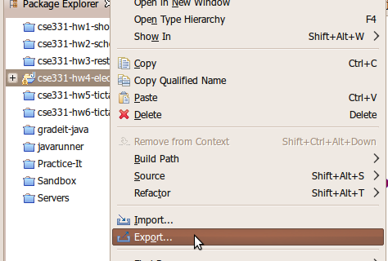
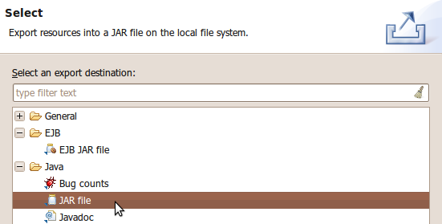
Creating a JAR archive
from the command line:
  jar -cvf filename.jar files
  Example:
  jar -cvf MyProgram.jar *.class *.gif *.jpg
some IDEs (e.g. Eclipse) can create JARs automatically
  File → Export... → JAR file

Slide 15
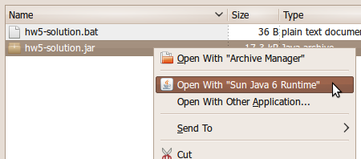
Running a JAR
Running a JAR from the command line:
  java -jar filename.jar
Most OSes can run JARs directly by double-clicking them:

Slide 16
Making a runnable JAR
manifest file: Used to create a JAR runnable as a program.
  jar -cvmf manifestFile MyAppletJar.jar
  mypackage/*.class *.gif
  Contents of MANIFEST file:
  Main-Class: MainClassName
  Eclipse will automatically generate and insert a proper manifest file into your JAR if you specify the main-class to use.

Slide 17
Resources inside a JAR
You can embed external resources inside your JAR:
  images (GIF, JPG, PNG, etc.)
  audio files (WAV, MP3)
  input data files (TXT, DAT, etc.)
  ...
But code for opening files will look outside your JAR, not inside it.
  Scanner in = new Scanner(new File("data.txt")); // fail
  ImageIcon icon = new ImageIcon("pony.png"); // fail
  Toolkit.getDefaultToolkit().getImage("cat.jpg"); // fail

Slide 18
Accessing JAR resources
Every class has an associated .class object with these methods:
  public URL getResource(String filename)
  public InputStream getResourceAsStream(String name)
If a class named Example wants to load resources from within a JAR, its code to do so should be the following:
  Scanner in = new Scanner(
  Example.class.getResourceAsStream("/data.txt"));
  ImageIcon icon = new ImageIcon(
  Example.class.getResource("/pony.png"));
  Toolkit.getDefaultToolkit().getImage(
  Example.class.getResource("/images/cat.jpg"));
  (Some classes like Scanner read from streams; some like Toolkit read from URLs.)
  NOTE the very important leading / character; without it, you will get a null result

Slide 19
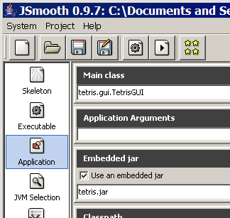
JAR to EXE (JSmooth)
JSmooth is a free program that
converts JARs into Windows EXE files.
  http://jsmooth.sourceforge.net/
  If the machine does not have Java
  installed, your EXE will help the user
  to download and install Java.
  A bit of a hack; not generally needed.
Using JSmooth:
  choose Skeleton → Windowed Wrapper
  name your .exe under Executable → Executable Binary
  browse to your .jar under Application → Embedded JAR
  select the main class under Application → Main class

