Slide 1
CSE 331
Timers, Threads, and Concurrency
slides created by Marty Stepp
based on materials by M. Ernst, S. Reges, D. Notkin, R. Mercer, Wikipedia
http://www.cs.washington.edu/331/

Slide 2

Timers
timer: An object that executes an action
repeatedly at given intervals.
Used to:
  create animations in GUI programs.
  add delays and pauses when required / desired.
  update the appearance of a UI periodically.
A Timer is an example of a "callback." Your code starts the timer, then later at a specified time, the timer activates, causing an event in your system.

Slide 3
The Timer class
import javax.swing.Timer;
  public Timer(int msDelay, ActionListener listener)
  Constructs a timer to fire an action event every msDelay ms.
method | description
start() | starts timer to generate events
stop() | stops timer so that no more events will occur
restart() | resumes a stopped timer, waiting its initial delay and then firing events at the usual rate
addActionListener(AL) | attaches an additional listener to the timer
isRunning() | returns true if the timer has been started
setInitialDelay(ms) | sets initial delay before first event, which can be different from delay between events
setRepeats(boolean) | set to false to cause a one-time event

Slide 4
Timer example
// This code might move a shape across the screen.
private int DELAY = 100;
...
public class Painter implements ActionListener {
public void actionPerformed(ActionEvent event) {
x += 5;
myPanel.repaint();
}
}
...
Timer tim = new Timer(DELAY, new Painter());
tim.start();

Slide 5
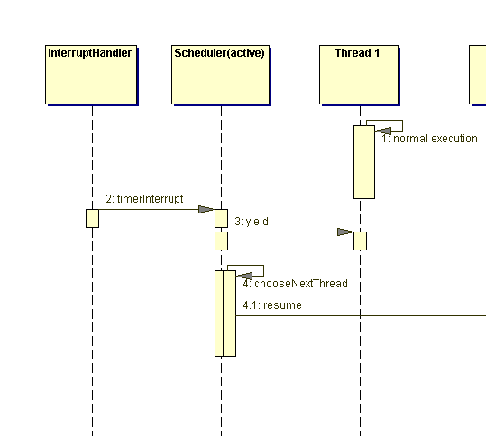
Processes and threads
process: A program running on the computer.
  Processes have memory isolation (don't share data with each other).
thread: A "lightweight process"; a single sequential flow of execution or isolated sub-task within one program.
  A means to implement programs that seem to perform multiple tasks simultaneously (a.k.a. concurrency).
  Threads within the same process do share data with each other.
    i.e., Variables created in one thread can be seen by others.
    "shared-memory concurrency"
  sometimes called a lightweight process

Slide 6
Places threads are used
I/O
  loading a file in the background
Networking
  example: thread that waits for another machine to connect
Graphics and animation
  Timer class is sometimes preferred for this (seen later)
event-handling loops
  largely handled for us by Java
parallelized algorithms
  example: multithreaded merge sort

Slide 7
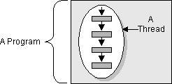
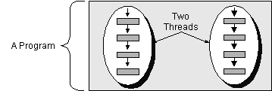
A multithreaded program
1 thread:
  program executes sequentially
  every program has a "main thread" for its main method
pre-emptive scheduling: OS lets each thread/process run for a short time slice then switches to another.
  High priority threads run first.
2 or more threads:
  runs each thread sequentially, but interleaves them
  overall program is concurrent

Slide 8
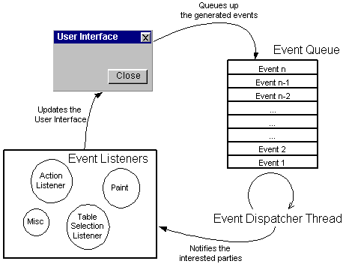
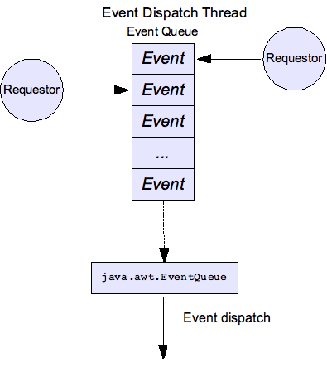
AWT/Swing event thread
The first time your program creates an AWT or Swing component, it causes an event dispatcher thread to be started.
  The event thread is the thread in which all event listeners (ActionListener, MouseListener, etc.) execute when events occur.
  Listeners should be short so they don't block each other or the GUI.
daemon thread: One that runs
solely to aid other threads.

Slide 9
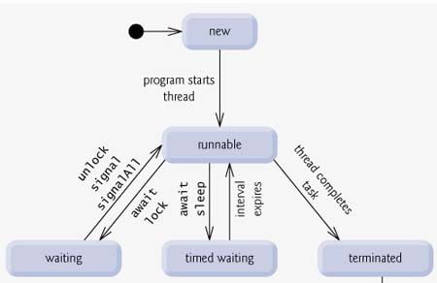
Thread states
new: Just constructed; hasn't started to run yet.
runnable: Running, or enqueued to be run.
blocked or waiting: Asleep, not running; waiting for some signal from elsewhere in the program to resume.
timed waiting: Waiting a given exact amount of time to resume.
terminated: Done running.
  see Thread's getState()

Slide 10
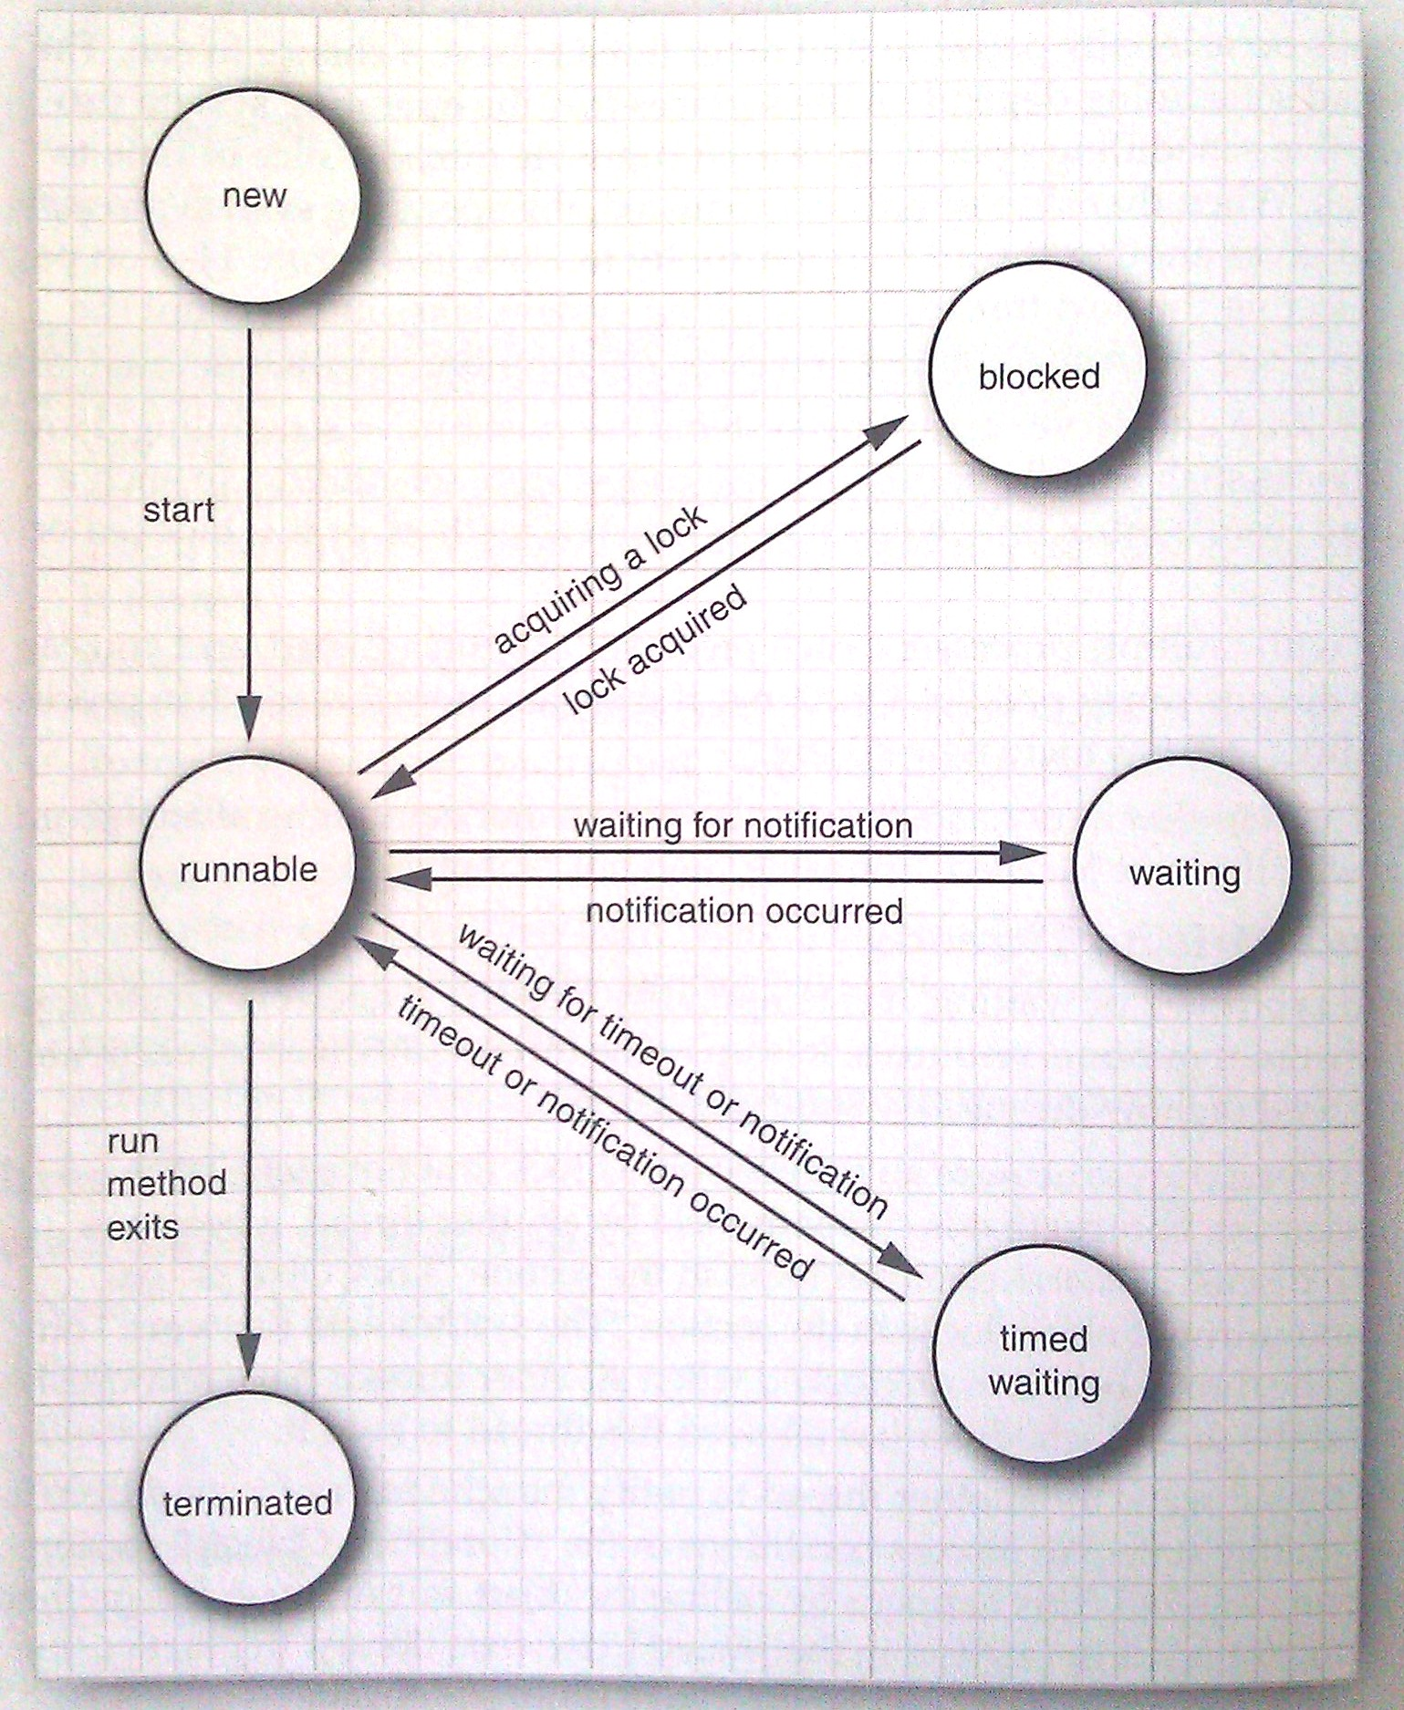
Thread state diagram
(Core Java Figure 14-3)

Slide 11
Thread object methods
Method name | Description
getPriority() setPriority(int) | gets/sets this thread's running priority. Possible values: Thread.MIN_PRIORITY, NORM_PRIORITY, MAX_PRIORITY
getName() setName(name) | gets/sets the name of this thread as a string
getState() | thread's state. One of Thread.State.NEW, RUNNABLE, BLOCKED, WAITING, TIMED_WAITING, or TERMINATED
interrupt() | stops the thread's current time slice
isAlive() | returns true if the thread is in runnable state
join() join(ms) | waits indefinitely, or for a given number of milliseconds, for the thread to finish running
start() | puts a thread into runnable state
stop() | instructs a thread to stop immediately (deprecated)

Slide 12
Thread static methods
Static method name | Description
activeCount() | number of currently runnable/active threads
dumpStack() | causes current thread to print a stack trace
getAllStackTraces() | returns stack trace data for all currently running threads
getCurrentThread() | returns the current code's active thread
holdsLock(obj) | returns true if current thread has locked the given object
interrupted() | returns true if current thread is in interrupted state
setDefaultUncaughtExceptionHandler(handler) | redefines what to do if an exception is not caught and reaches all the way up the stack to the top level
sleep(ms) | causes the current thread to wait for at least the given number of ms before continuing
yield() | temporarily pauses the current thread to let others run

Slide 13
The Runnable class
To cause your own code to run in its own thread, write a class that implements the Runnable interface.
  Then construct a new Thread, passing your runnable object,
  and start the thread.
  public Thread(Runnable runnable)
  public interface Runnable {
  public void run();
  }

Slide 14
Runnable example
  public class MyRunnable implements Runnable {
  public void run() {
  // perform a task...
  }
  }
  ...
  Thread t = new Thread(new MyRunnable());
  t.start();
Sometimes done with an anonymous inner class:
  new Thread(new Runnable() {
  public void run() {
  // perform a task...
  }
  }).start();

Slide 15
Problem: Infinite loops
Suppose we want to write a testing system that runs methods written by students and verifies their behavior.
  But some students write poor code that goes into an infinite loop:
  // run code that might have an infinite loop
  // (student might have a bug in his code)
  StudentCode student = new StudentCode();
  student.doStuff(); // might hang
  // if doStuff hangs, this will never be reached
  System.out.println("Completed.");
  The student's bug will hang our entire testing system! What to do?

Slide 16
Waiting for a thread
  // run code that might have an infinite loop
  StudentCode student = new StudentCode();
  ...
  Thread t = new Thread(new Runnable() {
  public void run() {
  student.doStuff(); // might hang
  }
  });
  // run code in thread and give up after 10 sec
  t.start();
  try {
  t.join(10000);
  } catch (InterruptedException ie) {}
  if (t.isAlive()) {
  System.out.println("Timed out!");
  } else {
  System.out.println("Completed.");
  }

Slide 17
Sleeping a thread
  try {
  Thread.sleep(ms);
  } catch (InterruptedException ie) {}
  Causes current thread to wait for the given number of milliseconds.
  If the program has other threads, they will be given a chance to run.
  Useful for writing code that checks for an update periodically.
  // check for new network messages every 2 sec
  while (!done) {
  try {
  Thread.sleep(2000);
  } catch (InterruptedException ie) {}
  myMessageQueue.read();
  ...
  }

Slide 18
Thread safety
thread safe: Can be used in a multithreaded environment.
  Many of the Java library classes are not thread safe!
  In other words, if two threads access the same object, things break.
Examples:
  AWT and Swing are not thread safe; if two threads are modifying a GUI simultaneously, they may put the GUI into an invalid state.
  ArrayList and other collections from java.util are not thread safe; two threads changing the same list at once may break it.
  StringBuilder is not thread safe.
Counterexamples:
  The Random class chooses numbers in a thread-safe way.

Slide 19
Unsafe code
How can the following class be broken by multiple threads?
1 public class Counter {
2 private int c = 0;
3 public void increment() {
4 int old = c;
5 c = old + 1; // c++;
6 }
7 public void decrement() {
8 int old = c;
9 c = old - 1; // c--;
10 }
11 public int value() {
12 return c;
13 }
14 }
Scenario that breaks it:
Threads A and B start.
A calls increment and runs to the end of line 4. It retrieves the old value of 0.
B calls decrement and runs to the end of line 8. It retrieves the old value of 0.
A sets c to its old (0) + 1.
B sets c to its old (0) - 1.
The final value() is -1, though after one increment and one decrement, it should be 0!

Slide 20
Object locks
Every Java object has a built-in internal "lock".
  A thread can "wait" on an object's lock, causing it to pause.
  Another thread can "notify" on an object's lock, unpausing any other thread(s) that are currently waiting on that lock.
  An implementation of monitors, a classic concurrency construct.
  These methods are not often used directly; but they are used internally by other concurrency constructs (see next slide).
method | description
notify() | unblocks one random thread waiting on this object's lock
notifyAll() | unblocks all threads waiting on this object's lock
wait() wait(ms) | causes the current thread to wait (block) on this object's lock, indefinitely or for a given # of ms

Slide 21
The synchronized keyword
  // synchronized method: uses "this" object's lock
  public synchronized type name(parameters) {
  statement(s);
  }
  // synchronized static method: uses the given class's lock
  public static synchronized type name(parameters) {
  statement(s);
  }
  // synchronized block: uses the given object's lock
  synchronized (object) {
  statement(s);
  }
The keyword synchronized causes a given method or block of code to acquire an object's lock before running.
  Ensures that only one thread can be in the given block at a time.

Slide 22
The volatile keyword
private volatile type name;
volatile field: An indication to the VM that multiple threads may try to access/update the field's value at the same time.
  Causes Java to immediately flush any internal caches any time the field's value changes, so that later threads that try to read the value will always see the new value (never the stale old value).
  Allows limited safe concurrent access to a field inside an object even if another thread may modify the field's value.
  Does not solve all concurrency issues; should be replaced by synchronized blocks if more complex access is needed.

Slide 23
Synchronized counter
  public class Counter {
  private volatile int c = 0;
  public synchronized void increment() {
  int old = c;
  c = old + 1; // c++;
  }
  public synchronized void decrement() {
  int old = c;
  c = old - 1; // c--;
  }
  public int value() {
  return c;
  }
  }
  Should the value method be synchronized? Why/why not?

Slide 24
Deadlock
liveness: Ability for a multithreaded program to run promptly.
deadlock: Situation where two or more threads are blocked forever, waiting for each other.
  Example: Each is waiting for the other's locked resource.
  Example: Each has too large of a synchronized block.
livelock: Situation where two or more threads are caught in an infinite cycle of responding to each other.
starvation: Situation where one or more threads are unable to make progress because of another "greedy" thread.
  Example: thread with a long-running synchronized method

Slide 25
Concurrency and collections
Collections from java.util are not thread safe!
  When two or more threads try to modify the same collection through an iterator, you get a ConcurrentModificationException.
  When ≥ 2 threads modify a collection otherwise, bad state can result.
But Java provides thread-safe collection wrapper objects via static methods in the Collections class:
Method
synchronizedCollection(coll)
synchronizedList(list)
synchronizedMap(map)
synchronizedSet(set)

Slide 26
When to make it safe?
When creating classes for a library, you may not know exactly how the classes will be used.
  Synchronizing everything makes your class slower.
  Give clients a choice by supplying a thread-safe wrapper object.
Or use an immutable object, especially if the object is small or represents a fundamental data type.
  Immutable objects are inherently thread safe.
When making an object thread-safe, synchronize only the critical sections of the class.

Slide 27
New classes for locking
  import java.util.concurrent.*;
  import java.util.concurrent.locks.*;
These classes offer higher granularity and control than the synchronized keyword can provide.
  Not needed by most programs.
  java.util.concurrent also contains blocking data structures.
Class/interface | description
Lock | an interface for controlling access to a shared resource
ReentrantLock | a class that implements Lock
ReadWriteLock | like Lock but separates read operations from writes
Condition | a particular shared resource that can be waited upon; conditions are acquired by asking for one from a Lock

