Slide 1
CSE 331
Group Projects and Teams
slides created by Marty Stepp
based on materials by M. Ernst, S. Reges, D. Notkin, R. Mercer, Wikipedia
http://www.cs.washington.edu/331/

Slide 2
Team pros and cons
Having more people work together has benefits:
  Attack bigger problems in a short period of time.
  Utilize the collective experience of everyone.
Having more people has risks, too
  Communication issues, conflict, and mistrust.
  Diffusion of responsibility.
Successful teams give each member clear responsibilities:
  Each person knows and is accountable for their work.
  Monitor each person's individual performance.
Have an effective communication system:
  Don't allow a problem to fester until it's too late (a "boiled frog").

Slide 3
Team organization
Most successful teams break into sub-groups by functionality.
  GUI team? Model team?
  Strategies team? Testing team?
  ...
Possible individual roles:
  unofficial team manager to break ties or make decisions
  (But you are all "equals," so nobody is truly the boss of anybody)
  communication manager or secretary
  (checks up on group members' progress; sends emails to TA)
  meeting planner (coordinates when people will get together)

Slide 4
Leadership and decisions
How are big decisions made in your team?
  One person? All, by unanimous consent? Majority vote? ...
Let everyone give their input (even if some of it is off-track).
  Write down pros/cons of alternatives in a grid or table (weighted?).
Have a clear procedure for what to do for a disagreement.
  Strive for consensus, but if it cannot be achieved, ...
  Majority vote? Designate a "manager" who decides on a tie? etc.
Compromise, compromise, compromise.

Slide 5
Once decisions are made
Write down decisions and responsibilities clearly:
  document by email, or post to a shared wiki or web page
Come up with a set of steps to accomplish the decided goal:
  list specific dates that progress should be made
  come up with several small milestones within the overall goal
  agree to communicate and/or meet after milestones are done
prioritize and order goals and TODOs:
  list them by urgency, by due date (or milestone date)
  make sure to list group member(s) are responsible for which
  make sure every group member has a significant role

Slide 6
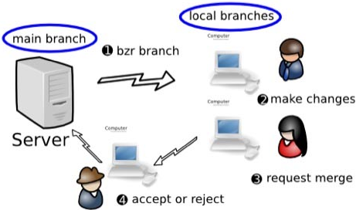
Version Control
When working on a non-trivial piece of code in a group, always use a version control system (svn, git, mercurial, ...).
  Don't just store the code on someone's computer.
  Don't email code files to each other.
Version control benefits:
  avoids overwriting changes
  shared access to code
  safe backup
  allows branching and merging

Slide 7
Coding nicely with others
Make sure that the code you check in is robust from the start.
  Add your error-handling and argument-checking early.
  State your class invariants and preconditions, and check for them.
  This way, partners using your objects won't have hidden bugs.
Make check-ins of appropriate size and frequency.
  Don't work for days and then check in 1,000 lines of code.
  But don't check in every few new lines you write.
  Don't check in code that is broken, doesn't compile, or will cause another part of the app to break.
  Resolve any merge conflicts carefully if necessary.
  Always write descriptive check-in text so others know what you did.

Slide 8
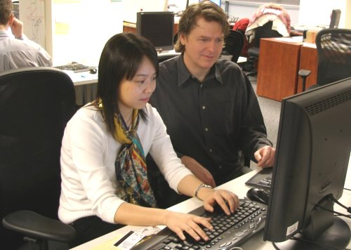
"Extreme" programming
pair programming: Two programmers working together at the same computer at the same time.
  supposed to sit close to each other
  take turns "driving" at the keyboard (very important!)
  nobody types any code until both people agree and understand
Benefits:
  Doesn't produce 2x the code.
  But produces better code.
  Weaker programmers learn.
  Stronger programmers avoid
  writing hackish code.

Slide 9
Achieving productivity
How can you get the most out of your team members?
  Give them specific, small, attainable goals that they can visualize.
  Have frequent communication and updates.
  Meet in person to work as much as possible.
  Put people in small teams (~2); minimize work done "solo."
  Build good team camaraderie.
What can block people or stop them from making progress?
  technical confusion: How do I start implementing that feature?
  unclear responsibilities: Oh, am I supposed to do that?
  unclear due dates: When was I supposed to have that done?
  lack of milestones: But it's not due until next Friday!
  laziness: Time to work on code ... Ooh look, World of Warcraft!

Slide 10
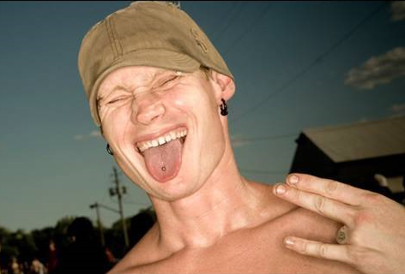
Dealing with slackers
What do you do if a group member is
slacking off instead of working?
  Check up on them frequently.
  Give them less "solo" work;
  put them in a sub-team of 2-3.
  Have them meet more in person (harder to slack in front of you).
If the problem persists, then what?
  Anonymous feedback
  Have others send them a kind but firm email with concerns.
  Have an in-person meeting with a few members.
  Contact us to let them know about the potential issue.

Slide 11
Email question
What's wrong with this email?
  "Hey Jim, I was wondering if you finished the XYZ feature you were assigned yet? You really messed up the ABC feature last week so I thought I better email you. It's due the day after tomorrow at 8am, you know! When you have time, please tell me if XYZ is done, okay?
  -- Ralph"

Slide 12
Being quantitative
Be quantitative and specific:
  Use specific, incremental goals, not just for things to be "done."
  List particular dates that results are expected.
  Give an expected date/time to reply to a communication.
  Don't be accusatory; offer support, help, gratitude as appropriate.
  Remind about upcoming deadlines, meetings, key points.
possibly better email:
  "Hey Jim, how is your work on the XYZ going? It's due a week from Friday. Like we talked about at our last meeting, we are hoping to have the rough sketch of the first 2/3 of it by Sunday so we can go over it together. Please let me know by tomorrow night how much progress has been made. If you have any questions or need some assistance along the way, please let me know. We'll all meet Saturday in person and you can give us another update at that time. Thanks! -- Ralph"

Slide 13
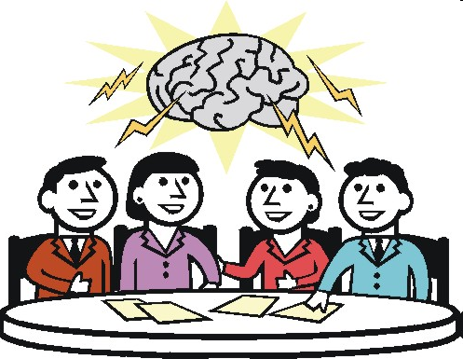
Running a meeting
How to run an effective meeting:
  Bring an agenda of topics to discuss
  (best to email this ahead of time).
  Each member/subgroup reports its progress.
  Get an update on every current work item.
  Take notes on decisions made and post or them to everyone.
  Have a whiteboard/paper handy for sketching out ideas.
  Keep everyone's attention (maybe ban laptops / cell phones, etc).
  Walk away with a clear plan of action, set of TODOs, etc.

Slide 14
Meeting gotchas
  Don't tolerate people showing up late, not being on task, etc.
    Punctuality is expected; have an on-task discussion.
  Don't ignore a group member's input
    Even if you don't go forward with their idea, at least listen to it.
  Don't let it run too long (people hate long meetings).
    If a discussion is sidetracked, steer the group back to the agenda.
    If still running over, find a stopping point and save some for next time.
    Agree to discuss some issues over email if necessary.
  Don't "meet just to meet"
    if you have nothing to discuss, make it a "work meeting" in the lab or cancel the meeting altogether (no one will complain)
  Don't use meetings for one-way flow of information (use email).

