Slide 1
CSE 331
Memento Pattern
slides created by Marty Stepp
based on materials by M. Ernst, S. Reges, D. Notkin, R. Mercer, Wikipedia
http://www.cs.washington.edu/331/

Slide 2
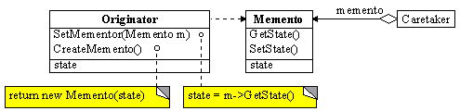
Pattern: Memento
a memory snapshot of an object's state

Slide 3
The problem situation
Problem: Sometimes we want to remember a version of an important object's state at a particular moment.
  example: Writing an Undo / Redo operation.
  example: Ensuring consistent state in a network.
  example: persistency; save / load state between runs of a program.
Poor solutions to this problem:
  Writing out the object's state as a formatted text file,
  reading it back in and parsing it again later.
  Making many deep copies of the object.

Slide 4
Memento pattern
memento: A saved "snapshot" of the state of an object or objects for possible later use.
  Often involves a mechanism for transporting an object from one location to another and back again.
We'll examine Memento in the context of saving an object to disk using streams.

Slide 5
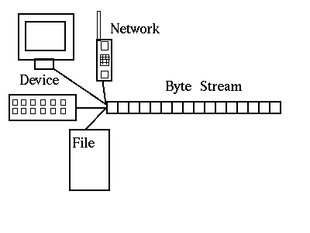
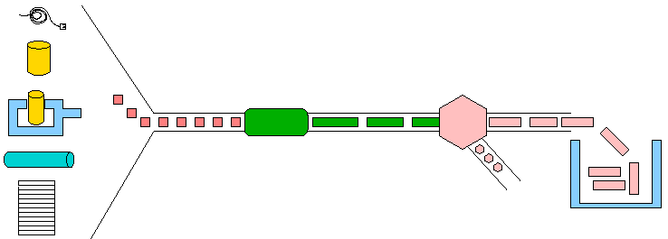
I/O streams, briefly
stream: An abstraction of a source or target of data.
  8-bit bytes flow to (output) and from (input) streams.
Can represent many data sources:
  files on hard disk
  another computer on network
  web page
  input device (keyboard, mouse, etc.)
Represented by java.io classes:
  InputStream
  OutputStream

Slide 6
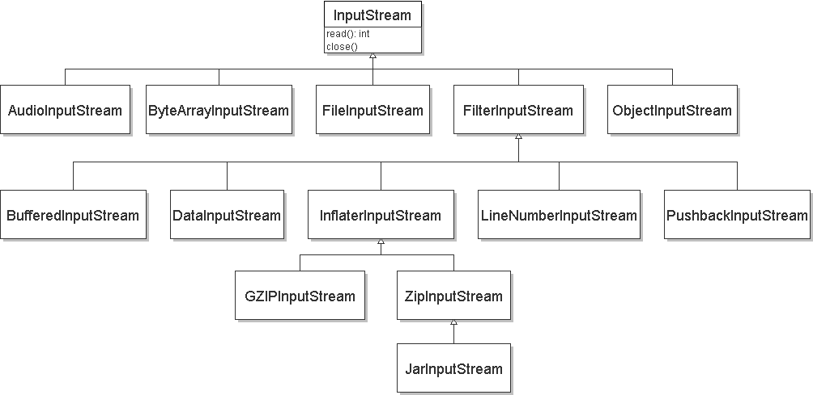
Streams and inheritance
all input streams extend common superclass InputStream;
all output streams extend common superclass OutputStream
  Guarantees that all sources of data have the same methods.
  Provides minimal ability to read/write one byte at a time.

Slide 7
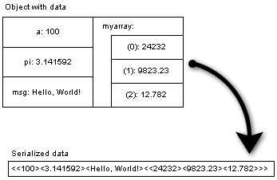
Serialization
serialization: Reading / writing objects and their exact state into a linear format using I/O streams.
  Entire objects can be written to files, a network, a database, etc.
  Lets you save your objects to disk and restore later.
  Avoids converting object's state into an arbitrary text format.

Slide 8
Classes for serialization
ObjectOutputStream : A connection to write (save) objects.
  public class ObjectOutputStream
    public ObjectOutputStream(OutputStream out)
    public void writeObject(Object o)
    throws IOException
ObjectInputStream : A connection to read (load) objects.
  public class ObjectInputStream
    public ObjectInputStream(InputStream in)
    public Object readObject() throws Exception
Common read/write target: A file.
  A FileInputStream or FileOutputStream can be constructed by passing a file name string.

Slide 9
Serialization example
// write the given object to the given file
try {
OutputStream os = new FileOutputStream("filename");
ObjectOutputStream oos = new ObjectOutputStream(os);
oos.writeObject(object);
oos.close();
} catch (IOException e) { ... }
// load the object named someObject from file "file.dat"
try {
InputStream is = new FileInputStream("filename");
ObjectInputStream ois = new ObjectInputStream(is);
Type name = (Type) ois.readObject();
ois.close();
} catch (Exception e) { ... }

Slide 10
Making a class serializable
You must implement the (methodless) java.io.Serializable interface for your class to be compatible with streams.
  public class BankAccount implements Serializable {
  ...
  (Recall: Methodless "tagging" interfaces (Serializable, Cloneable) pre-date better techniques such as annotations.)

Slide 11
serialVersionUID
There is a versioning issue with serializing / deserializing objects.
  You might save a BankAccount object, then edit and recompile the class, and later try to load the (now obsolete) object.
  Serializable objects should have a field inside named serialVersionUID that marks the "version" of the code.
    (You can set it to 1 and never change it.)
  public class BankAccount implements Serializable {
  private static final long serialVersionUID = 1;
  ...

Slide 12
Serializable fields
When you make a class serializable, all of its fields must be serializable as well.
  All primitive types are serializable.
  Many built-in objects are serializable:
    String, URL, Date, Point, Random
    all collections from java.util (ArrayList, HashMap, TreeSet, etc.)
  But your own custom types might not be serializable!
If you try to save an object that is not serializable or has non-serializable fields, you will get a NotSerializableException.

Slide 13
Transient fields
transient: Will not be saved during serialization.
private transient type name;
Example:
private transient PrintStream out;
Ensure that all instance variables inside your class are either serializable or declared transient.
  A transient field won't be saved when object is serialized.
  When deserialized, the field's value will revert back to null .

Slide 14
Custom serialization
The object in/out streams have a default notion of how objects should be serialized and saved.
  If this is unsatisfactory for your object for some reason, you can override it by writing these methods in your class:
  private void writeObject(ObjectOutputStream out)
  throws IOException
  private void readObject(java.io.ObjectInputStream in)
  throws IOException, ClassNotFoundException
  private void readObjectNoData()
  throws ObjectStreamException

