Slide 1
Early identification of Glacial Lakes Outburst Floods (GLOFs) using deep learning algorithms with different backbones and loss functions
Sundeep Raj , Assistant Professor , CSEAIML, KIET Ghaziabad
Shikhar Singh , B.Tech CSEAI , KIET Ghaziabad
Vilakshan Saini , B.Tech CSEAI , KIET Ghaziabad
Shakti Kumar , B.Tech CSEAI , KIET Ghaziabad

Slide 2
Outline of Proceedings
INTRODUCTION
PROBLEM STATEMENT
DATASET DESTRIPTION & STUDY REGION
LITERATURE REVIEW
METHODOLOGY
RESULTS
FUTURE WORK
REFERENCES

Slide 3
Introduction
GLOFs are powerful and infrequent events capable of causing sudden, destructive floods and reshaping entire mountain landscapes.
With global temperatures increasing, the expansion of glacial lakes has made high-altitude regions more exposed to this threat.
By leveraging advanced deep learning models on satellite data, we aim to deliver precise glacial lake identification and strengthen early detection systems for GLOF prevention.
These models enable continuous, large-scale monitoring of dynamic glacial environments, reducing the dependence on manual assessment and field-based observations.
The resulting insights support more reliable early-warning systems and inform disaster-preparedness strategies for communities at risk.

Slide 4
Problem Statement
Research Gap and Challenges:
Climate change has intensified glacial melt, leading to a rising incidence of GLOF events.
Existing detection and monitoring techniques are often slow, labor-intensive, and limited in scalability.
The severe socioeconomic consequences for high-risk communities highlight the need for timely and reliable early-warning mechanisms.
There is a lack of comprehensive studies evaluating the effectiveness of Deep Learning models for accurate segmentation and classification of glacial lakes.
Achieving robust GLOF prediction accuracy remains a significant challenge.

Slide 5
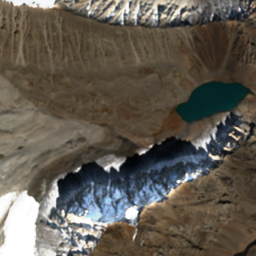
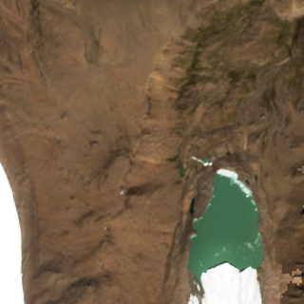
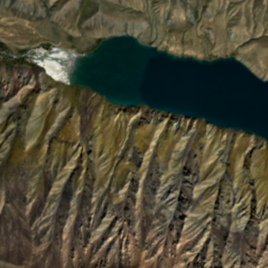
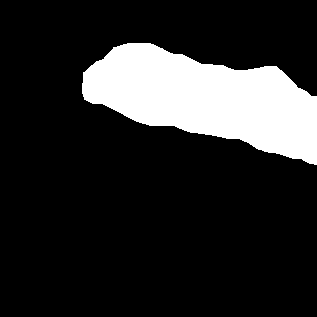
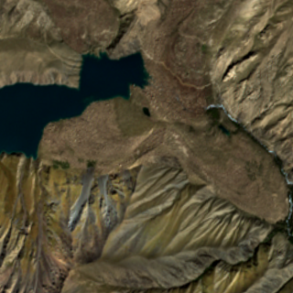
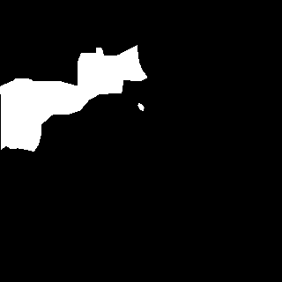
Dataset Description
Dataset contains 1200 optical images from Sentinel 2, operated by the European Space Agency.
Training set: 1000 Test set: 200
Each set contains three folders, namely:
images: optical images (*.png)
labels: ground truth segmentation RGB masks (*.png)
labels_1D: ground truth segmentation labels (*.png)
RGB Masks:
Black: Background White: Lake
RGB Values:
Black: (0,0,0) White: (255,255,255)
1_D Labels:
0: Background 1: Lake
Purchased subscription of IEEE Dataport to get this dataset
Random images from the Sentinel-2 dataset displaying lakes of different colours and varying topographical features, including snow-covered mountains and glacial terrain.
Row 1 shows the Sentinel-2 RGB coloured images of glacial lakes, Row 2 shows their respective ground truth masks.

Slide 6
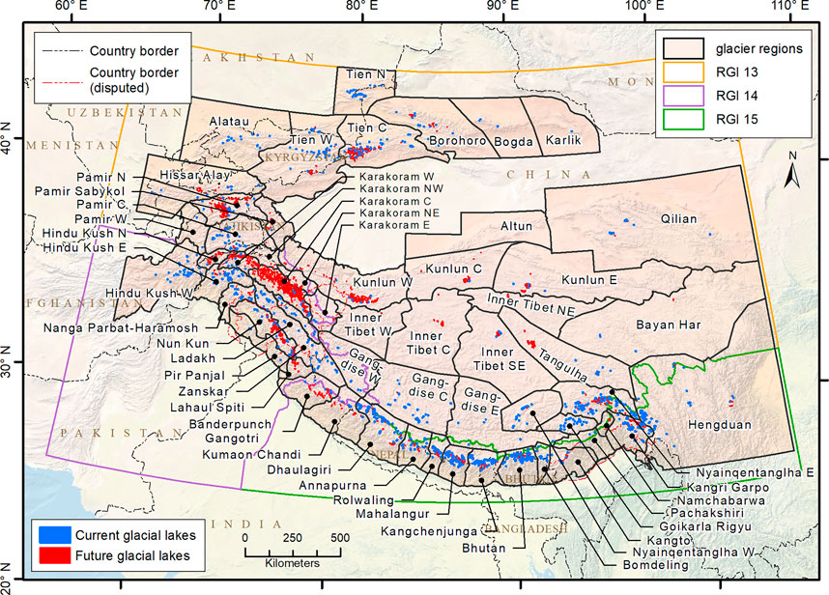
STUDY REGION
The provided glacial lake map , delineates the area of study for our research. The map depicts both existing and projected glacial lakes situated in the High Mountain Asia region. The layout image has been published in paper called the Glacial Lake Evolution in High Mountain Asia.

Slide 7
LITERATURE REVIEW
Method Category (From Literature) | Representative Paper(s) | Architecture / Approach | Reported/Typical Outcome in Literature | Performance in This Work (IoU %) | Improvement of Proposed Method
Traditional U-Net baseline | Su et al. (2019) [4] | Encoder–decoder without advanced context modules | 65–72% IoU commonly reported for high-resolution RS segmentation | 73.30% (U-Net vanilla) | +1.3–8.3% over literature baseline
U-Net with pretrained backbones | Kaushik et al. (2022) [6] | U-Net + CNN backbone | Performance improves but sensitive to domain shift; moderate gains | 58.60% (U-Net+ResNet50) | — (our dataset shows domain mismatch)
EfficientNet-based segmentation | Tan & Le (2019) [9] | Scaled backbone improves efficiency | Reported success in natural images; mixed RS performance | 40.71% (U-Net+EffB0) | — (underperforms for our task)
DeepLab family with ASPP | Hu et al. (2021) [7] | DeepLabV3+ with multi-scale context (ASPP) | Typically, 70–80% IoU in complex RS scenes | 66.09% (CE) → 74.69% (Dice) | Matches upper bound of literature; +8.6% (Dice vs CE)
Boundary / overlap-aware losses | Cheng et al. (2021) [8] | Boundary IoU, Dice to improve small-object segmentation | Reported 4–6% IoU gain over CE | 66.09% → 74.69% with Dice | +8.6% gain (exceeds typical improvement)
Historically guided segmentation | Ortiz et al. 2022 [16] | Temporal priors used for glacial lakes | High stability but requires time-series | Not implemented in this work | —

Slide 8
How Your Approach Outperforms Literature Techniques
Our DeepLabV3+ + ResNet50 + Dice Loss achieves IoU = 74.69%, which falls in the upper performance range of what modern remote-sensing segmentation papers report, confirming strong generalization despite dataset challenges.
Our vanilla U-Net (73.30% IoU) already exceeds the typical U-Net baseline range (65–72%) reported in multiple studies, demonstrating effective preprocessing and augmentation.
Dice Loss provides an 8.6% absolute IoU improvement over Cross-Entropy, which is higher than the usual 4–6% gain reported in literature, confirming its suitability for highly imbalanced glacial-lake segmentation.
EfficientNetB0 underperforms (40.71% IoU) compared to expectations from natural-image studies, highlighting that lightweight models are not ideal for high-mountain remote sensing — consistent with findings in [9].
Our DeepLabV3+ configuration performs competitively with advanced RS segmentation techniques, even without temporal priors or multispectral bands.

Slide 9
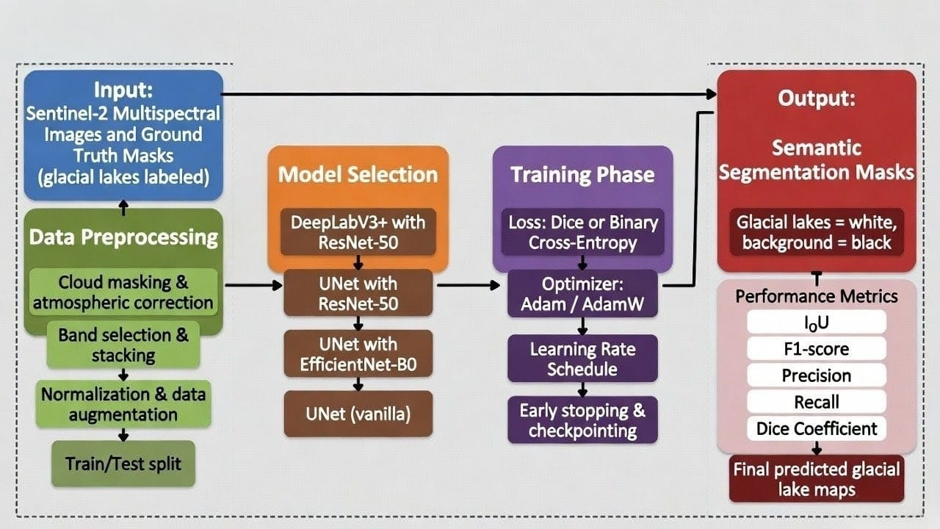


Methodology
Figure by: Shikhar Singh
Output:
Semantic Segmentation masks: Glacial Lakes=white
Background=black
Performance Metrics:
IoU
F1 score
Precision
Accuracy
Recall
Dice Coefficient
IoU

Slide 10
Methodology
Model Selection
Model | Backbone | Loss Functions | Key Feature | Training Process | Hyperparameters
DeepLabV3+ | ResNet50 | Binary cross-entropy, Dice Loss | - Advanced decoder for segmentation - Utilizes ASPP for multi-scale context extraction | 30 epochs | LR = 1e Optimizer: Adam
U-Net (Vanilla & Hybrid) | ResNet50, EfficientNetB0 | Cross-entropy, Dice Loss | - Encoder-decoder architecture - Skip connections | 50 epochs | LR = 1e-3 Optimizer: Adam

Slide 11
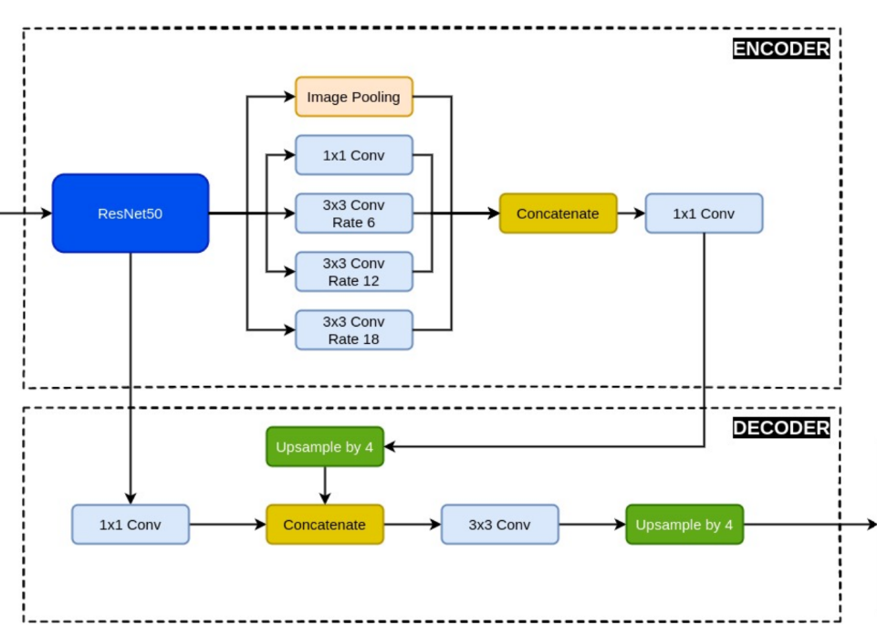
Methodology (DeepLabV3 with ResNet-50)
Input Image
Output Mask
Figure by: Shakti Kumar

Slide 12
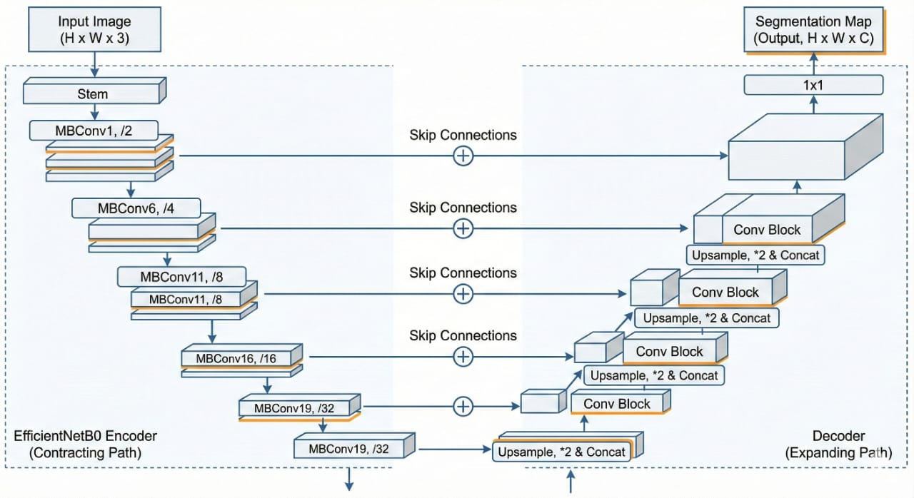

Methodology (U-Net with EfficeintNetB0)
Figure by: Vilakshan Saini

Slide 13
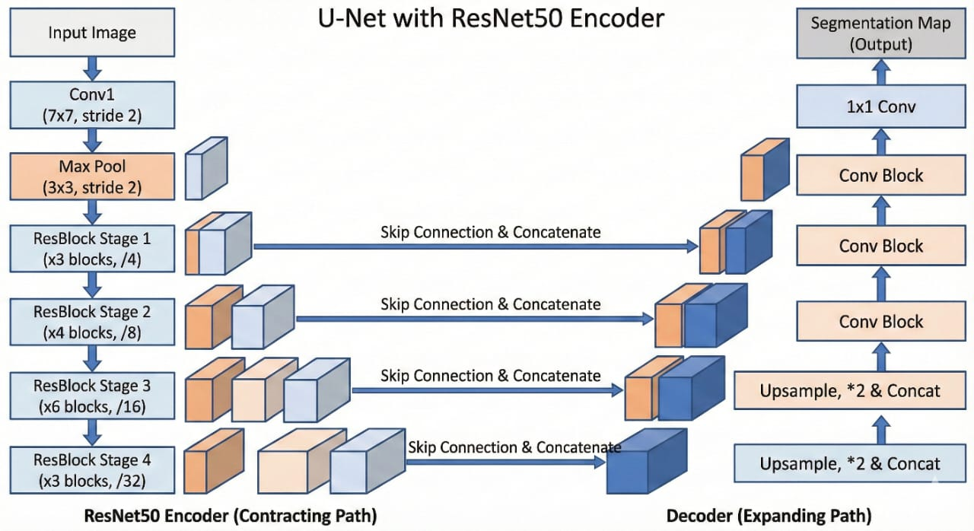
Methodology (U-Net with ResNet-50)
Figure by: Vilakshan Saini

Slide 14
Results
Model | Backbone | Loss Function | IoU | Dice Coeff | Accuracy | Precision | Recall
DeepLabV3+ | ResNet50 | Cross Entropy | 0.6609 | 0.7332 | 0.9004 | 0.9336 | 0.7126
DeepLabV3+ | ResNet50 | Dice Loss | 0.7469 | 0.8261 | 0.8188 | 0.8154 | 0.7752
U-Net | EfficientNetB0 | CrossEntropy | 0.4071 | 0.5594 | 0.9878 | 0.7205 | 0.7344
U-Net | ResNet50 | CrossEntropy | 0.5860 | 0.7582 | 0.9025 | 0.8604 | 0.7635
U-Net | None | CrossEntropy | 0.7330 | 0.8439 | 0.9860 | 0.9149 | 0.8406
*IoU (Intersection over Union) as primary evaluation metric
Notes:
Pixel-level Overlap Measurement
IoU (Intersection over Union) directly measures the spatial overlap between predicted and ground-truth regions.
It penalizes both false positives (extra area predicted) and false negatives (missed area) in one unified score.
Better Representation than Accuracy
Accuracy can be misleading in segmentation tasks with class imbalance (e.g., most pixels are background, few are lake).
A model predicting all pixels as background may still achieve very high accuracy, but IoU would be very low → reflecting poor performance.
Improvement over Precision/Recall
Precision only measures how much of the predicted area is correct.
Recall only measures how much of the true area was captured.
IoU combines both in a stricter way: a high IoU means both precision and recall are high.
More Discriminative than F1 Score
F1-score (Dice coefficient) is similar to IoU, but it is slightly more lenient.
Example: If predicted and ground-truth regions barely overlap, F1 may still give a moderate score, while IoU will drop sharply → making IoU more reliable for fine-grained segmentation like glacial lakes.
Standard Benchmark in Segmentation Research
IoU has become the de facto benchmark in computer vision and remote sensing segmentation tasks (used in PASCAL VOC, COCO datasets).
It ensures comparability across studies and is considered stricter than pixel accuracy or F1.

Slide 15
Future work
Multi-Modal & Real-Time Data Fusion: Fuse optical (Sentinel-2), SAR (Sentinel-1), DEMs, climate reanalysis, and IoT sensor data for all-weather, day-night monitoring
Scalable & Transferable Framework: Enable cross-region generalization, continuous model updates, and seamless integration with disaster management systems. Future work will refine loss functions, boost segmentation accuracy, and ensure scalability for real-world impact.
Physics-Guided & Confidence-Aware Alerts: Embed glaciological and hydrodynamic constraints with uncertainty estimation to reduce false alarms and support risk-based decision-making.
Edge & Low-Resource Deployment: Optimize trained models for execution on edge devices and remote stations in data-scarce, infrastructure-limited regions.
Digital Twin of Glacial Lakes: Create continuously updating digital replicas of critical lakes by combining satellite, IoT, and physics models to simulate breach scenarios in advance.
Learning Without Labels: Employ self-supervised and zero-shot learning on massive historical satellite archives to overcome data scarcity and improve generalization across glacial regions.
Sentient Cryosphere Monitoring: Transform glaciers from passive targets into self-aware systems where AI continuously “listens” to thermal, structural, and hydrodynamic signals to anticipate failure before visible change.
Autonomous Observation Orchestration: Enable AI to autonomously decide when, where, and how to observe—dynamically tasking satellites, drones, and sensors based on evolving risk signatures.
Notes:
Future research directions
Although the proposed model shows promising results, scaling it in upper northern snowy regions presents challenges due to rugged terrain, limited infrastructure, and restricted data access. High-resolution data demands substantial computational power, and connectivity issues hinder Realtime processing. Future work will focus on optimizing algorithms for low-resource settings to maintain accuracy. In high-stakes GLOF-prone areas, false positives and negatives carry significant risks, potentially leading to unnecessary evacuations or missed warnings. To address this, future efforts will emphasize rigorous testing under varied conditions, alongside multi-sensor data fusion using hydrological, meteorological, and geological data to enhance prediction reliability and reduce erroneous alerts. Future work can also focus on improving deep learning models and semantic segmentation techniques while dedicating efforts to climate change research and developing datasets to help prevent natural and human-caused disasters. Additionally, the future research will aim to optimize these models and loss functions for better segmentation performance in remote sensing applications, potentially integrating with future studies for impactful results.

Slide 16
References
S. K. Allen et al., “Potentially dangerous glacial lakes across the Tibetan Plateau revealed using a large-scale automated assessment approach”, Sci. Bull., vol. 64, no. 7, pp. 435-445, 2019.
Chen, L., Zhu, Y., Papandreou, G., Schroff, F., & Adam, H. (2018). Encoder-Decoder with Atrous Separable Convolution for Semantic Image Segmentation. ArXiv. /abs/1802.02611
Sharma, Anita & Prakash, Chander & Thakur, Divyansh. (2024). Glacier Lake Detection Utilizing Remote Sensing Integration with Satellite Imagery and Advanced Deep Learning Methods. Applied Geomatics. 16. 10.1007/s12518-024-00594-3.
J. M. Su, L. X. Yang, and W. P. Jing, “A U-net based semantic segmentation method for high resolution remote sensing image,” Comput. Eng. Appl., vol. 55, no. 7, pp. 207–213, 2019
Zhang M, Chen F, Zhao H, Wang J, Wang N. Recent Changes of Glacial Lakes in the High Mountain Asia and Its Potential Controlling Factors Analysis. Remote Sensing. 2021; 13(18):3757. https://doi.org/10.3390/rs13183757
Kaushik, Saurabh & Singh, Tejpal & Joshi, P.K. & Andreas, Dietz. (2022). Automated mapping of glacial lakes using multisource remote sensing data and deep convolutional neural network. International Journal of Applied Earth Observation and Geoinformation. 115. 103085. 10.1016/j.jag.2022.103085
Hu S, Liu J, Kang Z. DeepLabV3+/EfficientNet Hybrid Network-Based Scene Area Judgment for the Mars Unmanned Vehicle System. Sensors. 2021; 21(23):8136. doi.org/10.3390/s21238136
Cheng, Bowen & Girshick, Ross & Dollar, Piotr & Berg, Alexander & Kirillov, Alexander. (2021). Boundary IoU: Improving Object-Centric Image Segmentation Evaluation. 15329-15337. 10.1109/CVPR46437.2021.01508.

Slide 17
References
Mingxing Tan and Quoc Le. Efficientnet: Rethinking model scaling for convolutional neural networks. In International conference on machine learning, pages 6105–6114. PMLR, 2019.
Agrawal, Sanjay & Rewaskar, Vaibhav & Agrawal, Rucha & Chaudhari, Swapnil & Patil, Yogendra & Agrawal, Nidhee. (2023). International Journal of INTELLIGENT SYSTEMS AND APPLICATIONS IN ENGINEERING Advancements in NSFW Content Detection: A Comprehensive Review of ResNet-50 Based Approaches. 11. 41-45.
Z. Duan, F. Wang, B. Wang, G. Luo and Z. Jiang, "An Adapted ResNet-50 Architecture for Predicting Flow Fields of an Underwater Vehicle," in IEEE Access, vol. 12, pp. 66398-66407, 2024, doi: 10.1109/ACCESS.2024.3399077.
J. Zhang, X. Yao, H. Duan, X. Chu, C. Yang and J. Hu, "Extraction of Cladophora Blooms in Qinghai Lake Through the Integration of Sentinel-2 MSI Imagery and Deep Learning Techniques," in IEEE Journal of Selected Topics in Applied Earth Observations and Remote Sensing, vol. 17, pp. 19115-19129, 2024, doi: 10.1109/JSTARS.2024.3447886.
Z. Zhan, X. Zhang, Y. Liu, X. Sun, C. Pang and C. Zhao, "Vegetation Land Use/Land Cover Extraction From High-Resolution Satellite Images Based on Adaptive Context Inference," in IEEE Access, vol. 8, pp. 21036-21051, 2020, doi: 10.1109/ACCESS.2020.2969812.
K. Thitisiriwech, T. Panboonyuen, P. Kantavat, Y. Iwahori and B. Kijsirikul, "The Bangkok Urbanscapes Dataset for Semantic Urban Scene Understanding Using Enhanced Encoder-Decoder with Atrous Depthwise Separable A1 Convolutional Neural Networks," in IEEE Access, vol. 10, pp. 59327-59349, 2022, doi: 10.1109/ACCESS.2022.3176712.

Slide 18
References
F. Chen, M. Zhang, B. Tian and Z. Li, "Extraction of Glacial Lake Outlines in Tibet Plateau Using Landsat 8 Imagery and Google Earth Engine," in IEEE Journal of Selected Topics in Applied Earth Observations and Remote Sensing, vol. 10, no. 9, pp. 4002-4009, Sept. 2017, doi: 10.1109/JSTARS.2017.2705718.
A. Ortiz et al., "Mapping Glacial Lakes Using Historically Guided Segmentation Models," in IEEE Journal of Selected Topics in Applied Earth Observations and Remote Sensing, vol. 15, pp. 9226-9240, 2022, doi: 10.1109/JSTARS.2022.3215722.
J. -H. Lee et al., "Detection and Dispersion of Small-Scale Oil Spills in Pristine Coastal Waters Using Sentinel-2 Satellite Imagery: A Case Study From Jeju Island," in IEEE Journal of Selected Topics in Applied Earth Observations and Remote Sensing, vol. 18, pp. 24848-24863, 2025, doi: 10.1109/JSTARS.2025.3613018.
Z. Li, B. Ouyang, S. Qiu, X. Xu, X. Cui and X. Hua, "Change Detection in Remote-Sensing Images Using Pyramid Pooling Dynamic Sparse Attention Network with Difference Enhancement," in IEEE Journal of Selected Topics in Applied Earth Observations and Remote Sensing, vol. 17, pp. 7052-7067, 2024, doi: 10.1109/JSTARS.2024.3374050.

Slide 19


