Slide 1
Food Context Classification using Transfer Learning
Presenter – Raj Kamal Singh
Group - 8

Slide 2
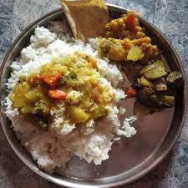
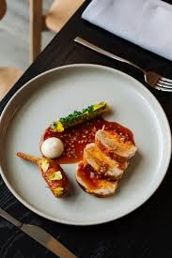
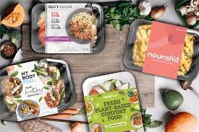
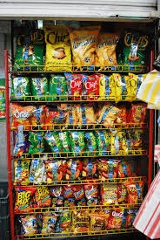
Why This Project?
Goal: classify food images into:
Home Food
Restaurant Food
Packaged Food
Focus is on context, not food item identity
Real-world challenge:
lighting variation
cluttered backgrounds
mixed image quality

Slide 3
Dataset and Approach
Dataset
Custom dataset collected from web images
3 classes
~300+ total images
Split
Train: 70%
Validation: 15%
Test: 15%
Model
Pretrained ResNet-50
Raw Images
Train/Test/Val Split
Preprocessing
ResNet-50
Classification

Slide 4
Experiments Performed
4 Training Configurations
Baseline
Data Augmentation
Synthetic Noise / Blur / Lighting
Combined Strategy
Examples:
Augmentation:
rotation
crop
flip
Examples:
Synthetic:
Gaussian blur
brightness shift
grayscale variation

Slide 5
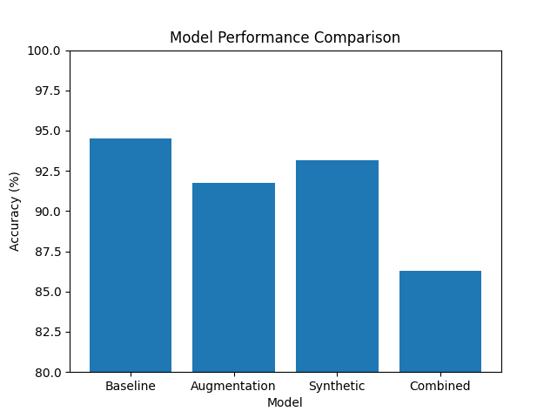
Results
Model | Test Accuracy
Baseline | 94.52%
Synthetic | 93.15%
Augmentation | 91.78%
Combined | 86.30%

Slide 6
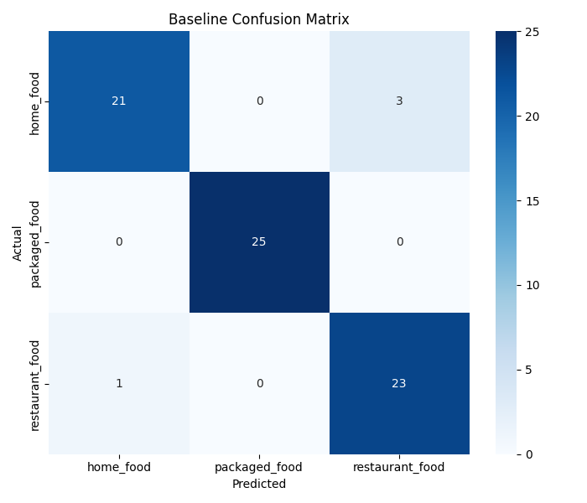
Analysis and Insights
Why?
✅ Packaged food easiest class ✅ Strong logos / wrappers / shelf cues
⚠ Main confusion:
Home Food vs Restaurant Food
⚠ Heavy augmentation removed contextual cues

Slide 7
Conclusion
Key Takeaways
Transfer learning worked very well on small custom dataset
More augmentation does not always mean better accuracy
Context-sensitive tasks require careful transform design
Future Work
Larger dataset
Mobile app deployment
Multi-label food + context prediction

