Slide 1
Real-World Lane Detection Using Classical Computer Vision
Analysis of Edge-Based Lane Detection in Real-World Conditions
Presenter – Raj Kamal Singh

Slide 2
Why This Project?
Lane detection is critical for autonomous vehicles.
Classical CV methods are interpretable but sensitive to real-world noise.
Goal: Analyze strengths and weaknesses of edge-based lane detection in realistic scenarios.

Slide 3
Lane Detection Pipeline
Video
Convert frame to grayscale
Apply histogram equalization (contrast enhancement)
Gaussian blur for noise reduction
Canny edge detection
Region of Interest (ROI) masking
Hough Line Transform for lane detection
Slope filtering to remove irrelevant edges
Gray
Blur
Canny
ROI
Two versions of the pipeline were implemented:
Baseline pipeline: fixed thresholds, minimal preprocessing
Improved pipeline: adaptive thresholding, contrast enhancement, and noise filtering
Hough
Lanes

Slide 4
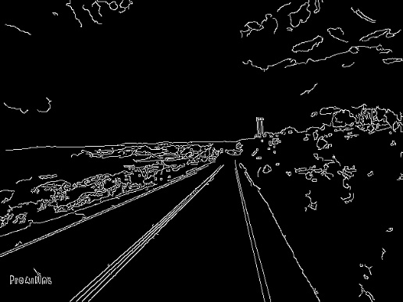
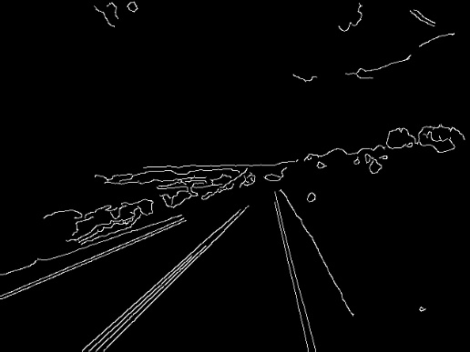
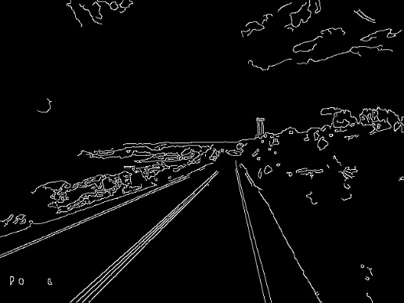
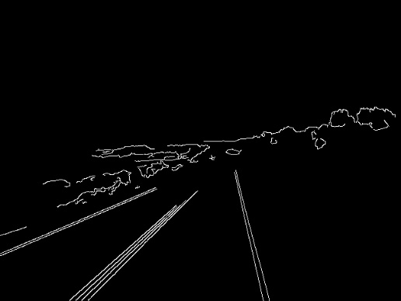
Structured Experiments
Gaussian Blur Study: Effect of kernel size on edges and noise
Canny Threshold Sensitivity: How thresholds impact edge detection
Real-World Stress Testing: Shadows, bright light, motion blur, cluttered background
Baseline vs Improved Comparison: Quantitative and qualitative performance analysis
Identified edges in same frame with kernel size 3*3(left) and 9*9(right) for Gaussian blur
Identified edges in same frame with canny threshold (50,150) (left) and (150,300) (right)

Slide 5
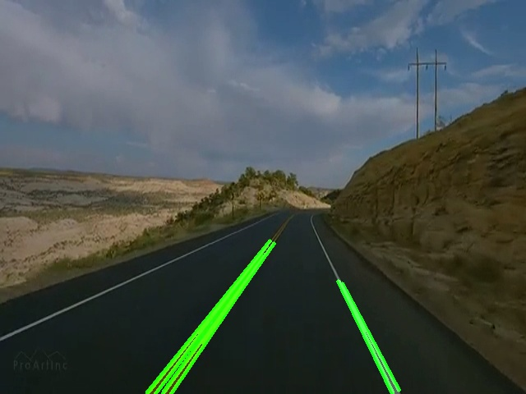
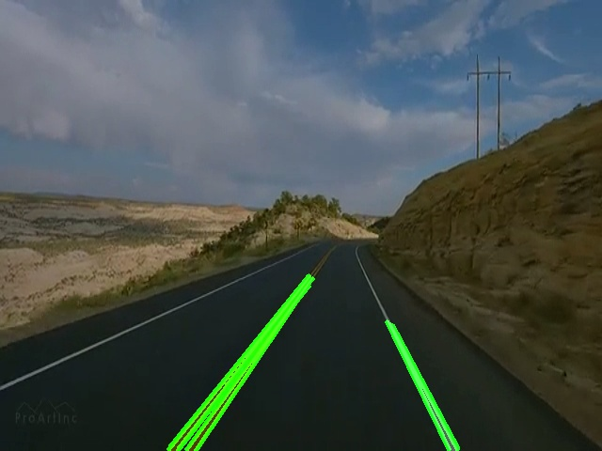
Results: Visual Comparison
v
Base pipeline for 600th frame
Improved pipeline for 600th frame

Slide 6
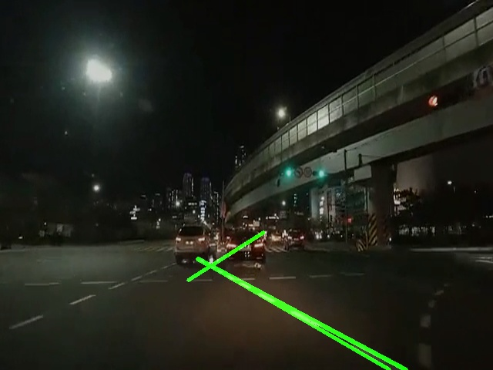
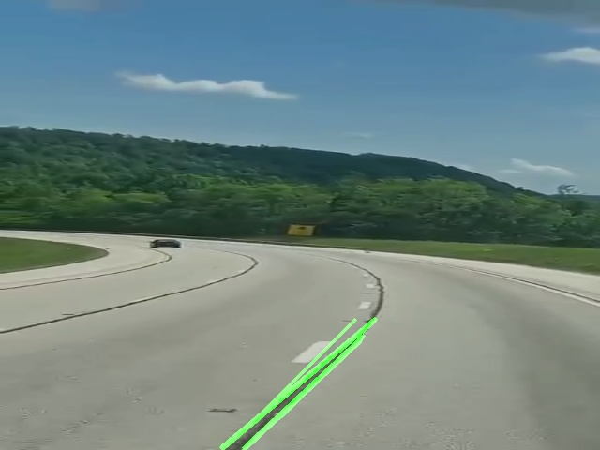
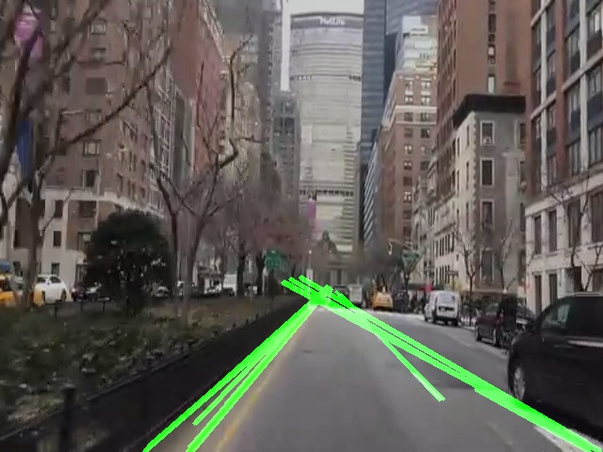
Real-World Challenges
Shadows: false edges detected
Bright sunlight: weak lane detection
Motion blur: fragmented or missing lanes
Curved lanes: straight-line detection limitation
Lane detection in night
Lane detection on curves
Lane detection in cities

Slide 7
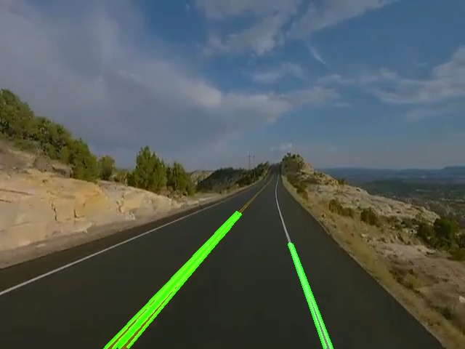
Enhancements to Baseline
Histogram equalization for contrast enhancement
Adaptive Canny thresholds for dynamic edge detection
Morphological operations (dilate + erode) to connect edges
Slope filtering to remove irrelevant lines
Different frames showing detected lane with improved pipeline

Slide 8
Key Takeaways
Classical edge-based lane detection works well in simple conditions.
Performance degrades under shadows, bright light, and motion blur.
Improvements (contrast, adaptive thresholds, morphology) increase robustness.
Highlights the limitations of traditional methods in real-world environments.

