Slide 1

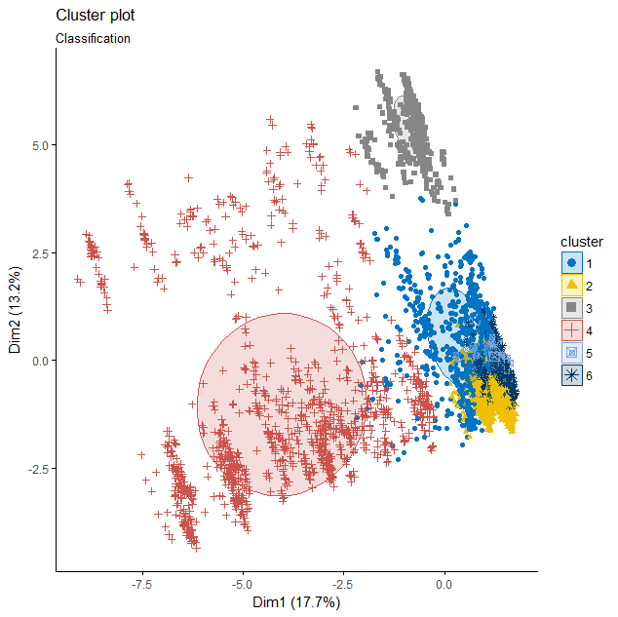
Student: Rajinder Kaur
Student Id: 21700551
Academic Supervisor: Adrian Hargreaves
Evaluation of the Predictive Accuracy of
Data Mining Algorithms using R
Website security is crucial for protecting people’s information. Hackers and attackers are always in search of new ways to lure internet users into providing confidential data, which is then stolen. In this project, data mining techniques have been successfully employed to analyse website characteristics. Using the models that these techniques create, it has been possible to accurately distinguish between phishing and legitimate websites.
Research Design
Design Science research was identified as the research methodology best suited for this project. Design science is particularly useful for research that aims to construct engineered artefacts. It specifies an approach for defining problems, processing data, identifying improvements, developing models and evaluating the artefacts created.
Literature Review
Data mining techniques can predict future trends, discover hidden patterns and assist managers in making critical decisions from the extraction of previously unknown information.
Findings
The table below summarises the predictive accuracy of some of the classification algorithms explored in this research. Naïve Bayes proved to be the most accurate, identifying phishing websites correctly 96.15% of the time.
Data mining classification techniques can help to determine the distinguishing characteristics from a set of website features that will facilitate the identification of phishing websites (Mohammad, Thabtah & McCluskey, 2012).
Figure 1: Visualising results generated by the K-Means clustering algorithm
Research Outcome
Theory Base
For building predictive models that can accurately categorise phishing and legitimate websites, a variety of data mining classification algorithms were explored and evaluated for their predictive accuracy. The theory that underpins these algorithms formed the theory base of this research.
1
The Naïve Bayes algorithm was determined to generate the most accurate predictive model for identifying phishing websites.
2
There are several alternative data mining classification algorithms available in R that also generated accurate models.
Research Question
A statistical software environment called R was used to generate predictive models using classification algorithms. A sample of the results generated by R is in shown in Figure 1.
3
This research could be used to build tools that would help business organisations and internet users to decide whether a website can be trusted.
What data mining classification algorithms provide the most promising opportunities for constructing predictive models that accurately identify phishing websites?
Reference:
Mohammad R.M, Thabtah F., McCluskey L. (2012) An assessment of features related to phishing websites using an automated technique. In: The 7th international conference for internet technology and secured transactions (ICITST-2012), London
Project Number: RP6- 2017

