Slide 1
https://wheremachinesthink.substack.com/p/the-enigmatic-multilayer-perceptrons
https://www.geeksforgeeks.org/deep-learning/grouped-query-attention-gqa/
Gaussian Error Linear Unit (GELU)
https://cs231n.stanford.edu/slides/2022/lecture_1_2_ruohan.pdf
paperswithcode

Slide 2
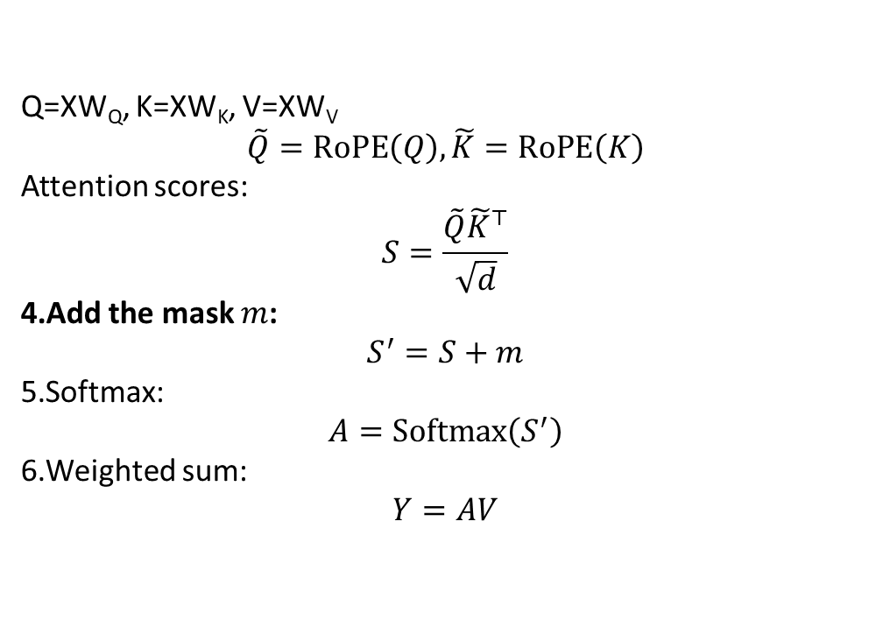
Q=XW_{Q}​, K=XW_{K}​, V=XW_{V}​
$$\tilde{Q}=RoPE\left(Q\right), \tilde{K}=RoPE\left(K\right)$$
Attention scores:
$$S=\frac{\tilde{Q}{\tilde{K}}^{⊤}}{\sqrt{d}}$$
Add the mask $m$:
$$S^{′}=S+m$$
Softmax:
$$A=Softmax⁡\left(S^{′}\right)$$
Weighted sum:
$$Y=AV$$

Slide 3
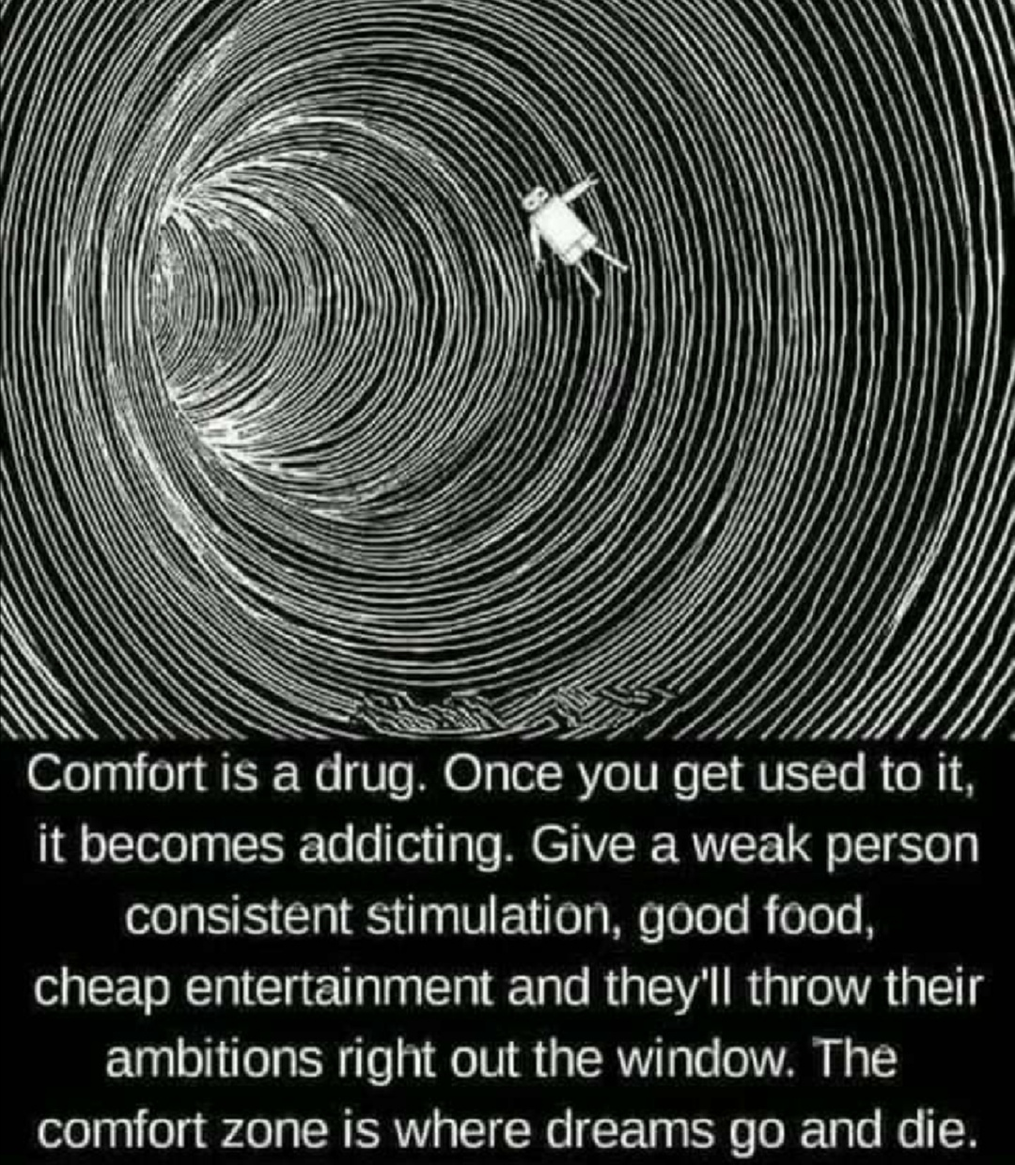
Layer Norm
preprocessor
Multi-Head Attention
Vision Blocks
Layer Norm
Vision Patch Merger
MLP

Slide 4
Num_tokens, hidden_size
Num_tokens, hidden_size
Linear
Split
Layer Norm
Vision Attention
q
k
v
M-ROPE
M-ROPE
m
Layer Norm
Softmax
Vision MLP
Linear
Num_tokens, hidden_size
Num_tokens, hidden_size

Slide 5
ID | Token | Text
0 | 151644 | '<|im_start|>'
1 | 8948 | 'system'
2 | 198 | '\n'
3 | 2610 | 'You'
4 | 525 | are'
5 | 264 | a'
6 | 10950 | helpful'
7 | 17847 | assistant'
8 | 13 | '.'
9 | 151645 | '<|im_end|>'
10 | 198 | '\n'
11 | 151644 | '<|im_start|>'
12 | 872 | 'user'
13 | 198 | '\n'
14 | 151652 | '<|vision_start|>'
15 | 151655 | '<|image_pad|>'
: | : | :
1730 | 151655 | '<|image_pad|>'
1731 | 151653 | '<|vision_end|>'
1732 | 74785 | 'Describe'
1733 | 279 | the'
1734 | 2168 | image'
1735 | 13 | '.'
1736 | 151645 | '<|im_end|>'
1737 | 198 | '\n'
1738 | 151644 | '<|im_start|>'
1739 | 77091 | 'assistant'
1740 | 198 | '\n'

Slide 6
The image depicts a black and white illustration of a person floating in a circular, concentric tunnel. The tunnel has a spiral pattern, and the person appears to be floating in the center of the tunnel, surrounded by concentric circles. The background is dark, emphasizing the tunnel and the floating figure. The text below the image reads: "Comfort is a drug. Once you get used to it, it becomes addicting. Give a weak person consistent stimulation, good food, cheap entertainment and they\'ll throw their ambitions right out the window. The comfort zone is where dreams go and die.

