Slide 1

Spring Boot
By:- Kaushal Joshi

Slide 2
What is Spring Framework
Spring is a popular open-source framework for building Java-based enterprise applications. It provides a comprehensive programming and configuration model for developing robust and maintainable applications. Spring offers various features and modules that facilitate development, testing, and deployment of applications.
Spring is widely used for creating scalable applications. For web applications Spring provides Spring MVC which is a widely used module of spring which is used to create scalable web applications.

Slide 3
Spring Framework was created by Rod Johnson in 2003 and released under the Apache 2.0 license.
It is the most popular application development framework for enterprise Java.
It is an open-source Java platform.
Spring Framework allows developers to create high-performing, easily testable, and reusable code.
It is organized in a modular fashion, making it flexible and adaptable to different application requirements.
It simplifies Java development by providing a comprehensive programming and configuration model.

Slide 4
Spring Framework enables a Plain Old Java Object (POJO) based programming model.
Spring Framework utilizes existing technologies such as:
ORM (Object-Relational Mapping) frameworks for easy database integration.
Logging frameworks for flexible and customizable logging.
JEE (Java Enterprise Edition) technologies for enterprise-level capabilities.
Quartz for scheduling and job execution.
JDK (Java Development Kit) timers for task scheduling and time-based operations.
Please note that while Spring integrates with these technologies, it also provides its own implementations and abstractions for many of them, allowing developers to choose the most suitable options for their applications.

Slide 5
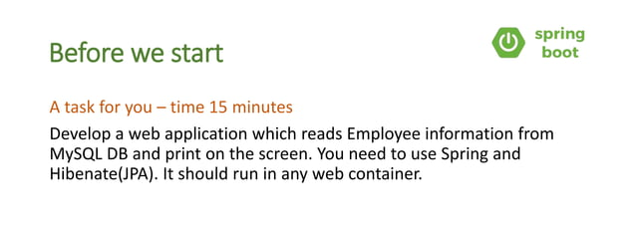

Slide 6
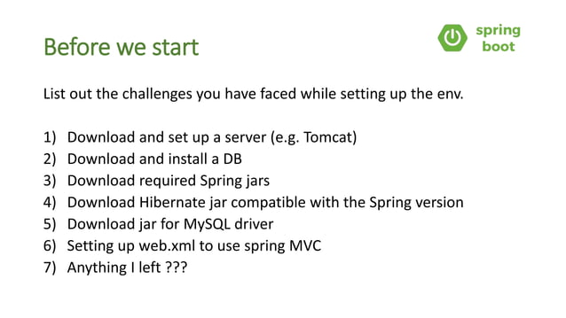

Slide 7
Spring Boot
The Spring Boot is built on top of the core Spring framework. It is a simplified and automated version of the spring framework. The spring boot follows a layered architecture in which each layer communicates to other layers(Above or below in hierarchical order). The spring boot documentation provides the following definition to the Spring Boot Framework.
“Spring Boot makes it easy to create stand-alone, production-grade Spring based application that you can “Just Run”.”
The main aim of spring boot is to remove the XML and annotations-based configuration settings from the application. Along with this spring boot provides the following benefits such as opinionated(options to later change the configuration), convention over configuration, stand-alone, and production-ready.

Slide 8
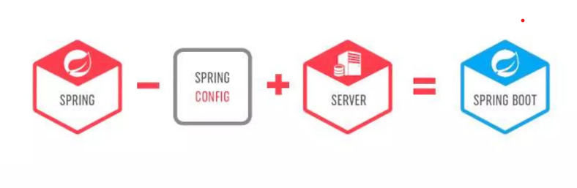

Slide 9
Features of Spring Boot
Spring Boot is built on the top of the conventional spring framework. So, it provides all the features of spring and is yet easier to use than spring.
It allows to avoid heavy configuration of XML which is present in spring: Unlike the Spring MVC Project, in spring boot everything is auto-configured. We just need to use proper configuration for utilizing a particular functionality.For example: If we want to use hibernate(ORM) then we can just add @Table annotation above model/entity class(discussed later) and add @Column annotation to map it to table and columns in the database
It provides easy maintenance and creation of REST end points: Creating a REST API is very easy in Spring Boot. Just the annotation @RestController and @RequestMapping(/endPoint) over the controller class does the work.
It includes embedded Tomcat-server:Unlike Spring MVC project where we have to manually add and install the tomcat server, Spring Boot comes with an embedded Tomcat server, so that the applications can be hosted on it.

Slide 10
Deployment is very easy, war and jar file can be easily deployed in the tomcat server: war or jar files can be directly deployed on the Tomcat Server and Spring Boot provides the facility to convert our project into war or jar files. Also, the instance of Tomcat can be run on the cloud as well.
Microservice Based Architecture: Microservice, as the name suggests is the name given to a module/service which focuses on a single type of feature, exposing an API(application peripheral interface).Let us consider an example of a hospital management system.
In case of monolithic systems, there will be a single code containing all the features which are very tough to maintain on a huge scale.
But in the microservice-based system, each feature can be divided into smaller subsystems like service to handle patient registration, service to handle database management, service to handle billing etc.
Microservice based system can be easily migrated as only some services need to be altered which also makes debugging and deployment easy. Also, each service can be integrated and can be made in different technologies suited to them.

Slide 11
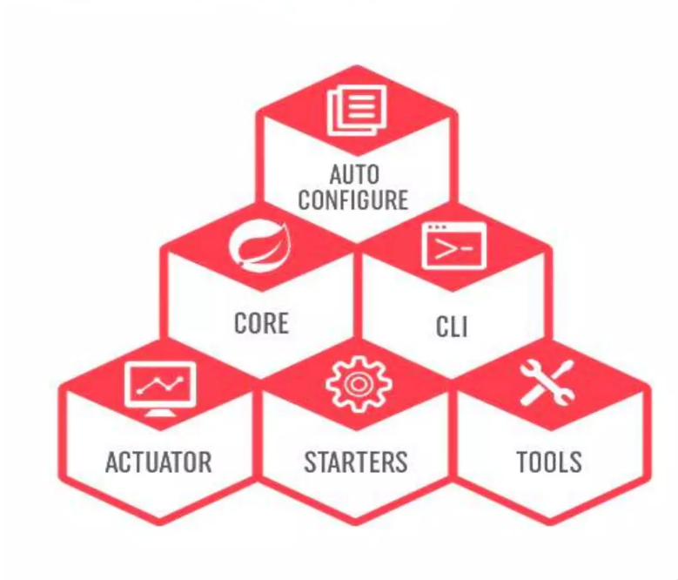
Spring Boot Components

Slide 12
Overview of Spring Architecture
Spring follows a layered architecture that provides a clear separation of concerns and promotes modular development.
The spring boot consists of the following four layers:
Presentation Layer – Authentication & Json Translation
Business Layer – Business Logic, Validation & Authorization
Persistence Layer – Storage Logic
Database Layer – Actual Database

Slide 13
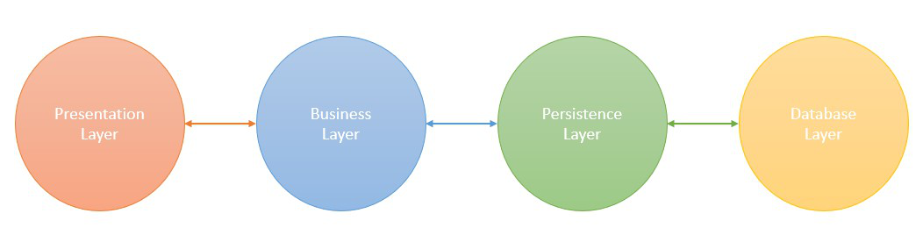

Slide 14
1. Presentation Layer
The presentation layer is the top layer of the spring boot architecture. It consists of Views. i.e., the front-end part of the application. It handles the HTTP requests and performs authentication. It is responsible for converting the JSON field’s parameter to Java Objects and vice-versa. Once it performs the authentication of the request it passes it to the next layer. i.e., the business layer.
2. Business Layer
The business layer contains all the business logic. It consists of services classes. It is responsible for validation and authorization.
3. Persistence Layer
The persistence layer contains all the database storage logic. It is responsible for converting business objects to the database row and vice-versa.
4. Database Layer
The database layer contains all the databases such as MySql, MongoDB, etc. This layer can contain multiple databases. It is responsible for performing the CRUD operations.

Slide 15
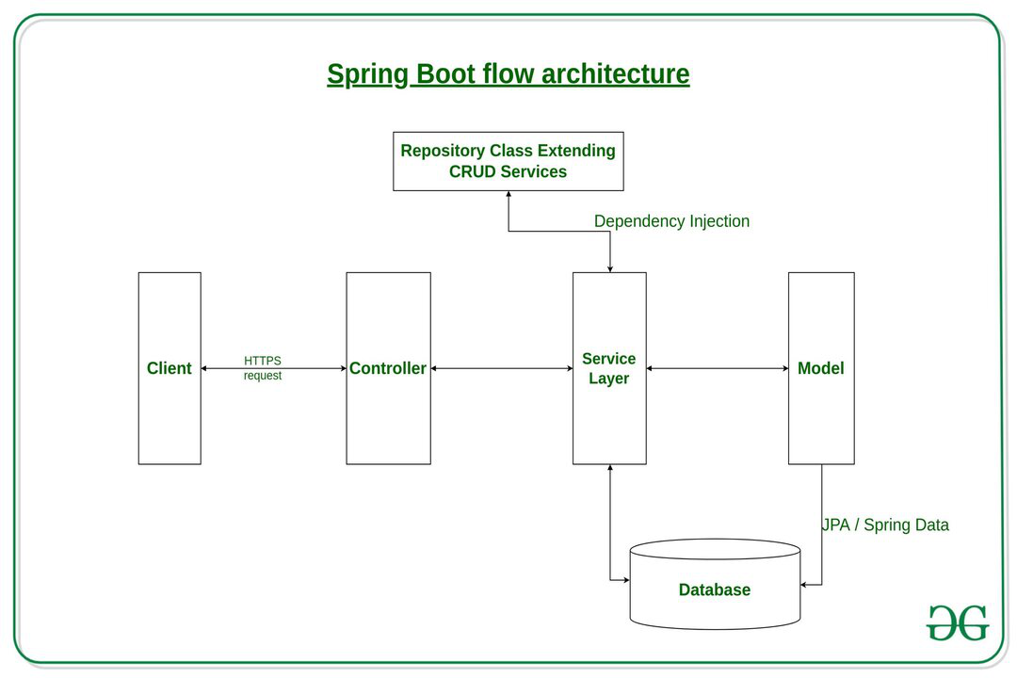

Slide 16
Spring Boot – Annotations
Spring Annotations are a form of metadata that provides data about a program. Annotations are used to provide supplemental information about a program. It does not have a direct effect on the operation of the code they annotate. It does not change the action of the compiled program.
Spring annotations present in the org.springframework.boot.autoconfigure and org.springframework.boot.autoconfigure.condition packages are commonly known as Spring Boot annotations. Some of the annotations that are available in this category are:
@SpringBootApplication
@SpringBootConfiguration
@EnableAutoConfiguration
@ComponentScan

Slide 17
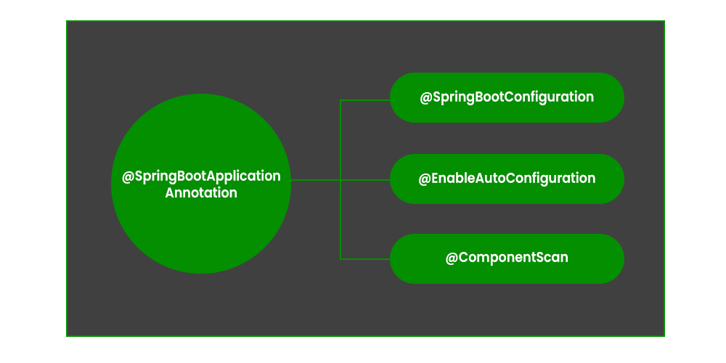
1. @SpringBootApplication Annotation
This annotation is used to mark the main class of a Spring Boot application. It encapsulates @SpringBootConfiguration, @EnableAutoConfiguration, and @ComponentScan annotations with their default attributes.

Slide 18
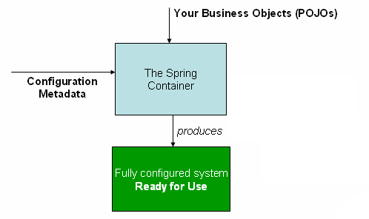
Spring IOC
Inversion of Control (IOC) is a fundamental principle in Spring Boot.
IOC allows loose coupling of components and promotes modular, maintainable, and testable code.
IOC in Spring Boot is achieved through Dependency Injection (DI) and annotations.

Slide 19
Dependency Injection (DI)
Spring Boot's DI container manages component dependencies.
Components focus on their responsibilities without managing dependencies manually.
Dependencies are injected into components automatically using the @Autowired annotation.
@Component public class MyComponent {
@Autowired
private Dependency dependency;
// Component code...
}

Slide 20
Component Scanning
Spring Boot's component scanning mechanism automatically discovers and registers beans.
Stereotype annotations (@Component, @Service, @Repository, @Controller) identify classes as beans.
Spring Boot manages the lifecycle and dependency injection for these beans.
@Component
public class MyComponent {
// Component code...
}

Slide 21
Configuration
Spring Boot allows configuration through files or Java-based configuration classes.
Configuration defines the application structure and behavior.
Spring Boot manages dependencies and wiring of components based on the configuration.
@Configuration
public class MyAppConfig {
@Bean
public MyComponent myComponent() {
return new MyComponent();
}
}

Slide 22
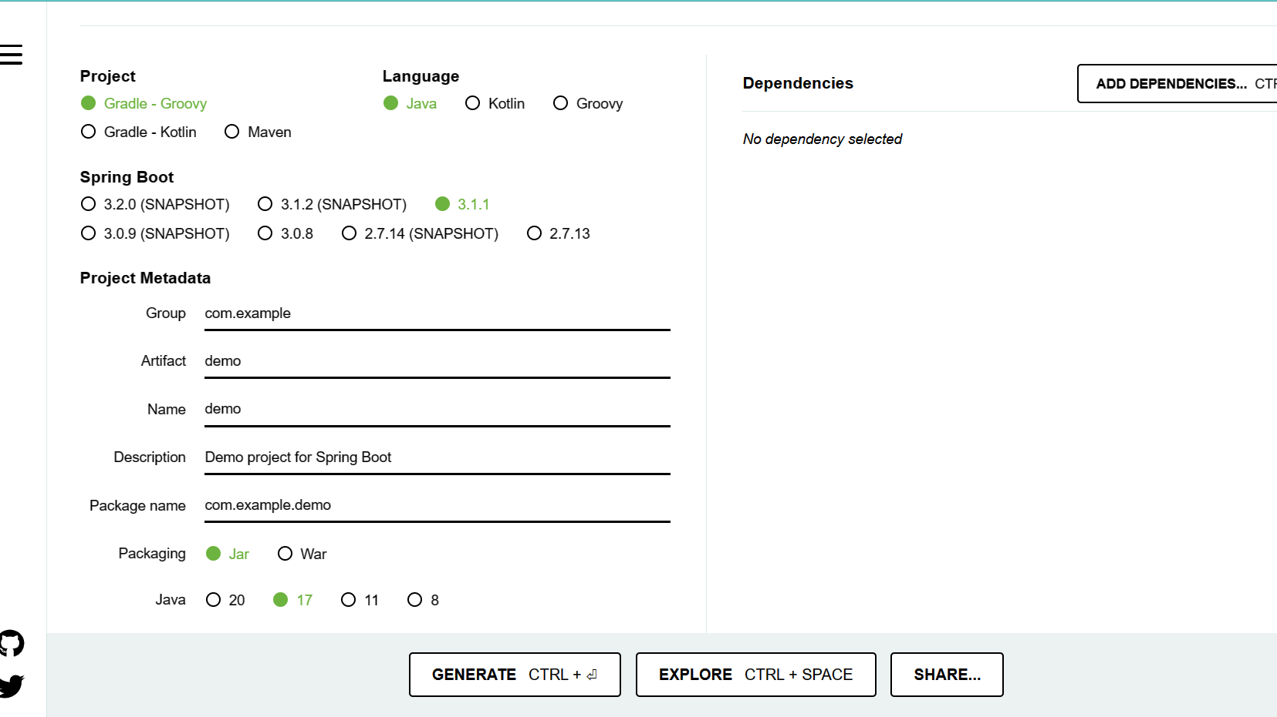
Getting Started
https://start.spring.io/

Slide 23
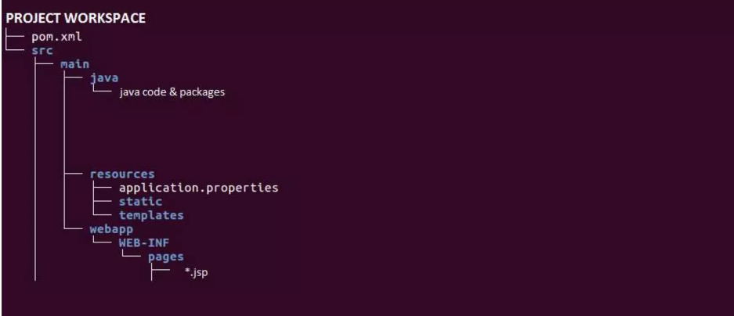
Folder structure

Slide 24
Thank you

