Slide 1


FSA: Fronthaul Slicing Architecture for 5G using dataplane programmable switches
Nishant Budhdev, Raj Joshi, Pravein Govindan Kannan, Mun Choon Chan, Tulika Mitra
Notes:
Good afternoon everyone. My name is Nishant Budhdev and today I will be presenting my work on enabling fronthaul slicing for 5G networks using dataplane programmable switches. The work was done in collaboration with my colleagues Raj and Pravein and my advisors Prof. Chan Mun Choon and Prof. Tulika Mitra.

Slide 2





New Use Cases with 5G
High Reliability and Low Latency transmissions for critical apps
Support for Mass Low-Power transmissions for machine-to-machine communication
High Throughput transmissions for different data intensive apps
Notes:
With 5G, Cellular networks are now expected to support a wide a variety of applications with different QoS requirements.
*CLICK* One of most unique set of use cases, involves critical applications such autonomous vehicle tracking and telesurgery that requires a combination of High Reliability and Low Latency communication, unlike existing use cases.
*CLICK* Another use case category is machine-to-machine communication which includes applications such as Internet-of-Things or Autonomous Factories that require low power communication with large number of devices.
*CLICK* Finally, 5G is also expected to unlock throughput-intensive applications, such Augmented Reality and 4K video streaming on mobile devices.
*PAUSE* As a result operators have spent over 30 billion dollars since 2018, to redesign their networks to be agile and scale efficiently with increasing and varied demand.

Slide 3
Slicing in 5G
Virtual networks for distinct applications with a tailored set of resources
Notes:
*PAUSE* Supporting these different use case categories with their varying QoS requirements has lead to the introduction of slicing in 5G architecture. Slices, are a logically independent virtual networks which run on a shared infrastructure. operators can then allocate a tailored set of resources to these virtual networks, in order to meet the QoS requirements for applications running on each slice.

Slide 4
Need for Slicing
Improved agility to deploy new services with little disruption
Improve resource utilization by tailored allocation of resources
Enable new applications with ability to guarantee KPI and meet SLA
Notes:
Thus slicing improves agility by enabling operators to deploy new services with little to no disruption to existing users in the network, as each slice operates independently.
*CLICK* Slicing is also key to improving resource utilization, by allowing operators to tailor resources for each slice to suit their demands. This allows operators to allocate resources on-demand to each slice, thus reducing both CAPEX and OPEX.
*CLICK* These two advantages put together, allow operators to dynamically support new applications with unique QoS requirements by ensuring performance isolation and on-demand resource allocation.

Slide 5









E2E Sliced 5G Network
Radio Access
Network
Core Network
uRLCC
Frontend
Fronthaul
Backhaul
DU/CU
DU/CU
mMTC
Mobile
Internet
eMBB
Host/Server
DU/CU
DU/CU
Notes:
Now that we established the importance of slicing, let’s take a closer look at a sliced 5G network.
*CLICK* Unlike 4G or LTE, 5G networks will need to support a heterogeneous set of devices belonging to different applications.
*CLICK* To support these heterogeneous set of devices, slicing has been introduced to different components in the cellular network including the frontend, RAN and the Core Network. For example, in the RAN, user data from different slices connected to a base station can be processed in independent virtual environments operating on the same host to provide performance isolation.
*CLICK* From this figure it is also apparent that the fronthaul is the only component within the cellular network which does not support slicing.

Slide 6
Missing Component for E2E Slicing
Lack of feasible fronthaul slicing solution
Notes:
This work tries to address this lack of feasible fronthaul slicing solution. However, before we design a solution for fronthaul slicing, we first need to understand how the lack of a feasible fronthaul slicing solution impacts 5G networks.

Slide 7








Impact on 5G Networks
point-to-point connection
Constant upgrade to support larger number devices
Overprovisioning to support different QoS
Large-scale upgrade for specialized RAN processing
DU/CU
DU/CU
Inefficient scaling with increasing number of devices and use cases
Notes:
The lack of fronthaul slicing forces operators to connect each frontend radio unit or RU to exactly one DU or host in the RAN. This point-to-point connection creates a number problems for cellular networks.
*CLICK* First, hosts in the cloud need to be upgraded as number devices in the network continue to increase as users connected to the same base station cannot be processed on different hosts.
*CLICK* Second, hosts also need to be overprovisioned to support increasing number of use cases with different QoS requirements.
*CLICK* Additionally, using specialized processers for supporting new applications, would require hardware modification to all hosts in the cloud.
*CLICK* All these factors put together make existing architecture unable to scale efficiently with increasing number of devices in network. On the other hand, Fronthaul slicing enables multipoint-to-multipoint connections enabling operators to assign any Radio Unit to any Distributed Unit on a per-packet basis.

Slide 8






5G Network with Fronthaul Slicing
Radio Access
Network
Core Network
uRLCC
Frontend
Fronthaul
Backhaul
Sliced Fronthaul
DU/CU
DU/CU
mMTC
DU/CU
Internet
eMBB
Host/Server
DU/CU
DU/CU
Notes:
Thus fronthaul slicing is key for enabling efficient scaling in the 5G networks.
*CLICK* With fronthaul slicing operators can now co-locate hosts responsible for processing users from the same application attached to different base stations. Thus, users can now be allocated to any host in the cloud.
*CLICK* Additionally, with fronthaul slicing, RAN processing for frontend units can now be scaled horizontally across multiple hosts in the RAN.
*PAUSE* Next, lets take a closer look at the challenges involved in developing a feasible solution for fronthaul slicing.

Slide 9
Main Challenge
Fronthaul packets lack User/Slice ID
Notes:
One of the main challenges for enabling fronthaul slicing is the lack of user or slice ID within the fronthaul packet. This lack of identifying ID or group of header fields comes from the fact that fronthaul traffic consists of digitized radio samples. Hence, until the radio samples are processed it is not easy to obtain the unique User/Slice ID.

Slide 10
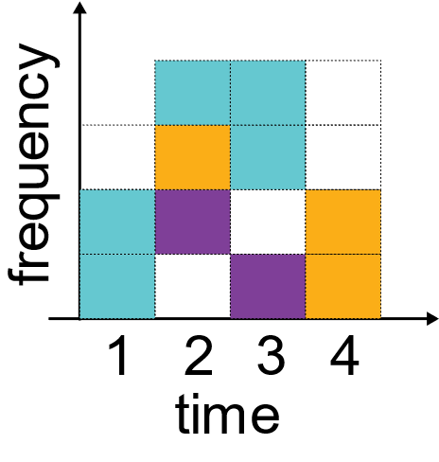
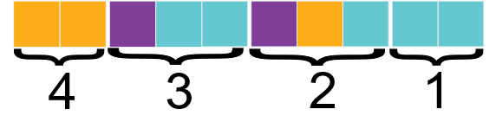
Key Insight
Network Scheduler
DU/CU
Wireless
Schedule
Fronthaul Packets
All transmissions in the network are scheduled and hence the sequence of packets in the fronthaul is known in advance
Notes:
The key insight to solve this challenge, is that all transmissions in the cellular network are schedule by a
*CLICK* network scheduler in advance. Thus the sequence of packets in the fronthaul is known in advance as the packets contain digitized radio samples corresponding to the wireless schedules generated by the network scheduler.
*CLICK* For example if at t=1 the blue user is allocated 2 units of wireless spectrum, we will also observe a corresponding number of packets in the fronthaul.
*CLICK* Similarly at t=2 when 3 users blue, yellow and purple are allocated 1 unit each, there will be a corresponding number of packets each belonging to the blue, yellow and purple user. Thus
*CLICK* packets in the fronthaul correspond to the users scheduled by the network scheduler.

Slide 11
Design Objective
Enable user/slice identification to support slicing functions
Notes:
The design objective for a fronthaul slicing solution is to enable user or slice identification for fronthaul packets at line rate to support slicing functions such as multipoint-to-multipoint routing, packet prioritization, guaranteed minimum throughput and support for broadcast/multicast services.

Slide 12


Proposed Solution: FSA
Fronthaul slicing using dataplane programmable switches
Routing information is stored in the data plane
Can be leveraged to provide other functions
Network Scheduler
DU/CU
DU/CU
DU/CU
Notes:
Our proposed solution called Fronthaul Slicing Architecture or FSA instead uses a programmable switch in the fronthaul to store routing information from the network schedule in the data plane.
*CLICK* This allows FSA to identify and route users at line rate in the fronthaul without adding any switching delay.
*CLICK* FSA can also be used to enable other functions such as packet prioritization or providing bandwidth guarantees to ensure QoS for different applications.
*PAUSE* Next, let’s take a closer look at an FSA-enabled 5G architecture.

Slide 13

High-Level Architecture
Radio Access
Network
Frontend
Fronthaul
DU/CU
DU/CU
1
DU/CU
DU/CU
DU/CU
2
Notes:
At a high level, the FSA switch sits in the fronthaul and slices traffic from all the base stations connected to the switch. Next, lets take a closer look at how FSA is implemented on programmable switches.

Slide 14
High-level Design
Sequence number in the header used to identify users
Routing entries stored in SRAM-based memory
Separate set of routing entries for each base station
Notes:
At a high level we use the sequence number embedded in the header to identify the user or the slice ID for each packet.
*CLICK* Thus each routing entry contains the sequence numbers corresponding to packets belonging to a scheduled user. These routing entries are stored in the switch’s dataplane using SRAM-based memory to ensure that entries can be written and read at line rate.
*CLICK* Additionally, we maintain separate set of routing entries for each base station connected to the switch, thereby enabling slicing for all connected base stations.

Slide 15

Adding Routing Information
Network Scheduler
-3
DU/CU
DU/CU
Wireless
Schedule
2
DU/CU
R
W
W
Notes:
Lets take a closer look at how FSA adds entries in the switch data plane.
*CLICK* Routing entries for each base stations are stored using a SRAM-based ring buffer in the switch dataplane. Lets take the same schedule as before.
*CLICK* At t=-3 the network scheduler generates a schedule which contains 1 user. The scheduler then sends the generated schedule to the FSA switch in the fronthaul. The switch receives the packet and
*CLICK* correspondingly updates the ring buffer. Since we use sequence based routing, each unique entry contains the highest sequence number for fronthaul packet corresponding to a user.

Slide 16
Adding Routing Information
Network Scheduler
-3
DU/CU
-2
DU/CU
2
x
x
x
x
x
x
x
Wireless
Schedule
2
3
5
x
x
x
x
4
DU/CU
R
W
W
Notes:
Next at t=-2, a new schedule is generated which consists of 3 different users each having a single packet.
*CLICK* Again the network scheduler send the schedule to the FSA switch which add 3 entries to the ring buffer and increments the write index by 3.

Slide 17
Routing Fronthaul Packets
Network Scheduler
1
DU/CU
DU/CU
Wireless
Schedule
2
3
5
7
8
10
x
4
DU/CU
W
R
R
Notes:
Finally after some point in time at t=1, 4 milliseconds after the initial schedule was generated, we see that the ring buffer has a number of entries. At this time, the FSA switch starts receiving fronthaul packets corresponding to the schedule generated at t=-3.
*CLICK* Therefore the switch receives 2 packet belonging to the blue user which are then routed based on the entry in the ring buffer.

Slide 18
Routing Fronthaul Packets
Network Scheduler
2
DU/CU
DU/CU
Wireless
Schedule
2
3
5
7
8
10
x
4
DU/CU
W
R
R
R
R
Notes:
Similarly at t=2 when the switch receives 3 packets belonging to 3 different users, the switch is able to route them accurately while incrementing the read index after each packet to ensure subsequent fronthaul packets are routed correctly.

Slide 19
Implementation Details
Strict constraints for SRAM based memory
Multiple SRAM register arrays for implementing ring buffers
2
3
x
x
x
x
4
2
3
x
x
x
x
2
x
x
x
x
x
x
x
2
3
5
x
x
x
x
4
W
W
W
W
Notes:
We face a number of challenges when implementing FSA on a programmable switch.
*CLICK* One of the implementation challenges comes from the fact that SRAM memory blocks used in the programmable switches are single-ported in nature. Therefore ring buffers in the dataplane can only read or write a single entry for each packet pass.
*CLICK* Thus reading/writing multiple entries requires recirculation.
*CLICK* We solve this challenge by using multiple SRAM register arrays to implement the ring buffer. This allows us to read/write multiple entries each packet pass.

Slide 20

Implementation Details
Strict constraints for SRAM based memory
Multiple SRAM register arrays for implementing ring buffers
SRAM based registers do not support complex match
Implement range match using multiple exact matches
ring
buffer
entries
2
is greater
than
false
packet
sequence
number
5
is greater
than
false
9
10
is greater
than
true
13
is greater
than
true
Notes:
*CLICK* Additionally SRAM based memory blocks do not support complex matches such as ternary or range matches.
*CLICK* We solve this challenge by comparing each packet’s sequence number from the header, to multiple entries and determine the correct user based on the output of those matches.
Another challenge inherent to sequence based routing is with handling anomalous network events such as packet reordering and packet drops which if not handled properly can cause misrouting. We handle both these anomalous network events in FSA. Details for handling these events are provided in the paper.

Slide 21
Experimental Setup
Implemented FSA on an Intel Tofino programmable switch
Use scaled up network traces captured from real Cellular Networks
Simulate 5G traffic with each base station transmitting up to a maximum of 10Gbps of fronthaul traffic
Schedule packets sent every millisecond from a server
Notes:
To evaluate FSA we implement it on an Intel Tofino programmable switch.
*CLICK* To generate fronthaul traffic, we capture network traces from real cellular networks. We capture these network traces from multiple base stations situated around the campus.
*CLICK* Since there are no large scale 5G installations, we scale these traces up by 8 times to simulate 5G network usage. With this each base station in our experiment can transmit up to 10Gbps of fronthaul traffic belonging to 7-2 functional split.
*CLICK* We transmit the schedule packet every millisecond to add routing entries to the FSA switch.

Slide 22





Verifying FSA
Host 0
Host 1
Host 2
FSA
Host 3
Notes:
Let's take simple experiment to verify FSA’s functioning. Here we have a single base station
*CLICK* with 5 different users connected to the
*CLICK* FSA switch with users distributed across 4 different hosts. Next, we plot the packet arrival time for all user packets received at each host.
*CLICK* In this plot the x-axis shows the time whereas the y-axis denotes the host number. Each X on the plot denotes a packet arrival at the corresponding host. We can see that at this time instance, 5 users have been scheduled in the same millisecond. From the graph we can see that each of these 5 users in the schedule are routed accurately by the FSA switch as the users with different shades of green are routed to Host 0 whereas the purple user is routed to Host 1.

Slide 23
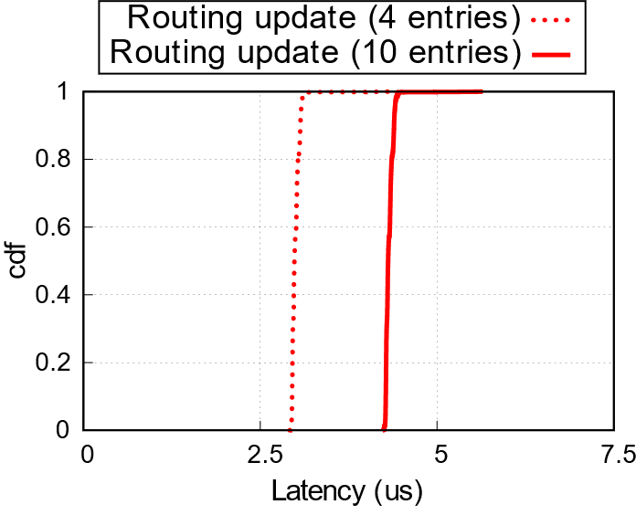
Total Latency for Adding Entries
Max. Latency for adding entries in the ring buffer is ~6μs
10x lower overhead as compared to the smallest slot size in 5G
Notes:
We also calculate the total latency for adding entries in the FSA switch, including the delay taken to transmit the packet from the network scheduler. We see that the total delay is less than 6 microseconds. *CLICK* Even if a new schedule is generated as fast as every 62 microseconds in 5G, FSA can add routing entries for up to 10 schedules before the next schedule is generated.
FSA can also be used to enable other applications in the fronthaul such as packet scheduling, throughput guarantees, multicast/broadcast services. To illustrate this, we implement Packet Prioritization which uses the user identification provided by FSA, as an fronthaul application on the programmable switch.

Slide 24
Application: Packet Prioritization
Prioritize users in order:
Low Latency use cases
Large RAN processing
Small RAN processing
Use Least Slack Time First (LSTF) to prioritize based on:
RAN processing deadline
Expected RAN processing latency
Queue Delay
Notes:
For our scheme we aim to prioritize users in the following order. Users from low latency critical use cases should be given the highest priority. Next, users with larger amount of RAN processing should be prioritized over small users with less amount of RAN processing.
*CLICK* To achieve these goals, we implement Least Slack Time First on top of FSA. The key challenge here is adapting LSTF for cellular network environments. To calculate the slack for each user we need to calculate 3 things: namely the RAN processing deadline, expected processing latency and queuing delay. We estimate the RAN processing deadline for each packet based on the use case or application belongs to. We use the number of packets for a scheduled user to estimate the relative RAN processing latency. Finally since fronthaul traffic is constant bit rate in nature, we use the inter-packet arrival gap to estimate the queuing delay experienced by each packet before it arrives at the FSA switch.

Slide 25
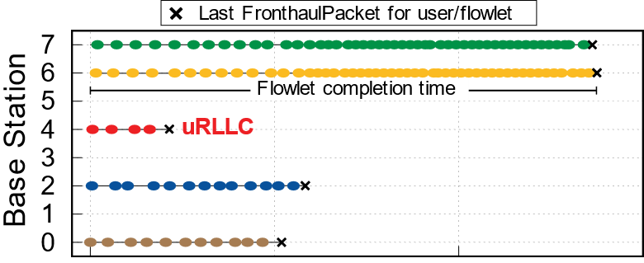
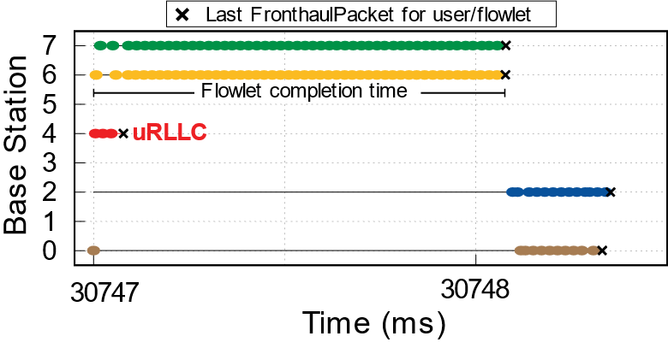
Evaluating Packet Prioritization
Large users from same slice prioritized over small users
uRLLC user’s packet encounter little to no queuing delay
FIFO
LSTF
Notes:
We evaluate our packet prioritization scheme using 8 base stations. . We also define flowlet completion time as the time take to receive all the packets for a user within a schedule.
*CLICK* The graph here shows the packet arrival time for 5 users scheduled in the same time slot belonging to different base stations when using a FIFO packet scheduling scheme in the fronthaul. From this figure we can see that large users scheduled by base stations 6 and 7 take a large amount of time before all their packets are received at Host 1. This delay caused due to queueing in the fronthaul can cause the large users to miss their RAN processing deadlines, which would in turn trigger a retransmission thereby reducing the user’s throughput.
*CLICK* However, in the presence of LSTF, since large users are prioritized over small users, the flowlet completion time is much lower thus reduceing the probability of triggering a retransmission due to deadline miss.
*CLICK* Furthermore, flowlet completion time for uRLLC users is significantly lower since they have the highest priority in the network.

Slide 26
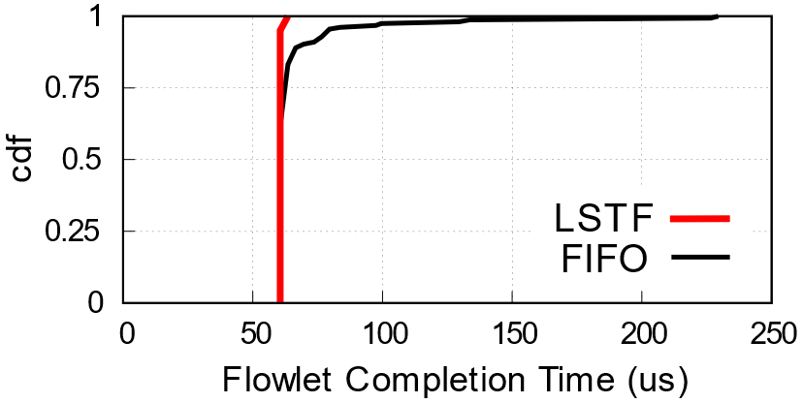
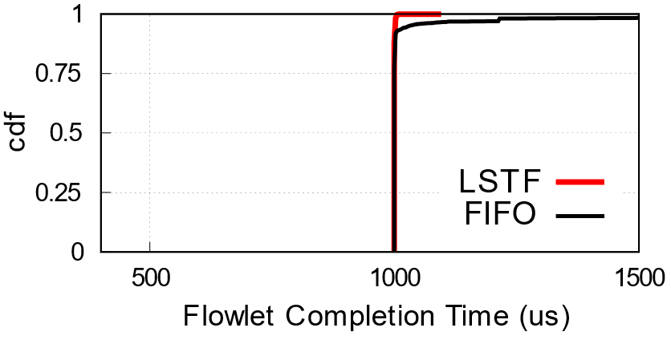
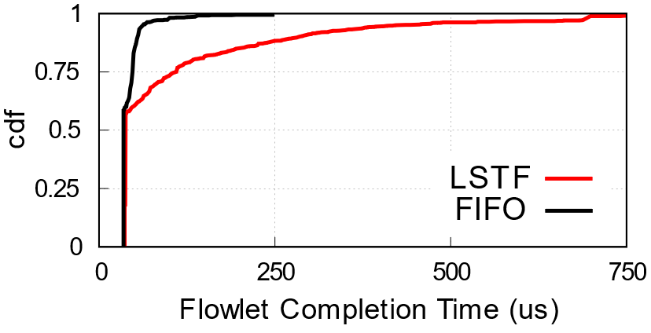
Evaluating Packet Prioritization
(a) Low latency users
(b) Large users
(c) Small users
High Priority for Low Latency users reduces max. FCT by 4x
Packets from large intensive users prioritized to allow sufficient processing time in the RAN
Notes:
We also plot the CDF of the 95th percentile of the flowlet completion time for different users.
*CLICK* From plot A we can see that prioritizing low latency or uRLLC users, reduces their maximum flowlet completion time by up to 4 times when compared to FIFO.
*CLICK* On the other hand, from plots B and C we observe that prioritizing large users saves precious time for large users, which can be instead used for RAN processing thereby reducing the probability of a deadline miss.

Slide 27
Key Takeaways
FSA enables fronthaul slicing via high speed user identification
FSA enables other applications such as packet prioritization, broadcast/multicast, joint processing etc.
Notes:
*PAUSE* In conclusion, there are 2 Key Takeaways from this work. FSA enables slicing in the fronthaul network in by identifying users in the switch data plane using network schedules generated in advance. This enables a multipoint-to-multipoint connection in the fronthaul and thus enabling disaggregated RAN architecture.
*CLICK* FSA also enables a wide variety of other applications such as multipoint-to-multipoint routing, packet prioritization, courtesy of its ability to identify users in the fronthaul at line rate.

Slide 28
Thank You
Q & A
nishant@comp.nus.edu.sg
Notes:
Thank you all for attending my talk and am happy to take further questions. You can also reach out to me at my email address on the screen.

